Slide 1
Overview of lexical models and introduction to the TEI dictionary chapter
Laurent Romary
Inria & BBAW & DARIAH
Lexical Master Class
Berlin, 5 December 2017

Slide 2
Overview
Lexical models – onomasiological and semasiological forms
An general introduction to the TEI dictionary chapter
Hands-on discovery of the TEI dictionary model in oXygen

Slide 3
Lexical databases – a variety of objects
Lexical data as part of a wider landscape of language resources
First level of abstraction in linguistic analysis
Psycholinguistic, field linguistics, computational linguistics
Input to language technology processes
Wider interest from language learners and general public
A huge amount of legacy information
Proprietary formats
E.g. dictionary publishers
Proprietary tools
E.g. Shoebox
From highly narrative to deeply structured content
… open an MS Word document and start typing in your dictionary entry (sorry, just kidding)
Are there coherent principles in the representation of lexical data?
Can we treat electronic dictionaries and lexical databases in a uniform manner?

Slide 4
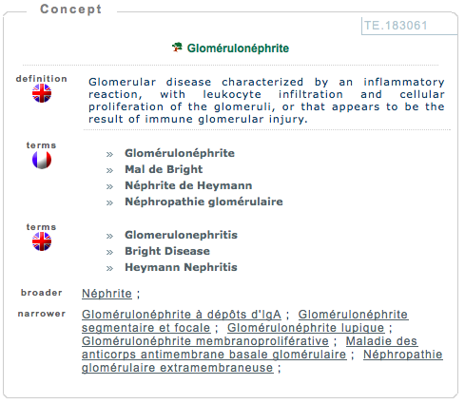
Various types of applications
Linguistic
Precise description of linguistic information
Natural language processing
Optical Character Recognition, Spell checkers, Information extraction
“Traditional” dictionary projects
Publishing industry, large scale dictionary projects (e.g. DWDS — http://www.dwds.de/)
Translation domain, technical writing
Terminological databases

Slide 5
Why standardizing all this?
Defining methods or models to facilitate
Exchange of lexical data
Pooling heterogeneous lexical data
Interoperability between software components
Search engines, layout, extraction of linguistic properties
Comparability of results
E.g. Linguistic coverage of lexical databases

Slide 6
Can scholars bear standards?
Standards are essentially “bad” for scientists
Freezing knowledge
Lost of time (which could be dedicated to “real” work)
Forcing diverging views to agree
…especially if the work is done by others
[also known as NIH syndrome: “not invented here”]
Forcing one to make data readable by others
…

Slide 7
How to answer reluctance?
Main issues
Managing the trade-off between interoperability and variability of linguistic representation
Documenting and maintaining document formats
A possible answer
Standards as specification platforms
Major factors
Expressing constraints on models, adaptation to use cases
Identifying generic structures, preventing representation silos

Slide 8
What should be represented: form or structure?
Considering the precise typographic information in the source dictionary
“Editorial” view on encoding
Should we go towards an HTML like transcription?
Identifying the underlying logical structure
“Lexical” perspective
Need for defining specific representation models/formats
Defining a lexical database is always a compromise between the two
Depends on the available data and user scenarios

Slide 9
Standardization initiatives for lexical/terminological resources
TEI
Initiated in 1987, driving force behind XML creation
P5 edition of the guidelines
Cf. specification platform (ODD)
Dictionary chapter
Former terminology chapter
ISO
ISO/TC 37: Terminology and language resources
ISO/ TC 37/SC 2: ISO 639 series (language codes)
ISO/TC 37/SC 3: ISO 16642 (Terminology), ISO 12620 (Data categories), ISO 30046 (TBX)
ISO/TC 37/SC 4: Language resource management (2002)
ISO 24613 (LMF)
W3C
SKOS, Ontolex

Slide 10
Standards, standards, everywhere!
ISO TC 37
SC4: ~20 published standards since 2002
TEI – Text Encoding Initiative
Stand-off annotation
MAF
Feature structures
ODD
SynAF
Transcription of speech
…
ISO-TimeML
TMF
TBX
Terminology chapter
MLIF
LMF
Dictionary chapter

Slide 11
Lexical structures at a glance
Observing the data:
Various forms of lexical structures
Basic distinctions:
Onoma- and semasiological structures
Onomasiological forms:
TMF and TBX
Semasiological forms:
LMF and TEI
Common concepts:
Data categories

Slide 12
Lexicography or terminology
Lexicography
Generic view on “words”
Attempt to provide a large coverage of a language
Semasiological view
Word > meaning(s)
Terminology
Term: form associated to a specific concept within a given domain
Onomasiological view
Concept > various possible linguistic forms
Again: depends on available data and user scenarios

Slide 13
Comparing approaches
Semasiological approach
Onomasiological approach
Large coverage
All parts of speech
Build-in polysemy
Multiple senses for the same entry
Referential synonymy
Domain oriented
Essentially nouns
Extension to verbs, adjectives
No polysemy (needs to be reconstructed)
Build-in synonymy
Multiple terms for the same concept

Slide 14
Onomasiological data (concept to term)

Slide 15
Standards for the digital representation of terminologies
ISO 6156:1987 (Mater) — format for representing terminological information on magnetic tapes; followed by an adaptation for microcomputers (MicroMater; see Melby, 1991);
Chapter in the TEI guidelines; SGML-based representation; remained there until the P4 edition
ISO 12200 (Martif), published in 1999; improves the TEI proposal
Strongly inspired from the TEI (e.g. the header-text organisation; entries embedded within a <text> and <body> hierarchy)
Reaching out the translation and localisation industry
ISO 12620:1999, set of reference descriptors (or data categories)
ISO 16642:2003 (TMF) — Terminological Markup Framework
TBX (TermBase eXchange) published in 2007 by LISA (Localisation Industry Standards Association) as a follower to Martif
TBX: ISO standard 30042 in 2008

Slide 16
Modeling terminological entries with ISO 16642 and ISO 12620:1999
ISO 16642:2003 Computer applications in terminology -- Terminological markup framework
Provides a meta-model for the description of terminological databases
ISO 12620:1999 — Computer applications in terminology -- Data categories
Provides a reference set of descriptors for building-up terminological data models

Slide 17
Building up a terminological model (TMF)
Terminological entry
Language section
Term section
Term section
Language section
Term section

Slide 18
Building up a terminological model
Terminological entry
Language section
Term section
Term section
Language section
Term section
subjectField
definition+source
note
term
source

Slide 19
TBX serialisation (ISO 30042)
<termEntry xmlns="http://www.tbx.org">
<descrip type="subjectField" xml:lang="fr">Industrie mécanique</descrip>
<langSet xml:lang="de">
<descripGrp>
<descrip type="definition">endloser Riemen mit trapezförmigem Querschnitt, der auf zwei Riemenscheiben mit Eindrehungen läuft</descrip>
<admin type="source">De Coster, Wörterbuch, Kraftfahrzeugtechnik, SAUR, München, 1982</admin>
</descripGrp>
<note>wird zum Antrieb der Lichtmaschine, des Ventilators und der Wasserpumpe benutzt</note>
<tig>
<term>Keilriemen</tei:term>
<admin type="source">De Coster, …</admin>
</tig>
</langSet>
<langSet xml:lang="fr”>
<tig>
<term>courroie trapézoïdale</term>
…
</tig>
</langSet>
</termEntry>

Slide 20
Quick wrap-up
Implementation in numerous industrial project
Translation workbenches (e.g. Trados), European commission, etc.
Definition of specific “flavors”
Fixed sets of data categories
TBX-basic, TBX-min
Integration to the TEI guidelines
Terminological entries in wider text-based applications (e.g. technical writing)

Slide 21
Semasiological data (word to sense)

Slide 22
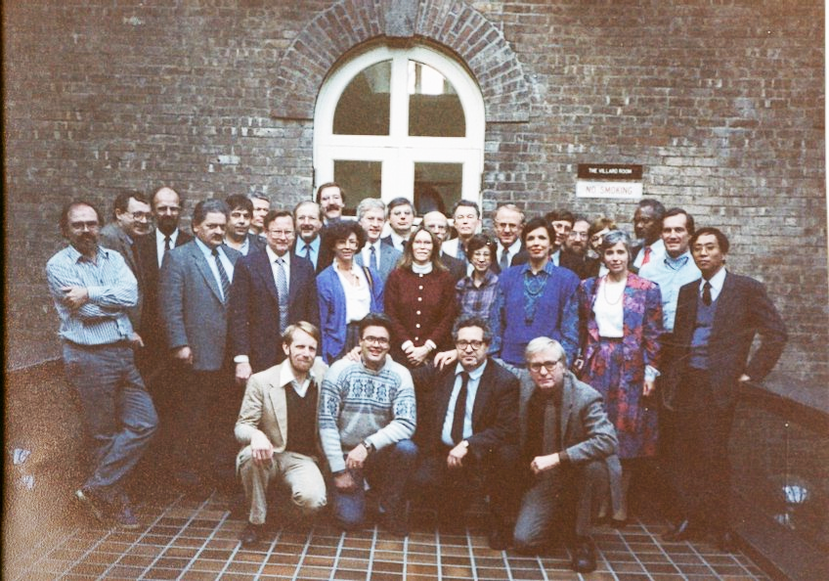
In the beginning
Humanities
Text archives
Standards
SGML
Michael Sperberg-McQuen
Lou Burnard
1. Novembre 1987: Vassar College, Poughkeepsie

Slide 23
TEI in a nutshell
TEI namespace:
xmlns="http://www.tei-c.org/ns/1.0"
TEI documentation:
http://www.tei-c.org/release/doc/tei-p5-doc/en/html/
TEI processor, Roma:
http://www.tei-c.org/Roma/
TEI document model
Read: http://www.tei-c.org/release/doc/tei-p5-doc/en/html/DS.html
TEI architecture: modules, classes
TEI vocabulary: more than 500 elements…
Read: http://www.tei-c.org/release/doc/tei-p5-doc/en/html/CO.html

Slide 24
TEI and “dictionaries”
The TEI Dictionary chapter (know before as the “Print Dictionary”)
Initially designed by N. Ide and J. Veronis
Accounts for both presentational and editorial (“content”) issues
Cf. <entry>, <entryFree>, … and <dictScrap>
Based on a hierarchical abstract model (crystals)
<form>: for characterizing the orthographic or phonetic form of the word
<orth>, <pron>, etc.
<gramGrp>: grammatical features
May characterize an entry, a specific form or a specific sense
<pos>, <gen>, generic <gram> feature
<sense>: iterative and recursive
May contains definitions, examples, etymological information, translations, etc.
Main characteristic (drawback?): +very+ flexible

Slide 25
Prototypical entry in TEI
<entry>
<form>
<orth>table</orth>
</form>
<gramGrp>
<pos>n.</pos>
<gen>f.</gen>
</gramGrp>
<sense>
<def>Pièce de mobilier…</def>
<cit type=”example”>
<quote>Une table de cuisine</quote>
</cit>
</sense>
</entry>
Notes:
Issues: definition of grammatical information (classes), definition of gen, constraining the values => customization, what about semantics,

Slide 26
Example – simple word to sense representation
<entry> <form>一乘顯性教</form> <sense>One of the five divisions made by 圭峰 Guifeng of the Huayan 華嚴 or Avataṃsaka School; v. 五教.</sense> </entry>
<entry> <form>眾生不可思議</form> <sense> <usg type="dom">術語</usg> <def>四事不可思議之一。見不可思議條。</def> <ref>不可思議</ref> </sense> </entry>
Source: http://buddhistinformatics.ddbc.edu.tw/glossaries/;
thanks to Marcus Bingenheimer

Slide 27
Example – full-form lexicon
<entry> <form type="lemma"> <orth>chat</orth> </form> <gramGrp> <pos>noun</pos> <gen>masculine</gen> </gramGrp> <form type="inflected"> <orth>chat</orth> <gramGrp> <number>singular</number> </gramGrp> </form> <form type="inflected"> <orth>chats</orth> <gramGrp> <number>plural</number> </gramGrp> </form> </entry>

Slide 28
LMF as an ISO project
Summer 2003: new work item proposal (US) delegation
Fall 2003: technical proposal (FR) for a data model dedicated to NLP lexica
ISO 24613:2008 Language resource management - Lexical markup framework (LMF)
Convenor:
Nicoletta Calzolari (IT)
Editors:
Gil Francopoulo (FR), Monte George (US)
13 versions written, dispatched (to the National delegations nominated experts), commented and discussed in various ISO technical meetings
IS (= published standard) in oct. 2008

Slide 29
LMF core package

Slide 30
Serializing LMF using the TEI

Slide 31
Why is the TEI a good idea for serialising LMF?
Basic structure already defined
Provision of additional tags
Surface annotation (e.g. names, dates, abbreviations, alternatives)
Cf <equiv> equivalences to reference data categories when needed
Integration of lexical data in a textual macro-structure
Creating an edited version of a lexica
Grammar books, teaching material, scientific papers
Interoperability with other lexical sources
Community of users: sharing a common culture of TEI tags rather than constantly worrying about mappings
Sharing tools: e.g. stylesheets, editors, etc. (cf. Roma)
Note: continuity between dictionary and lexical sources

Slide 32
Identifying the meta-model components
Lexicon
1..1
0..n
<entry>
Lexical entry
1..1
1..1
1..1
1..1
1..1
0..n
Form
Morphology
Sense
0..n
1..1
<form>
<gramGrp>
<sense>

Slide 33
Mapping data categories
Lexicon
1..1
0..n
Lexical entry
1..1
1..1
1..1
1..1
1..1
0..n
Form
Morphology
Sense
0..n
/part of speech/ (<pos>)
/inflexional class/ (<itype>)
/gender/ (<gen>)
/number/ (<number>)
/case/ (<case>)
/person/ (<per>)
/tense/ (<tns>)
/mood/ (<mood>)
1..1
/orthography/ (<orth> )
/pronunciation/ (<pron> )
/hyphenization/ (<hyph> )
/syllabification/ (<syll>)
/stress pattern/ (<stress> )
/definition/ (<def>)
/example/ (<eg>)
/usage/ (<usg>)
/etymology/ (<etym>)

Slide 34
Construing an TEI dictionary entry
<entry>
<form>
<orth>demigod</orth>
<pron>...</pron>
</form>
<gramGrp
<pos>n</pos>
</gramGrp>
<sense n='1'>
<sense n='a'>
<def>a being who is part mortal, part god</def>
</sense>
<sense n='b'>
<def>a lesser deity</def>
</sense>
</sense>
<sense n='2'>
<def>a godlike person</def>
</sense>
</entry>

Slide 35
Issues and prospects
Stabilizing good practices in TEI encoding
Identifying a catalogue of reference constructs for various lexicographic phenomena
E.g. Etymology in TEI: Bowers & Romary, in progress
Cf. TEI Lex 0
More convergence between TEI and ISO
Revision of 24613 as a multi-part standard
More room for enlarging the coverage of LMF serialization by means of the TEI
Towards a stable TBX extension to the TEI (cf. Bowers, Pernes and Romary, 2017)
Data delivery in flat models for the semantic web
No manual production
TBX2SKOS
TEI2Ontolex

Slide 36
Should we/you be afraid of standards?
<cit>
<quote>Yes you should be afraid, but you should be more afraid of not having them</quote>
<author>Wendell Piez</author>
</cit>

Slide 37
Thank you for your attention
Merci de votre attention

Slide 38
For the long winter evenings
Laurent Romary. TBX goes TEI -- Implementing a TBX basic extension for the Text Encoding Initiative guidelines. Terminology and Knowledge Engineering 2014, Jun 2014, Berlin, Germany. 2014, Terminology and Knowledge Engineering, TKE 2014. <hal-00950862v2>
Laurent Romary, Andreas Witt. Méthodes pour la représentation informatisée de données lexicales/Methoden der Speicherung lexikalischer Daten. Lexicographica, de gruyter Mouton, 2014, 30. <hal-00991745>
Laurent Romary. TEI and LMF crosswalks. JLCL - Journal for Language Technology and Computational Linguistics, 2015, 30 (1), <http://www.jlcl.org>. <hal-00762664v4>
Laurent Romary. An abstract model for the representation of multilingual terminological data: TMF - Terminological Markup Framework. TAMA 2001, Feb 2001, Antwerp, Belgium. 2001. <inria-00100405>
Laurent Romary. Standards for language resources in ISO – Looking back at 13 fruitful years. edition - die Terminologiefachzeitschrift, Deutscher Terminologie-Tag e.V. (DTT), 2015. <hal-01220925>
…
https://cv.archives-ouvertes.fr/laurentromary

