Slide 1


High-Speed Graph Coloring on GPUs
Ghadeer Alabandi, Evan Powers, and Martin Burtscher*
GPU Technology Conference (GTC) 2021

Slide 2
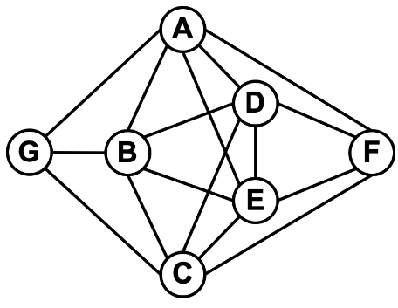
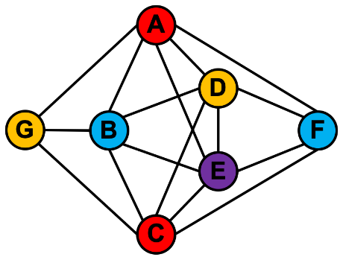
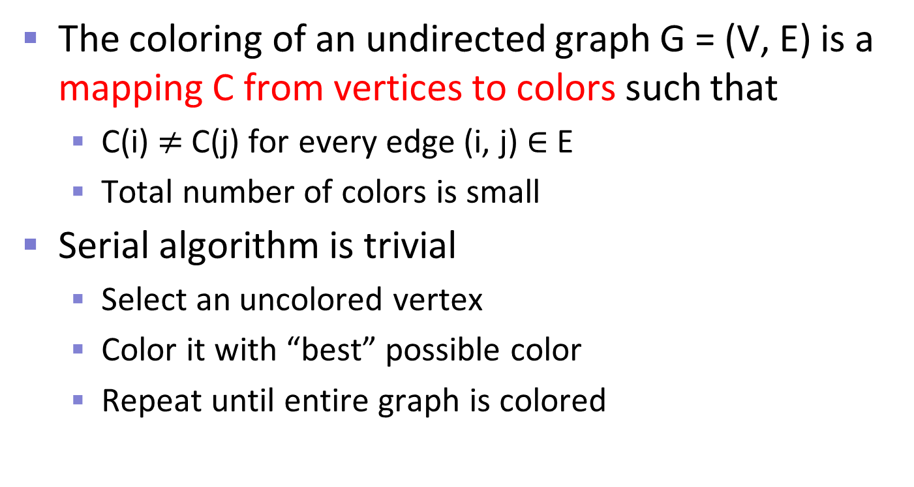
Graph Coloring
The coloring of an undirected graph G = (V, E) is a mapping C from vertices to colors such that
  C(i) $≠$C(j) for every edge (i, j) ∈ E
  Total number of colors is small
Serial algorithm is trivial
  Select an uncolored vertex
  Color it with “best” possible color
  Repeat until entire graph is colored

Slide 3
Highlights
Our parallel ECL-GC algorithm
  Increases parallelism by breaking dependencies
    Call these techniques “shortcuts”
  Produces deterministic color assignment
    Serial, parallel w/o shortcuts, parallel with shortcuts
CUDA code
  Demonstrates efficient implementation of shortcuts
Results
  2.5 times more intrinsic parallelism (1.0x - 12.4x)
  2.9 and 4.0 times faster than fastest GPU & CPU codes

Slide 4
Background
Finding a graph coloring with the minimum number of colors is NP-hard
Several heuristics exist to color graphs
  Guarantee that adjacent vertices have distinct colors
  Require different numbers of colors
These heuristics provide different tradeoffs
  Trade off coloring quality and execution time

Slide 5
Prior GC Algorithms

Slide 6
Greedy Algorithm
Assign a random priority to each vertex
Select the highest-priority uncolored vertex
Color this vertex with the best possible color
  The colors are ordered (see below)
    First color is the most preferred color
Repeat steps 2 and 3 until entire graph is colored

Slide 7
Priority Heuristics
First fit (FF)
Random (R)
Largest degree first (LDF)
Smallest degree last (SDL)
Saturation degree (SD)
Incidence degree (ID)

Slide 8
LDF Example: Input Graph
A
D
G
B
F
E
C

Slide 9
LDF Example: Imposed Priority DAG
From higher- to lower-degree vertex (alpha tie breaker)
A
D
G
B
F
E
C

Slide 10
LDF Example: Resulting Coloring
A
D
G
B
F
E
C

Slide 11
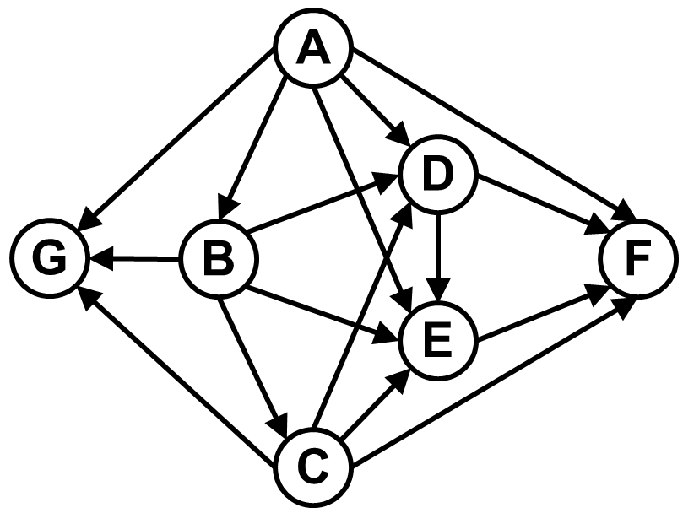
Jones-Plassmann Parallel Algorithm
Many parallel graph coloring
algorithms follow JP approach
Initialization step
  Compute direction of edges
    Based on a priority heuristic
Parallel computation steps
  Check every uncolored vertex
  Color ready vertices with best possible color
  Repeat until entire graph has been colored

Slide 12
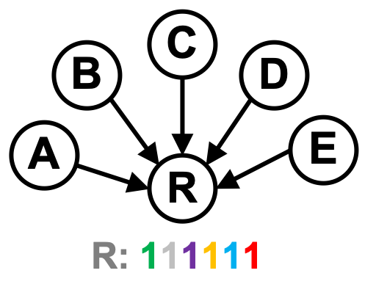
Possible Colors
In JP, each vertex has list of k+1 possible colors
  k is number of higher-priority neighbors
  When neighbor is colored, that color is deleted from list
  Vertex is ultimately colored with best remaining color
JP often uses bitmaps for implementing these lists
  Each bit represents one color
    “1” means the color is still possible
    “0” means the color is not available

Slide 13
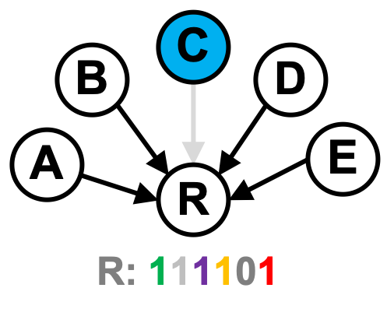
Possible Colors
In JP, each vertex has list of k+1 possible colors
  k is number of higher-priority neighbors
  When neighbor is colored, that color is deleted from list
  Vertex is ultimately colored with best remaining color
JP often uses bitmaps for implementing these lists
  Each bit represents one color
    “1” means the color is still possible
    “0” means the color is not available

Slide 14
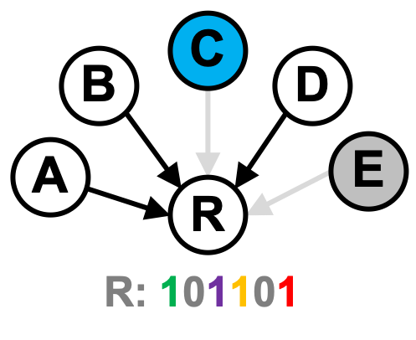
Possible Colors
In JP, each vertex has list of k+1 possible colors
  k is number of higher-priority neighbors
  When neighbor is colored, that color is deleted from list
  Vertex is ultimately colored with best remaining color
JP often uses bitmaps for implementing these lists
  Each bit represents one color
    “1” means the color is still possible
    “0” means the color is not available

Slide 15
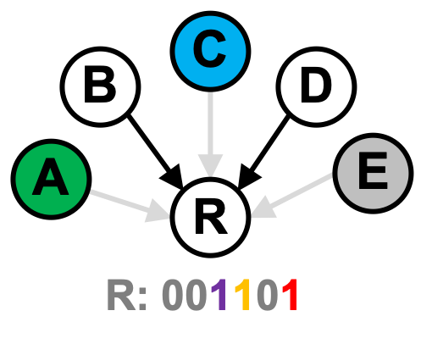
Possible Colors
In JP, each vertex has list of k+1 possible colors
  k is number of higher-priority neighbors
  When neighbor is colored, that color is deleted from list
  Vertex is ultimately colored with best remaining color
JP often uses bitmaps for implementing these lists
  Each bit represents one color
    “1” means the color is still possible
    “0” means the color is not available

Slide 16
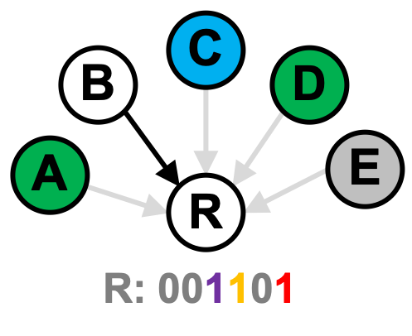
Possible Colors
In JP, each vertex has list of k+1 possible colors
  k is number of higher-priority neighbors
  When neighbor is colored, that color is deleted from list
  Vertex is ultimately colored with best remaining color
JP often uses bitmaps for implementing these lists
  Each bit represents one color
    “1” means the color is still possible
    “0” means the color is not available

Slide 17
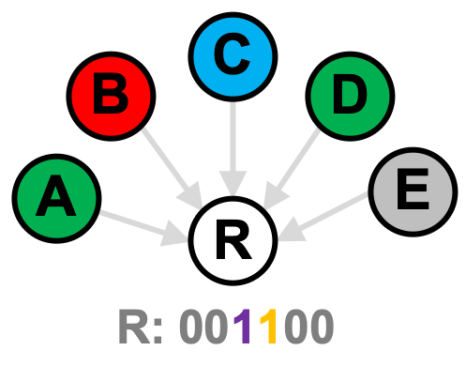
Possible Colors
In JP, each vertex has list of k+1 possible colors
  k is number of higher-priority neighbors
  When neighbor is colored, that color is deleted from list
  Vertex is ultimately colored with best remaining color
JP often uses bitmaps for implementing these lists
  Each bit represents one color
    “1” means the color is still possible
    “0” means the color is not available

Slide 18
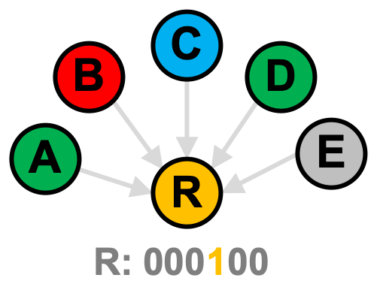
Possible Colors
In JP, each vertex has list of k+1 possible colors
  k is number of higher-priority neighbors
  When neighbor is colored, that color is deleted from list
  Vertex is ultimately colored with best remaining color
JP often uses bitmaps for implementing these lists
  Each bit represents one color
    “1” means the color is still possible
    “0” means the color is not available

Slide 19
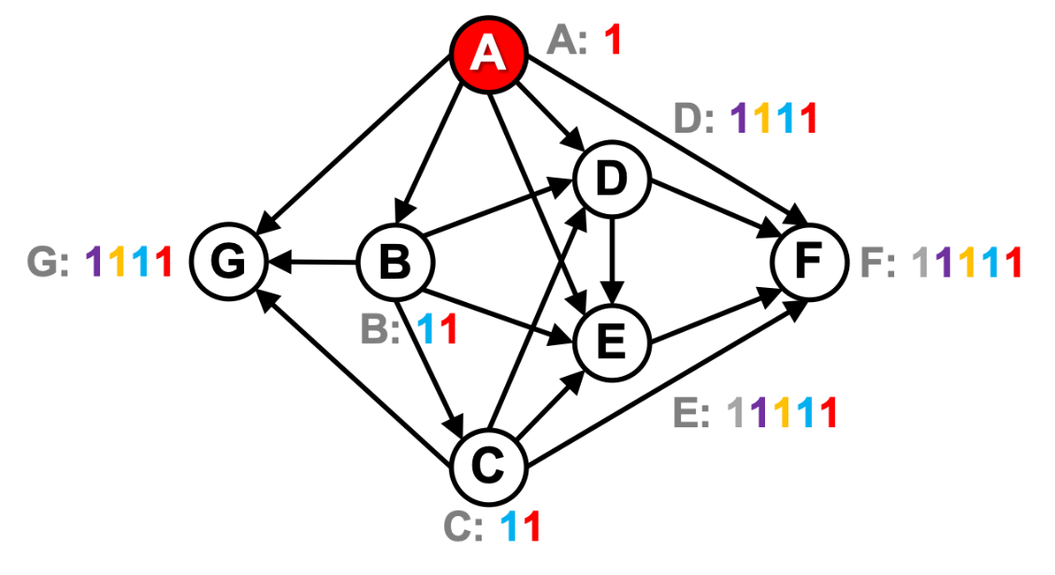
Jones-Plassmann Algorithm
Initialization step
  Compute direction of each edge
    Based on LDF heuristic
  Initialize bitmaps
Operation
  Go from higher to lower degree
  Use alphabetic ordering to break ties
Result
  Turns graph into DAG; already colors vertex A “red”

Slide 20
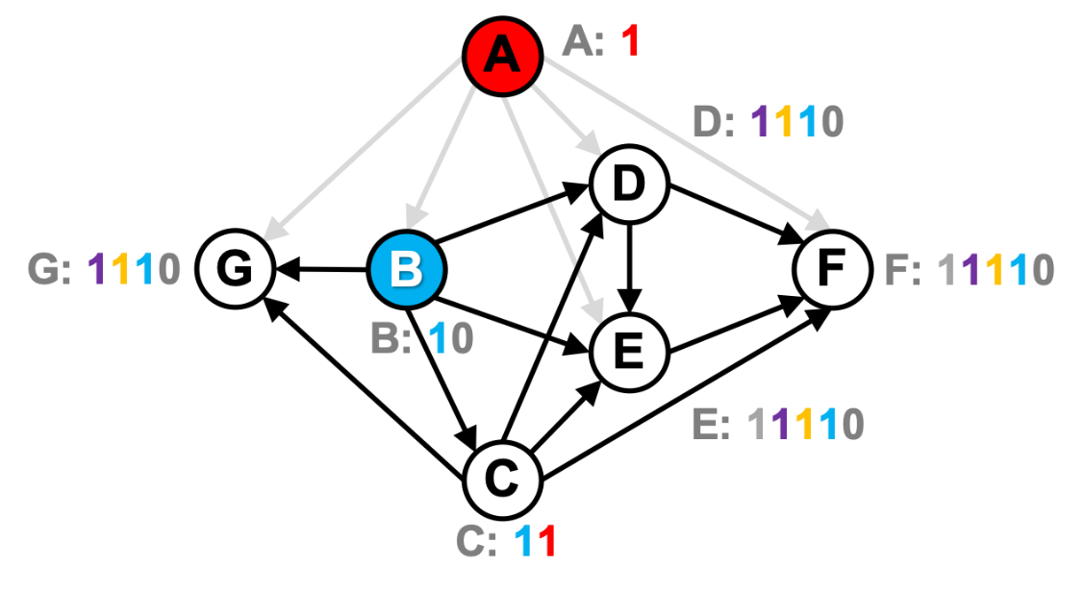
Jones-Plassmann Example
Computation step 1
  Check every uncolored vertex
  Color ready vertices
Operation
  Neighbors of A clear “red” bit
  Vertex B is ready
  Color vertex B “blue”

Slide 21
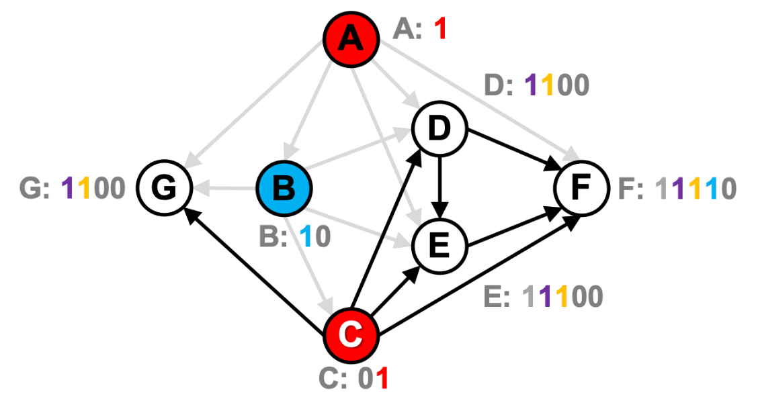
Jones-Plassmann Example
Computation step 2
  Check every uncolored vertex
  Color ready vertices
Operation
  Neighbors of B clear “blue” bit
  Vertex C is ready
  Color vertex C “red”

Slide 22
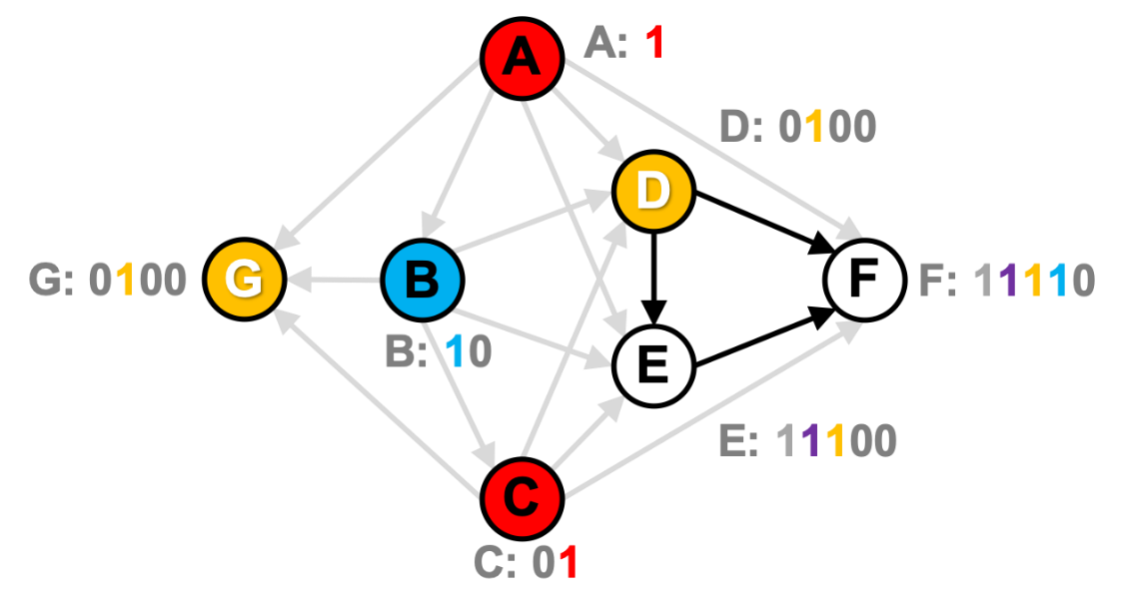
Jones-Plassmann Example
Computation step 3
  Check every uncolored vertex
  Color ready vertices
Operation
  Neighbors of C clear “red” bit
  Vertices D & G are ready
  Color vertices D & G “orange”

Slide 23
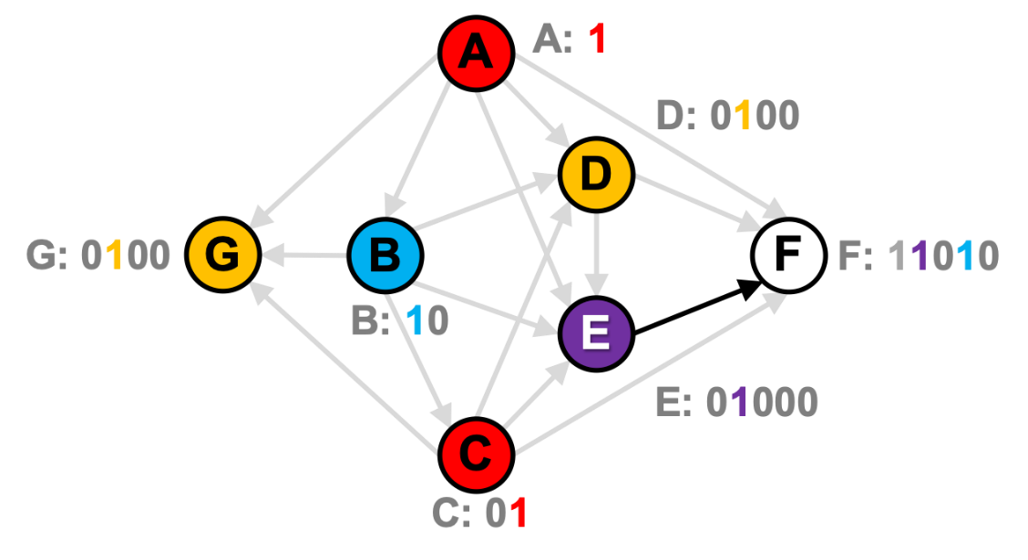
Jones-Plassmann Example
Computation step 4
  Check every uncolored vertex
  Color ready vertices
Operation
  Neighbors of D & G clear “orange” bit
  Vertex E is ready
  Color vertex E “purple”

Slide 24
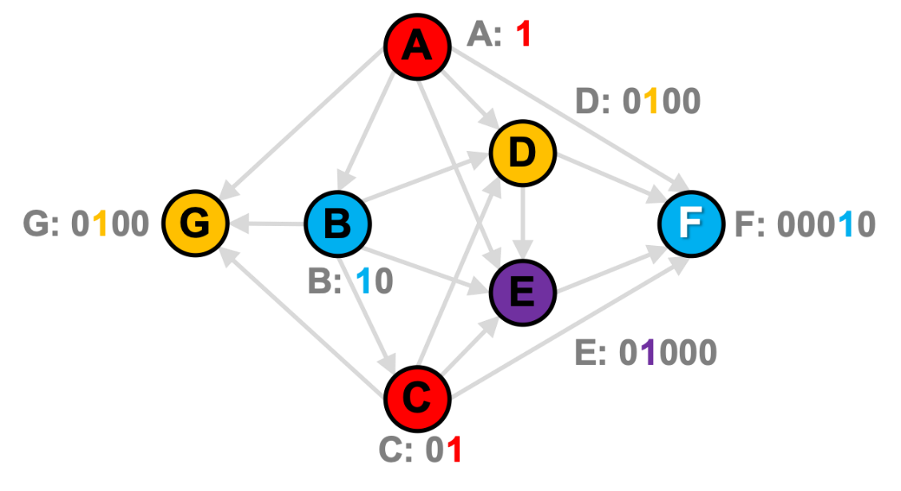
Jones-Plassmann Example
Computation step 5
  Check every uncolored vertex
  Color ready vertices
Operation
  Neighbors of E clear “purple” bit
  Vertex F is ready
  Color vertex F “blue”
JP terminates after 5 steps b/c longest dependence chain has 5 edges

Slide 25
Our ECL-GC Algorithm with Shortcuts

Slide 26
ECL-GC
Our algorithm extends JP-LDF
  JP-LDF tends to be fast and produces good colorings
JP-LDF colors vertices with higher degrees first
  Lower-degree vertices must wait → low parallelism
JP tends to exhibit limited parallelism
  Additional non-speculative parallelism may exist!

Slide 27
ECL-GC (cont.)
ECL-GC exploits intermediate bitmap states
  Based on systematic search of operations between adjacent vertices’ bitmaps
  Found two cases that yield exploitable info (shortcuts)
    See paper for derivation
Our shortcuts minimize the waiting
  Break dependences to increase parallelism
  Guarantee same final coloring as JP-LDF

Slide 28
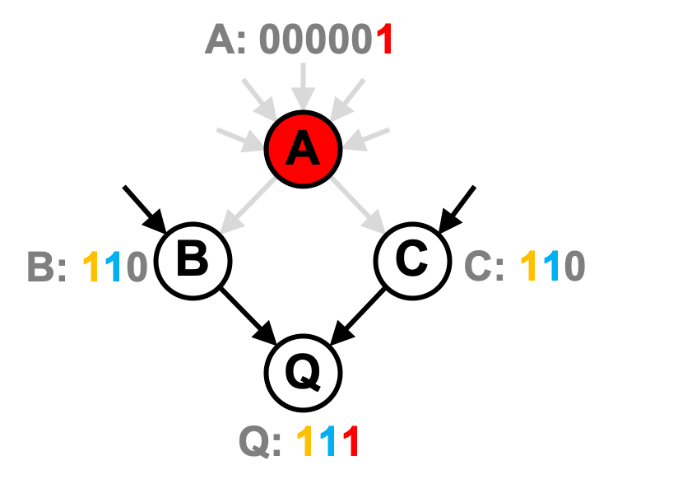
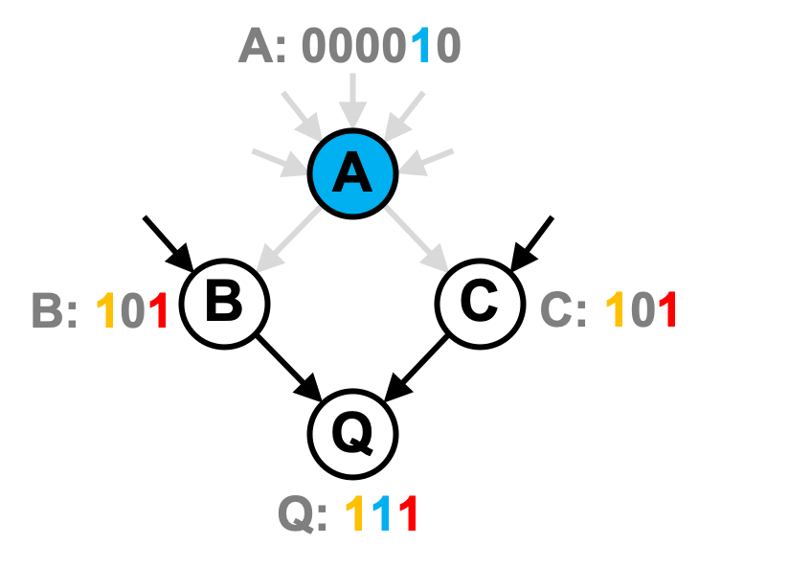
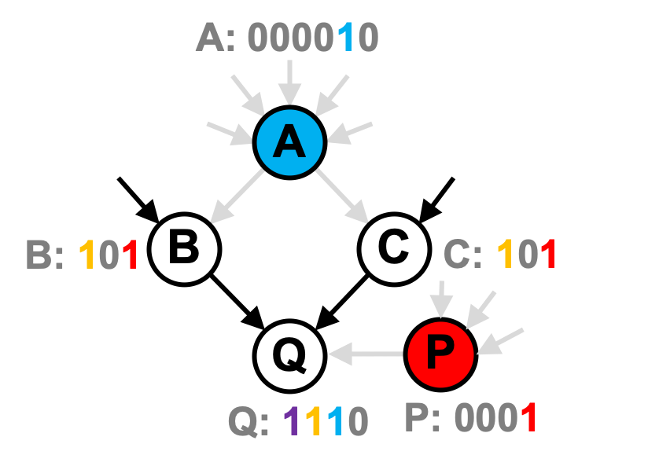
Shortcut 1
A vertex can be colored with its best possible color
  As soon as all uncolored higher-priority neighbors are no longer considering that color
Q can safely be colored “blue”, but best possible color is “red”
Q can safely be colored “blue” since blue is best possible color for Q
Q can safely be colored “red”

Slide 29
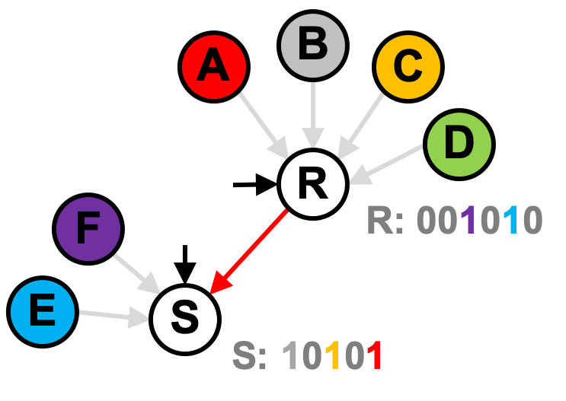
Shortcut 2
An edge can be removed
  As soon as there is no overlap in possible colors
Benefits
  Removes one possible color from bitmap
  Speeds up later processing
Can delete edge from R to S
R can be either “blue” or “purple”
S can be “red”, “orange” or “gray”
There is no overlap between possible colors of R and S

Slide 30
ECL-GC Operation

Slide 31
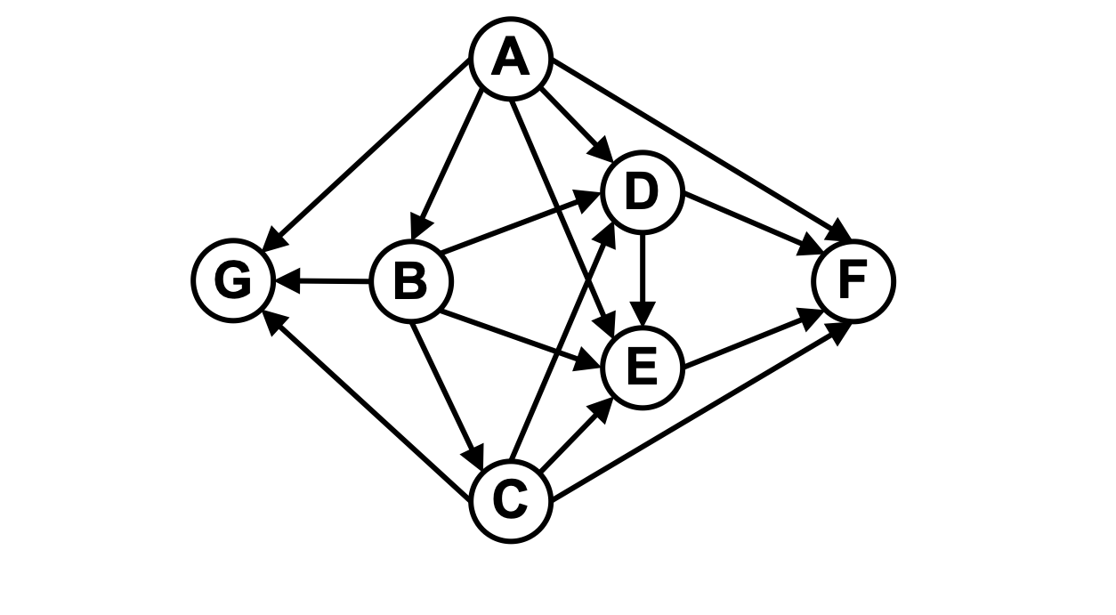
ECL-GC Algorithm
Initialization step
  Compute direction of edges
    Based on priority heuristic
Computation steps
  Check every uncolored vertex
  Color ready vertices with best possible color
  Apply shortcuts to remaining vertices if feasible
  Repeat until entire graph has been colored

Slide 32
ECL-GC Algorithm
Initialization step
  Compute direction of each edge
    Based on LDF heuristic
  Initialize bitmaps
Operation
  Go from higher to lower degree
  Use alphabetic ordering to break ties
Result
  Turns graph into DAG; already colors vertex A “red”

Slide 33
ECL-GC Algorithm
Computation step 1
  Check every uncolored vertex
  Color ready vertices
  Apply shortcuts if possible
Operation
  Neighbors of A clear “red” bit
  Vertex B is ready
  Color vertex B “blue”

Slide 34
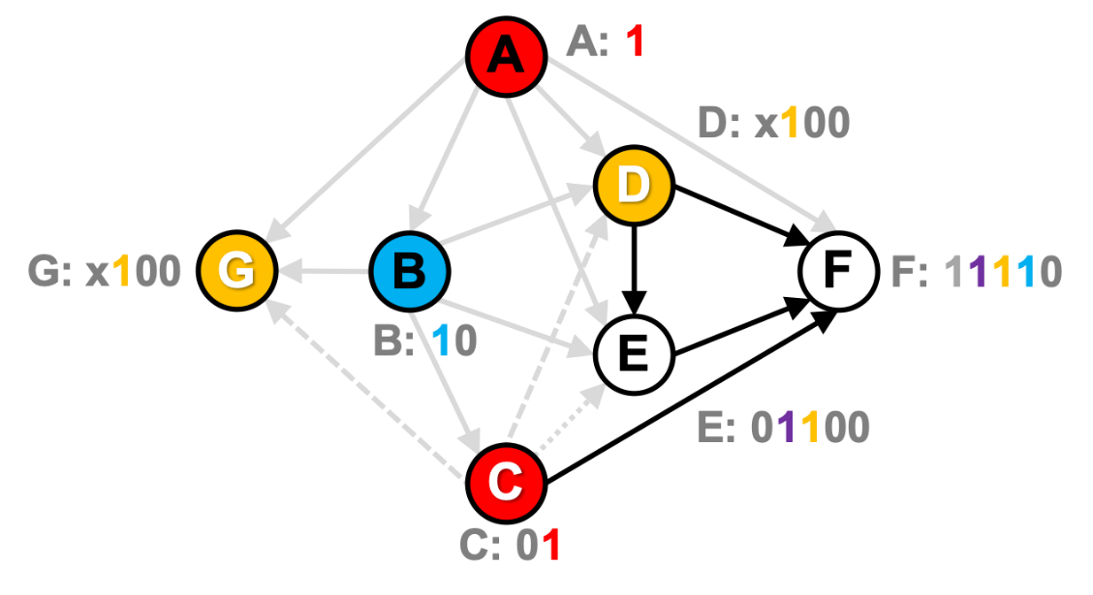
ECL-GC Algorithm
Computation step 2
  Color vertices and use shortcut
Operation
  Neighbors of B clear “blue” bit
  Colors vertex C “red”
  Enables Shortcut 2 on vertex E
    E can delete edge CE (whether it sees C as 11 or 01)
  Enables Shortcut 1 on vertices D and G
    Both can be colored “orange” (whether they see C as 11 or 01)

Slide 35

ECL-GC Algorithm
Computation step 3
  Check every uncolored vertex
  Color ready vertices
  Apply shortcuts if possible
Operation
  Neighbors of C and D clear bits
  Colors vertex E “purple”
  Enables Shortcut 1 on vertex F
    Can be colored “blue” (whether it sees E as 01100 or 01000)
ECL-GC terminates after 3 steps instead of 5

Slide 36
Efficient Implementation

Slide 37
Efficient Shortcut Implementation
Fully implement shortcuts on low-degree vertices
  Degree < 32, bitmap fits in 32-bit integer
Approximate shortcuts on high-degree vertices
  To avoid slow processing of long bitmaps
  Only use two integers for shortcut computations
    First integer specifies best possible color
    Second integer specifies worst possible color
  Like JP, still maintains full bitmap for color assignment

Slide 38
Results

Slide 39
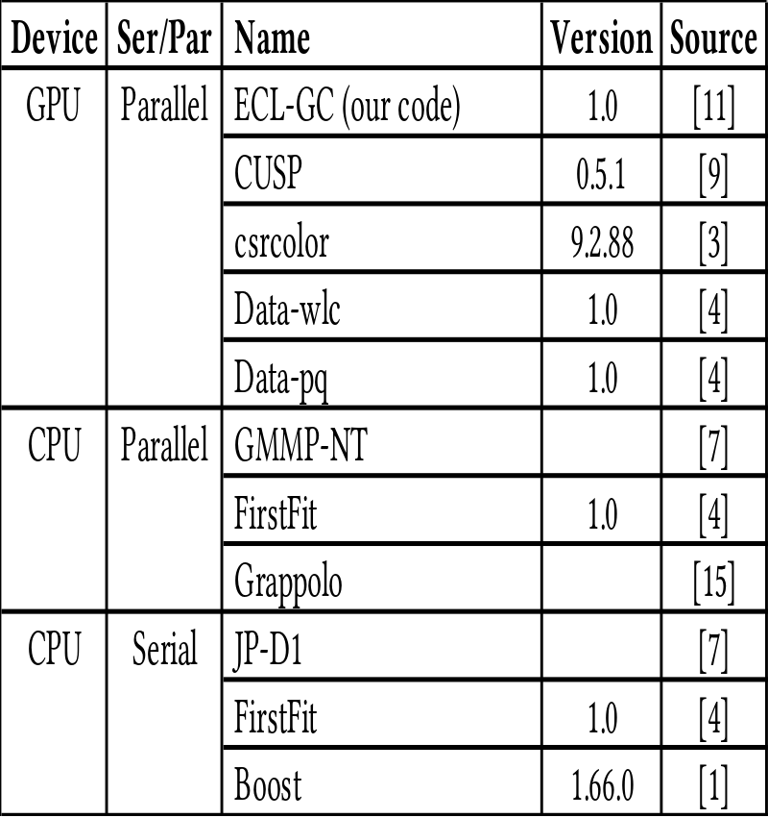
Methodology: 2 Devices and 11 Codes
1.2 GHz Titan V GPU
  5120 cores
  4.5 MB L2, 12 GB (652 GB/s)
3.1 GHz dual Xeon CPU
  20 cores, 40 threads
  25 MB L3, 128 GB (68 GB/s)
One more device in paper
Comparison
  5 GPU codes
  3 parallel CPU codes
  3 serial CPU codes

Slide 40
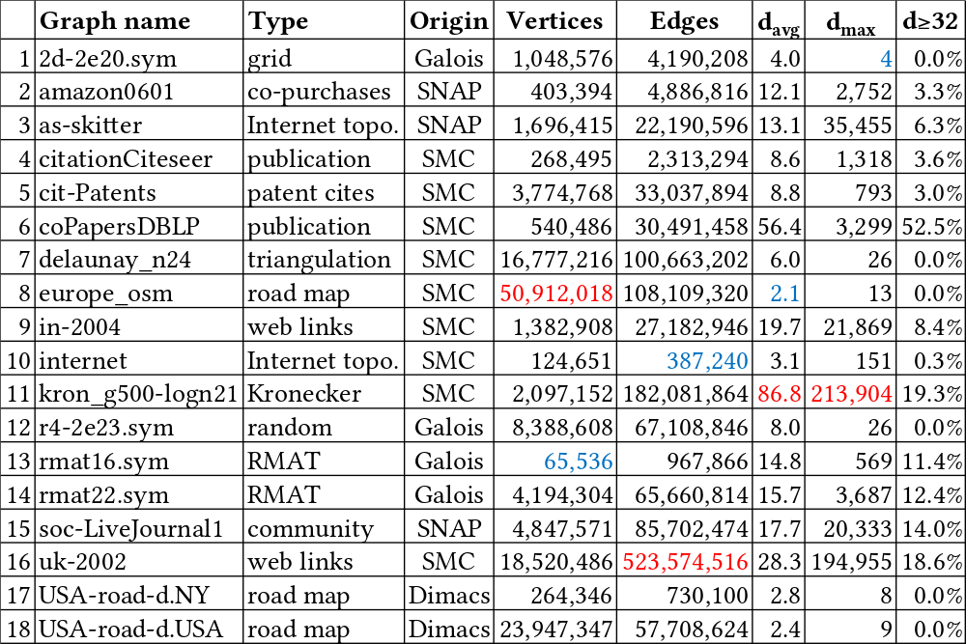
Methodology: 18 Input Graphs

Slide 41
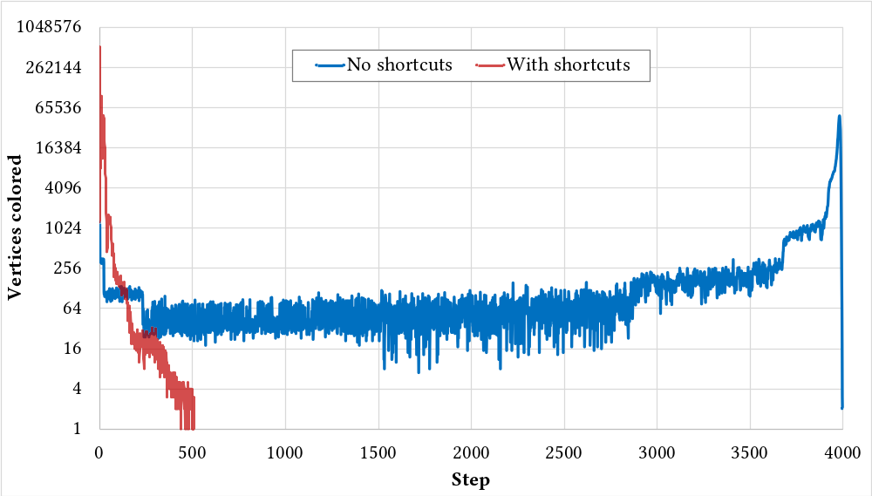
Amount of Parallelism on Kron Graph
3997 steps without shortcuts
509 steps with shortcuts

Slide 42
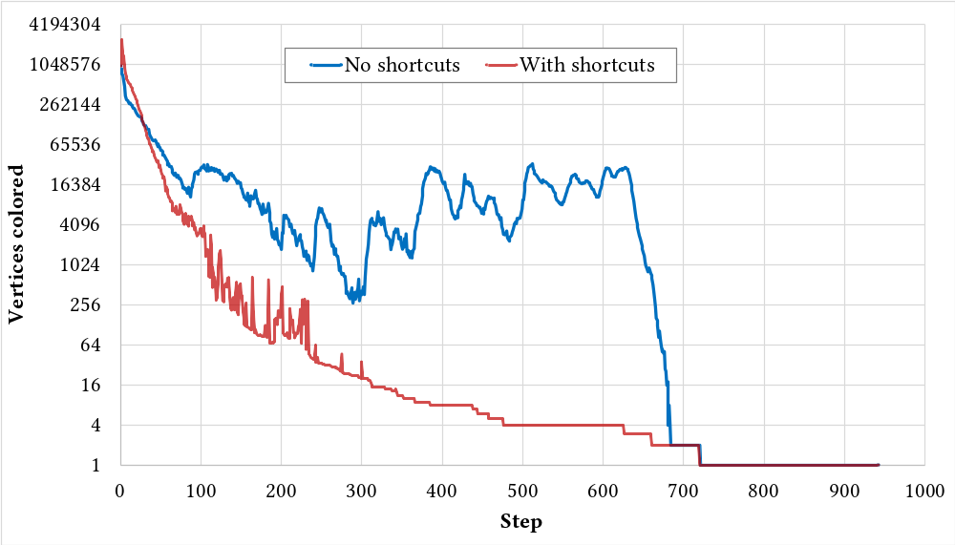
Amount of Parallelism on UK Graph
Lines overlap and end at same point

Slide 43
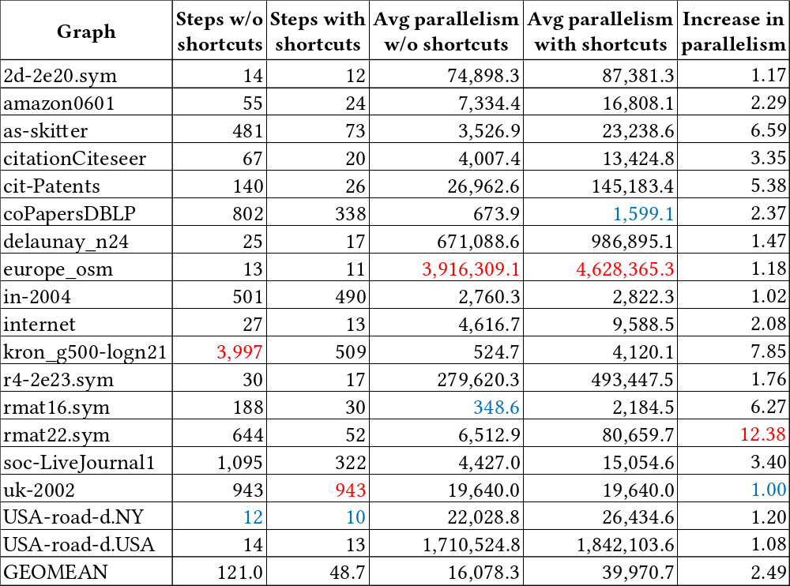
Available Parallelism

Slide 44
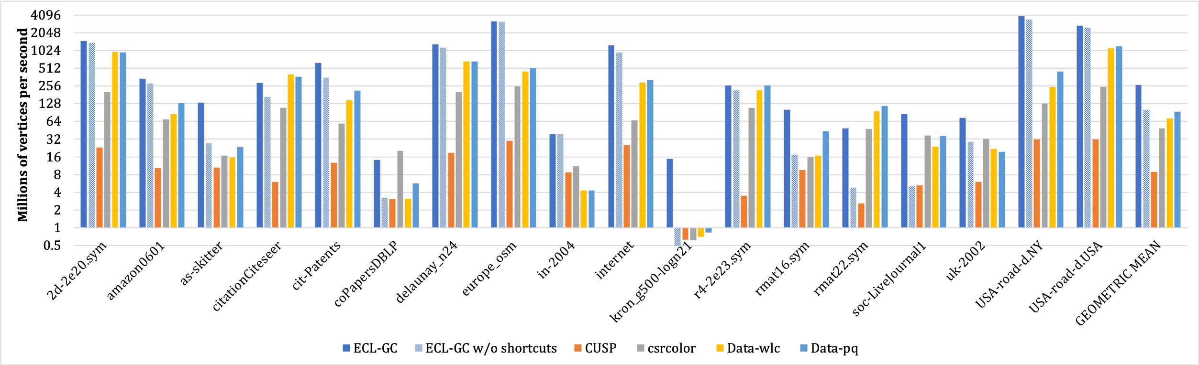
Throughput on Titan V (GPU Codes)
On kron_g500-logn21, ECL-GC is 17 times faster than Data-pq
On average, ECL-GC is 2.9 times faster than the fastest GPU code Data-pq
ECL-GC w/o shortcuts is slightly faster than other GPU codes
Our baseline implementation
without the shortcuts

Slide 45
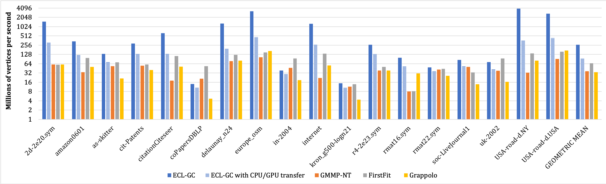
Throughput (Parallel CPU Codes)
ECL-GC is faster than GMMP-NT & Grappolo on all tested graphs and faster than FirstFit on 15 graphs
On average, ECL-GC is 4.0 times faster than FirstFit
Lowers throughput by 2.8x but still faster than CPU codes
Including time to send graph to GPU & the resulting colors to CPU

Slide 46
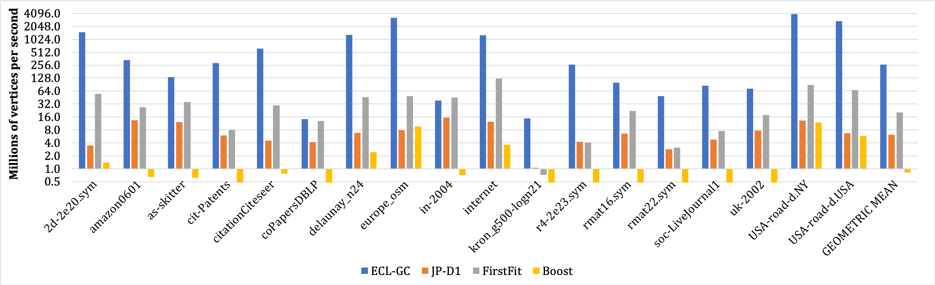
Throughput (Serial CPU Codes)
ECL-GC is faster on all tested graphs except in-2004
On average, ECL-GC is 13.2 times faster than FirstFit

Slide 47
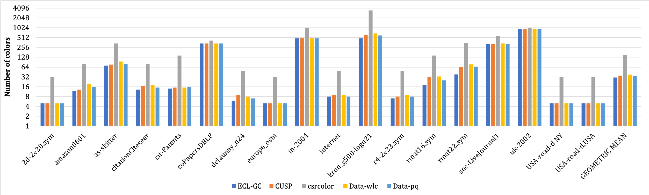
Number of Colors (GPU Codes)
ECL-GC assigns the smallest or the same number of colors on all tested inputs
On average, ECL-GC has the best coloring quality

Slide 48
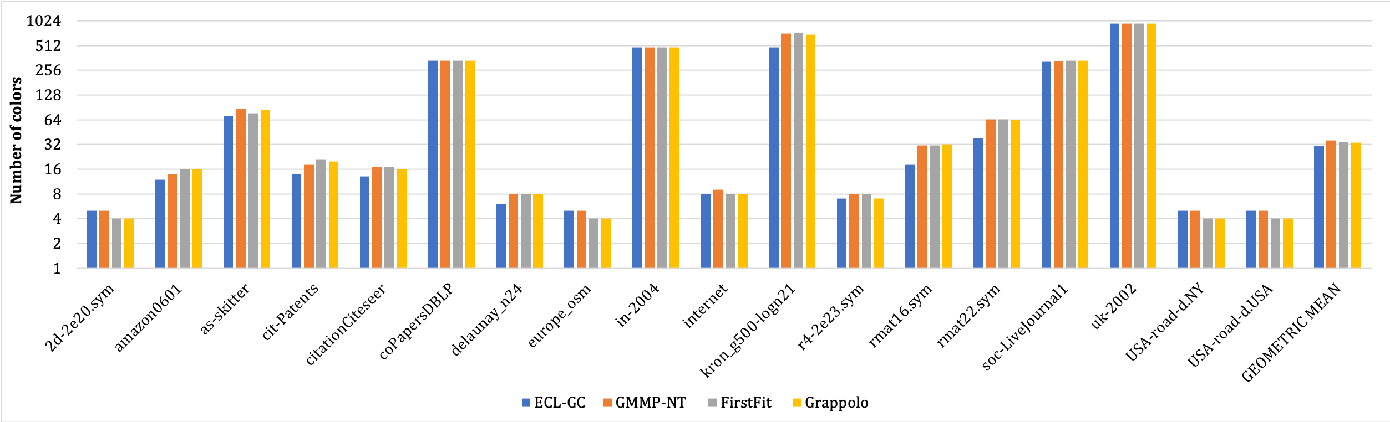
Number of Colors (Parallel CPU Codes)
ECL-GC assign the smallest or the same number of colors as FirstFit & Garppolo on 11 of the 18 graphs
ECL-GC assigns only 1 more color on the remaining 7 graphs

Slide 49
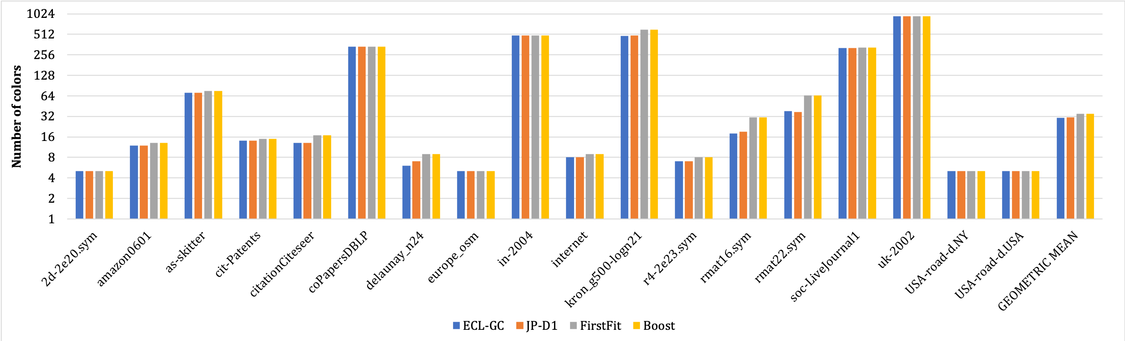
Number of Colors (Serial CPU Codes)
ECL-GC assigns the smallest or the same number of colors on all tested inputs
ECL-GC’s and JP-D1’s coloring quality is almost identical

Slide 50
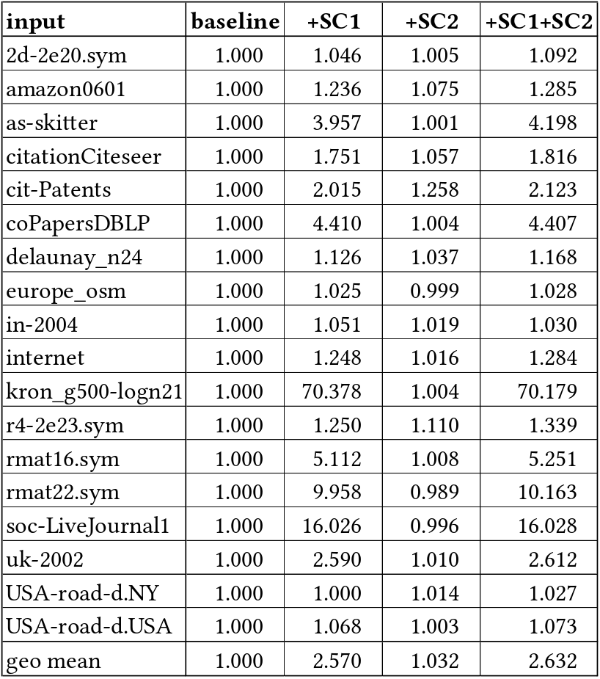
Titan V Speedup due to Shortcuts
Shortcut 1 is much more important than Shortcut 2

Slide 51
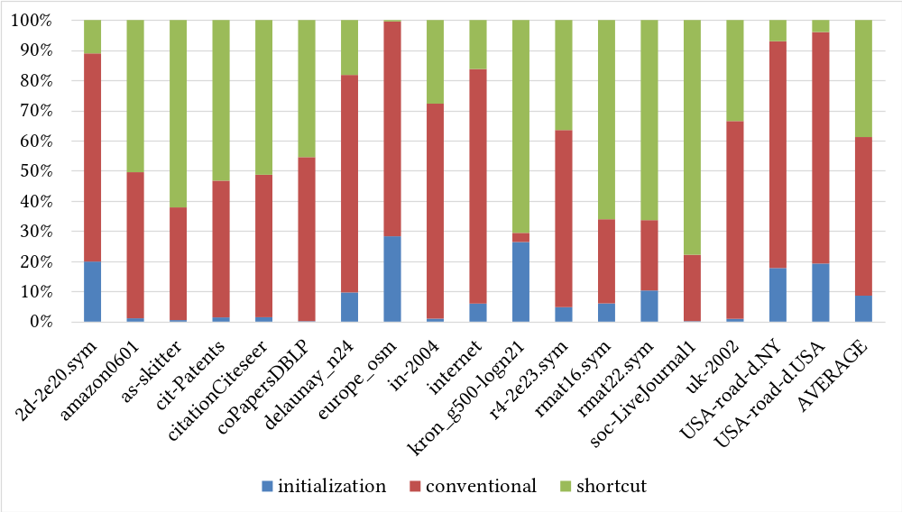
Source of Color Assignment
38.8%
52.6%
8.6%

Slide 52
Summary and Conclusion
New algorithmic optimizations for graph coloring
  Increases parallelism by breaking data dependencies
    Exceeds intrinsic (LDF) DAG parallelism by 2.5x
  These “shortcuts” guarantee same final coloring
ECL-GC GPU performance
  Faster on average than prior CPU and GPU codes
    Especially on high-degree graphs
Conclusion
  ECL-GC can speed up apps that use graph coloring
  Look for shortcuts to increase parallelism in other fields

Slide 53
Thank you!
Acknowledgments
  NSF, NVIDIA
Contact information
  burtscher@txstate.edu
Web page (link to paper and source code)
  http://cs.txstate.edu/~burtscher/research/ECL-GC/
ACM Symposium on Principles and Practice of Parallel Programming (PPoPP), pp. 262-275. February 2020.

