Slide 1
COMP-382-ON1
Sahil Chhokar
Karan Dhanoa
William Craske
Balkar Singh
Assignment 2
Converting any Context-Free Grammar into Chomsky Normal Form

Slide 2
Introduction
For our project, we focus on developing an algorithm that converts any Context-Free Grammar (CFG) into Chomsky Normal Form (CNF) through a structured and multiphase algorithm that’s implemented through python.
CNF has various uses, such as
- Formal language theory
- Compiler construction
- Automated parsing
Due to its strict rule structure that provides uniform and organized grammar.
This project emphasizes on algorithm correctness, clarity of transformation steps, and preservation of language equivalence.

Slide 3
Problem Statement
Context-Free Grammars (CFGs) may contain productions that are unrestricted, such as Ɛ-productions, unit productions, mixed symbol sequences, and extremely long right-hand sides.
These forms complicate parsing and verification.
As we work to achieve our goal of converting CFGs to CNF, we must ensure:
- The generated language is preserved
- All productions stick to CNF constraints
- The transformation is deterministic and reproducible

Slide 4
What is Chomsky Normal Form?
Before we delve into the algorithm, we must first understand Chomsky Normal Form.
A grammar is said to be in Chomsky Normal Form if its productions conform to one of the following:
A -> BC
A -> a
S -> Ɛ
The first means that a variable produces exactly two variables
The second means that a variable produces a single terminal
The third, while optional, is only allowed if the language includes the empty string.
We restrict grammars to CNF due to
- Uniform rule structure
- Efficient parsing
- Clearer analysis due to simplified structures

Slide 5
Algorithm Overview
The algorithm proceeds through four sequential phases, which each phase addressing a specific issue.
1. Eliminate occurrences of the start symbol on the right-hand side
2. Remove Ɛ-productions while preserving derivable strings
3. Remove unit productions by collapsing variable-to-variable chains
4. Convert the remaining grammar to CNF
At every stage, the grammar always remains equivalent to the original.

Slide 6
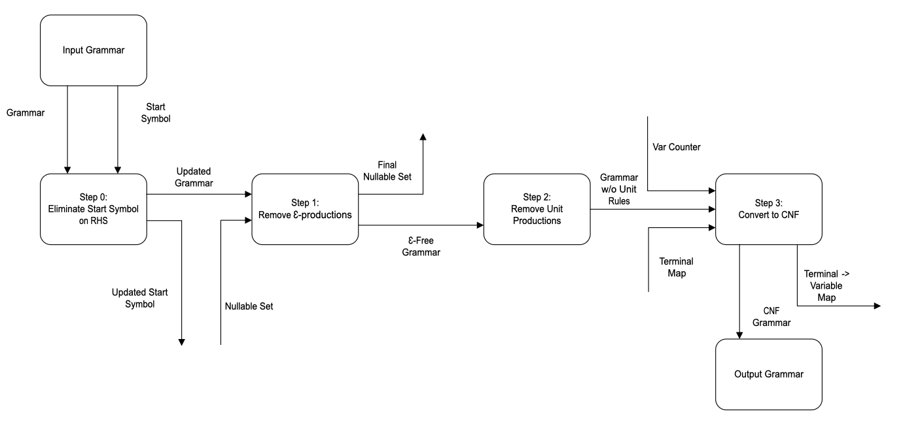
Visual Programming Conversion Model
The conversion is visually programmed to demonstrate an easy-to-digest overview of our algorithm, with the nodes representing the steps and their inputs/ outputs.
Any auxiliary structures (nullable set, terminal mapping, and variable counter ) are only introduced within the specific phase that they’re required and do not extend to the other phases.

Slide 7
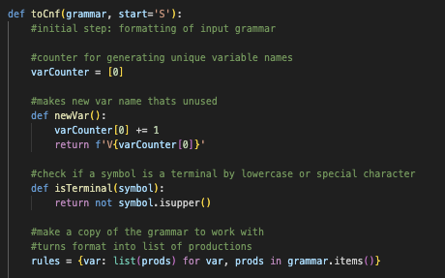
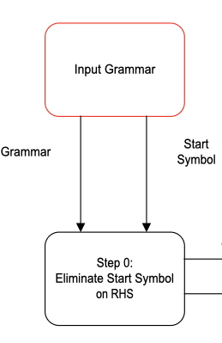
Input Grammar Node
The first node is the input grammar.
The algorithm begins with the input grammar and designated start symbol.
The grammar is represented as a mapping from variables to lists of productions.
No structural modifications happen in this phase, it simply establishes a baseline in which all future phases can work off of.

Slide 8
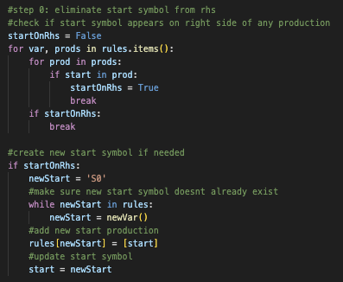
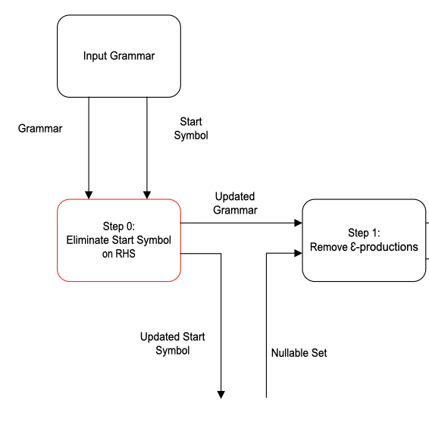
Step 0: Eliminate Start Symbol on RHS
The second node is the elimination of the start symbol on the right hand side.
This step ensures that the start symbol does not appear on the right hand side of any production, which helps prevent any confusion during derivations.
If the algorithm deems it necessary, a new start symbol is introduced along with its matching production.
This guarantees that the grammar remains well formed in the next steps.

Slide 9
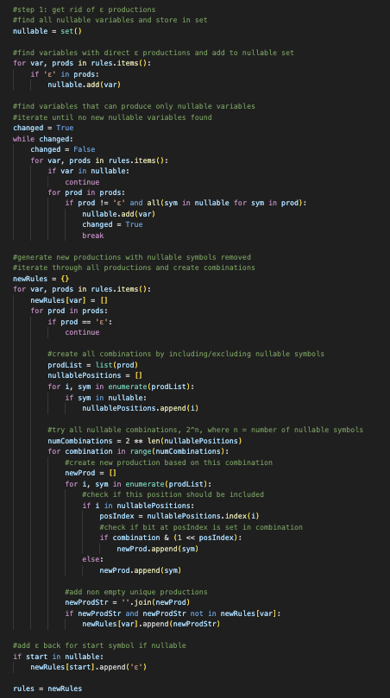
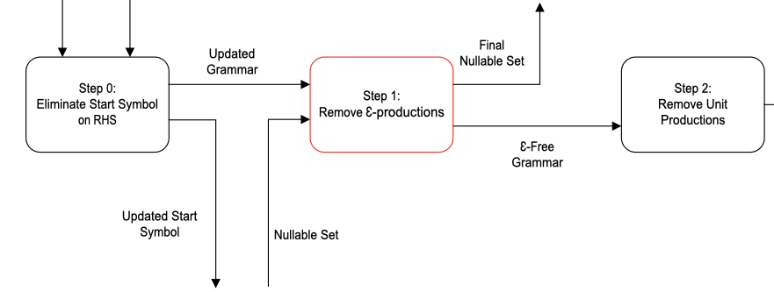
Step 1: Remove Ɛ-Productions
The third node is the elimination of Ɛ-productions.
A nullable set is constructed to identify variable capable of deriving Ɛ.
Productions are then expanded combinatorially to represent all derivations that exclude nullable symbols, which removes Ɛ while preserving the language equivalence.
The nullable set is retained only as an intermediate computation.
All nullable variables are examined to generate alternative RHS expansions without losing derivable strings.

Slide 10
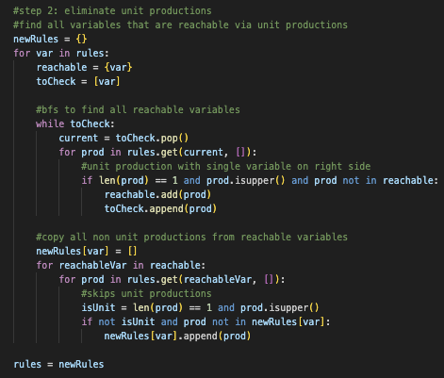
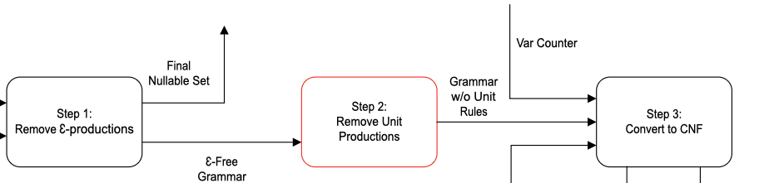
Step 2: Remove Unit Productions
The fourth node is the removal of unit productions.
This phase eliminates productions of the form A -> B by computing variable reachability and replacing unit chains with the full set of terminal-producing, or multi-variable productions of the reachable variables.
The result is a grammar where all productions directly contribute to terminal derivation.

Slide 11
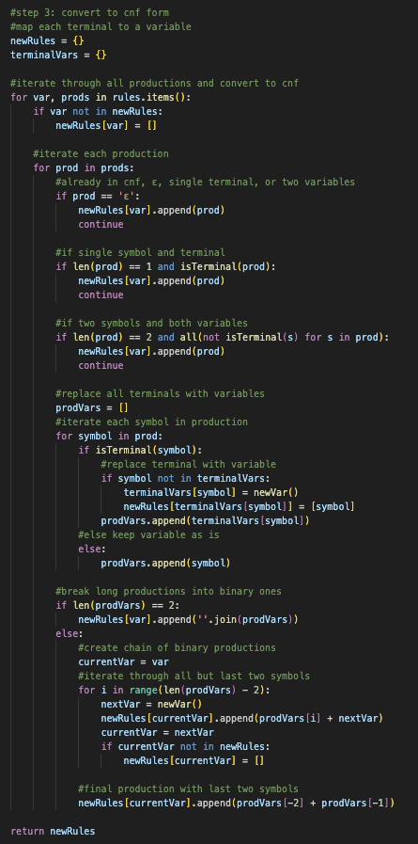
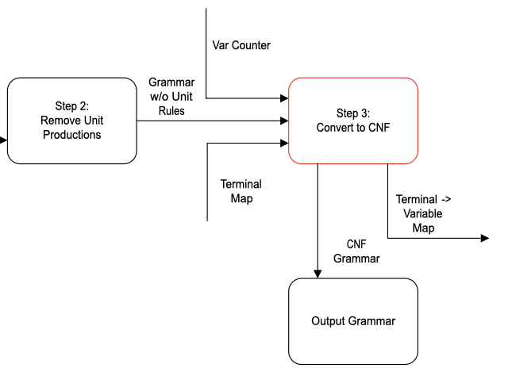
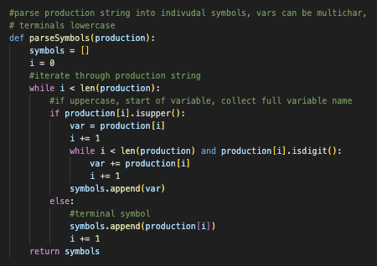
Step 3: Convert to CNF
The fifth node is where the grammar is converted into CNF.
The grammar is restructured to conform to the previously mentioned CNF requirements.
Terminals in multi-symbol productions are replaced with dedicated variables, and long right-hand sides are recursively broken down into binary productions using newly created variables.
A local terminal-to-variable map and a variable counter support this decomposition.

Slide 12

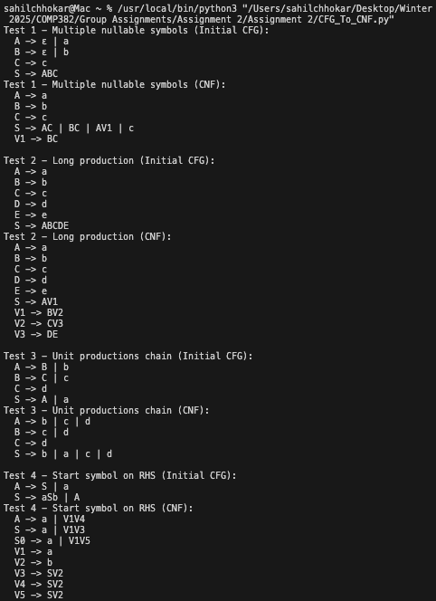
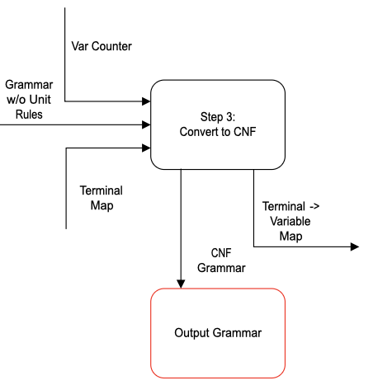
Output Grammar
The sixth, and final node, is where the grammar is outputted.
The final output contains grammar that adheres to CNF, where all productions are either binary variable expansions, or terminal producing rules.
This grammar is now suitable for analysis, efficient parsing, and theoretical computation, as mentioned earlier with the CNF uses.

Slide 13
Lessons Learned/ Improvements
Through this project and developing this algorithm, we learned that this is much more than just grammar theory. This taught us both algorithmic design and problem solving. We learned that breaking a complex transformation down into much smaller, modular phases, makes it significantly easier to understand.
Also, we redesigned our original presentation after the presentation with the Professor. From that conversation, we included/ changed the following:
- Simplified the text, and instead have the word heavy explanations in the audio presentation, since it prevents initial confusion when trying to explain the topic
- Followed more of the textbook convention
- Recreated our original diagram in Visio in a visual programming way, with nodes that have input/ outputs, which significantly helps with understanding when presenting the project.

Slide 14
References & Acknowledgement
The list of resources utilized, and their usages, are as follows:
Python Software Foundation. (2025) Python 3 Documentation. Retrieved from https://www.python.org
Microsoft. (2025). Visual Studio Code. Retrieved from https://code.visualstudio.com
GeeksForGeeks. (2025). Converting Context-Free Grammar to Chomsky Normal Form. Retrieved from https://www.geeksforgeeks.org/theory-of-computation/converting-context-free-grammar-chomsky-normal-form/)
GitHub, for pushing updates to code, assigning tasks, and creating a collaborative environment
Discord, used for all intermediary communication
OpenAI. (2025). ChatGpt 5.0. Used to generate small code snippets which were then expanded on.
Youtube, CNF Conversion Example. Retrieved from https://www.youtube.com/watch?v=eUlUzH9fmXQ&t=953s
TutorialsPoint, Context-Free Grammar Introduction. Retrieved from https://www.tutorialspoint.com/automata_theory/context_free_grammar_introduction.htm
Microsoft Visio, through UFV access. Visual Programming Creation. Retrieved from https://www.microsoft.com/en/microsoft-365/visio?market=af

Slide 15
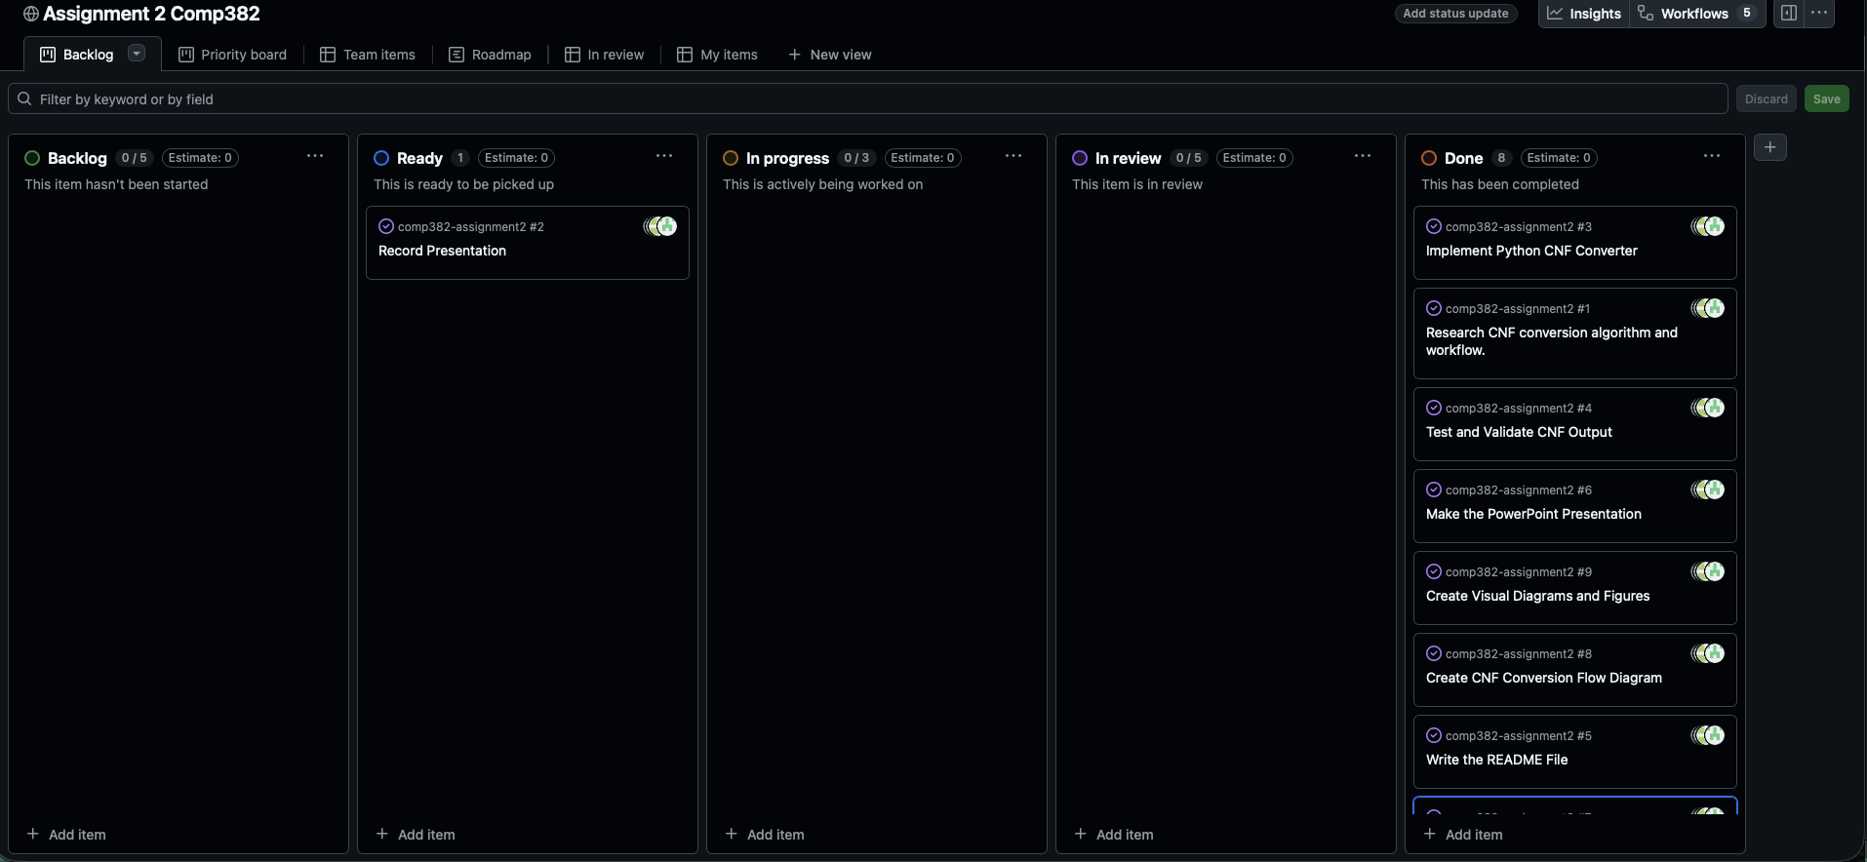
Logging & Misc
Almost all communication about the project was done via discord. Main problem solving was solved synchronously via Discord voice calls, and asynchronously for smaller updates.
GitHub also contains all deliverables for the project, for reproducibility purposes. – Powerpoint, Python, readme, dot file, and png file. We also utilized GitHub’s project board feature, as seen below. Issues, and all other project information, are available for view through the public repository link found in “GitHub_Link.txt”.
All portions of this project/ presentation were split equally, and collaborative efforts were roughly equal on each part.

