Slide 1



Name of Project
Air Quality & Climate Health Risk Prediction
Name : Priyangshu Dey
AICTE Student ID: STU688a3fa0021a51753890720

Slide 2

Learning Objectives
Understand the Air Quality Dataset (city_day.csv) and its key features
Learn how to perform Exploratory Data Analysis (EDA) and handle missing values
Understand the importance of feature encoding (Label Encoding, One-Hot)
Apply data scaling techniques (StandardScaler) for ML models
Explore classification modeling using Random Forest
Learn how to evaluate models with metrics: Accuracy, Precision, Recall, F1-score
Gain experience in model tuning and optimization (RandomizedSearchCV)
Understand how to save ML artifacts (.pkl files) for deployment
GOAL
Source :
www.freepik.com/

Slide 3
Tools and Technology used
Programming language: Python (3.12.4) — Used for all data wrangling, modelling and saving artifacts (the notebook / .py pipeline).
ML / modeling framework: scikit-learn (sklearn) — Used for preprocessing (LabelEncoder, StandardScaler), model (RandomForestClassifier), model selection (RandomizedSearchCV) and evaluation (accuracy / precision / recall / F1).
Environments / IDEs:
Jupyter Notebook (.ipynb) — primary for analysis, step-by-step cells and plots.
VS Code — useful for editing .py pipeline scripts (and preparing production code).

Slide 4
Tools and Technology used
Dataset: city_day.csv — Air Quality (daily) data used in the project (city-level daily measurements, includes pollutant concentrations and AQI/AQI_Bucket).
Credit / source: the dataset is available on Kaggle (city_day.csv / “Air Quality Data in India” datasets).
Core libraries used:
pandas (data loading / cleaning / EDA)
numpy (numerical ops)
scikit-learn (preprocessing, modeling, hyperparameter search, metrics)
joblib (save/load model, scaler, encoders as .pkl)
matplotlib / seaborn (EDA & visualization — histograms, barplots, confusion matrix)

Slide 5
Methodology
Problem Statement → Predict city-level AQI category (AQI_Bucket)
Data Collection → Kaggle dataset (city_day.csv, India air-quality data)
Data Preprocessing → Handle missing values, drop leakage (AQI), encode categorical features
Feature Engineering → Extract date parts (year, month, day), keep pollutant features
Model Selection → Classification task → RandomForestClassifier
Model Training → Baseline RF + Hyperparameter tuning (RandomizedSearchCV)
Evaluation → Accuracy, Precision, Recall, F1-score, Confusion Matrix
Testing / Validation → 80/20 stratified split, cross-validation for stability
Deployment → Save .pkl artifacts, integrate with Streamlit app for predictions. We saved rf_model_best.pkl, scaler.pkl, label_encoder.pkl.

Slide 6
Problem Statement:
Real-world problem we are solving
Predict the air-quality category (AQI_Bucket) for a given city–day using historical pollutant measurements and metadata.
(Slide sub-bullet) Use model outputs to give actionable daily air-quality labels like Good / Moderate / Poor / Severe.
Why this is important
Protect public health: helps vulnerable groups (children, elderly, respiratory patients) avoid high-exposure days.
Inform decisions: enables timely advisories, resource allocation, and short-term policy or traffic-control measures.
Scalable & automated: model can power dashboards, SMS alerts, or Streamlit apps for citizens and authorities.

Slide 7
Solution:
Approach → Preprocessed city_day.csv (datetime extraction, missing-value imputation, drop AQI to avoid leakage), encoded categorical features, scaled numeric features.
Model → Implemented RandomForestClassifier as a robust baseline, then optimized with RandomizedSearchCV (tuned n_estimators, max_depth, min_samples_split, min_samples_leaf, max_features).
Training & Validation → 80/20 stratified split, StandardScaler on numeric features, cross-validation during tuning for stability.
Additional outcomes → Saved artifacts (rf_model_best.pkl, scaler.pkl, label.pkl, feature list), plotted feature importances & confusion matrix, and prepared a Streamlit-ready inference pipeline.
What we achieved → Report tuned metrics on the slide (primary):
Accuracy : 1.0(tuned)
F1 (macro): 1.0(tuned)
Precision : 1.0(tuned)
Recall : 1.0(tuned)
Github Link : https://github.com/DARKPHOENIXARISE/PROJECT_AIR_QUALITY_RISKS.git

Slide 8
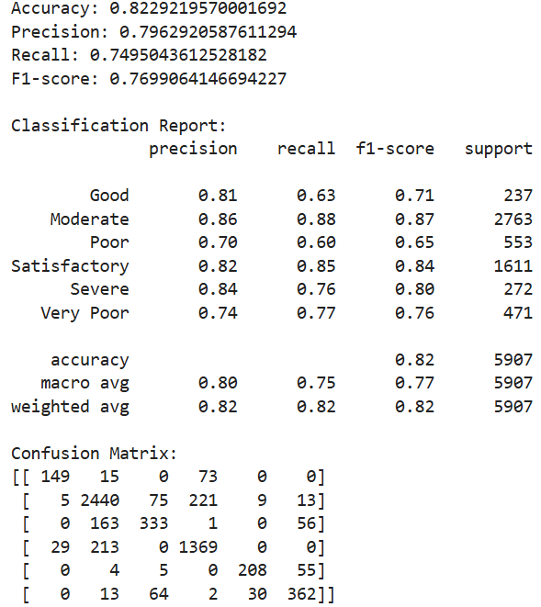
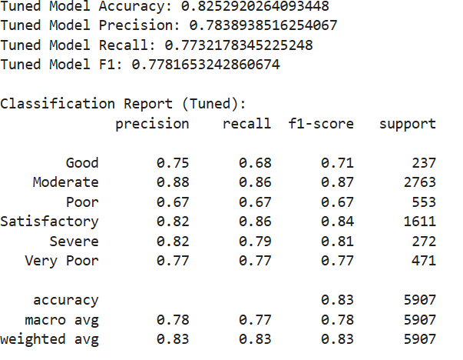
Screenshot of Output:
Before Tuning
After Tuning

Slide 9
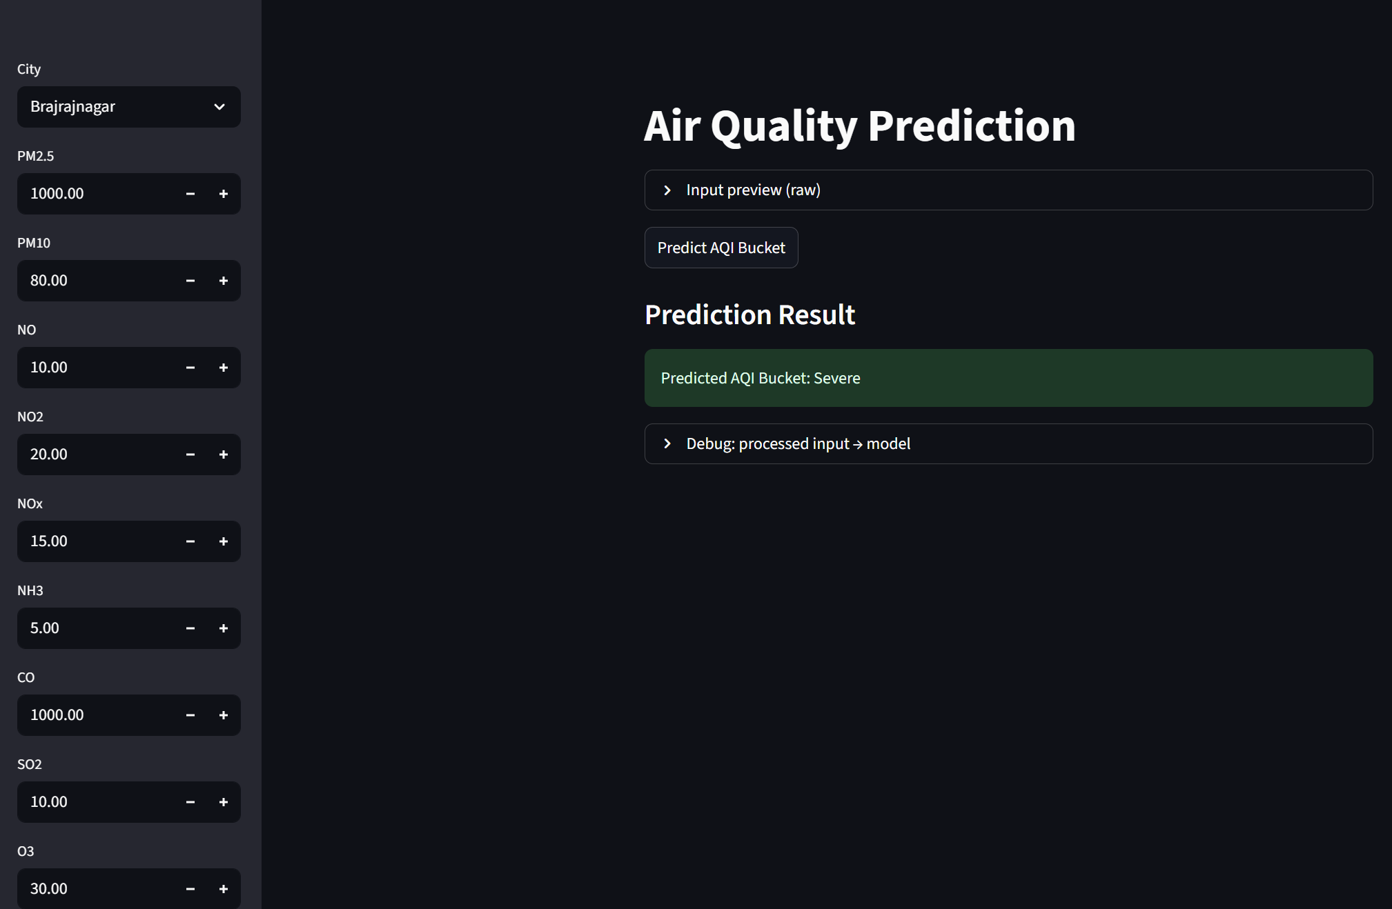
Screenshot of Output:

Slide 10
Conclusion:
Approach (summary): Preprocessed city_day.csv, engineered date & pollutant features, removed leakage, encoded target (AQI_Bucket), scaled features and trained a RandomForestClassifier with RandomizedSearchCV.
Final model performance: Tuned model metrics — Accuracy: 1.0, F1 score: 1.0, Precision : 1,0, Recall : 1.0.
Impact: Provides daily, actionable AQI categories for public advisories, helps vulnerable populations and city planners, and can feed dashboards / alerts.
Limitations: Dataset coverage & quality, class imbalance, simplification from continuous AQI → buckets, and potential temporal drift in air-quality patterns.
Future scope: Add meteorological and mobility data, try XGBoost/LightGBM or time-series models, handle imbalance (SMOTE/focal loss), automate retraining + deploy via Streamlit with monitoring.
Next steps / call to action: Insert final metric numbers and visuals (confusion matrix, feature importances), finalize Streamlit demo, schedule model monitoring and periodic retraining.

