Slide 1
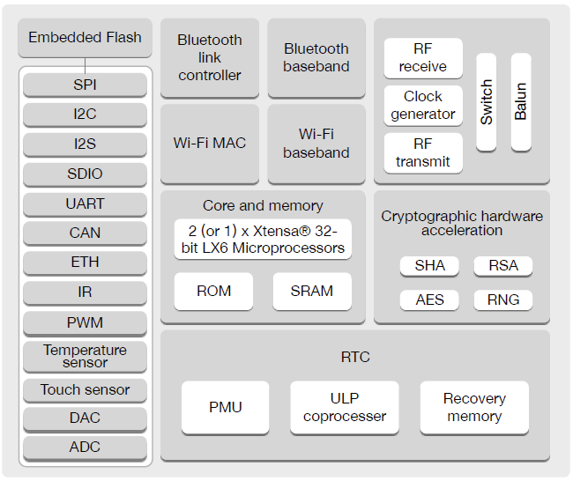
Opción 1 Pantalla
Celular
(App)
Opción 2 Pantalla
Pantalla LCD
Opcional
Modulo GPS
Circuito de carga/ Regulador LDO
Tarjeta RFID
Vin
Batería LiPo
Fotorresistencia
Luces delanteras
Luces Direccionales
Modulo de Ultrasonido o IR
GPIO
Sensor efecto hall
Botones

Slide 2
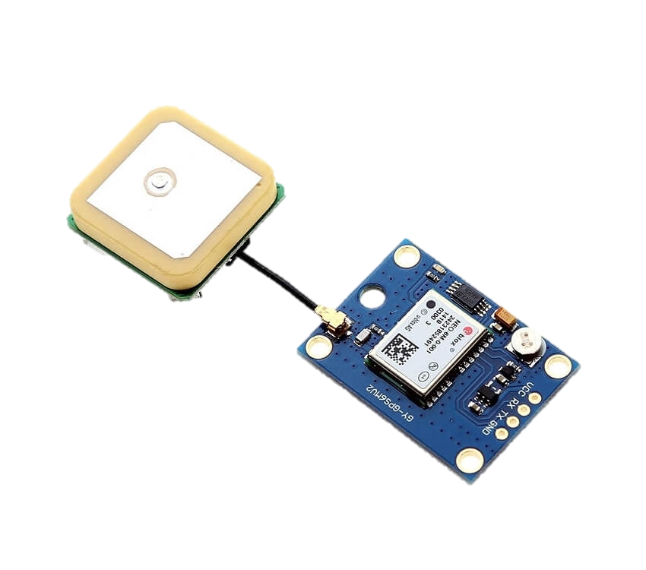
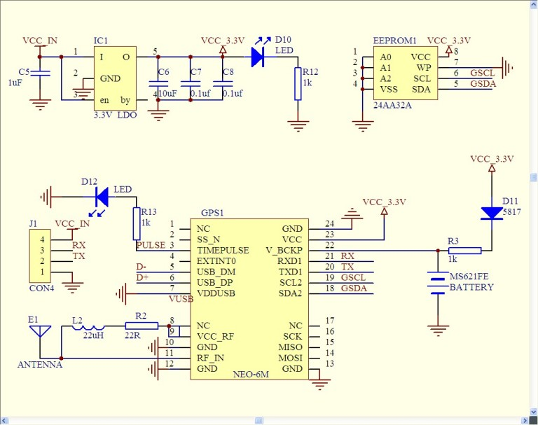
Modulo GPS
NEO-6M v2

Slide 3
Modulo GPS
NEO-6M v2
https://www.tme.eu/Document/274aa97d7454f2dc99f0a8e6148999f0/NEO-6_DataSheet.pdf
https://electronilab.co/tienda/modulo-gps-ublox-neo-6m-v2-con-memoria-eeprom/
https://www.electroschematics.com/neo-6m-gps-module/

Slide 4
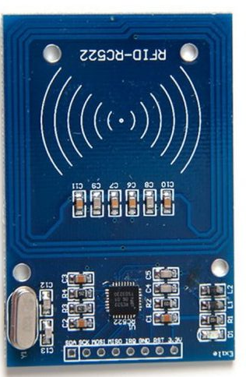
Modulo RFID
https://www.tme.eu/Document/274aa97d7454f2dc99f0a8e6148999f0/NEO-6_DataSheet.pdf
https://electronilab.co/tienda/modulo-gps-ublox-neo-6m-v2-con-memoria-eeprom/
https://www.electroschematics.com/neo-6m-gps-module/

Slide 5
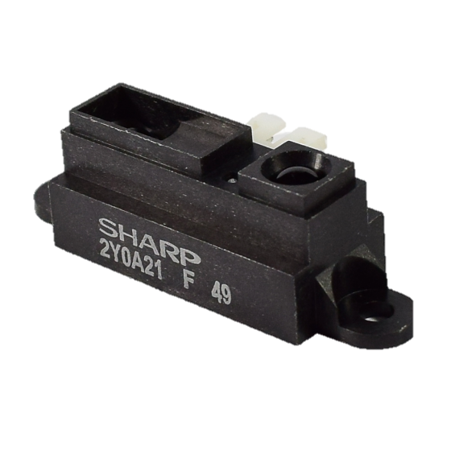
Sensor distancia IR
SENSOR DE DISTANCIA INFRARROJO SHARP
https://global.sharp/products/device/lineup/data/pdf/datasheet/gp2y0a21yk_e.pdf

Slide 6
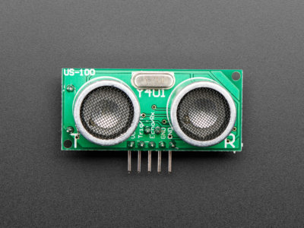
Sensor distancia Ultrasonido
US-100
https://c1555f5ec9.clvaw-cdnwnd.com/34662fcf1f1e607c561442431023ac8e/200007933-c8b72c9b05/US-100%20Ultrasonic%20Sensor%20Module.pdf

Slide 7
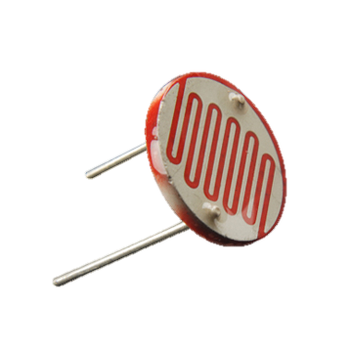
FOTORRESISTENCIA LDR
https://www.electan.com/datasheets/cebek/CE-C2795.pdf

Slide 8
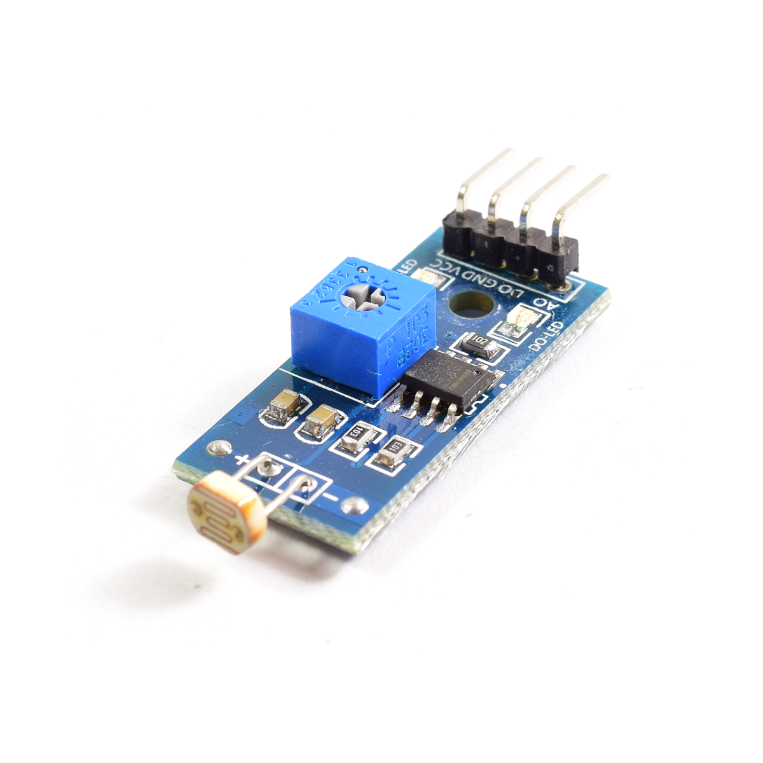
MÓDULO SENSOR LDR
https://naylampmechatronics.com/sensores-luz-y-sonido/135-modulo-sensor-ldr.html

Slide 9
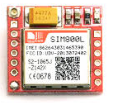
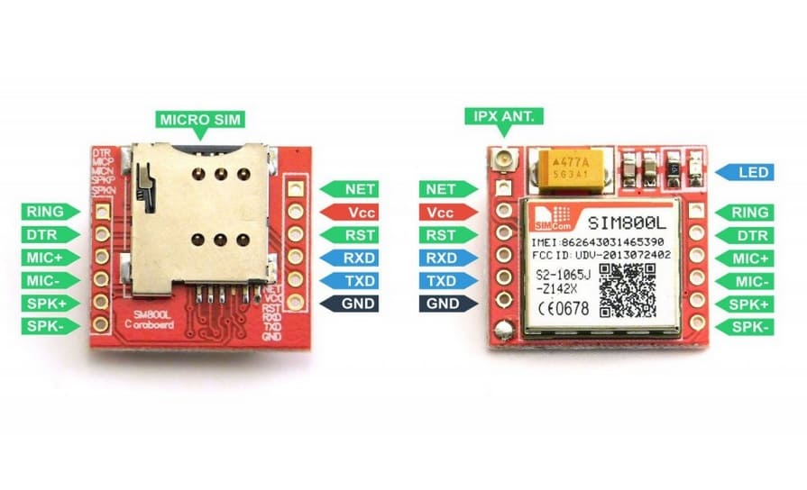
Modulo Sim
Sim800l

Slide 10
Modulo Sim
Sim800l
https://lastminuteengineers.com/sim800l-gsm-module-arduino-tutorial/
https://www.filipeflop.com/img/files/download/Datasheet_SIM800L.pdf

Slide 11
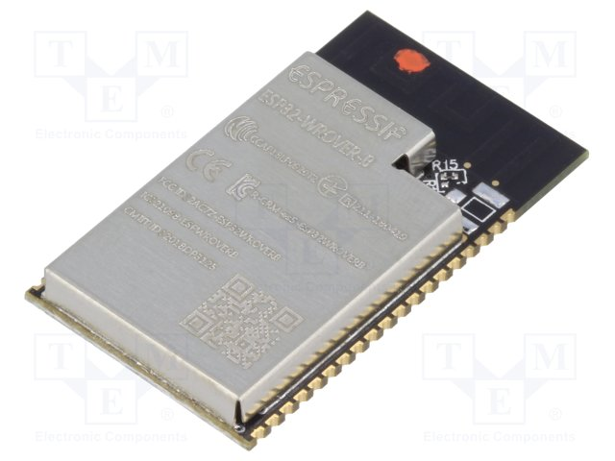
ESP32­-WROVER­-B
snapeda.com/parts/ESP32-WROVER-B/Espressif%20Systems/view-part
https://www.espressif.com/sites/default/files/documentation/esp32-wrover-b_datasheet_en.pdf

Slide 12
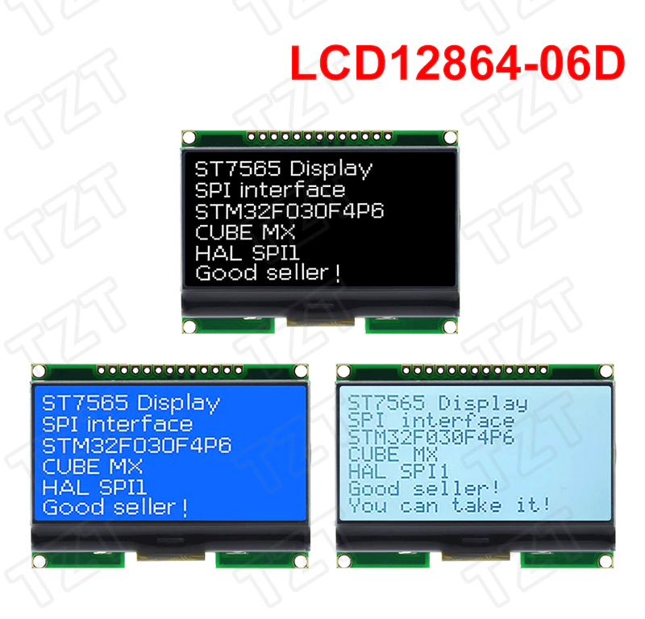
128 x 64 Graphic LCD
https://www.vishay.com/docs/37329/37329.pdf

Slide 13

Luces
NEO-6M v2

Slide 14

Diseño APp
https://www.kodular.io/

