Slide 1
Curating Structured Knowledge with Semi-structured Sources and Knowledge Extraction

Slide 2
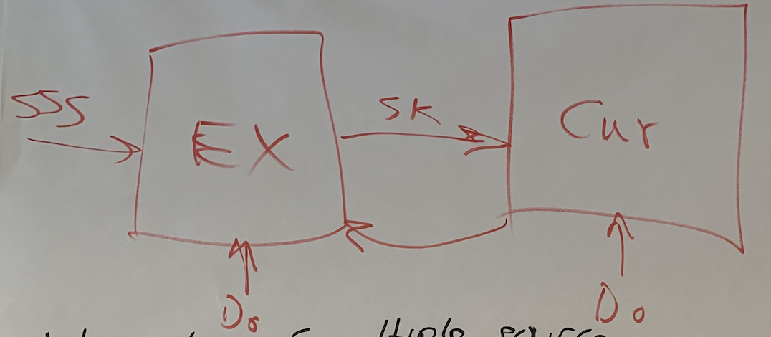
(Knowledge Extraction and) Curation
Fundamental dimensions:
Collect knowledge*
KE, including contextual info
Organize the knowledge
flexible/universal underlying representation needed
Get user-customized facet/view* of the knowledge
using context from user
Present to user
How to actually get implementation out of curated knowledge?
How can you get the user to trust what you give them?
What representations/structures/resources are needed to have knowledge that can be maintained as new knowledge comes in?
Extraction
Curation
Transformation
Augmentation
* Don’t read too much into the usage of this particular term…

Slide 3
Curation
Discussion of whether we should be generating structured KBs (or, maybe who should be generating these, curator? User?)
Seems to vary by domain/use case
Extractions are hypotheses, then these are evaluated to see if they fit/belong in the KB (from which models are constructed)
This evaluation could be manual, but also semi-automated (i.e., there is a machine role)
Hypothesis agrees, contradicts, etc.

Slide 4
Curation with confidence
Evaluation of validity/utility of a given extraction:
Should the extraction/new source be merged/pruned/modified/flagged?
What in this new source augments existing knowledge?
Is it new, or new way of saying something already there?
Does it contradict?
Is it technically wrong (i.e., extraction mistake)?
Should we only extract and curate what’s in the paper? Or should we “fix” it? (and what does ”fix” mean? Human? Gather more data to resolve?) What provenance is needed (paper trail)?

Slide 5
Curation with confidence
Need some measure(s) of extraction confidence
Human curation is hard to scale, so the curation process should be at least semi-automated…
And when humans do intervene/annotate, their changes should propagate so that we get additional bang for our buck – how to do this well?

Slide 6
What is being collected/combined/curated?
What data:
Some gather large amounts of data (from a specific domain or domain-independent)
Others are gathering data from narrow sources (papers, blogs, websites directing corresponding to a specific set of models, etc.)
What to extract:
Subsets of text, equations, figures, tables, code
Curation:
For some: not enforced, let user decide
weighting up/discarding info
Subsets of redundancy criteria, human annotations
Mechanisms to allow users to evaluate the curation evaluations
Mechanisms to allow machine to learn/extrapolate from the evaluation of the curation evaluations …
Representations
Lots of thought into representations which are universal*/flexible/composable*/domain-independent
To facilitate assembly from many sources and modalities
To facilitate filling in gaps through reading at scale
To facilitate development of confidence/believability scores/estimates
To facilitate a variety of context (which can unite the modalities)

Slide 7
What is being collected/combined/curated?
(Gallup) Epidemiology:
(effort to develop domain independent approaches)
Source data - literature from that domain that describe the relevant models (SIR, SEIR)
Text
Equations
Curation: weighting up/discarding info (during compilation into markov network) using redundancy criteria
(Siemens) Deep Learning Papers:
Text, diagrams, and equations from papers, blogs (focus on being able to generalize)
Code for corresponding papers
Infer code from diagrams
Curating into RDF?

Slide 8
What is being collected/combined/curated?
(UW) Across Domains:
(effort to develop general methods, without enforcing curation)
Extracting and connecting data between modalities (text, equations, figures, tables, etc.)
Representations that carry the context and cut across the multiple modalities
How to asses or validate/use:
Go from unstructured to structured:
Database, without enforcing schema -- universal representation of info with multiple modalities
Develop tools have LW mechanisms for users to specify what they’re interested in
Build representations (embeddings, xml graphs) to more easily transform into the representation users want, given their needs/output
Then put in table so users can access
QA mechanisms (Open IE)
Mechanisms with minimal info, take subspace, transform into something structured
If more specific needs, start with extractions, build model that will know how to read for what you’re interested in
What does confidence score mean? Where does it come from?
Only domain experts can assess curation, so argue that we need to provide mechanisms
And, how can we bring context (knowledge user knows, KB, additional papers, etc.) as a domain expert in a way that intersects with available representations?

Slide 9
What is being collected/combined/curated?
(HMS) (independent of domain):
Lesson: In going from text to executable models, super helpful to have intermediate representation for assembling
INDRA: automated machine curation to make sense of machine reading
Error correction (systematic)
Recognizing and resolving redundancy
Full/partial redundancy (differences in granularity, etc.)
Assess believability (technical and scientific)
Infer missing pieces and fill in gaps
Machine can help with this!
Humans can help with (~tuning):
Fixing error patterns
Modify believability module
Have right representation to make use of these human effort

Slide 10
What is being collected/combined/curated?
(UAZ) Crop modeling:
Read, but with narrow focus
Software and documents about the code, to get grounded representations that can be used at higher level for model assembly, comparison, maintenance
(GE) Hypersonics:
NASA website as corpus, definitions, some code associated with text
Equations from text (bc not as images, but text)
Extractions from text and code can inform each other (i.e., done in context)
Automated extraction manager in a curation loop (i.e., Give me more info about X, …)
How much should be automated?
Some domains, need more human when accuracy is more critical

Slide 11
Curation
Models of curation in order to do curation – is it static, does it change?
Human-in-the-loop:
System identify conflicts, etc, and human can resolve, etc.
Ask a question, system find model, get result
Need to know info about the inputs and outputs, relations between elements in a data source
We need rich context to answer this
Provenance/Interpretability:
To what extent can you present to user the behind-the-scenes way that information was gathered/curated?
Machine like helpful human – Grice!
Curation analogies:
Museums (exhibit vs basement):
Curator determines what belongs in exhibit, conditioned on desires (and/or schemas) of users
(Hipster version): craft cocktails (ordering off menu vs telling bartender tastes and the bartender makes the drink)
Textbooks → curated form of knowledge (vs. the Library of Congress)

Slide 12
Curation vs. Maintenance
What is needed to have knowledge that can be maintained as new knowledge comes in
Fundamental dimensions:
Collect (including contextual info)
Organize (underlying representation needed)
Get Customized “exhibit” (using context from user)
Present
Actually get implementation out of curated knowledge
Give confidence and provenance so user trusts the system
(and don’t commit early…)

Slide 13
Breakout 2

Slide 14
What are the hard parts in extraction?
Hard: Multi-modal aggregation:
Synergy between the modalities:
Text, equations, images, figures, code, tables, code, video, sound, powerpoint, existing curated knowledge graph, ….
To be truly domain agnostic – anything goes!
To answer scientific questions, you need scientific sources and beyond (i.e., the news, etc.)
The problem of dealing with different levels of granularity/abstraction (and what deduplicates with what?) compound when you add additional modalities
Solution:
Leverage redundancy across modalities, enabled by representations
Define downstream tasks, inform/evaluate methods by them

Slide 15
Gathering the quantity of training data need to train large models
And can the use-case flow all the way down to what data is used

Slide 16
What are the hard parts in extraction?
Hard: Interpretability
Maintaining the provenance needed to satisfy domain experts, again, compounds when dealing with multiple modalities and machine learning methods…
How to expose to users? Do we have access to users and data?
Knowledge-driven extraction – (contextualized extraction)
Take knowledge we have, how does this inform what we extract
Project knowledge extracted into the prior knowledge/context
(e.g., an expert reading a paper gets much more out of it vs. someone without knowledge of domain)
Can we develop a system that can “build an expert,” using this process
Building-block assumptions – to be able to swap them out (and avoid baking in bias)
Solutions:
(to test drive we need the infrastructure to facilitate this – expose and evaluate, needs to be at scale)

Slide 17
What are the hard parts in curation?
Hard: How to represent what you extract?
Interoperability (extra modalities make that extra challenging)
Faithfulness to original source, in machine readable format
Accommodate partial/missing information
Solutions:
Representation must have model theory and proof
Allow inference, self-evaluation
Application of formal methods to assess completeness / compatibility of representation itself
Easily translated into something with relatively close compatibility with how experts see the domain so they can use it
Utilize research what aspects of visualizations/presentation facilitate user trust, conditioned on the user

Slide 18
What are the hard parts in curation?
Hard: What are the roles of and modes of human interaction with curation?
Make sure users able to catch and edit errors
And propagate the corrections (i.e., through ML or approach augmentation)
The less you assume about what humans will want to be able to do, the more scenarios you have to accommodate
Solution:
Inform extraction/curation with model* (BYO code/model/(query?))
Expose curation assumptions
Learn what needs to be pushed up for manual annotation

Slide 19
What are the hard parts in curation?
Hard: How do we deal with the dynamic aspect of information (maintenance)?
e.g., some aspects/biological mechanisms of older climate models are no longer relevant due to climate change
Solution:
Lift different modalities to be able to aggregate/make use of them
Methods that are maintainable:
Develop methods for merging new information, model comparison, model augmentation, collaborative
We need models of curation, that can be developed, semi-automated:
Understand similarities and differences between what people are doing
Develop incremental approaches with versioning (to what we’re doing to allow people to manage model changes, as well as update representations/models as new data comes in)
So people can start with simple models and build/edit/refine
Develop interfaces with plug-and-play architectures, to plug in what groups are doing

Slide 20
Plans
Defining and sharing *interfaces*
Defining classes of queries / use-cases, e.g. structural model comparison
Which modeling shemes can represent which semantics to support which inferences?
Use case scenarios
Someone with NIH funding, got code, lost startup, how can we get the knowledge out of that code?
The knowledge encoded in taxonomies?
How fast can we develop models of infectious diseases, etc.
Starting with simple model and deepening as much as is required to resolve issue (“Why is my rocket blowing up?”)
Develop database of information locked in publications, accessible

