Slide 1


University of Arizona AutoMATES Post-Phase 2 Kickoff Homework
Clayton T. Morrison
ml4ai.github.io/automates

Slide 2
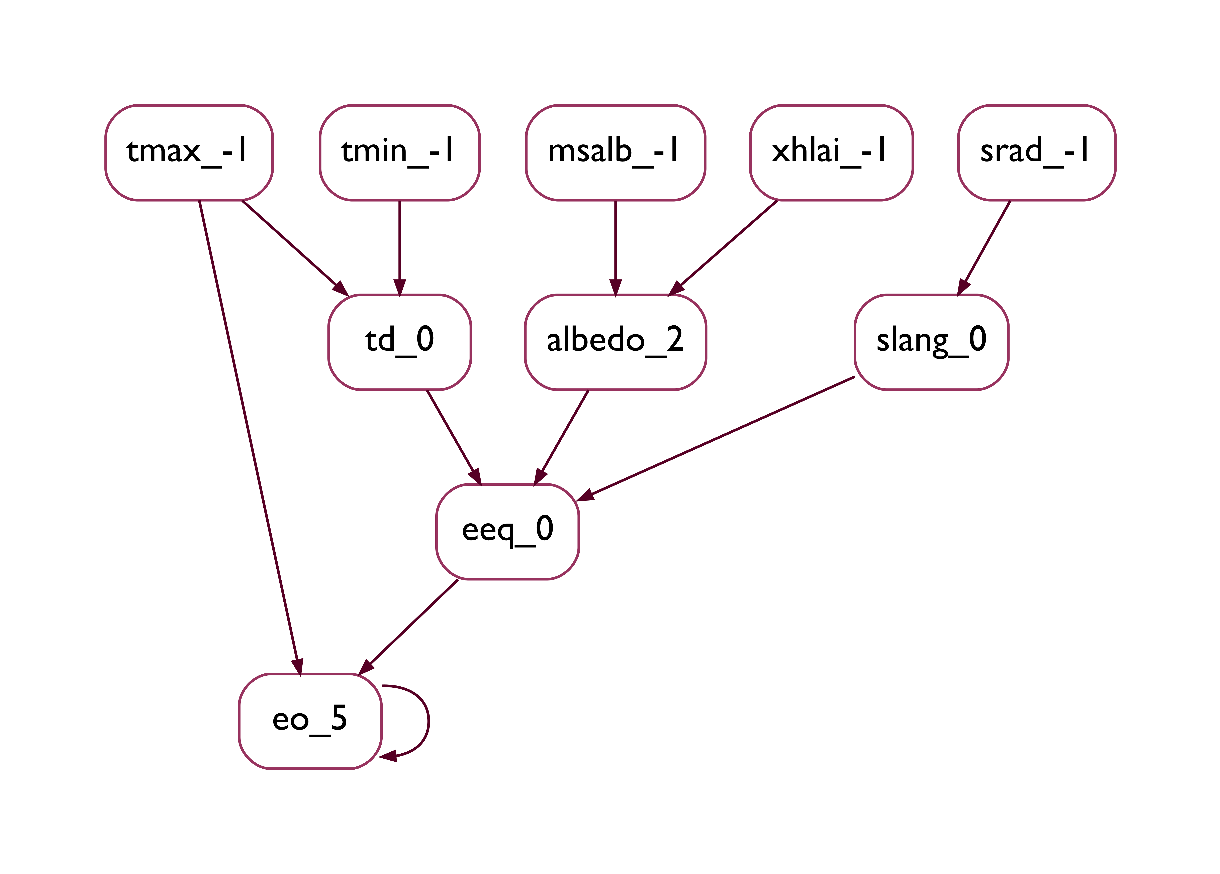
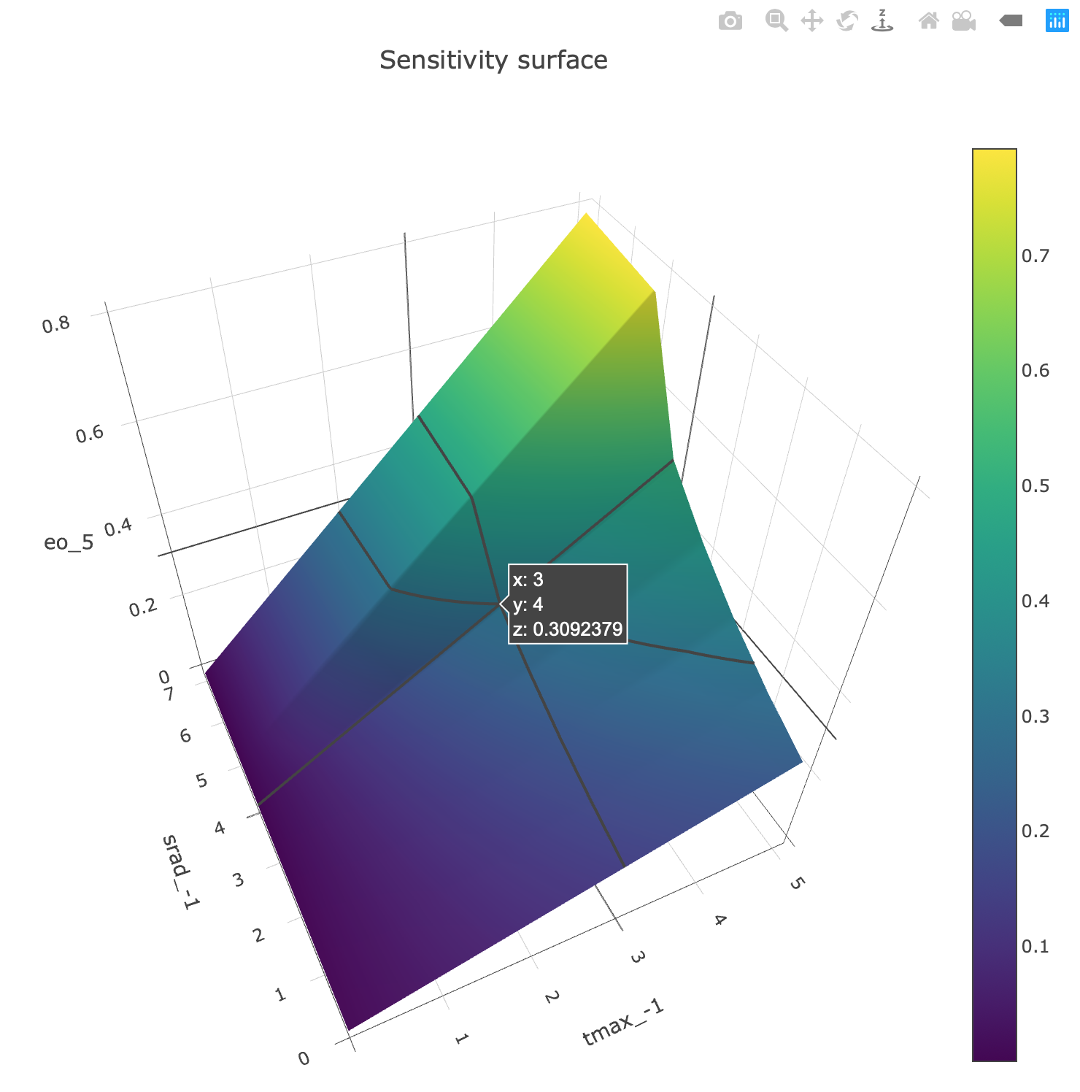
Knowledge from semi-structured sources
Text and Equation Reading (TR/ER)
Variable definitions (“𝜇 is fluid dynamics viscosity”)
Formulation/Abstraction
(Domain specific semantics,
semantic constraints, model patterns)
Variable constraints (0.05 < 𝜇 < 5000)
GrFN IR
Equations
mu_-1
Link/ground
inform
TR/ER+Code
comment linking
(grounding)
Structured
(Domain agnostic, mathematical model)
Model Analysis (MA)
Variable domain constraint propagation
Structural Model Comparison (overlap, diff)
Sensitivity Analysis (influence ranking)
Experiment design
Structure identifiability analysis
parse
generate
Program Analysis (PA)
Executable
(Source code, inference engine input)
Comments (“mu = viscosity”)
Variable functional relationships
Notes:
Left 2/3rds of figure show components of AutoMATES contribution in context of ASKE architecture. The right 1/3 is the “schematic” representation of the three levels of representation in the new ASKE architecture.
The orientation of GrFN as between the “Formulation/Abstract” and ”Structured” ASKE representation layers is intentional, as GrFN spans both, although the intention is not to suggest that GrFN does *everything* (it is not a “universal” representation appropriate for all desired scientific model operations, but captures semantic components at both levels).
Semi-structure data sources include: text documents, documents with equations, source code (with comments)
Text Reading (TR) extracts scientific domain definitions associated with variable names and symbols. TR also extracts variable value domain information (types, units, value constraints).
Equation Reading (ER) extracts symbolic representation of equations (represented in GrFN) and links to TR extractions
Program Analysis (PA) extracts GrFN intermediate representation that isolates functional relationships between variables (i.e., how variable values are set as a function of other variables), abstracting away from program idioms (to the extent possible) to isolate the function computation graph (directed graph of variables functionally determining other variable values).
Code comments are also extracted (locally) and associated with source code components; these are passed through the TR pipeline. TR/ER/Code comment variables are linked for variable grounding hypotheses, connecting code constructs to scientific domain concepts and variable constraints.
The Grounded Function Network (GrFN) is AutoMATES intermediate representation (a kind of semantic graph) that combines all of this information into an integrated representation. GrFN can be serialized/communicated in a JSON format.
NOTE: GrFN spans the structured and Formulation layers of the ASKE representation layers: PA contributes from-code function network, and TR/ER contribute scientific domain concept grounding along with some domain semantic constraints (variable value types and ranges/constraints) along with mathematical expression of variable relationships
Model Analysis (MA) operates on GrFN IR for code-agnostic analysis of model structure and functional relationships.
NOTE: MA functions span between Structured and Formulation/Abstract layers due to working on GrFN IR
Variable domain constraint propagation: This happens at the “structured” (middle) AKSE representation, based on code-derived “syntactic” relationships (e.g., arcsine is restricted to input/output values in range [-1, 1])
Structural model comparison: Model comparison, similarity, difference – spans ASKE “structured” and “formulation/abstract” layers by respecting structural constraints but with grounded variables and semantic domain variable value constraints
Sensitivity Analysis: compute sensitivity coefficients, measure of relative influence of upstream input variables and rates of changes of downstream variables.
Identification of variable value ranges maximizing similarity (Using dReal SMT (satisfiability modulo theory) sat solver to test satisfiability: http://dreal.github.io/)
Identification of value ranges to distinguish two model – experiment design
Causal analysis to determine identifiability of variable causal structure from given data

Slide 3
Ongoing/follow-on Activities
Working with GTRI (SemanticModels.jl) and Galois (AMIDOL) for integrated demo for Sept 10 (see next slide)
Expanding model comparison exercise with DSSAT
Comparing PET-PT and PET-ASCE
Using dReal SMT solver to search for variable values that make two models behave similarly/identically
Working with UFlorida to develop analysis report of model comparison
Developing model composition scenario

Slide 4
GTRI x Galois x Arizona Demo
Extant
Extracted
Enhanced
extract
compare
Visualization
Docs
Visualization
render
render
transform
Formulation
IR Model
IR Model
parse
generate
Fortran Code
extract
Julia Code
compare
Julia Code
Notes:
Demo Plan:
Arizona
extracts 2 Fortran models to GrFN representation
extracts variable definitions and var value constraints from associated documentation
Extracts and represents associated equation(s) in GrFN
Links read var definitions/constraints to equation and model GrFN
Performs model comparison on GrFN
Translates GrFN to Julia for GTRI representation and communicates GrFN JSON to Galois
GTRI parses the Julia code into an IR structured model
Galois renders the IR structured model
GTRI transforms the IR model to create several new models
Galois renders the new models
GTRI generates the new IR models to Julia models
Visualizations are compared to see the semantic differences between the models
Julia models are compared to see performance and result differences
The three columns are:
Extant: materials that are written by the primary scientist users / existing in the literature
Extracted: representations of the extant sources/models/documents in our formats
Enhanced: representations of new models that we have derived from the extracted representations.
The colors indicate the layers on the previous slides.
The Formulation is in light blue because it doesn’t exist in the primary source materials, but needs to be expressed to complete the 3x3 matrix.
In terms of the four stage framework (problem, formulation, model, code) are represented by the boxes, “Docs, Formulation, IR Model, Julia Code.”

