Slide 1
Project Perspectives
SemanticModels.jl
James Fairbanks, Christine Herlihy, Micah Halter

Slide 2
Modeling Stack (3-layer diagram)
Abstract
(Domain specific, semantically rich)
add/strip
semantic details
render
inform
Structured
(Domain agnostic, mathematical model)
add/strip implementation details
parse
generate
Executable
(Machine specific executable)
Notes:
Model Stack
More specific layers are responsible for being able to add and remove their specific details
Model becomes less specific moving inwards, and becomes more specific moving outwards
Analysis of a single or multiple models between layers can be used to fill in gaps of information like assumptions/constraints/equivalences
Structured IR
Category theory based representation to define transformations between structured models to make analysis and augmentation easy
Graph based IR representation can hold and organize model structure, constraints, and dependencies
Also allows IR components to be mapped to semantic and code details
Knowledge Extraction
Limit structure to collected knowledge
Models impose the meaning the need from the collected knowledge
Knowledge Curation
Evaluate validity and utility of knowledge
Balance unstructured knowledge with hand curated information

Slide 3
GTRI TEAM project description
This is our implementation of the 3 layer representation
All subtypes of AbstractModel¹ are XModel and store structured layer information
Xmodel(expr) extracts structured knowledge from code
expr(m::AbstractModell) generates code from structured knowledge
Knowledge Graph
Concepts and relations between them
render
inform
AbstractModel
Types and Expressions representing Objects and Morphisms
parse
generate
Julia Code
Abstract Syntax Trees for programs fed to julia compiler/runtime
¹AbstractModel is a julia type that follows the convention of naming supertypes in Julia with AbstractX.

Slide 4
GTRI x Galois x Arizona Demo
Extant
Extracted
Enhanced
extract
compare
Visualization
Docs
Visualization
render
render
transform
Formulation
IR Model
IR Model
parse
generate
Fortran Code
extract
Julia Code
compare
Julia Code
Notes:
Demo Plan:
Arizona extracts a Fortran model to a Julia model
GTRI parses the Julia code into an IR structured model
Galois renders the IR structured model
GTRI transforms the IR model to create several new models
Galois renders the new models
GTRI generates the new IR models to Julia models
Visualizations are compared to see the semantic differences between the models
Julia models are compared to see performance and result differences
The three columns are:
Extant: materials that are written by the primary scientist users / existing in the literature
Extracted: representations of the extant sources/models/documents in our formats
Enhanced: representations of new models that we have derived from the extracted representations.
The colors indicate the layers on the previous slides.
The Formulation is in light blue because it doesn’t exist in the primary source materials, but needs to be expressed to complete the 3x3 matrix.
In terms of the four stage framework (problem, formulation, model, code) are represented by the boxes, “Docs, Formulation, IR Model, Julia Code.”

Slide 5
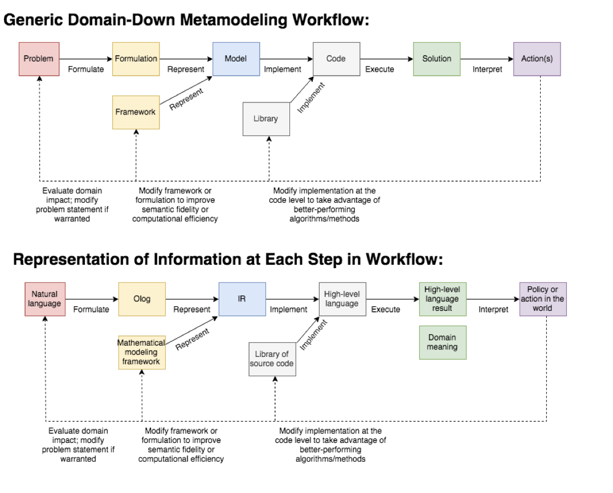
Metamodeling Operations Workflow

Slide 6
Metamodeling Information Representation

Slide 7
Frameworks and libraries
ODE.jl framework for representing ordinary differential equations
We wrote our own agent based modeling microframework for development
Libraries
DifferentialEquations.jl -- ODEs
Stan.jl -- Bayesian Analysis
BayesNets.jl -- Bayesian Networks
Turing.jl -- Probabilistic Programming
GLM.jl -- Generalized Linear Models
ModelingToolkit.jl -- symbolic algebra
MacroTools.jl -- metaprogramming
Catlab.jl -- Category Theory representations of models and formulations
These libraries define some kind of language-like API for expressing models.

Slide 8
Representing Programs with CCC
A Cartesian closed category can represent programs,
The objects are types and the functions are morphisms.
Functions are also objects (called exponential objects)
Since Models are represented as types in Julia we can encode them in CCC.

Slide 9
Model Transformations as Functors on CCC
Functors between CCCs can represent transformations between programs
Characterizing these functors informs our understanding of the relationships between programs
We think that transitions between levels (formulation, model, code) can be expressed as functors.
The transformations within a level can also be a functor (formulation modification, model augmentation, program transformation)

Slide 10
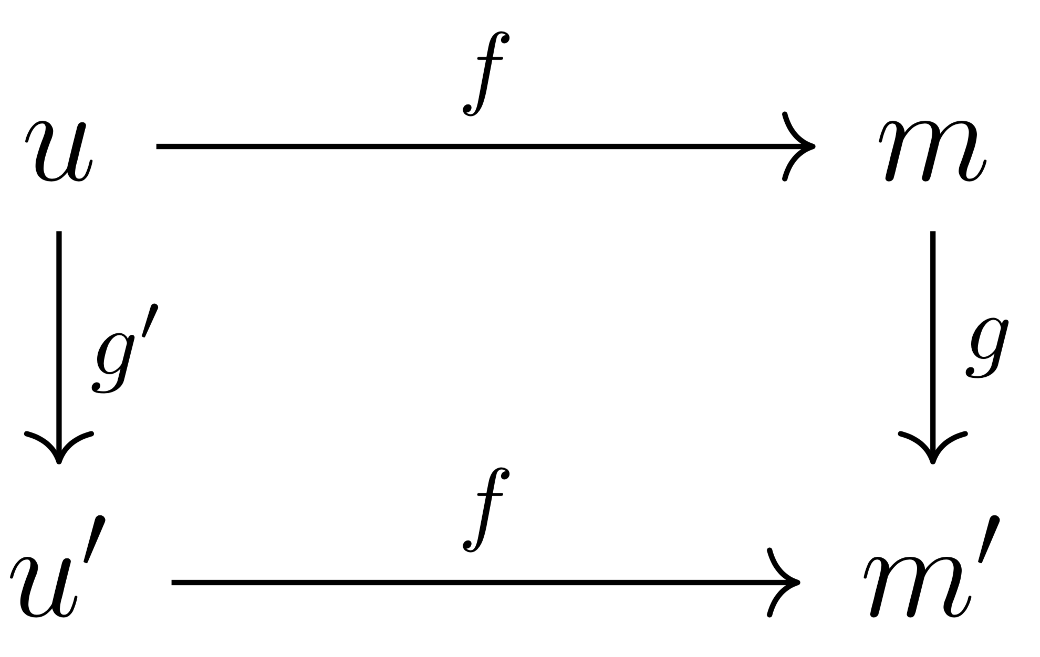
Horizontal vs Vertical Functors
Between layers there are transformations that change the category
Within layers there are transformations that preserve category but give a different instance
Ex. formulation u to model m vs model m to model m’
f takes formulations to models
g transforms that model
We ask “what u’ satisfies f(u’) = m’ ?”
f* the adjoint functor of f takes m’ to u’

Slide 11



Use Case 1: Rapid Response to Emergent Epidemic
Scenario:
An epidemic has emerged in a particular geographic region, and the risk of escalation to a pandemic is high.
Some characteristics of the epidemic (e.g., a subset of transmission mechanisms; mortality rate) have been observed during previous epidemics, and modeled by researchers ex post-facto, while other characteristics are novel (e.g., a subset of clinical symptoms; geographic location or regime type of the country of the index patient, etc.).
There is ambiguity at the onset about the cause: bioterrorism warrants investigation and may require tactical response.
Scientific and Policymaking Objectives:
Synthesize existing epidemiological models constructed for previously seen epidemics and geographic/sociodemographic profiles; modify to account for observed or hypothesized differences.
Rapidly conduct scenario planning; identify optimal public health intervention(s) based on past successes/failures.
Iterate as situation and information available evolve.
Assumed Semantic Constraints
Scarcity of time and resources: We cannot build a new model from scratch, or iterate through policy responses.
Rapid response required to prevent pandemic.
Acceptability: Not all interventions are ethical/legal/politically palatable.
Uncertainty: We assume our knowledge of all data generating processes is incomplete; ∃ known and unknown unknowns.

Slide 12
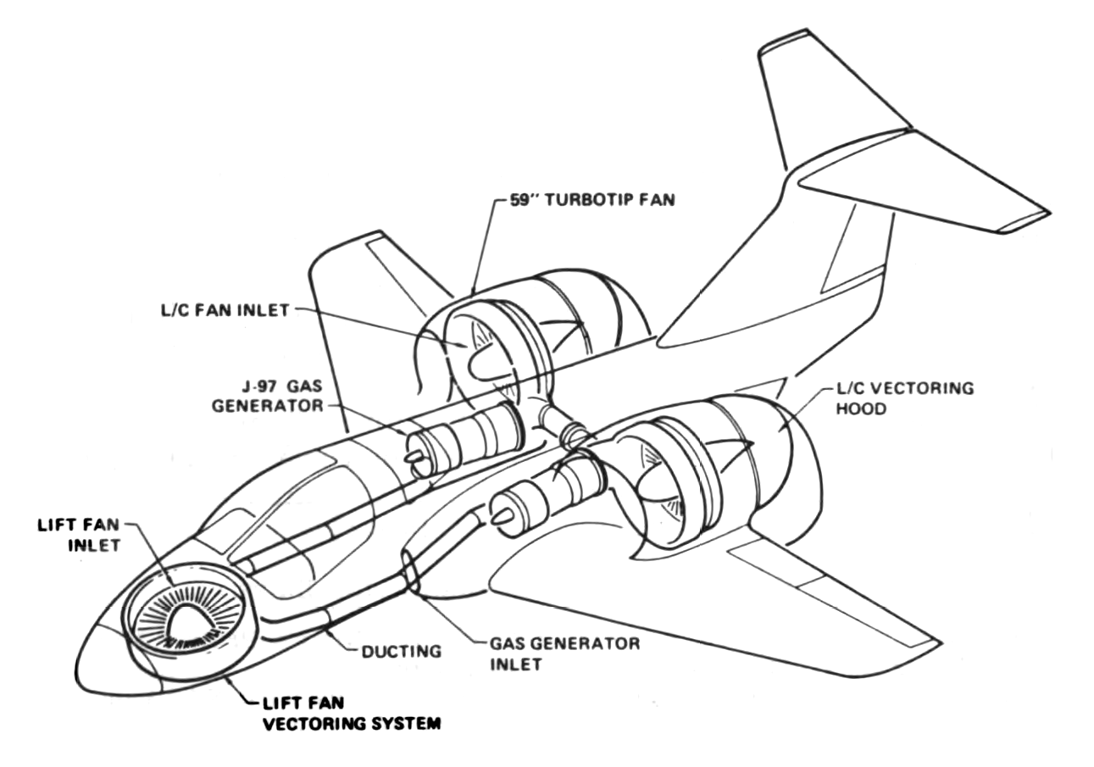

Use Case 2: Model Based Design
Scenario:
DoD engineers use simulations to consider design choices for complex engineered systems
Simulations for specialized components have been developed
Changes to the design prompt changes to the simulations
Scientific and Engineering Objectives:
Synthesize existing models constructed for existing components and scenarios; modify to account for observed or hypothesized differences
Rapidly conduct design comparison and evaluation; identify optimal design choices based on performance characteristics
Iterate as subcomponent designs are improved and refined
ASKE system generates new simulations based on changes to design; model selection algorithms can identify optimal system design.
Assumed Semantic Constraints
Scarcity of time and resources: We cannot build a new model from scratch.
Agility of simulations required to allow for creative solutions to DoD engineering problems.
Acceptability: Not all designs are feasible or affordable.
Uncertainty: Trade space is wide and not fully characterized

Slide 13
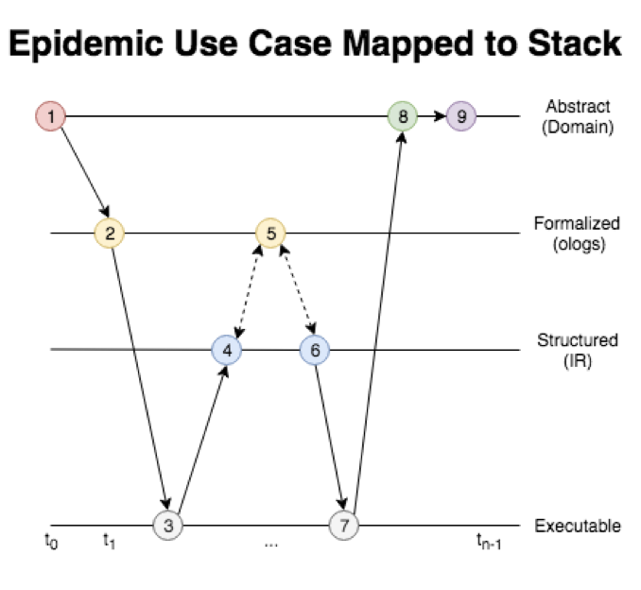
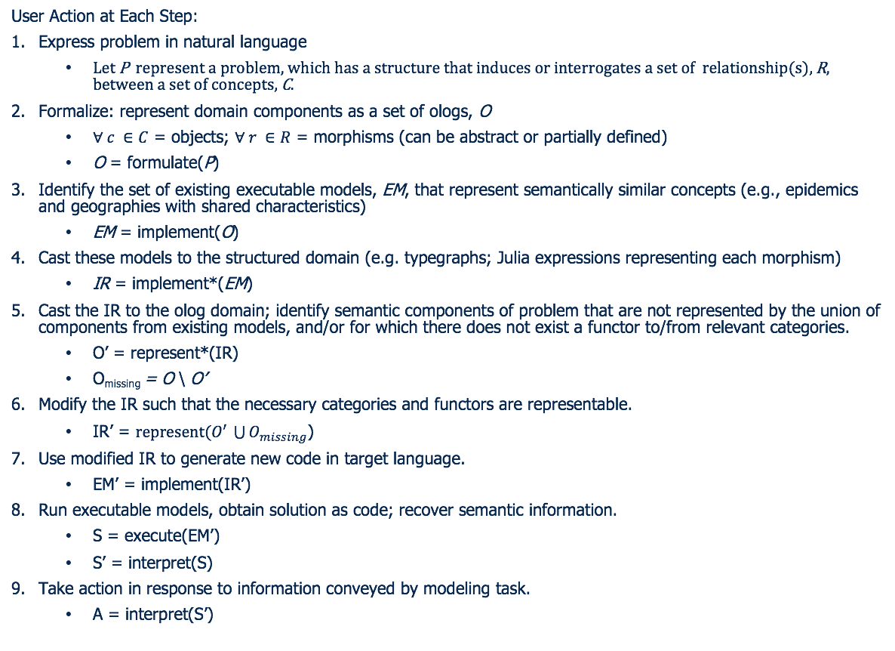
Addressing Use Case 1 via the Metamodeling Stack

Slide 14
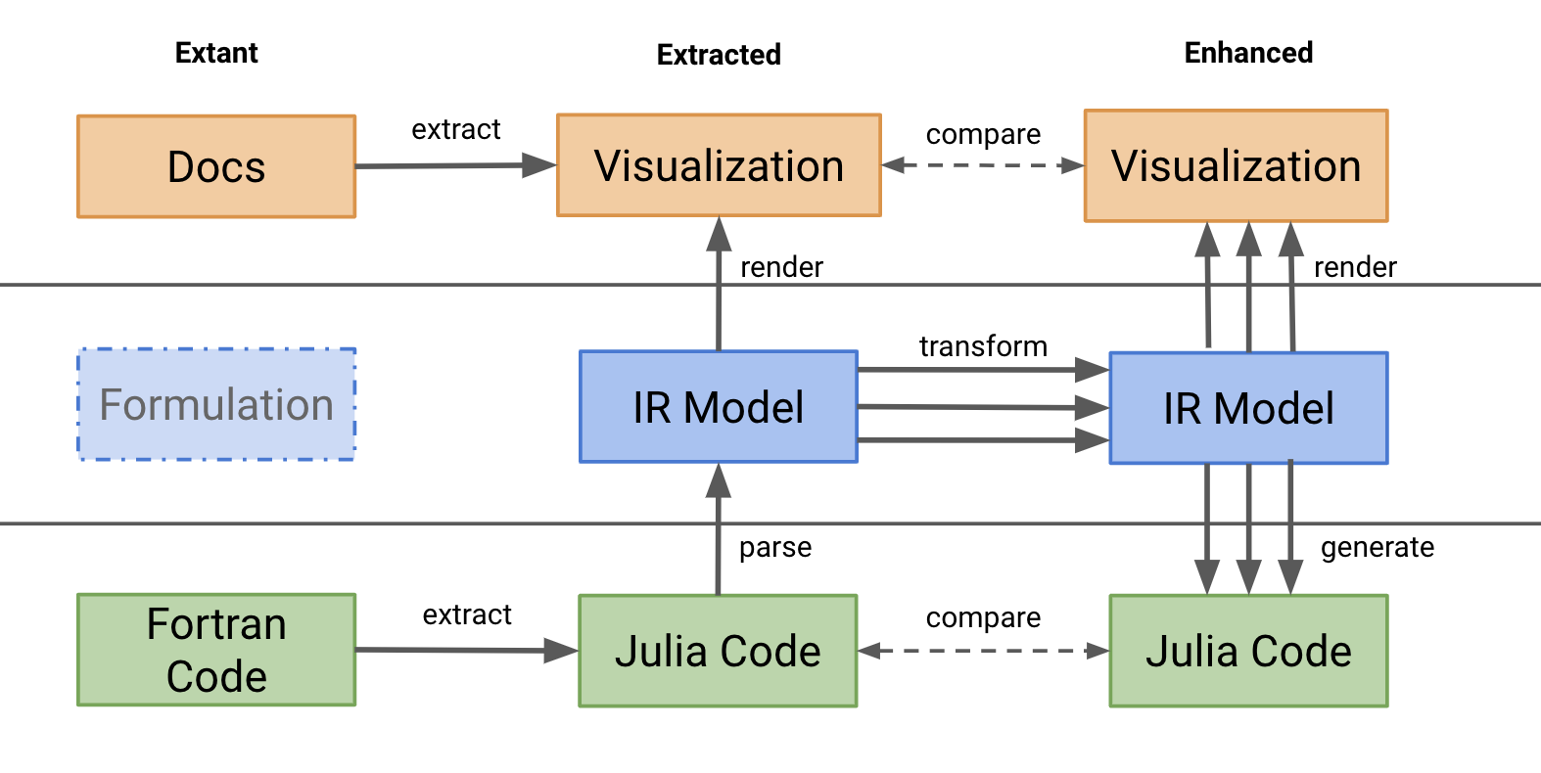
Follow on activities
Ideas for working groups around key cross-program topics
MIRWG: Model IR Working Group (June 17th at GTRI in ATL)
Summaries of potential linkages between ASKE technologies, starting with what’s the simple first step (e.g. I give X model file to Y and see if they can translate it into their system to do Z).
Extracted models coming from UA into GTRI technology, model transformations applied, and IR exported to AMIDOL for visualization in the diagrammatic languages
Mock-up plans for possible demo(s) at the Sept 12 demo day at DARPA HQ
See Slide 4 for demo

