Slide 1
Metamodeling
Breakout Session

Slide 2
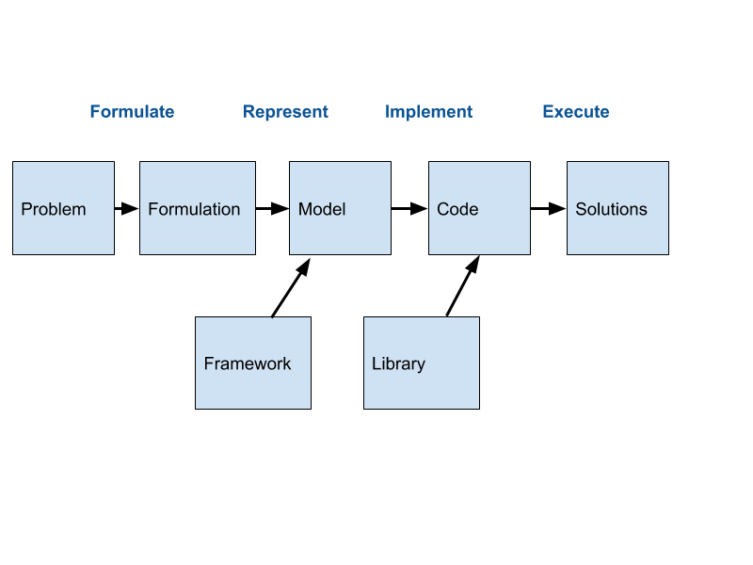
Workflow
New process diagram for the program

Slide 3
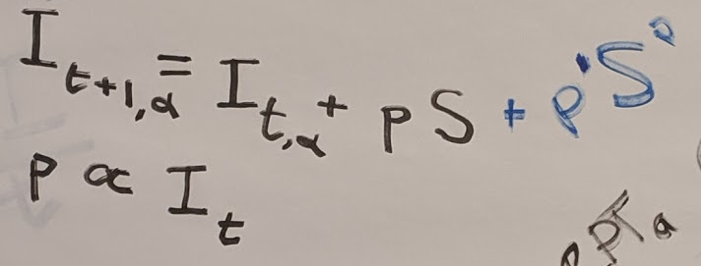
Transformations on Models
Examining properties
Quantitative, Relational, Agency, Observation/Information
Higher order tasks
UQ
Alternative planning
Parameter Estimation / Calibration
Differential Programming
Adding/Removing/Changing components

Slide 4
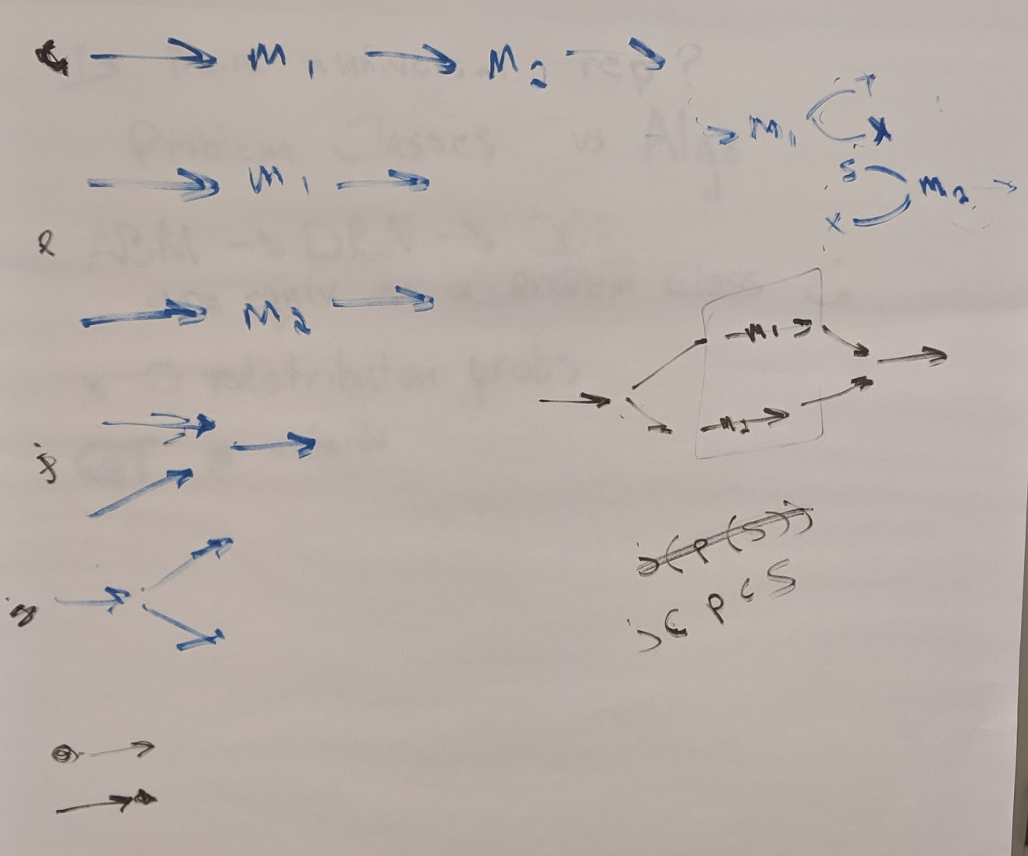
Abstraction Layers
Abstract formulations,
domain specific primitives
and grammars

Slide 5
Equivalence Classes of Frameworks / Models
Modeling Frameworks that are reducible to each other in the sense of theory of computation
When you reduce a model from one framework to another, what model do you get?

Slide 6
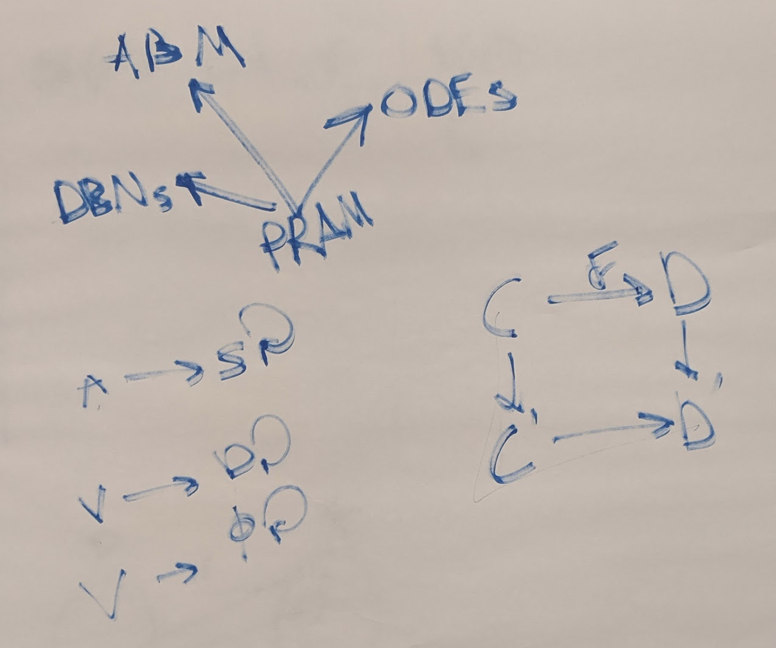
Structure Preserving Maps between Frameworks
What Structures are preserved?
CT: Objects & Morphisms,
BN: Variables & Expressions,
ABM: Agents & Transitions
ODE: Compartments & Flux

Slide 7
The formulation step needs Ethnographic Methods

