Slide 1
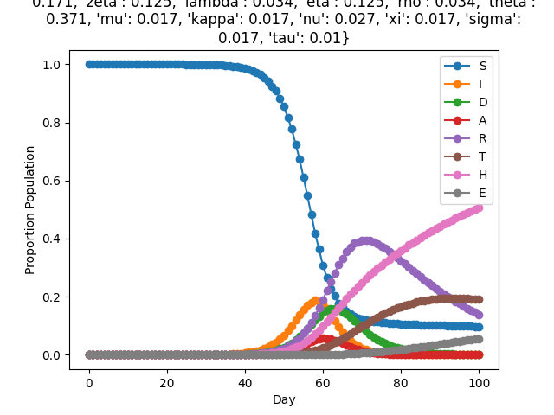
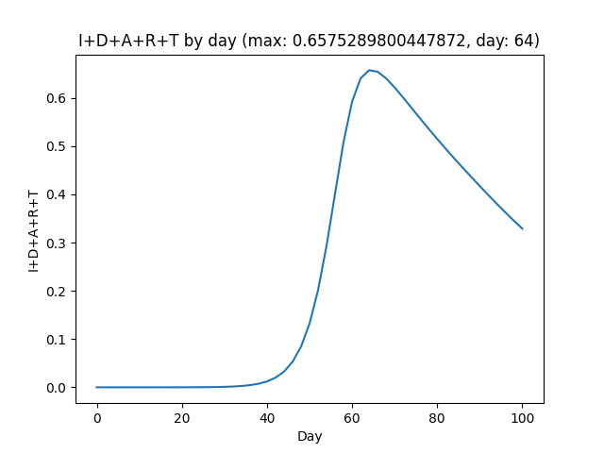
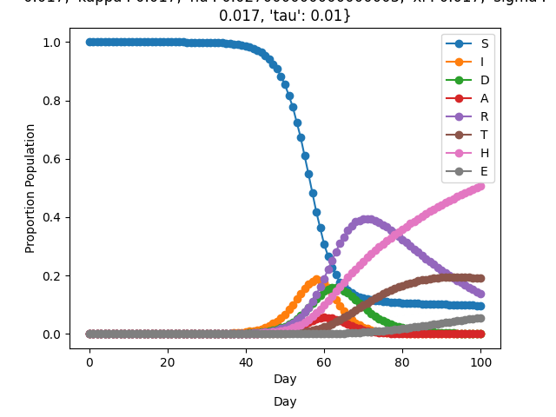

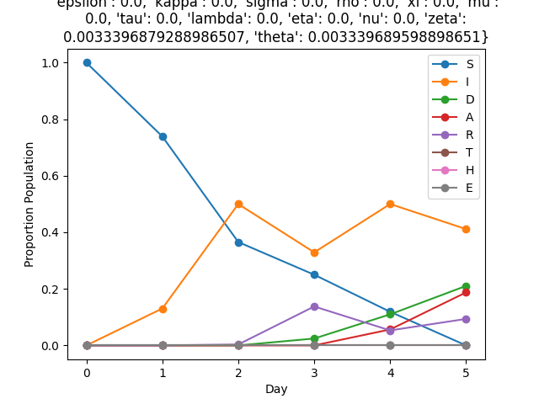
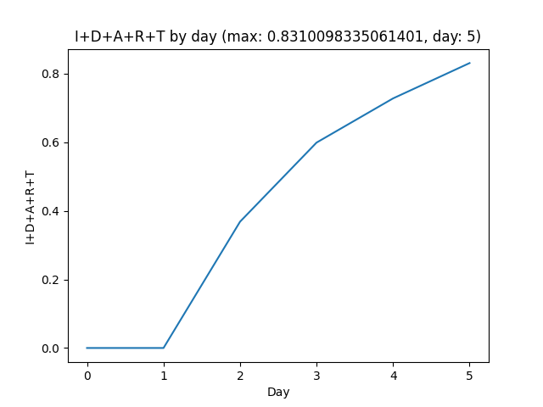
SIDARTHE Unit Test 1 (Verifying with FunMAn)
Timeseries
I+D+A+R+T
Hand Coded Bilayer
Pass
Max 66%,
Day 64
SKEMA Petri Net Converted Bilayer
FUNMAN builds SMT Encoding, solved by dReal:
Bilayer dynamics
Initial conditions
Parameter values/bounds
Constrain all variables to [0, 1]
100 steps
Julia Petri Net Converted Bilayer
UF Petri Net Converted Bilayer
Original is Unsat.
Relaxed Parameters to [-inf, inf], and found a consistent simulation for only short timespans. Violates [0, 1] bounds on vars with longer duration.

