Slide 1
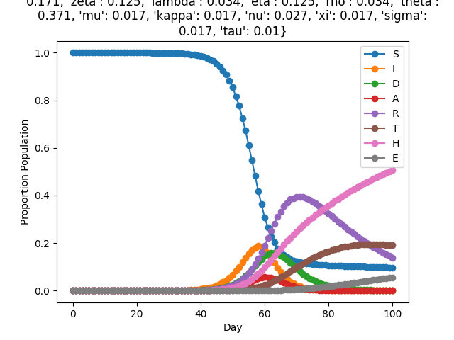
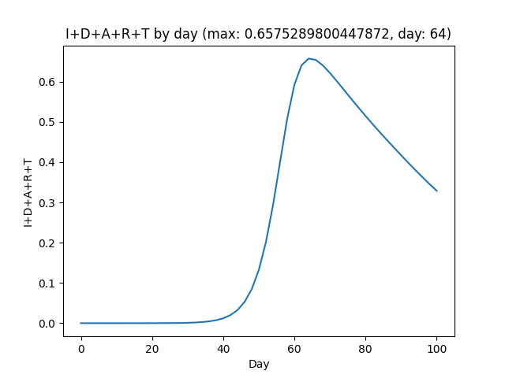
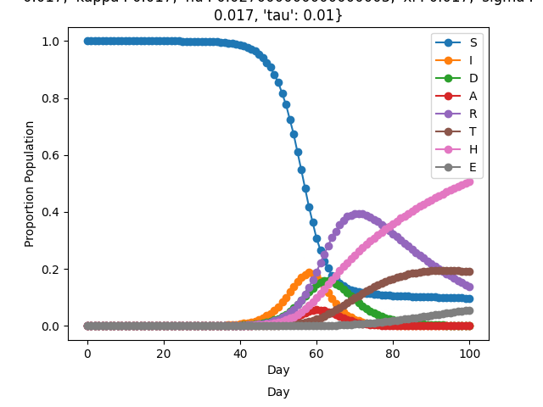

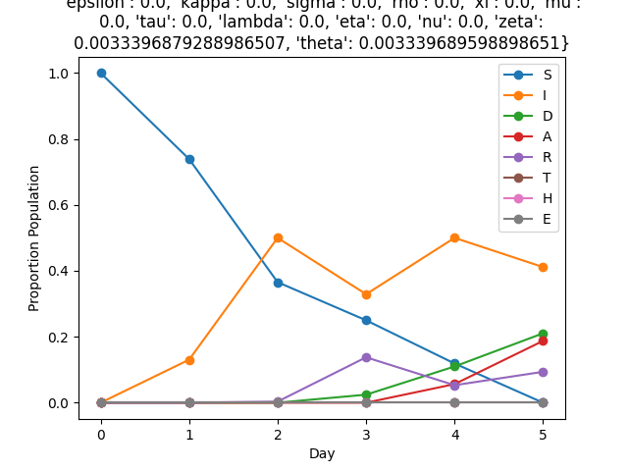
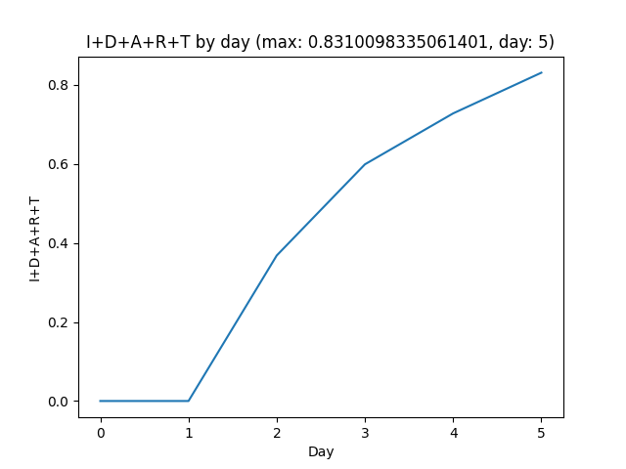
SIDARTHE Unit Test 1 (Verifying with FunMAn)
Timeseries
I+D+A+R+T
Hand Coded Bilayer
Pass
Max 66%,
Day 64
SKEMA Petri Net Converted Bilayer
FUNMAN builds SMT Encoding, solved by dReal:
Bilayer dynamics
Initial conditions
Parameter values/bounds
Constrain all variables to [0, 1]
100 steps
Julia Petri Net Converted Bilayer
UF Petri Net Converted Bilayer
Original is Unsat.
Relaxed Parameters to [-inf, inf], and found a consistent simulation for only short timespans. Violates [0, 1] bounds on vars with longer duration.

Slide 2
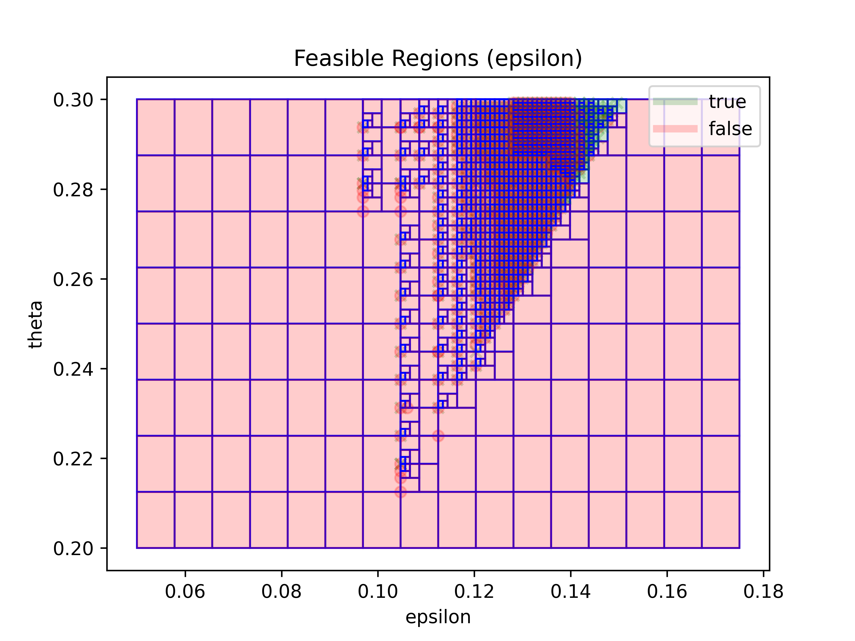
S2.1.d: Synthesize 𝜀 and 𝜃 with FunMAn
Increase the detection parameters 𝜀 and 𝜃, and assume that 𝜃 >= 2* 𝜀.
Find minimum values to ensure sum(IDART) < 1/3 of the total population?
Constraints (for all steps):
𝜃 >= 2* 𝜀
𝜀 in [0.05, 0.2)
𝜃 in [0.17, 0.4)
Sum(SIDARTHE) in [0 – 1e-5, 1 + 1e-5)
All variables non-negative
Sum(IDART) <= 0.33 (Query)
Bilayer Dynamics + Parameters
SIDARTHE Bilayer
Minimum Box:
{
"epsilon": {
"lb": 0.13886718750000002,
"ub": 0.13984375000000002
},
"theta": {
"lb": 0.27656250000000004,
"ub": 0.27812500000000007
}
}
Original values:
(0.171, 0.371)
FunMAn proves that a box is either:
“true” (contains no values violating query)
Model and Not(Query) is unsat
“false” (contains no values satisfying query)
Model and Query is unsat
FunMAn splits boxes until:
Each box is proven true or false
Remaining box widths fall below threshold

