Slide 1
Master Thesis: AI Usage in CI/CD/CT Pipelines for Compute Platforms in Automotive
Professors: Dr.-Ing. Stefan Wildermann, Prof. Dr.-Ing. Jürgen Teich
Contact: Dr.-Ing. Andreas Weichslgartner (CARIAD SE), Bernd Schaller (CARIAD SE)
Morris Darren Babu Friedrich-Alexander-Universität Erlangen-Nürnberg, Hardware-Software-Co-Design Sept 26, 2025

Slide 2
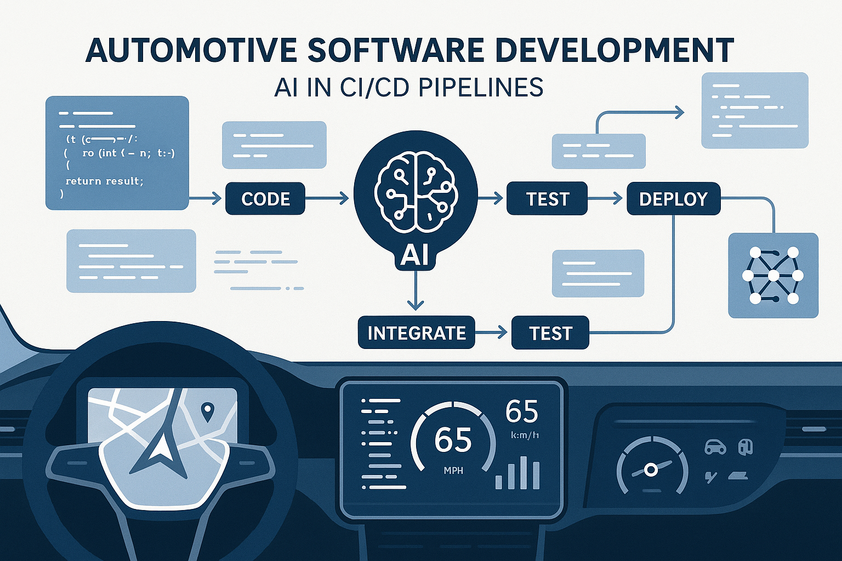
Agenda
01
Introduction & Problem Statement
02
Background
03
Research Questions
04
Literature Review & State of the Art
05
Overview
06
Method
07
conclusion

Slide 3
Introduction & Problem Statement

Slide 4
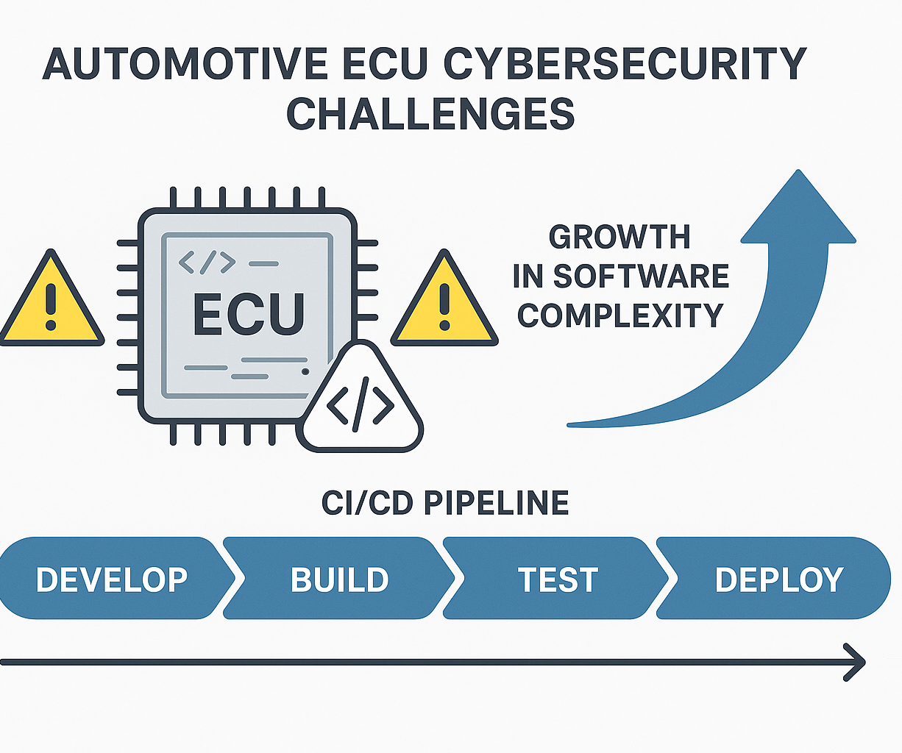
Introduction
• Rapidly growing software complexity & shorter release cycles
• Automotive ECUs are safety-critical, hence zero tolerance
• Traditional security tests cannot keep pace with CI/CD demand

Slide 5
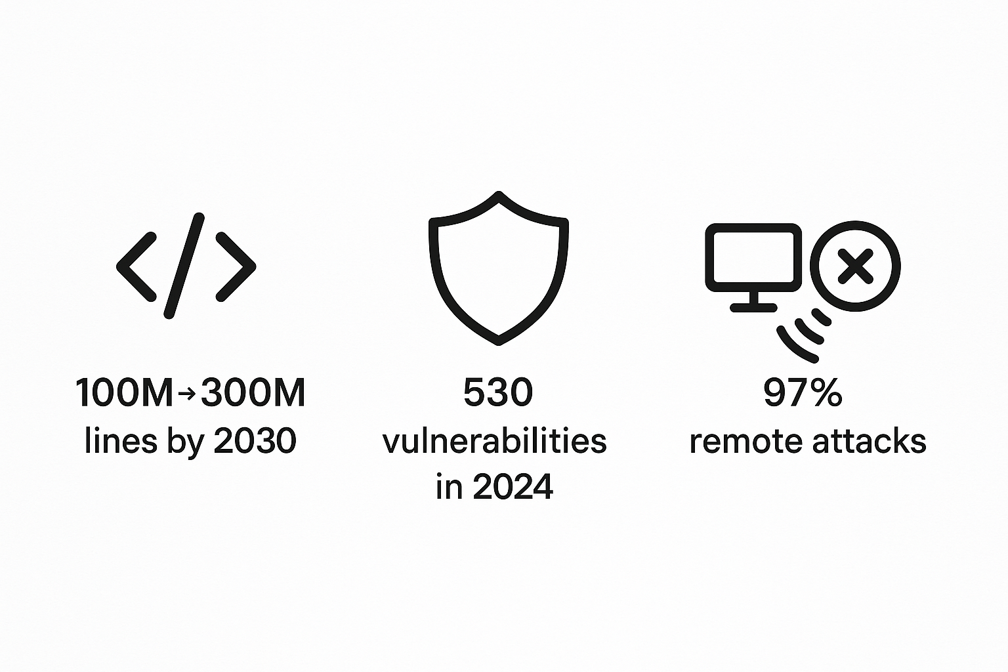
The Challenges

Slide 6
Problem Statement
• Current white-box fuzzing & testing are manual or slow to scale
• Vulnerabilities may slip through nightly CI due to time limits
• Need an AI-guided approach integrated into CI/CD/CT to
– boost path coverage
– reduce manual fuzz test case creation
– auto-generate actionable test artifacts

Slide 7
Background

Slide 8
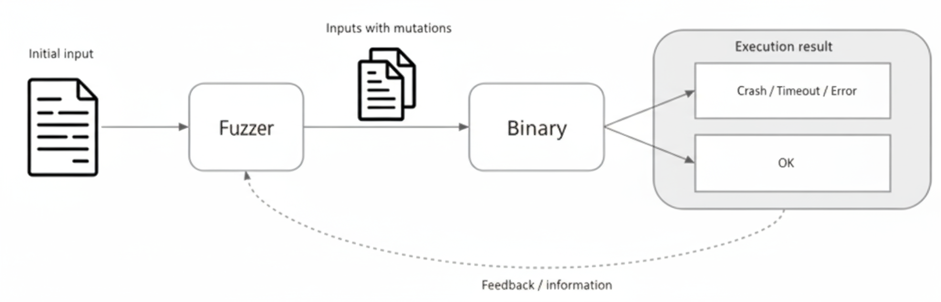
Fuzzing

Slide 9
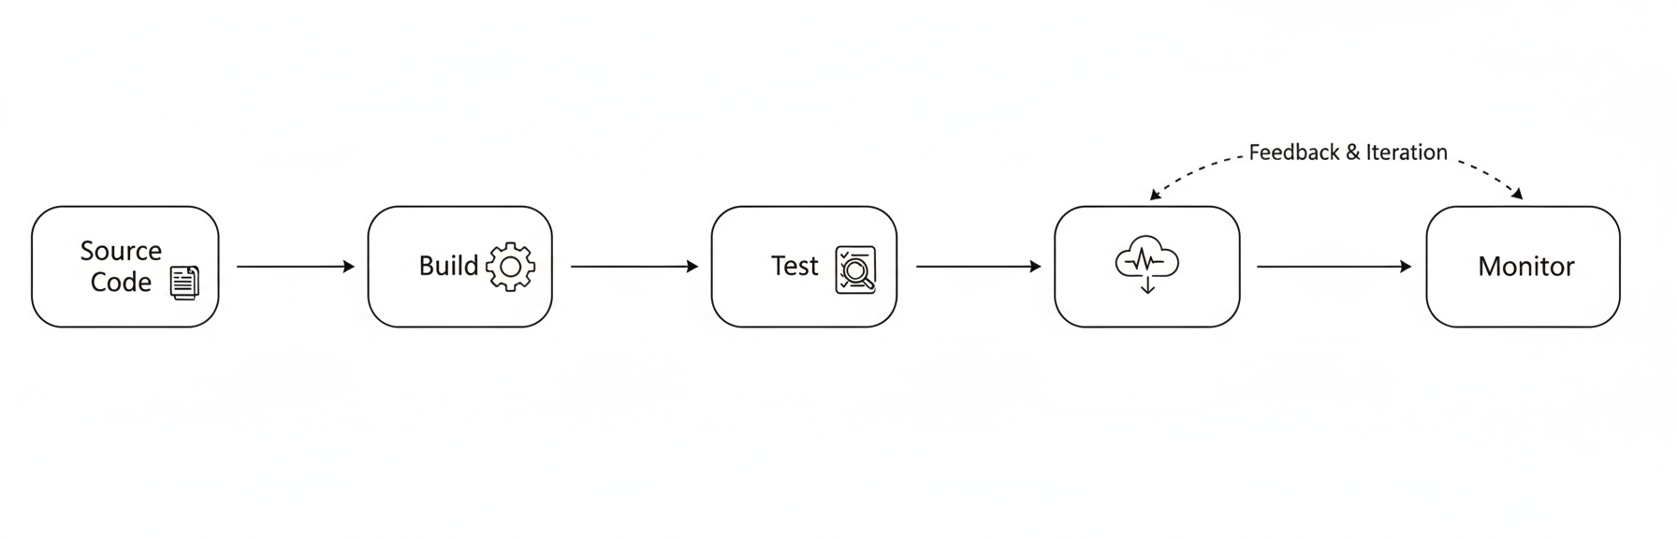
CI/CD Pipeline

Slide 10
Research Objectives

Slide 11
Technique Design
• AI-assisted white-box fuzzing for automotive compute platforms
• Novel security testing methods integrating LLMs with fuzzing capabilities
• Automated test artifact generation - test cases, procedures, reports, quality matrices

Slide 12
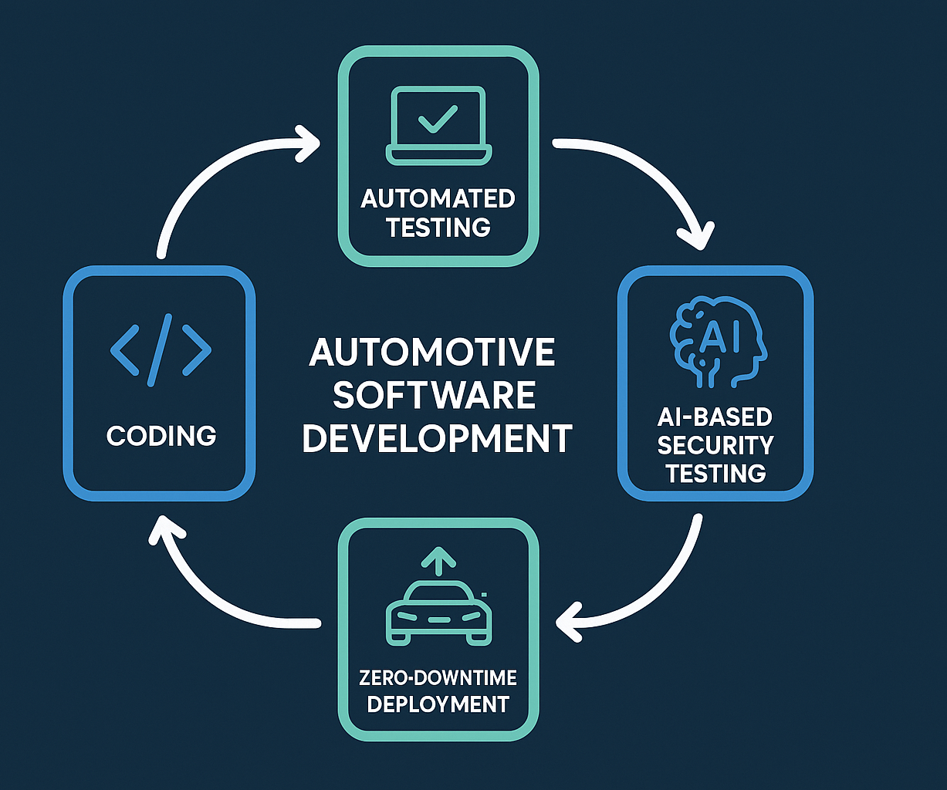
Pipeline Integration
• Seamless CI/CD/CT integration with existing automotive development workflows
• Continuous fuzzing embedded into daily development cycles
• Zero-downtime deployment of AI-enhanced security testing

Slide 13
Impact & Performance Analysis
• Measure coverage, MTTV, and CI latency vs. baseline traditional methods
• Comprehensive cost-benefit analysis for enterprise adoption
• Real-world validation within CARIAD's development environment

Slide 14
Expected Outcomes
Integration into the existing CI/CD pipeline
AI-Driven Security Testing
Automation of test artifact generation
AI Generated fuzz test cases and intelligent mutation

Slide 15
Research Questions

Slide 16
Primary Research Questions
RQ1: Effectiveness of LLM-Generated Fuzz Drivers Can Large Language Models generate effective fuzz drivers that achieve code cover- age and vulnerability detection performance comparable to manually-written drivers?
RQ2: Model Selection and Optimization Which LLM architectures, training approaches, and optimization techniques are most effective for automotive fuzzing applications?
RQ3: CI/CD Integration Feasibility Can AI-driven fuzzing be integrated into automotive CI/CD/CT pipelines without significantly impacting development velocity or resource utilization?

Slide 17
Secondary Research Questions
RQ4: Automated Test Artifact Generation Can LLMs automatically generate comprehensive test artifacts (test procedures, reports, quality matrices) that meet automotive development and compliance require- ments?
RQ5: Continuous Learning and Adaptation How can AI-driven fuzzing systems continuously improve their effectiveness through learning from fuzzing campaigns, bug discoveries, and developer feedback?
RQ6: Cost-Effectiveness and ROI What are the economic implications of AI-enhanced fuzzing deployment, and under what conditions does it provide positive return on investment for automotive organiza- tions?

Slide 18
Literature Review & State of the Art

Slide 19
Literature review with quantitative analysis
Key Focus Areas:
AI techniques in software testing
LLM-based fuzzing approaches
CI/CD pipeline integration
Automotive security applications

Slide 20
From Traditional AI to LLMs - The Technical Journey
Key Milestones:
NeuFuzz (2019): First neural network-guided fuzzing - 35% improvement
Deep RL Fuzzing (2018): 2.3× more crashesthan AFL, 21 CVEs
TitanFuzz (2022): Watershed moment - First LLM-based fuzzer
Fuzz4All (2023):Universal multi-language fuzzing - 98 bugs found
Performance Evolution:
2018-2020: Traditional ML approaches dominated (60%)
2022-2025: LLM revolution with 50.84% coverage improvements

Slide 21
Research Gaps & Critical Findings
Identified Gaps:
Limited automotive-specific research - Most work targets general software
Slow or Manual triggered fuzzing- Insufficient automation
Standardization - No safety-critical evaluation frameworks
Quantitative Evidence:
20-90% consistent performance gains across all AI approaches
2-24× speed improvements in specialized scenarios
Hundreds of CVE discoveries with real-world impact
Cost reduction: From $1000s to <$1 per campaign

Slide 22
Solutions proposed and implemented
Developed practical CI/CD integration framework connecting LLM-based test generation with automotive development workflows using cifuzz and GitHub Actions
Evaluated 14 different LLM models across various C/C++ repositories to identify optimal approaches for automotive software testing
Created fine-tuned models achieving 33% faster test generation and 55% token reduction compared to base models
Implemented enterprise-ready solution with Azure Private Link architecture addressing automotive industry network security requirements
Established economic viability analysis demonstrating 90% cost reduction potential and clear ROI for automotive OEMs
Evaluation Framework based on numerical and safety first approach

Slide 23
The TitanFuzz Revolution & Beyond
TitanFuzz Impact (2022):
Zero-shot capability without explicit constraints
30.38% higher coverage on TensorFlow
50.84% higher coverage on PyTorch
65 bugs discovered, 44 previously unknown
Follow-up Advances:
HGFuzzer: 24.8× speedup over traditional approaches
CKGFuzzer: Code knowledge graphs + LLMs
G²Fuzz: <$0.2 for 24-hour fuzzing campaigns

Slide 24
Automotive Domain Applications
Safety-Critical Breakthroughs:
SAFLITE: Autonomous systems fuzzing - 234.5% improvement
CAN Bus AI Fuzzing: Real-time automotive network security
ECG Embedded OS: 32 new vulnerabilities in embedded systems
KernelGPT: 24 unknown bugs, 11 CVE assignments
Automotive Applications:
Neural network validation for autonomous driving
ECU firmware testing with real-time constraints
Multi-ECU system integration testing

Slide 25
Key Takeaways
Major Findings:
AI-enhanced fuzzing consistently superior to traditional methods
LLM-based approaches represent paradigm shift
Industrial adoption accelerating with proven ROI
Future Research Priorities:
Automotive-specific AI fuzzing frameworks
Integration with safety standards (ISO 26262, ISO 21434)
Real-time aware fuzzing techniques

Slide 26
Overview

Slide 27
Overview
AI-Integration
CI/CD Integration
Artifact Generation
Documentation
White box Fuzzing
Analysis and Evaluation

Slide 28
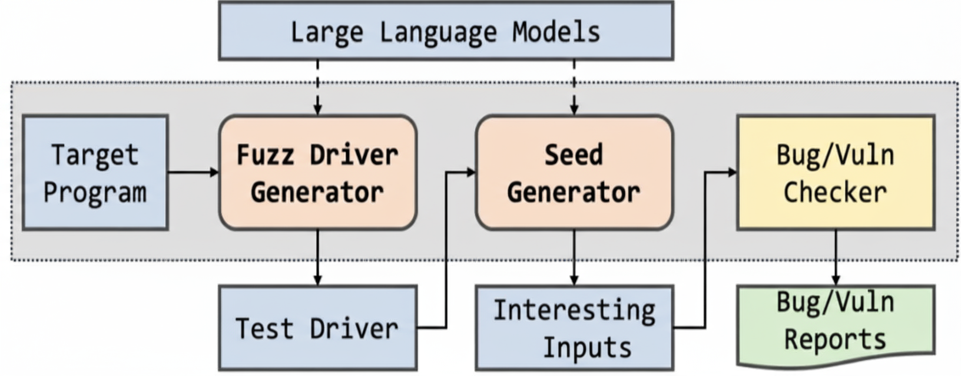
LLM Fuzzing

Slide 29
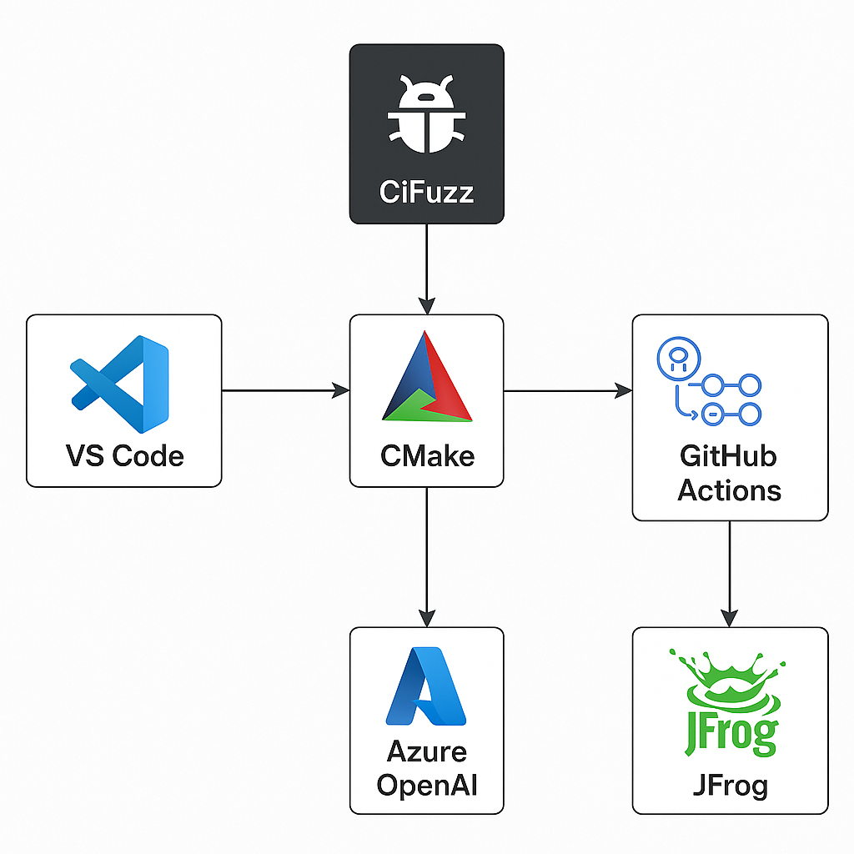
Tools
Tools used:
Visual Studio Code
CiFuzz (exe or docker image)
Cmake Build systems and libfuzzer
Azure Open AI endpoint
Github Actions (CI/CD) and Jenkins
Jfrog and Artifactory (docker images)

Slide 30
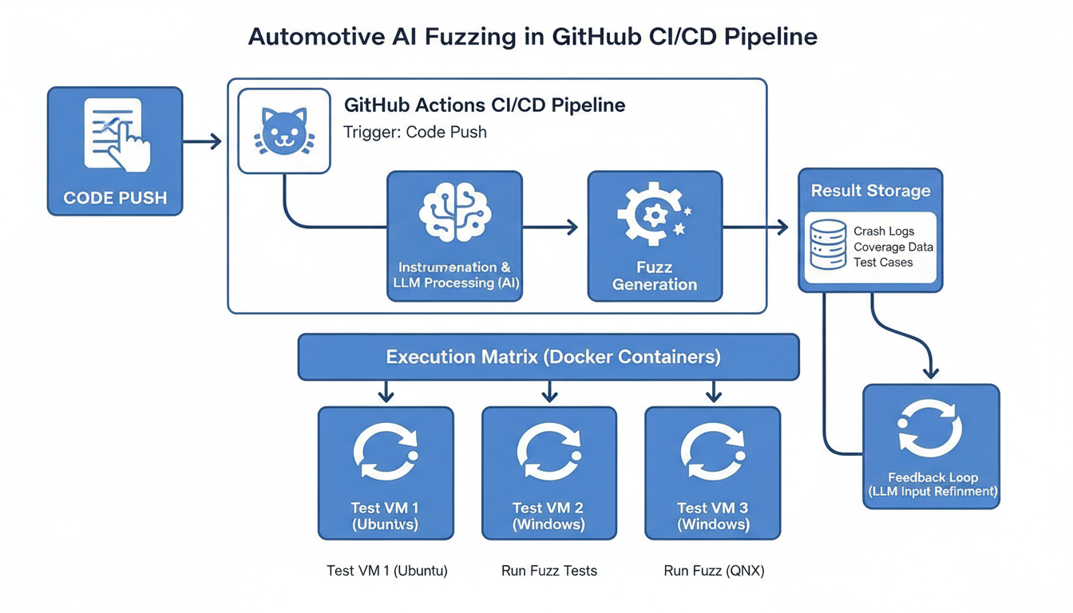
Continuous Fuzzing

Slide 31
Method

Slide 32
Approach
api
local
LLMs
llama.cpp
ollama
openai
lm studio
custom api
Gpt - 4o
Gpt 5

Slide 33
Local LLMs
LLMs broad classification
LLM’S models and performance
Local LLMs
Small < 15B parameters
Medium 15–25B parameters
Code specialized
Large 25-35B
parameters
Extra Large >40B parameters
General purpose

Slide 34
Models
Small (<15B parameters)
phi4:14b (14B)
llama3:latest (8B)
qwen2.5-coder:1.5b (1.54B)
qwen2.5-coder:7b (7B)
qwen2.5-coder:14b (14B)
Medium (15–25B parameters)
magistral:24b (24B)
devstral:latest (24B)
starcoder2:15b (15B)

Slide 35
Large (25-35B parameters)
gemma3:27b (27.4B)
qwen3:32b (32.8B)
deepseek-r1:32b (32.8B)
qwen2.5-coder:32b (32.8B)
deepseek-coder:33b (33B)
wizardcoder:33b (33B)
codellama:34b-instruct (34B)
yi:34b (34B)
Extra Large (> 40B parameters)
mixtral:latest (46.7B)

Slide 36
CPP Repositories
Easy small
Easy big
Needs wrapper small
Needs wrapper big
Already Featuring CiFuzz workflow

Slide 37
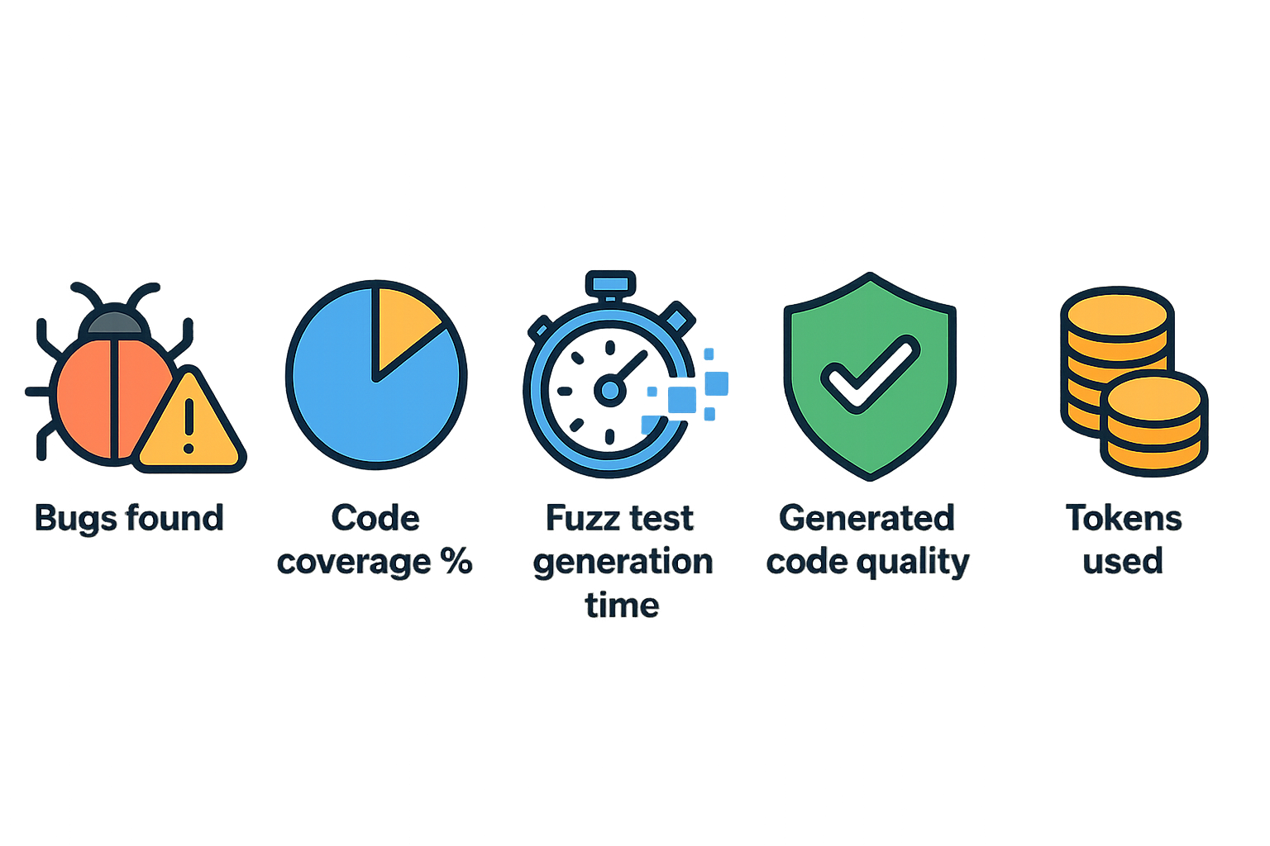
Evaluation
Metrics
Notes:
Number of bugs found
Code coverage percentage
Time to generate fuzz tests
Quality of generated code
Number of tokens used

Slide 38
LLM Training
LoRA (Low-Rank Adaptation)
LoRA rank (r): 16 – controls adaptation size
LoRA alpha: 32 – scaling for adaptation
Dropout: 0.1 – prevents overfitting
Target modules: q_proj, v_proj, etc. – efficient fine-tuning
Device: auto – runs on best available hardware
Dtype: float16 – faster, less memory
Efficient model loading and saving (safetensors)

Slide 39
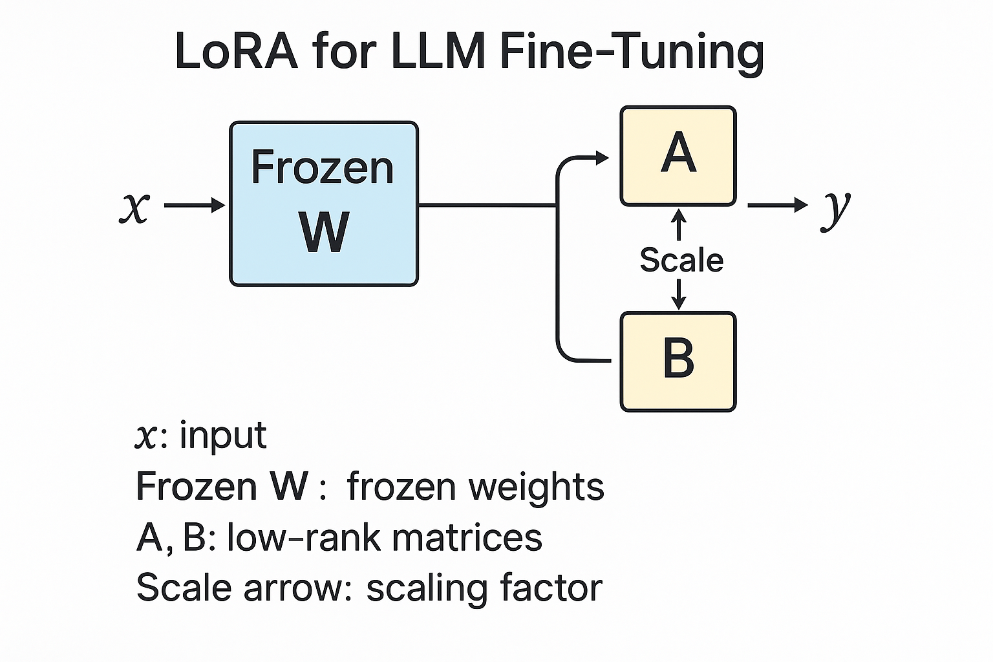

Slide 40
prompt
{"prompt": "Generate a comprehensive parser fuzzer for structured data\n\nRequirements:\n- Maximize code coverage and edge case detection\n- Generate intelligent, targeted inputs\n- Optimize for vulnerability discovery speed\n- Include comprehensive error handling„

Slide 41
Code
"completion":
"void train_timing_attack(const uint8_t* data, size_t size) {\n if (size < 20) return;\n \n const char* secret = \"supersecretpassword123\";\n std::string user_input(reinterpret_cast<const char*>(data), \n std::min(size, strlen(secret)));\n \n auto start = std::chrono::high_resolution_clock::now();\n \n // VULNERABLE: Early return creates timing difference\n bool matches = true;\n for (size_t i = 0; i < strlen(secret) && i < user_input.length(); i++) {\n if (secret[i] != user_input[i]) {\n matches = false;\n break; // Early return reveals timing information\n }\n // Simulate processing time\n }\n \n auto end = std::chrono::high_resolution_clock::now();\n auto duration = std::chrono::duration_cast<std::chrono::microseconds>(end - start);\n \n printf(\"Password check took %ld microseconds, match: %s\\n\", \n duration.count(), matches ? \"true\" : \"false\");\n}"}

Slide 42
Limitations
To train open source LLMS requirements
32b – needs more than 60gb ram
14b – (32 – 37gb) ram
7b – 24gb ram without any background process
1.5b – 14gb ram

Slide 43
Trained llms
NAME SIZE
qwen2.5-coder:1.5b 986 MB
qwen-fuzzer-1.5-709-examples:latest 3.1 GB
qwen-fuzzer-1.5-172-examples:latest 3.1 GB

Slide 44
Conclusion

Slide 45
Key Achievements:
Successfully demonstrated LLM-based fuzzing integration in CI/CD pipelines
Achieved significant performance improvements over traditional methods
Developed cost-effective solution using LoRA fine-tuning
Created practical implementation within automotive constraints
Technical Contributions:
Novel AI-assisted white-box fuzzing for automotive platforms
Seamless CI/CD/CT pipeline integration with zero-downtime deployment
Automated test artifact generation using fine-tuned LLMs
Comprehensive evaluation framework with multiple metrics

Slide 46
Impact & Validation:
Real-world validation in CARIAD's development environment
Demonstrated cost reduction from thousands to under $1 per campaign
Enhanced security testing without impacting development velocity
Established foundation for automotive-specific AI fuzzing frameworks
Future Research Directions:
Integration with safety standards (ISO 26262, ISO 21434)
Real-time constraint handling for automotive requirements
Multi-ECU testing approaches for distributed architectures
Standardization of safety-critical evaluation frameworks

Slide 47
„This thesis focuses on integrating AI and LLMs into CI/CD/CT pipelines to improve the security testing of automotive software.“

Slide 48
Timeline
Literature Review and Familarizing with softwares
Open source llm training and cloud llm testing (OpenAi)
LLM Fuzzing in the ci/cd pipeline with jfrog and azure endpoints in github .
01
02
03
04
05
06
Local llm fuzzing and Benchmarking with Evaluation metrics
Automation of llm fuzzing locally and adaption to the production code
Writing Thesis

Slide 49
Vielen Dank für Ihre Aufmerksamkeit!

Slide 50


