Slide 1
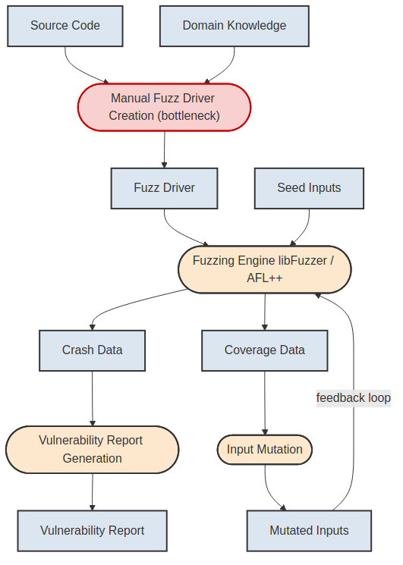
Figure 1.1 — The Fuzzing Process
The Fuzzing Process. Rectangular boxes = data artifacts; rounded boxes = processing steps. Manual fuzz driver creation (red) is the bottleneck this thesis automates.

Slide 2
Figure 1.2 — The Automotive CI/CD/CT Pipeline
The Automotive CI/CD/CT Pipeline. Security Validation (highlighted) is where fuzzing integrates. The feedback loop from telemetry enables continuous improvement.

Slide 3
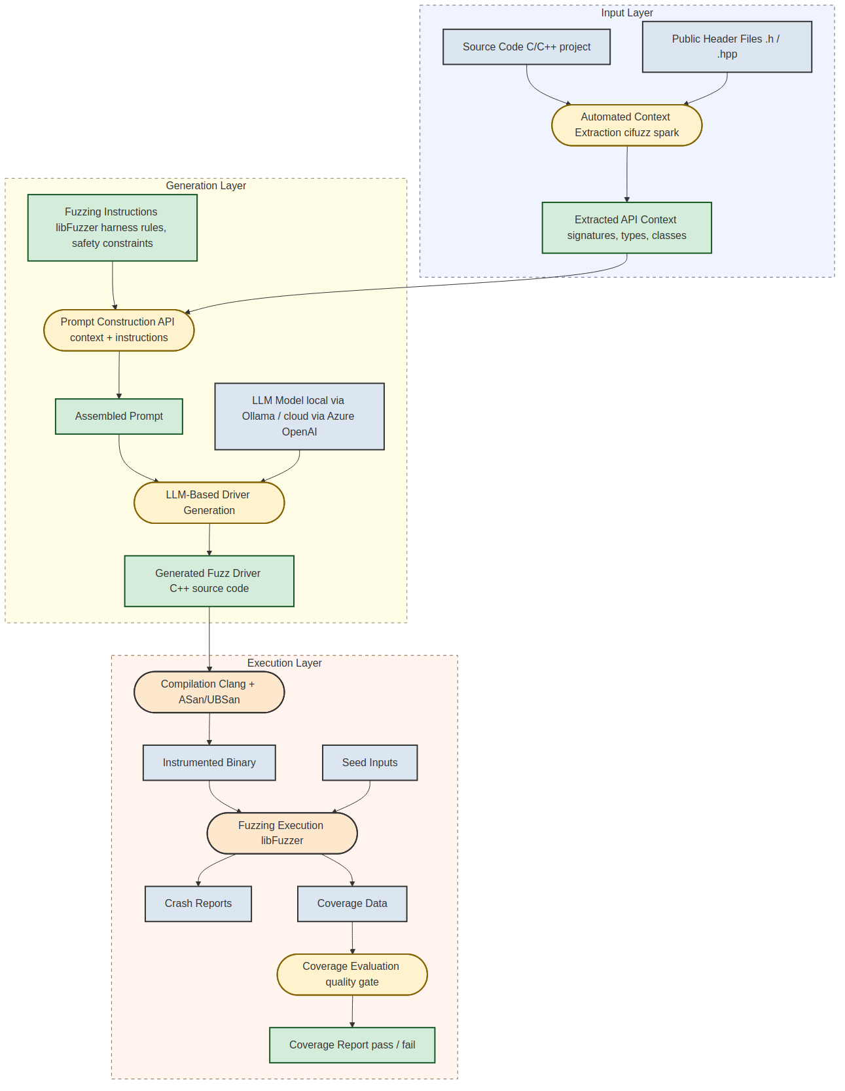
Figure 3.1 — Technical Architecture (LLM-based Fuzz Driver Generation)
Three-layer architecture: Input Layer (context extraction), Generation Layer (LLM-based driver generation), Execution Layer (fuzzing). Green/yellow = new contributions.

Slide 4
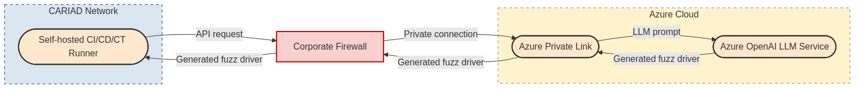
Figure 3.2 — Enterprise Integration Strategy
The self-hosted CI/CD/CT runner communicates with Azure OpenAI through a Private Link endpoint via the corporate firewall — no public internet traversal.

Slide 5
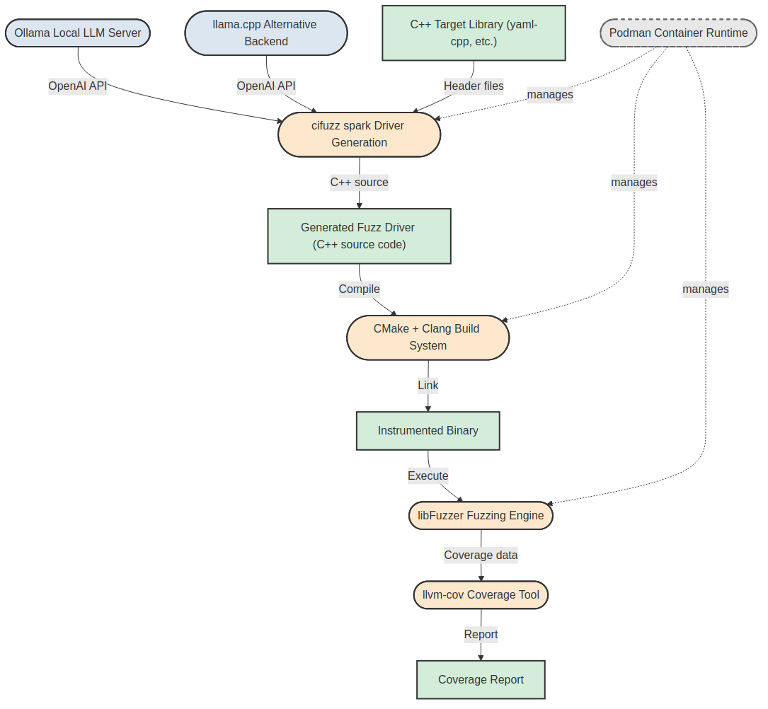
Figure 4.1 — Evaluation Environment Component Diagram
Evaluation Environment. Ollama/llama.cpp serve the LLM; cifuzz spark orchestrates driver generation; CMake/Clang builds; libFuzzer executes; llvm-cov measures coverage. All inside Podman.

Slide 6
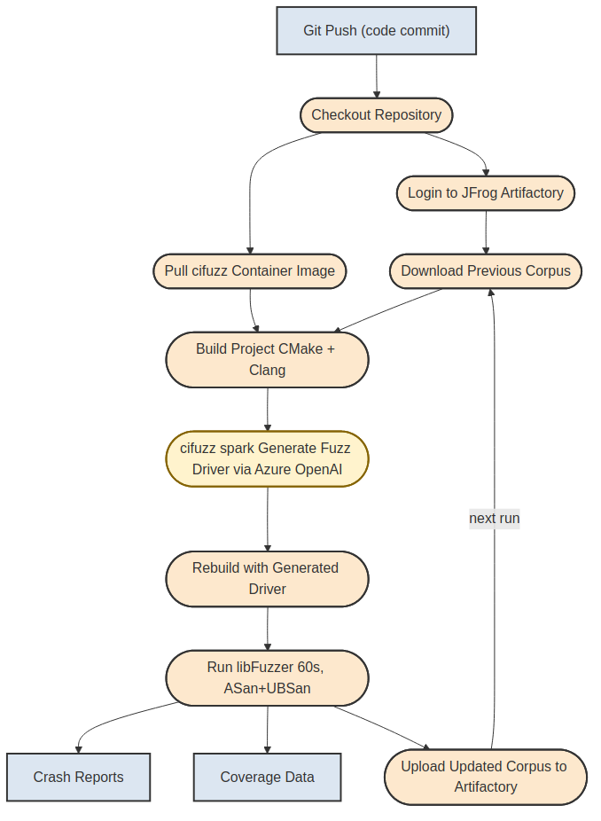
Figure 4.2 — CI/CD/CT Pipeline Workflow
CI/CD/CT Pipeline Workflow. cifuzz spark (highlighted) invokes the LLM via Azure Private Link. JFrog Artifactory enables cumulative corpus persistence across runs.

Slide 7
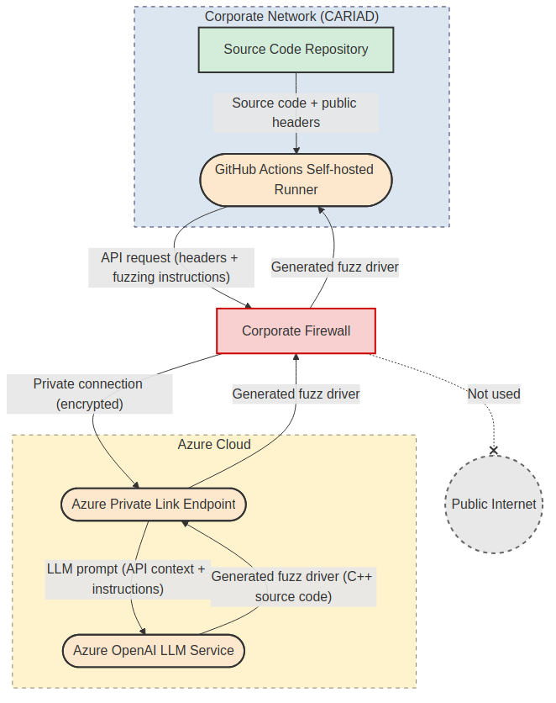
Figure 6.1 — Enterprise Network Architecture with Azure Private Link
Enterprise Network Architecture. Traffic flows through a private connection and never traverses the public internet. Edges are labeled with data exchanged between components.

