Slide 1
NSW Properties Sales and Rental Mashup
COMP9321 Assignment 3
Design and Development of a Data Mashup Application

Slide 2
Data sources
This mashup application mainly consists of 2 sources:
NSW properties (houses and units) prices between 2006 and 2016
NSW properties (houses and units) rents between 2006 and 2016
Others: hospitals, public transport, supermarkets, etc

Slide 3
Model
For example
'id' : 'Randwick',
'houses' : ['attribute_1' : '...',
'attribute_2' : '...',
...],
'units' : ['attribute_1' : '...',
'attribute_2' : '...',
...],
...

Slide 4
Target users
Investors who want to purchase properties (Investment)
People who are looking for properties to rent (Rental)

Slide 5
Investment
What do investors care about the most?
How much do they need to spend on the investment?
What is the return rate?

Slide 6
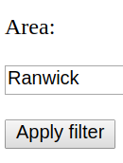
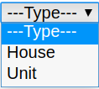
Investment
Two ways for users to search the information of properties
Scenario 1
Charlotte is interested in houses in Randwick, so she chooses 'houses' in 'Type' filter and enter 'Randwick' in the search box.

Slide 7
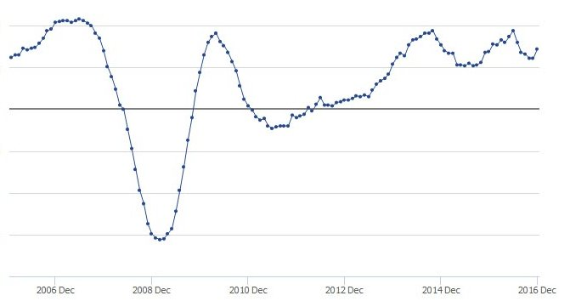
Investment - scenario 1
Sale prices (2006-2016) Rents (2006-2016)
Return rate (2006-2016)
Summary
Min price | xxx
Max price | xxx
Mean price | xxx
Min return rate | xxx
Max return rate | xxx
Mean return rate | xxx

Slide 8
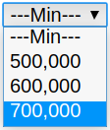
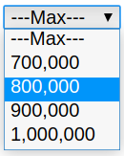
Investment
Scenario 2
Jonathan is planning to buy his first property, but he is not sure what is the best for him, and all he knows is that he has a budget of $800,000 and wants to buy an apartment.

Slide 9
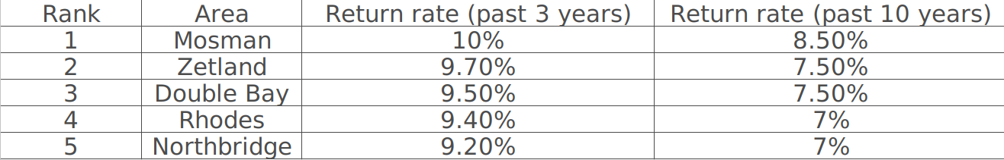
Investment - scenario 2
Provide users with suggestions (e.g. Top 5 areas with highest mean return rate)

Slide 10
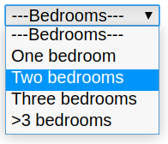
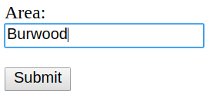
Rental
There are also 2 ways for users to search rental info
Scenario 1
Elsa wants to rent a two-bedroom unit in Burwood so she would like to get more info/details about this.

Slide 11
Rental
Scenario 1
Rent (past 2 years)
Burwood
Mean Rent | xxx
Min Rent | xxx
Max Rent | xxx
No. of supermarkets | xxx
No. of hospitals | xxx
No. of bus stops | xxx

Slide 12
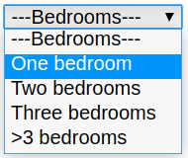
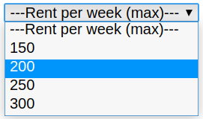
Rental
Scenario 2
John does not have a job so he has very limited budget. He does not care where to live as long as the rent is within his budget ($200/week).

Slide 13
Rental
Scenario 2
Suggest 5 areas that fulfill John's requirements (sort by low to high)
Area | Rent (past 2 years) | No. of supermarkets | No. of bus stops | No. of hospitals
xxx | 170 | x | x | x
xxx | 175 | x | x | x
xxx | 180 | x | x | x
xxx | 190 | x | x | x
xxx | 200 | x | x | x

Slide 14
Roles and tasks
Members | Tasks
Darren (Fudi Zheng) | Data publication + API
Shirley (Xue Wen) | Web interaction (front end)
Notail (Jingchen Wang) | Data publication + API
Benny (Jianhui Shi) | Obtain and process data + data analytics

