Slide 1

Government Engineering College, Gandhinagar Subject : Advanced Java Programming (Group Project)
1
Student Information:
Name | Enrollment No. | Batch
Darshak Zadafiya(Leader) | 190130107149 | B3
Patel Darshil | 190130107081 | B1
Prajapati Ajay | 190130107112 | B1
Viradiya Jeel | 190130107145 | B3

Slide 2
Online Shopping
2

Slide 3


3
Topic learned by this project
1)JDBC(Java Database Connectivity)
2) JSP(Java Server Pages)

Slide 4
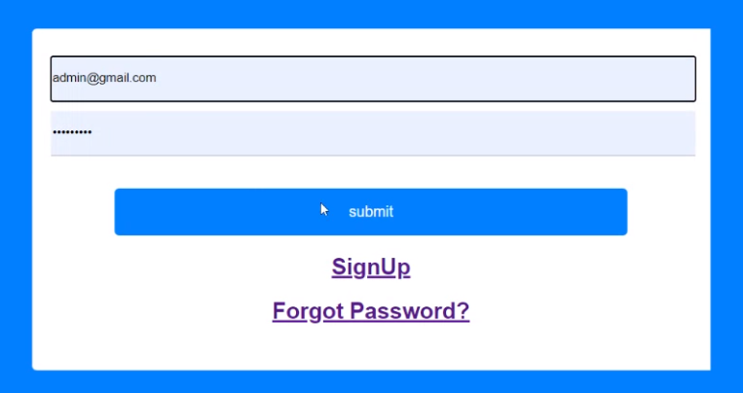
Admin Side
Step 1 : Login
Enter Admin Email id & password on given field
And Click on Submit Button

Slide 5
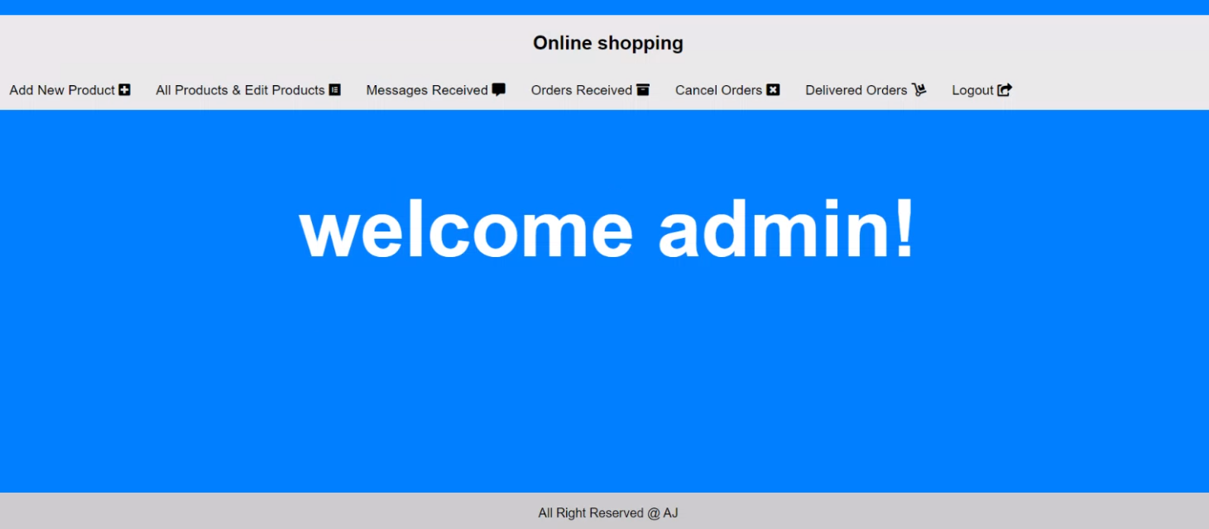
5
Step 2
Admin Features
Can add new product
Can edit product
Can read messages from customers
Can see order received
Cancel order
Delivered Order

Slide 6
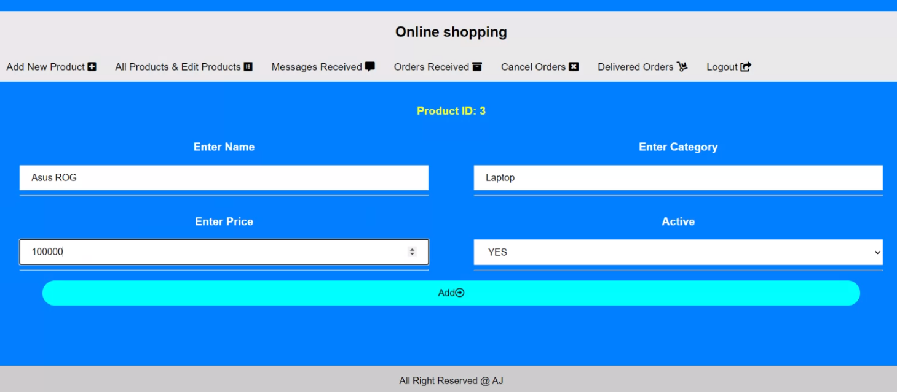
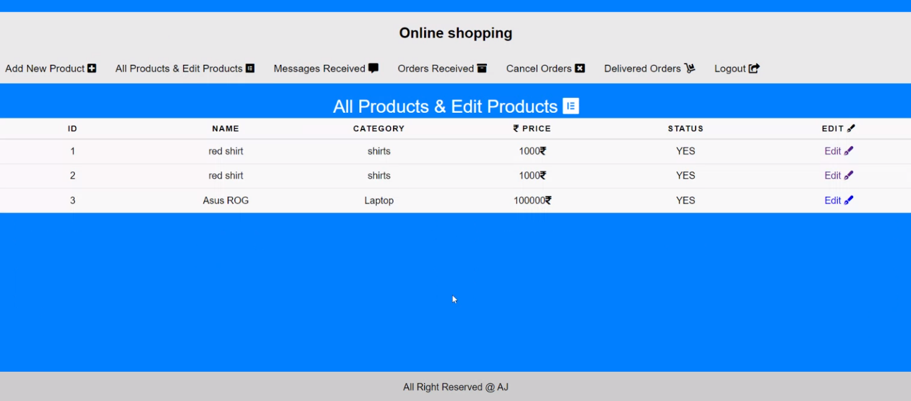

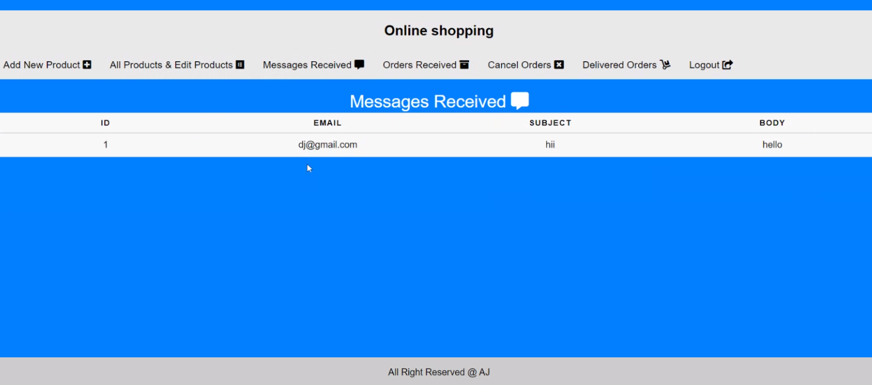
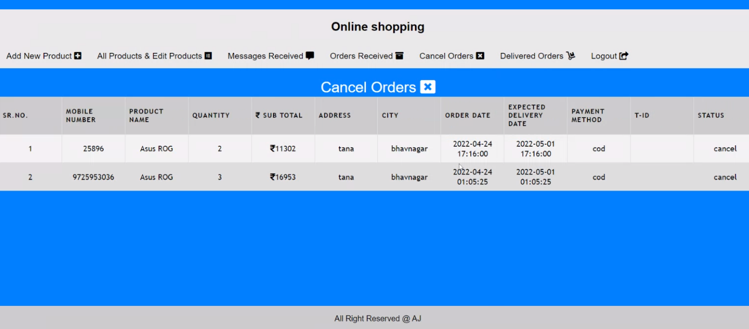
Features Snap Shots
Add Product
Edit Product
Messages From Customer
Cancel Order

Slide 7
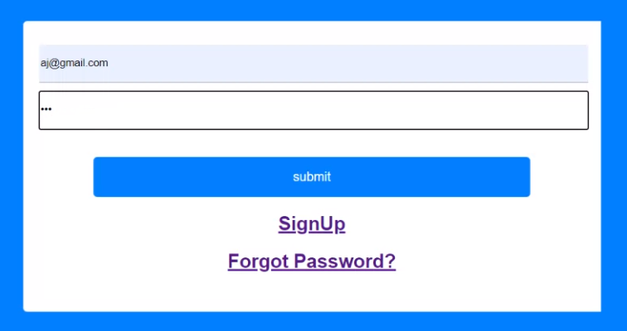
Customer Side
Step 1 : Login
Enter Customer Email id & password on given field
And Click on Submit Button

Slide 8
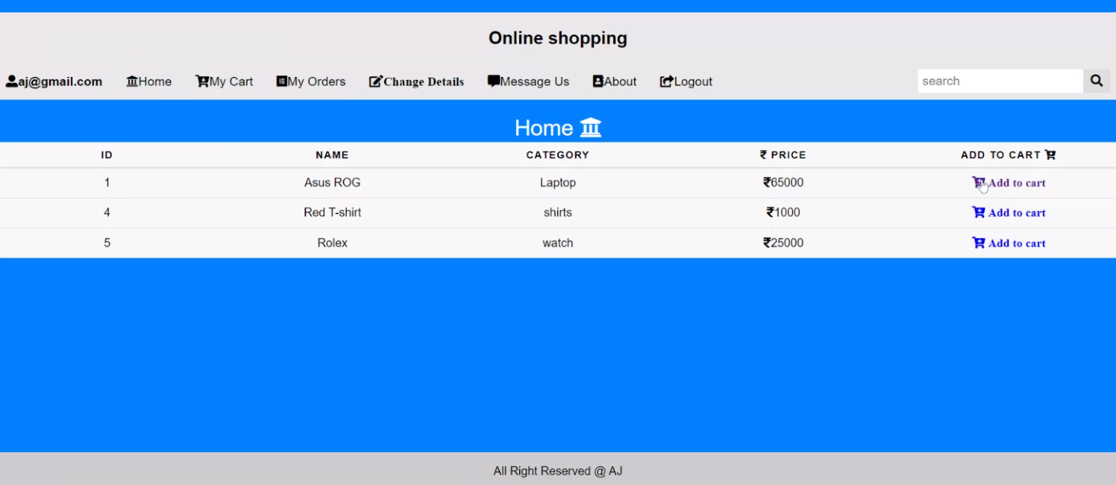
Step 2: Congratulations!! Now You can interact with website

Slide 9
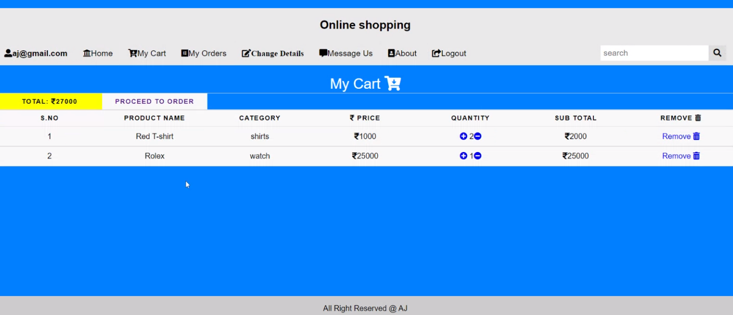

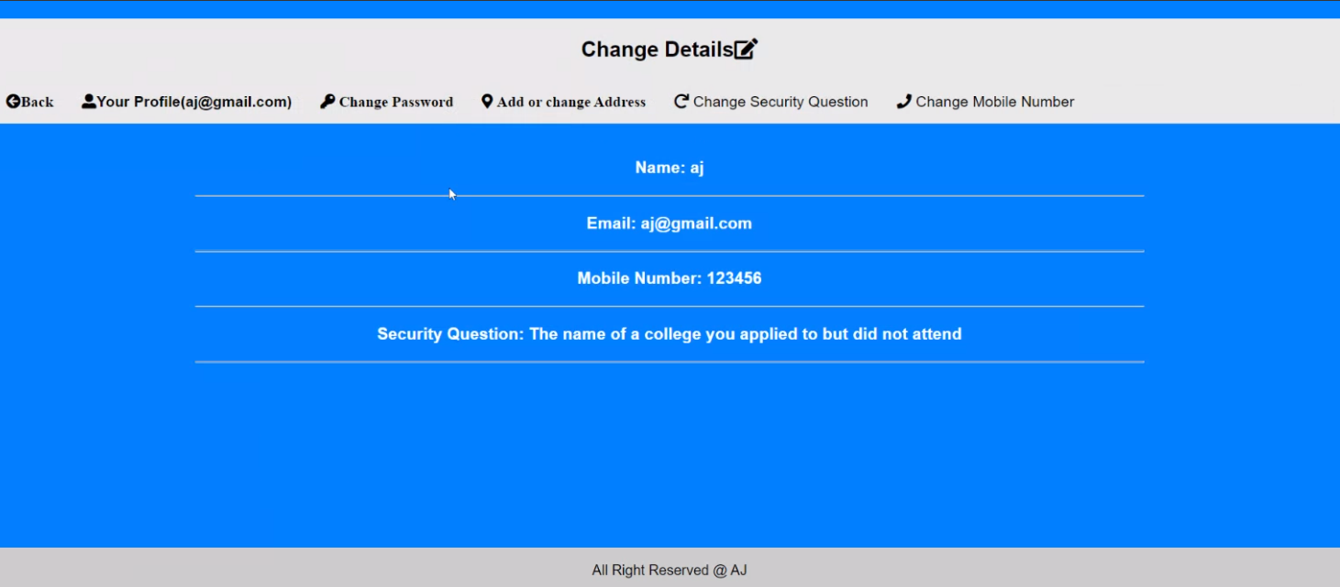
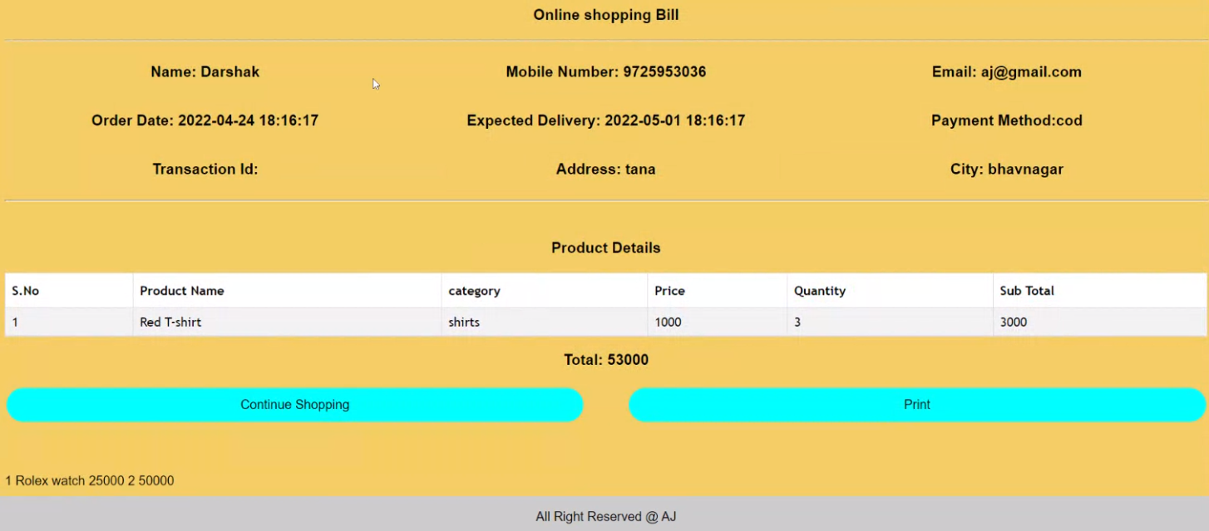
Add to Cart
Remove From Cart
Customer
Edit Personal Details
Print Bill

Slide 10
Refference From: Btech Days

Slide 11


