Slide 1
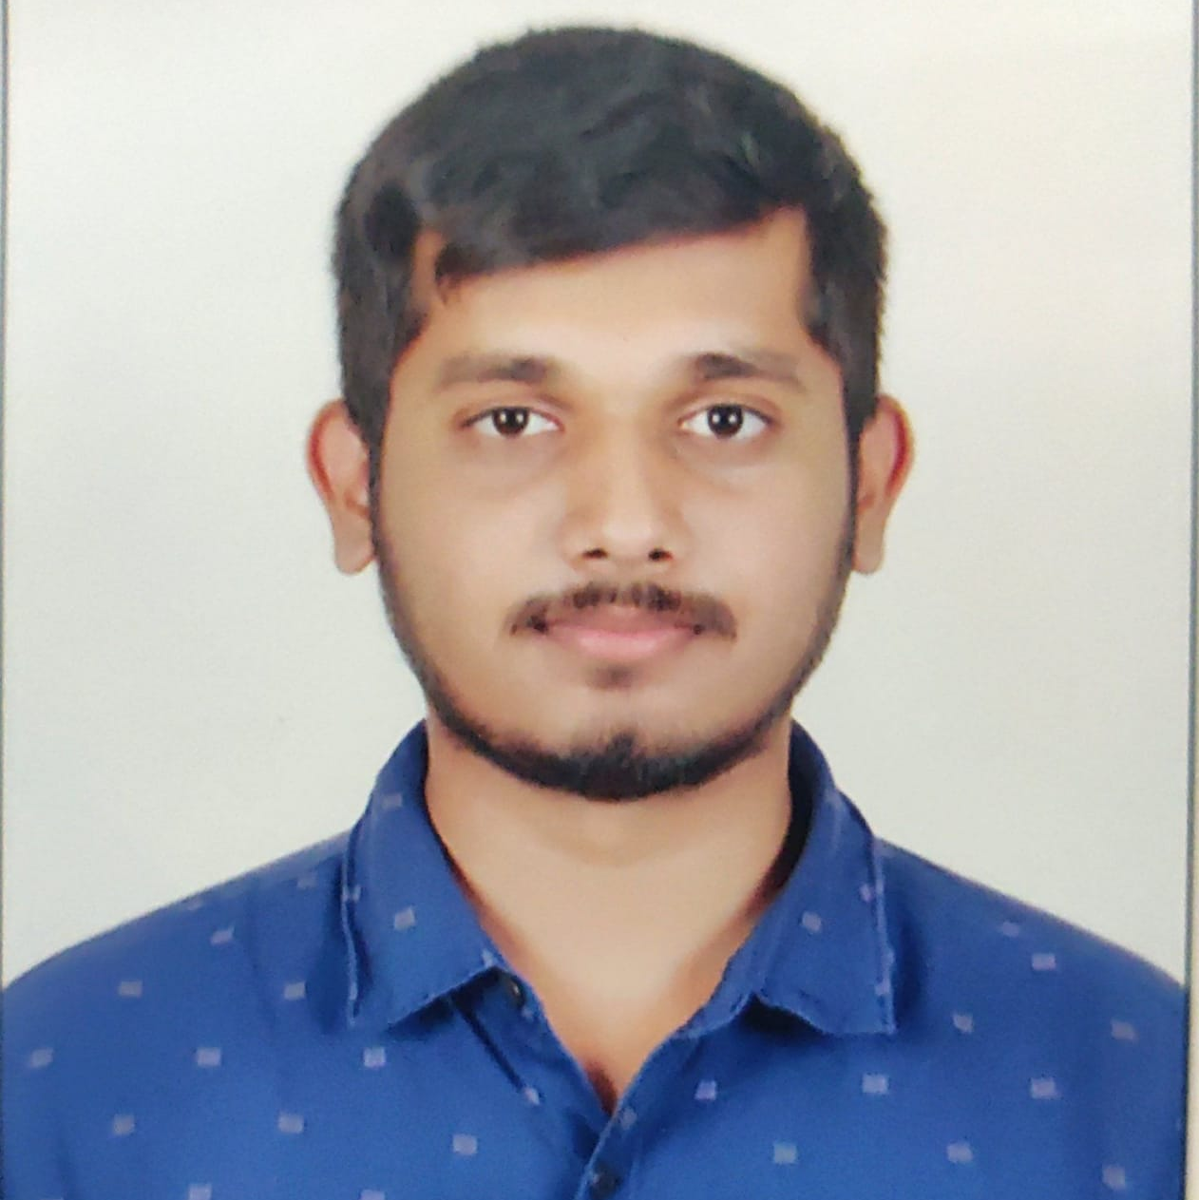
V DARSHAN
Bachelor of Engineering
2015 - 2019
Skills Java 8 / J2EE
Spring Boot
Spring MVC
JPA CRUD
Bootstrap
Backend
Spring Boot
Hibernate
REST-API
Database
SQL database – MySQL
Postgres SQL
Web Technologies
HTML5
CSS3
JavaScript
Bootstrap
React JS
Add On
Maven
Postman
Additional Details
Leadership
Good Communication Skills
Team management
Analyst/Software Engineer
Bangalore
xxxxxxxxxxxxxx@capgemini.com
+91 XXXXXXX249
A4
Full Stack Developer
Hands on experience in developing web pages using HTML5, CSS3, Java script, ES6, JSON, XML.
Eager to work in a team of dedicated people and serve a key role in the enhancement and development of the project.
Has working knowledge on ReactJS , Java Microservice Development using Spring framework on an intermediate level.
Software Engineer who is Strong in design and integration with intuitive problem-solving skills. Passionate about implementing and launching new projects.
Online Sweet Shop
Completed end to end case study of Online Sweet Shop along with Postman Authentication.Material-UI and React Bootstrap used for user interface.
LOGIN AND REGISTRATION OF ONLINE SWEET SHOP
Where customers and admins can visit and login to the online sweet shop through webpage
Customer logs in to customer homepage where they can shop online.
Admin logs in to the admin homepage where they can manage products and users.

