Slide 1
Cohort state-transition Modeling in R
DARTH Advanced Decision Modeling in R workshop
April 1-3, 2020

Slide 2
Cohort State-Transition Models
Models where proportions of a cohort occupy states at each point in time (e.g., healthy, sick, stable, progressed, dead).
Transitions allowed between states with some probability.
Transitions occur in cycles (months, years etc).
Each state associated with a value associated with a model outcome ($, utility).
Markov assumption: no “memory” within states.

Slide 3
Building a cohort State-Transition Model
Determine health states
Determine transitions
Choose cycle length
Estimate transition probabilities
Estimate state utilities and costs per cycle
Calculate
Sensitivity analyses

Slide 4
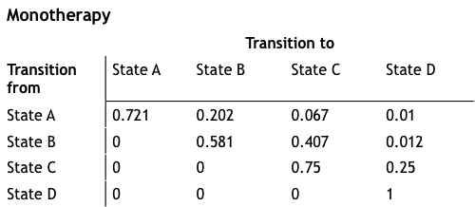
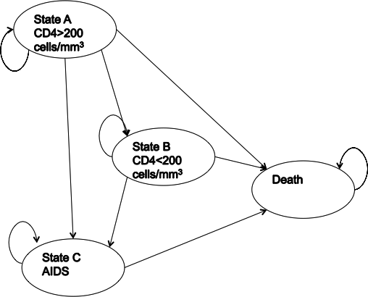
Markov Model of HIV Progression
Transition matrix
State-transition diagram
Drummond, Michael F. Methods for the economic evaluation of health care programmes. Oxford university press, 2005.

Slide 5
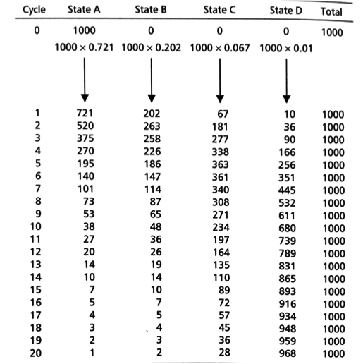
Markov
Trace
Number or distribution of individuals at each cycle

Slide 6
Three-State Model
p_HS
Healthy (H)
Sick (S)
p_HD
p_SD
Dead (D)

Slide 7
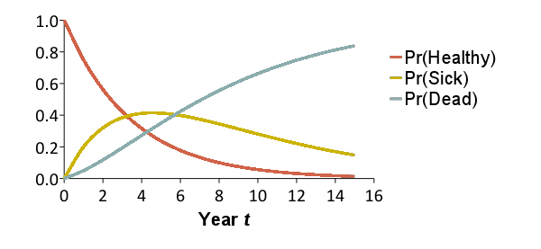
Trace the Cohort Through Time
Reflects the distribution of a cohort of patients over a set of health states over time
x₀ = [1.00 0.00 0.00]
x₁ = [0.75 0.20 0.05]
x₂ = [0.56 0.32 0.12]
x₃ = [0.42 0.38 0.19]
x₄ = [0.32 0.41 0.27]
x₅ = [0.24 0.41 0.35]
x₁₀ = [0.06 0.28 0.66]
0.20
0.15
0.75
Healthy
Sick
Dead
0.85
1.0
0.05
x_{t}(1)
x_{t}(2)
x_{t}(3)

Slide 8
Trace the Cohort Through Time
Reflects the distribution of a cohort of patients over a set of health states over time
x₀ = [1.00 0.00 0.00]
x₁ = [0.75 0.20 0.05]
x₂ = [0.56 0.32 0.12]
x₃ = [0.42 0.38 0.19]
x₄ = [0.32 0.41 0.27]
x₅ = [0.24 0.41 0.35]
x₁₀ = [0.06 0.28 0.66]
x₁₅ = [0.01 0.15 0.84]
0.20
0.15
0.75
Healthy
Sick
Dead
0.85
1.0
0.05
x_{t}(1)
x_{t}(2)
x_{t}(3)

Slide 9
Model as a Transition Matrix
Summarize transition probabilities as a matrix
Cohort distribution at next time step calculated through matrix multiplication
To:
 | Healthy | Sick | Dead
Healthy | 0.75 | 0.20 | 0.05
Sick | 0 | 0.85 | 0.15
Dead | 0 | 0 | 1.0
From:
= A
A
x_{t+1}
=
x_{t}

Slide 10
“Running” the Model
Summarize transition probabilities as a matrix
Cohort distribution at next time step calculated through matrix multiplication
To:
 | Healthy | Sick | Dead
Healthy | 0.75 | 0.20 | 0.05
Sick | 0 | 0.85 | 0.15
Dead | 0 | 0 | 1.0
From:
= A
A
0.75
0.20
0.05
x_{t+1}
=
x_{t}
0
0.85
0.15
0
0
1.0

Slide 11
“Running” the Model
Summarize transition probabilities as a matrix
Cohort distribution at next time step calculated through matrix multiplication
To:
 | Healthy | Sick | Dead
Healthy | 0.75 | 0.20 | 0.05
Sick | 0 | 0.85 | 0.15
Dead | 0 | 0 | 1.0
From:
= A
A
x₁
x₀
0.75
0.20
0.05
0.75
0.20
0.05
=
1.0
0.0
0.0
0
0.85
0.15
0
0
1.0

Slide 12
Markov Trace (Life-Years)
Calculate expected remaining LE, QALE, costs
Multiply cohort distribution by state-specific values to calculate expected value at each time
Sum expected values over time (discount if desired)
Life-Years:
1.0
1.0
0.0
Time | Healthy | Sick | Dead | E[LYs]
0 | 1.0 | 0.0 | 0.0 | --
1 | 0.75 | 0.20 | 0.05 | 0.95
2 | 0.56 | 0.32 | 0.12 | 0.88
3 | 0.42 | 0.38 | 0.19 | 0.81
 | … | … | …
Sum
* 1/(1+r)
* 1/(1+r)²
* 1/(1+r)³
Total life years: 6.77 years
(Remaining life expectancy)

Slide 13
Markov Trace (Costs)
Calculate expected remaining LE, QALE, costs
Multiply cohort distribution by state-specific values to calculate expected value at each time
Sum expected values over time (discount if desired)
Costs:
$500
$2,500
$0
Time | Healthy | Sick | Dead | E[Costs]
0 | 1.0 | 0.0 | 0.0 | --
1 | 0.75 | 0.20 | 0.05 | $875
2 | 0.56 | 0.32 | 0.12 | $1,081
3 | 0.42 | 0.38 | 0.19 | $1,1,72
 | … | … | …
Sum
* 1/(1+r)
* 1/(1+r)²
* 1/(1+r)³
Total costs: $11,557
(Total remaining lifetime costs)

Slide 14
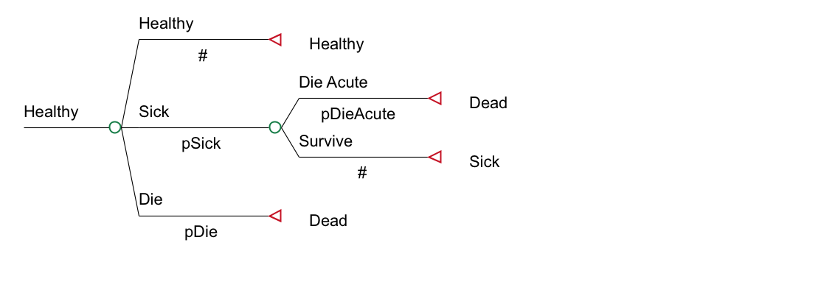
Transition Probabilities
Pr(Healthy → Dead) may not be conceptualized as one number
p_HD = p_Die + p_Sick * p_DieAcute

Slide 15
Parameter Estimation
Many parameters can be directly informed by primary or secondary data
Sometimes there is no direct information to inform a subset of parameters
However, data exist that are similar to output from the model
Estimation of these “deep” model parameters involves calibration

Slide 16
Microsimulation
Each patient proceeds through the decision tree one at a time
At each chance node, there is a p₁ chance they will go down the first branch, a p₂ chance they will go down the second branch, etc. Each patient will end up at one of the terminal nodes
Within a Markov cycle tree, patients will transition from state to state until they enter a state with a utility of 0
Allows “memory” to be introduced

Slide 17
Cancer Recurrence
(Recur=0)
Well
Recur
Dead
Recur=Recur+1
Well
Recur
Dead
(Recur=1)
Well
Recur
Dead

Slide 18
Populations vs. Cohorts
Depends on the perspective of the decision maker
What is the cost-effectiveness for the population of interest if intervention is implemented today?
Example: Cervical cancer screening
Option 1: Compare screening with no screening for cohort of 15-year-old girls
Run a cohort of 15-year-old girls under both strategies
Option 2: Compare screening with no screening for population of women ages 15-69
Run several cohorts: 15-19, 20-24, etc.
Costs and effectiveness are a weighted average of the multiple cohort runs
Dewilde & Anderson. Med Decis Making 2004;24:486.

Slide 19
Population Models
Models both the incident and prevalent cases over time (calendar time explicitly modeled)
Intervention duration
Length of time over which the intervention is applied per person or cohort
Implementation period
Period over which the intervention is applied
Analytic Horizon
Period over which costs and effects are assessed
Should be long enough to capture all meaningful differences in costs and effects between altenatives

Slide 20
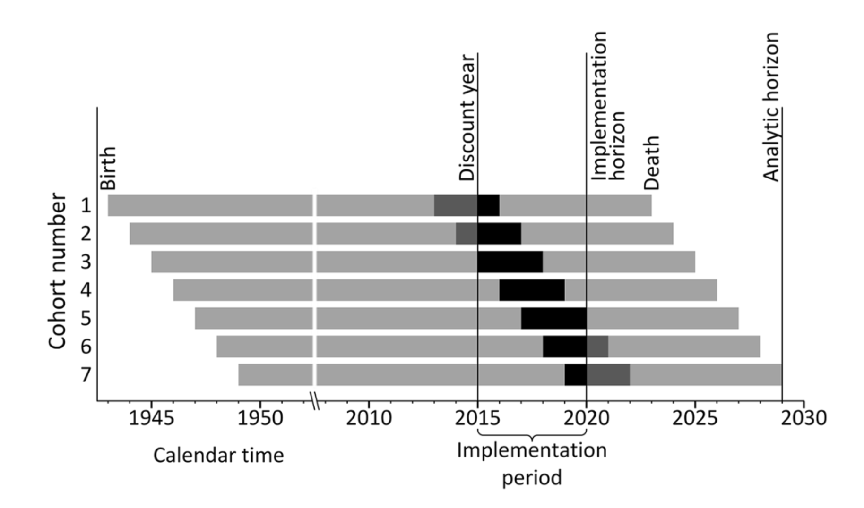
Population Evaluations
O’Mahony JF et al. PharmacoEconomics 2015;33:1255.

Slide 21
Conceptualizing the Markov model in R

Slide 22
Simple state transition model in R
p_HS
Healthy (H)
Sick (S)
p_HD
p_SD
Dead (D)
Notes:
Simple Markov to illustrate the use of Markov models
First letter from state and second letter to state

Slide 23
Simple state transition model
Model input:
p_{HS}: transition probability from Healthy to Sick
p_{HD}: transition probability Healthy to Dead
p_{SD}: transition probability Sick to Dead
c_{H}: cost of being in state Healthy
c_{S}: cost of being in state Sick
e_{H}: outcomes associated with state Healthy
e_{S}: outcomes associated with state Sick
No cost or disutility associated with death

Slide 24


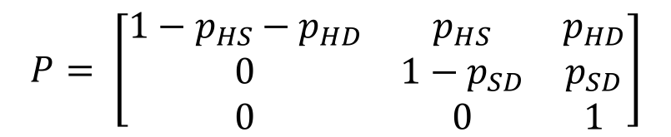
Matrix Implementation of the Markov Model
p_HS
Healthy (H)
Sick (S)
Transition probability matrix
Vector of cycle’s cost/outcomes
H S D
$$P= \left[\begin{matrix}1−p_{HS}−p_{HD} & p_{HS} & p_{HD} \\ 0 & 1−p_{SD} & p_{SD} \\ 0 & 0 & 1\end{matrix}\right]$$
H
S
D
p_HD
p_SD
Dead (D)
$$C= \left[\begin{matrix}c_{H} \\ c_{S} \\ 0\end{matrix}\right]$$
H
S
D
$$E= \left[\begin{matrix}e_{H} \\ e_{S} \\ 0\end{matrix}\right]$$
H
S
D
Notes:
Who is familiar with basic matrix calculations?
-> Inner product

Slide 25
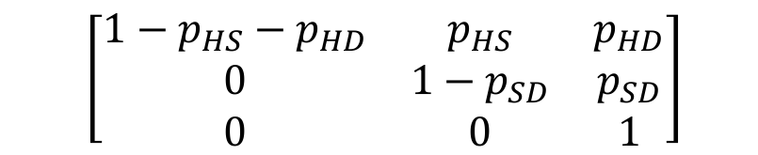

Matrix Implementation of the Markov Model
Create the t x 3 matrix M that will store the proportion of the cohort at each state and cycle:
At t = 0 :
M₀ = [1, 0, 0]
For t < T :
M_{t + 1}=M_{t} P
$$\left[\begin{matrix}1−p_{HS}−p_{HD} & p_{HS} & p_{HD} \\ 0 & 1−p_{SD} & p_{SD} \\ 0 & 0 & 1\end{matrix}\right]$$
$$\left[\begin{matrix}H_{t} & S_{t} & D_{t}\end{matrix}\right]$$

Slide 26
Calculating total costs & effects
E = M e
TE = 1_{T} E
Total effects (TE):
Total costs (TC):
C = M c
TC = 1_{T} C
1_{T} : 1 × T vector of ones
Notes:
M(tx3) e(3x1) = t * 1
(n x m) (m x p) = (n x p)

Slide 27
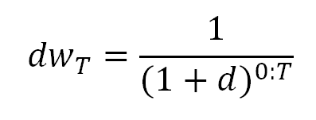
Calculating total costs & effects (discounted)
Total effects (TE):
Total costs (TC):
E = M e
TE = dw_{T} E
C = M c
TC = dw_{T} C
Notes:
M(tx3) e(3x1) = t * 1
(n x m) (m x p) = (n x p)

Slide 28
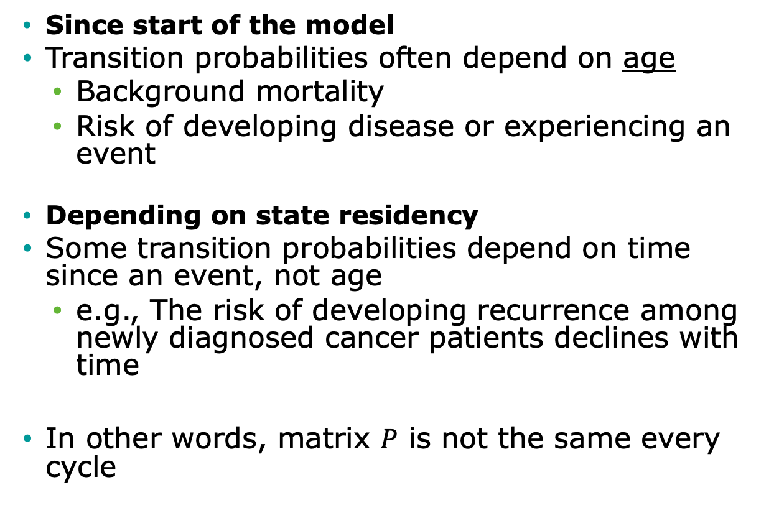
Time-dependency
Since start of the model
Transition probabilities often depend on age
Background mortality
Risk of developing disease or experiencing an event
Depending on state residency
Some transition probabilities depend on time since an event, not age
e.g., The risk of developing recurrence among newly diagnosed cancer patients declines with time
In other words, matrix $P$ is not the same every cycle

Slide 29
Time dependency since start of the model

Slide 30
Time-dependency since model start
Transition probabilities often depend on time since model start
Background mortality
Risk of developing disease or experiencing an event
In other words, matrix P is not the same every cycle
Replace matrix P with matrices P_{t}, where t is time since model start

Slide 31
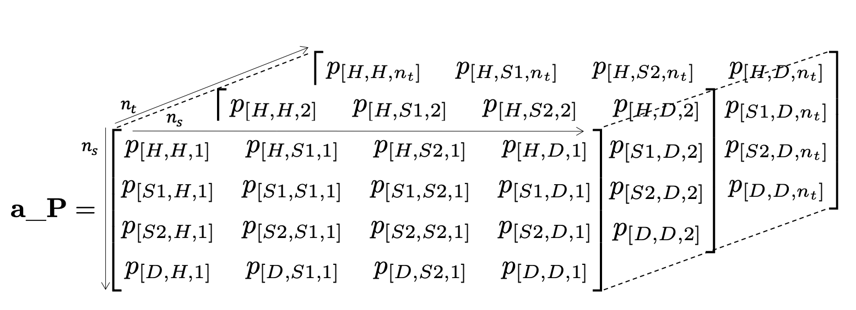
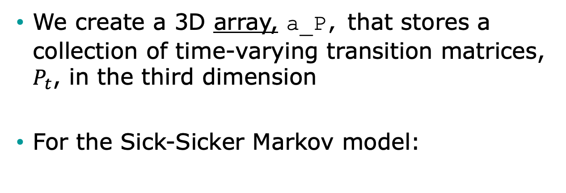
Time-varying probabilities in R
We create a 3D array, a_P, that stores a collection of time-varying transition matrices, $P_{t}$, in the third dimension
For the Sick-Sicker Markov model:

Slide 32
Time-dependent based on state residence

Slide 33
Other Types of Dependence
“Memoryless” property of Markov models is a BIG assumption
Transition probabilities only depend on the current state and not on past states
Many transition probabilities depend on model history, not time since model start
Risk of myocardial infarction (MI) greater for persons with prior MI
Effectiveness of a drug used as first-line therapy may be better than if used as second-line therapy

Slide 34
When history matters, create more states…
Healthy – Sick - Dead:
Once recovered, the risk of getting sick again or dying increases
Healthy (H)
Sick (S)
Dead (D)
Healthy (H)
Sick (S1)
Recovered (R)
Dead (D)
Healthy – Sick – Recovered - Dead

Slide 35

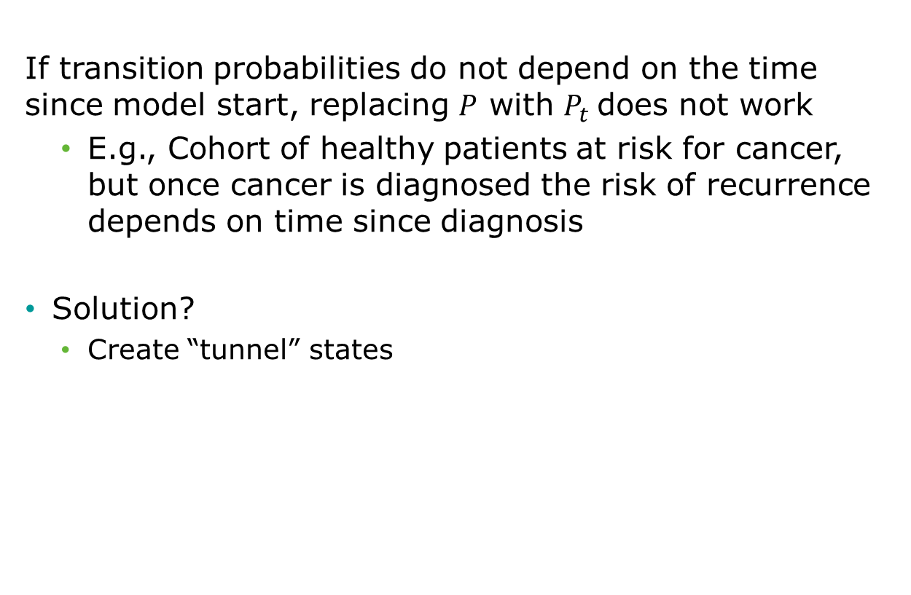
Tunnel states
If transition probabilities do not depend on the time since model start, replacing $P$ with $P_{t}$does not work
E.g., Cohort of healthy patients at risk for cancer, but once cancer is diagnosed the risk of recurrence depends on time since diagnosis
Solution?
Create “tunnel” states

Slide 36
Cohort state-transition model variations in R
DARTH Advanced Decision Modeling in R workshop
April 1-3, 2020

Slide 37
State Time
f(model time)
f(state time)
Healthy
Cancer
Recur
Dead
Tunnel state

Slide 38
Tunnel States
p_Recur₁
Cancer 1
p_Recur₂
Cancer 2
p_Recur₃
Cancer 3
Recur
p_Recur₄
Cancer 4
p_Recur_{n}
Cancer n
Transitions to Dead also allowed.

Slide 39
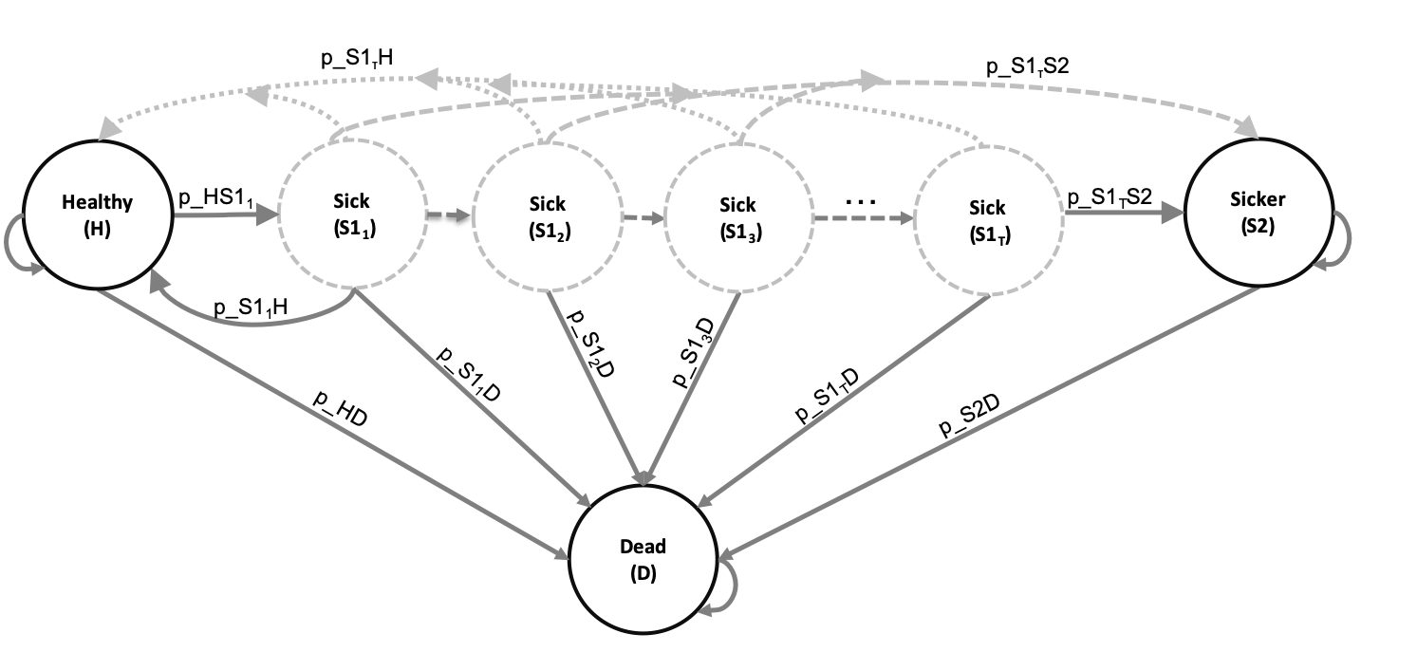
Time-dependent probabilities
Expand the states of the 3D array by the number of cycles considered in the time-dependency variable(s)
For the Sick-Sicker Markov model:

