Slide 1

DARTH Advanced Decision Modeling in R
A 3-day workshop
April 1-3, 2020

Slide 2
Teaching Team
Instructors:
Petros Pechlivanoglou, Assistant Professor
Eva Enns, Assistant Professor
Fernando Alarid-Escudero, Assistant Professor
Hawre Jalal, Assistant Professor
Eline Krijkamp, PhD candidate
Alan Yang, MSc, Research Assistant
Admin support:
Alan Yang

Slide 3
The DARTH Workgroup
Materials for this course were largely developed by the Decision Analysis in R for Technologies in Health (DARTH) Workgroup
Goals: To expand knowledge in decision analysis using R and develop educational materials to empower people to construct R-based decision models.
For more information
http://www.darthworkgroup.com/

Slide 4
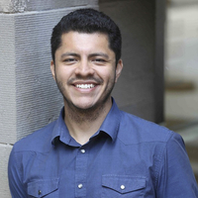
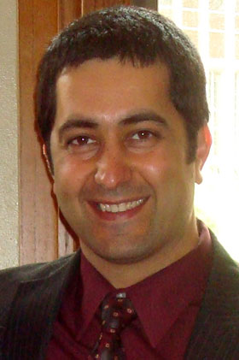
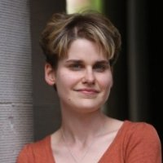
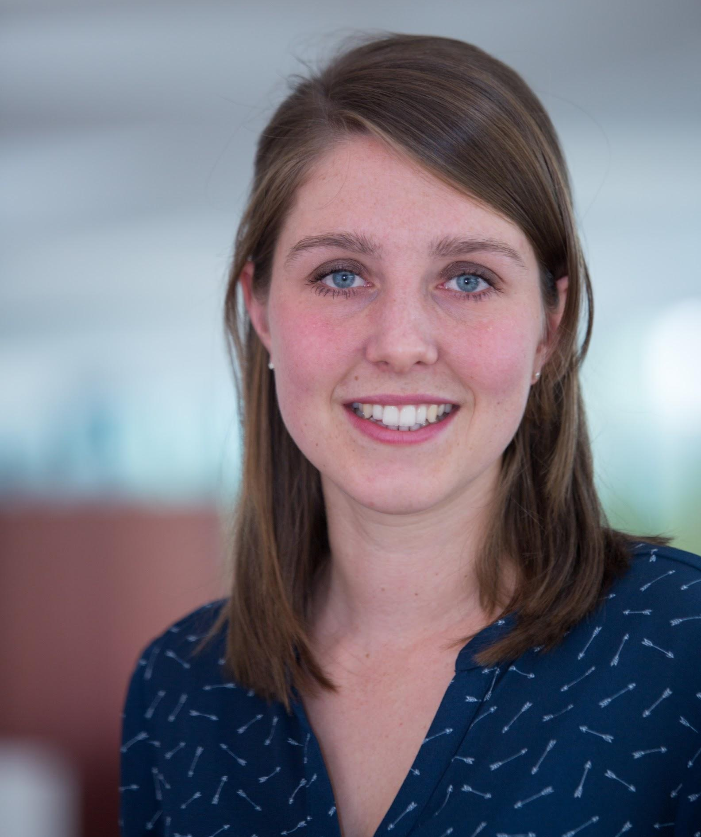
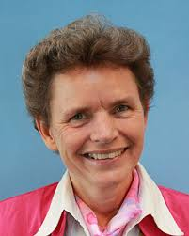
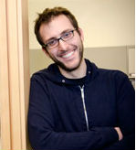
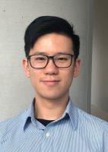
The DARTH Workgroup
F. Alarid-Escudero PhD H. Jalal MD PhD E. Enns PhD
E. Krijkamp PhDc M. Hunink MD P. Pechlivanoglou PhD
Alan Yang MSc

Slide 5
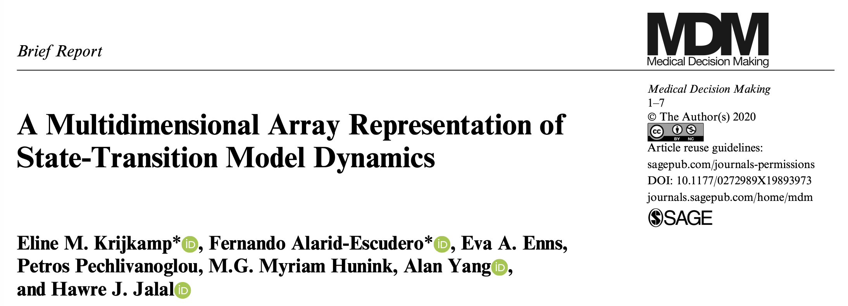
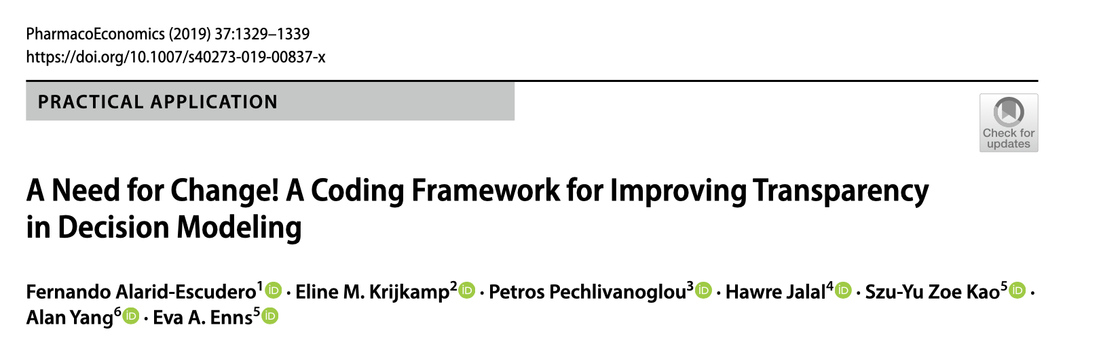
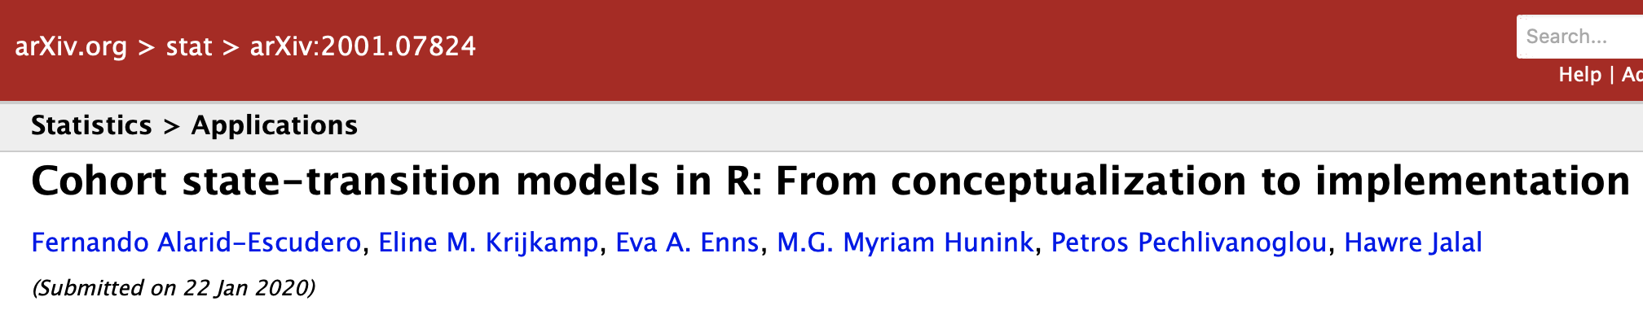
DARTH Publications

Slide 6
DARTH Teaching
Offering workshops and short courses since 2016
Short courses at annual meetings of the Society for Medical Decision Making
Introduction to Decision Modelling Using R
Microsimulation Modelling in R
Sensitivity Analysis and Value of Information Analysis Using Regression Meta-modelling in R
Survival Analysis in Decision Modeling
Hands-on Model Calibration in R **2018 best short course award**
Multi-day workshops held in US, Canada, Chile, the Netherlands, Norway, Swiss

Slide 7
Student introduction
Let’s go around the table and have each participant introduce themselves and their decision case!
If you have slides to aid your intro that’d be awesome!
Notes:
Before we go into details about his group, our work and the relation of this work with the group we are interested in who you are, what your experience is and what you like to get out of this course.

Slide 8
This course
Notes:
Before we move on to the basics of R for decision sciences - questions?
This next section will be a live coding section, we encourage you to follow allong
Introduction to R outline
9.00am - 9.15am Breakfast - meet and greet
9.15 am - 10.00am Introduction to R: An overview
Graphical Interface
Getting help
Libraries
Simple operations
10.00am - 10.45am Mathematics and statistics in R
Assigning values
Elements vectors and matrices
Vector and matrix operations
Distributions
10.45am - 11.00am Coffee break
11.00am - 12.00pm Data manipulation and data handling
Data input output
Data selection
Replacing data
Converting variables with logical expressions
12.00pm - 1.00pm Lunch Break
1.00pm - 1.45pm Plotting in R
Scatterplots
Bar Plots
Histograms
The ggplot package
1.45pm - 2.30pm Exercise I & Discussion
2.30 pm - 2.45pm Coffee Break
2.45pm - 3.15pm Statistical analysis in R
Mean, variance, correlations
Linear (multiple) regression
Regression diagnostics
Exercise II & Discussion
3.15pm - 4.15pm Advanced data handling in R
The dplyr package
4.15pm - 5.00pm Logical expressions and random sampling in R
Logical expressions
Iterative processes
Vectorization
Random sampling in R
Exercise III & Discussion

Slide 9
Logistics
Everything (schedule, files, etc) will be on the course website:
https://darth-advanced-2020.netlify.com/
Offline communications:
alan.yang@sickkids.ca
Slack Workspace: https://app.slack.com/client/TUN1YV8T1/CUNC6J99U
Virtual meetings on Zoom

Slide 10
Files and assignments
You should upload all model files to your GitHub repository for the workshop
Instructors will work with you individually, so they will need access to your GitHub repo, make sure you invite them!
Make sure you are familiar with using GitHub!
GitKraken and other user-friendly interfaces like GitHub Desktop are super useful.

