Slide 1

Microsimulation modeling in R
DARTH Advanced Decision Modeling in R workshop
April 1-3, 2020

Slide 2
Introduction to discrete time microsimulation

Slide 3
What is microsimulation?
Micro = individual-level model
Simulation = stochastic implementation of a dynamic process
Reflects events experienced by an individual

Slide 4
Microsimulation Basics
Simulate disease progression and health outcomes in an individual
Simulate many individuals to estimate expected value and standard deviation of health outcomes over a large population
Zoe:
H
H
H
H
H
S
S
S
D
D
t →
Eline:
H
H
H
H
D
D
D
D
D
D
Petros:
H
H
S
S
S
S
S
S
S
D

Slide 5
Pros/Cons of Microsimulation
Advantages
Disadvantages
Flexible model structure
Easy to include:
Individual heterogeneity
Complex history-dependencies
Continuous health measures
Relation among individuals (network)
Complex to implement
Computationally intensive
Requires more data to inform model parameter values

Slide 6

Individual state-transition model
Sometimes called “Markov Monte Carlo” or “First-Order Monte Carlo” or “Individual state transition model”
Simulates individual disease progression through a state-transition model
Track individual’s health state over time (can only be in one state at any given time)
0.20
0.15
0.75
Healthy
0.85
Sick
1.0
Dead
0.05
t = 0:
t = 1:
t = 2:
t = 3:
t = 4:
t = 5:

Slide 7
General Microsimulation
Need not explicitly follow a Markov model structure
Track current state of individual as well as relevant history/characteristics
Need not be discrete categories; continuous measures possible
Probabilities of simulated events can depend on
Individual characteristics (age, gender, etc.)
Full clinical history, time since clinical events

Slide 8
Microsimulation in R
Generate a representative, virtual population
Sample characteristics from demographic data
Age distribution, M:F ratio, etc.
Simulate the occurrence of events
Write functions that calculate individual-specific probabilities of different events
p_{event1} = f(age, sex, health status, time since event, ...)
Simulate events (and their consequences) over time using random numbers
Calculate population-level outcomes by averaging individual outcomes

Slide 9
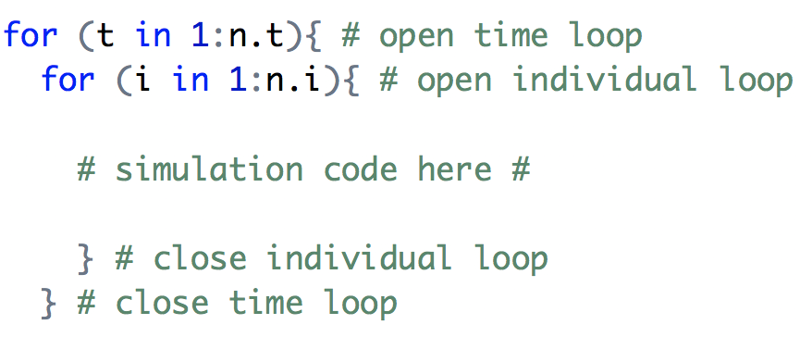
Efficiency in Microsimulation
Microsimulation can be computationally intensive
An intuitive, but inefficient, approach is to simulate one individual at a time

Slide 10
Efficiency in Microsimulation
One individual at a time (two for-loops)
Intuitive, but inefficient
t₁
t₂
t₃
t₄
t₅
t₆
. . .
. . .
Zoe:
H
H
H
H
H
S
Eline:
. . .
H
H
H
H
D
D
Petros:
. . .
H
H
S
S
S
S
Notes:
This slide say that this loop is intuitive but inefficient -> we will teach it them this way

Slide 11
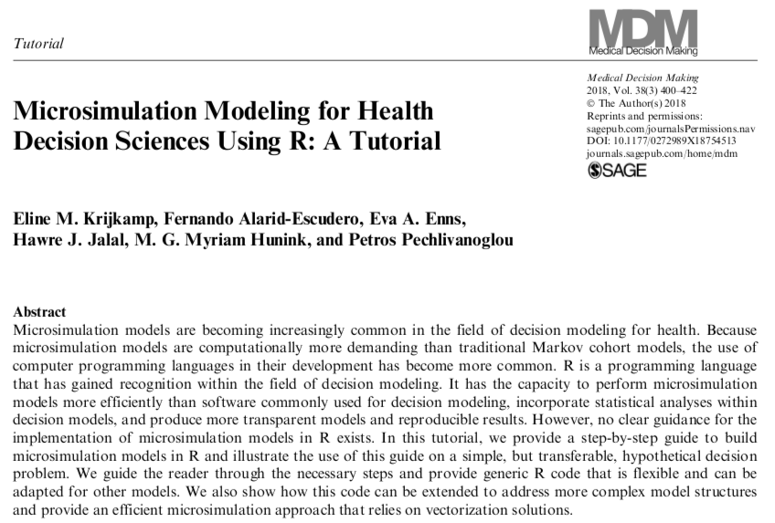
Microsimulation in R
Notes:
This year our second paper and first tutorial came out. With this paper we fill a gap of knowledge that I discovered during my Master thesis. By that time, I was building a microsimulation simulation in both Treeage and R, but quickly became stuck in R. I couldn’t find information on how to build a Microsimulation model to generate data. Much more packages or instructions were available when you have data but nothing about what do do when you don’t.
In this tutorial we guide a reader through the steps you need to take in order to code a Microsimulation model and how you can do a basic CE analysis.

Slide 12
Efficiency in Microsimulation
”Batch process” individual at each time step (one for-loops)
We’ll show you this more efficient method
t₁
t₂
t₃
t₄
t₅
t₆
t₇
t₈
t₉
t₁₀
Zoe:
H
H
H
H
H
S
S
S
D
D
Eline:
H
H
H
H
D
D
D
D
D
D
Petros:
H
H
S
S
S
S
S
S
S
D

Slide 13
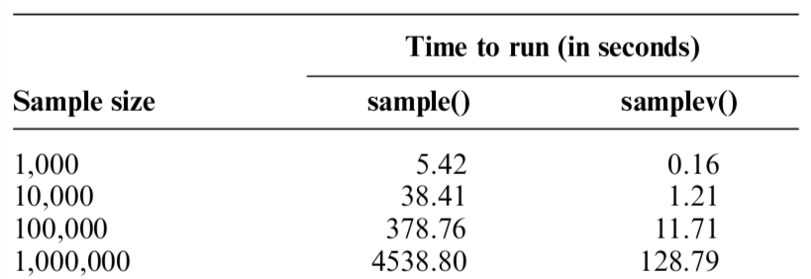
iterative vs vectorized
Notes:
Teaching model vs efficient coding

Slide 14
Individuals Characteristics
age
sex
height
Country of birth
Zoe:
35
Female
1.55
Taiwan
Eline:
28
Female
1.68
NL
Petros
36
Male
1.89
Greece

Slide 15
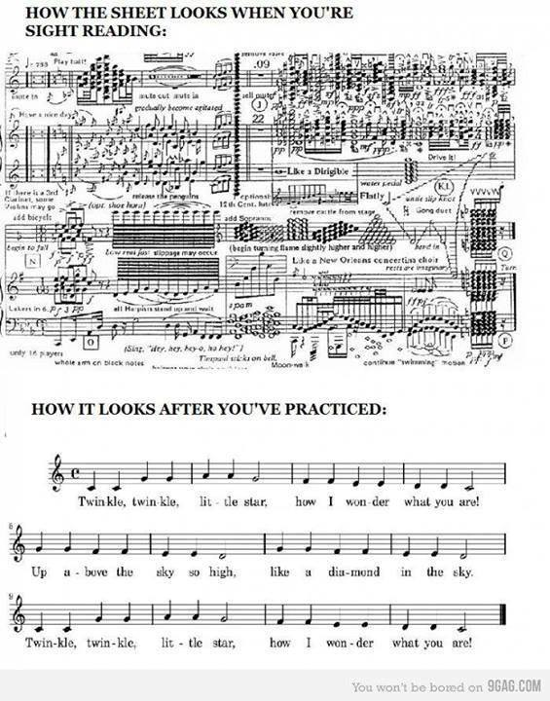

Slide 16
Individuals Characteristics
Zoe:
H
H
H
H
H
S
S
S
D
D
t →
Eline:
H
H
H
H
D
D
D
D
D
D
t = 1
Petros:
H
H
S
S
S
S
S
S
S
D
age
sex
height
Country of birth
time Sick
p_HS
Zoe:
35
Female
1.55
Taiwan
0
0.3
Eline:
28
Female
1.68
NL
0
0.3
Petros
36
Male
1.89
Greece
0
0.4

Slide 17
Individuals Characteristics
Zoe:
H
H
H
H
H
S
S
S
D
D
t →
Eline:
H
H
H
H
D
D
D
D
D
D
t = 2
Petros:
H
H
S
S
S
S
S
S
S
D
df_X$Age = df_X$Age + 1
age
sex
height
Country of birth
time Sick
p_HS
Zoe:
36
Female
1.55
Taiwan
0
0.3
Eline:
29
Female
1.68
NL
0
0.3
Petros
37
Male
1.89
Greece
0
0.4

Slide 18
Individuals Characteristics
Zoe:
H
H
H
H
H
S
S
S
D
D
t →
Eline:
H
H
H
H
D
D
D
D
D
D
t = 3
Petros:
H
H
S
S
S
S
S
S
S
D
P_HD= df_X$p_HD[m_M[, t] == ”H”]
age
sex
height
Country of birth
time Sick
p_HS
36
0.3
37
Female
Female
1.60
1.55
Canada
Taiwan
0
Zoe:
0
Eline:
29
30
Female
Female
1.68
1.68
NL
NL
0
0
0.3
Petros
38
Male
1.89
Greece
1
--

Slide 19
Individuals Characteristics
Zoe:
H
H
H
H
H
S
S
S
D
D
t →
Eline:
H
H
H
H
D
D
D
D
D
D
t = 4
Petros:
H
H
S
S
S
S
S
S
S
D
age
sex
height
Country of birth
time Sick
p_HS
Zoe:
38
Female
1.55
Taiwan
0
0.3
Eline:
31
Female
1.68
NL
0
0.3
Petros
39
Male
1.89
Greece
2
--

Slide 20
Individuals Characteristics
Zoe:
H
H
H
H
H
S
S
S
D
D
t →
Eline:
H
H
H
H
D
D
D
D
D
D
t = 5
Petros:
H
H
S
S
S
S
S
S
S
D
age
sex
height
Country of birth
time Sick
p_HS
Zoe:
39
Female
1.55
Taiwan
0
0.3
Eline:
32
Female
1.68
NL
0
--
Petros
40
Male
1.89
Greece
3
--

Slide 21
Individuals Characteristics
Zoe:
H
H
H
H
H
S
S
S
D
D
t →
Eline:
H
H
H
H
D
D
D
D
D
D
t = 6
Petros:
H
H
S
S
S
S
S
S
S
D
age
sex
height
Country of birth
time Sick
p_HS
Zoe:
40
Female
1.55
Taiwan
1
--
Eline:
33
Female
1.68
NL
0
--
Petros
41
Male
1.89
Greece
4
--

Slide 22
R session
Notes:
3-state model

Slide 23
3-state example
•Three-state model of disease: Healthy, Sick, Dead
•Simulate a population of 10,000 individuals
•Individual characteristics
• Sex – assume equal proportion of women and men
•p_HD is sex-dependent
Female | 0.0382
Male | 0.0463

Slide 24
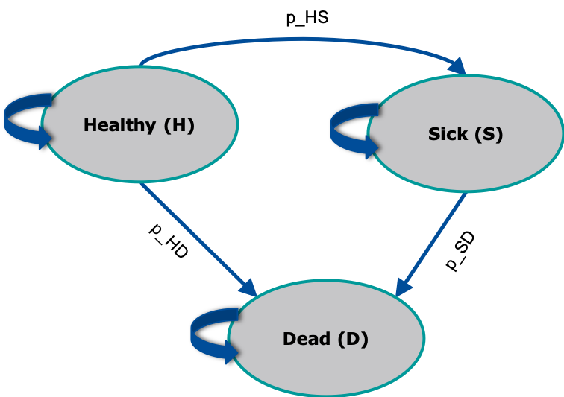

Slide 25
State-residence
Notes:
Wrap up - deadlines & about tomorrow

Slide 26
State-residency
Probability might be dependent on how long someone is in a state
The probability of recovery depends on the duration of being sick
t₁
t₂
t₃
t₄
t₅
t₆
t₇
t₈
t₉
t₁₀
Duration of being sick (step) | p_SH
1 | 0.9
2 | 0.5
3+ | 0.1
Zoe:
H
S
S
S
H
H
H
H
H
H
Eline:
H
H
H
S
S
H
H
H
H
H
Petros:
H
H
S
S
S
S
S
S
S
H
Notes:
Zoe : can add something to explain state-residency
-> How being sick for a duration of time is effecting probabilities (longer sick has an effect).

Slide 27
Individuals Characteristics
Zoe:
H
S
S
S
H
H
H
H
H
H
t →
Eline:
H
H
H
S
S
H
H
H
H
H
t = 1
Petros:
H
H
S
S
S
S
S
S
S
H
time Sick
p_SH
Zoe:
0
--
Eline:
0
--
Petros
0
--

Slide 28
Individuals Characteristics
Zoe:
H
S
S
S
H
H
H
H
H
H
t →
Eline:
H
H
H
S
S
H
H
H
H
H
t = 2
Petros:
H
H
S
S
S
S
S
S
S
H
time Sick
p_SH
Zoe:
1
0.9
Eline:
0
--
Petros
0
--

Slide 29
Individuals Characteristics
Zoe:
H
S
S
S
H
H
H
H
H
H
t →
Eline:
H
H
H
S
S
H
H
H
H
H
t = 3
Petros:
H
H
S
S
S
S
S
S
S
H
time Sick
p_SH
Zoe:
1
0.5
Eline:
0
--
Petros
1
0.9

Slide 30
Individuals Characteristics
Zoe:
H
S
S
S
H
H
H
H
H
H
t →
Eline:
H
H
H
S
S
H
H
H
H
H
t = 4
Petros:
H
H
S
S
S
S
S
S
S
H
time Sick
p_SH
Zoe:
1
0.1
Eline:
1
0.9
Petros
1
0.5

Slide 31
Individuals Characteristics
Zoe:
H
S
S
S
H
H
H
H
H
H
t →
Eline:
H
H
H
S
S
H
H
H
H
H
t = 5
Petros:
H
H
S
S
S
S
S
S
S
H
time Sick
p_SH
Zoe:
0
--
Eline:
1
0.5
Petros
1
0.1

Slide 32
PSA
Notes:
Wrap up - deadlines & about tomorrow

Slide 33
Heterogeneity vs. uncertainty
Eline can check slides Myriam

Slide 35
Presenting the PSA results
TC
. (TE², TC²)
. (TE¹, TC¹)
0
TE

Slide 37
Presenting the PSA results
TC
.
.
.
.
.
.
.
.
.
.
.
.
.
.
.
.
.
.
.
.
.
.
.
.
.
.
.
.
.
.
.
.
.
.
.
.
.
.
.
.
.
.
.
.
.
.
.
.
.
.
.
.
.
.
.
.
.
.
.
.
.
.
.
.
.
.
.
.
.
.
.
.
.
.
.
.
.
.
.
.
.
.
.
.
.
.
.
.
.
.
.
.
.
.
.
.
.
.
.
.
.
.
.
.
.
.
.
.
.
.
.
.
.
.
.
.
.
.
.
.
.
.
.
.
.
.
.
.
.
.
.
.
.
.
.
.
.
.
.
.
.
.
.
.
.
.
.
.
.
.
.
.
.
.
.
.
.
.
.
.
.
.
.
.
.
.
.
.
.
.
.
.
.
.
.
.
.
.
.
.
.
.
.
.
.
.
.
.
.
.
.
.
.
.
.
.
.
.
.
.
.
.
.
.
.
.
.
.
.
.
.
.
.
.
.
.
.
.
.
.
.
.
.
.
.
.
.
.
.
.
.
.
.
.
.
.
.
.
.
.
.
.
.
.
.
.
.
.
.
.
.
.
.
.
.
.
.
.
.
.
.
.
.
.
.
.
.
.
.
.
.
.
.
.
.
.
.
.
.
.
.
.
.
.
.
.
.
.
.
.
.
.
.
.
.
.
.
.
.
.
.
.
.
.
.
.
.
.
.
.
.
.
.
.
.
.
.
.
.
.
.
.
.
.
.
.
.
.
.
.
.
.
.
.
.
.
.
.
.
.
.
.
.
.
.
.
.
.
.
.
.
.
.
.
.
.
.
.
.
.
.
.
.
.
.
.
.
.
.
.
.
.
.
.
.
.
.
.
.
.
.
.
.
.
.
.
.
.
.
.
.
.
.
.
.
.
.
.
.
.
.
.
.
.
.
.
.
.
.
.
.
.
.
.
.
.
.
.
.
.
.
.
.
.
.
.
.
.
.
.
.
.
.
.
.
.
.
.
.
.
.
.
.
.
.
.
.
.
.
.
.
.
.
.
.
.
.
.
.
.
.
.
.
.
.
.
.
.
.
.
.
.
.
.
.
.
.
.
.
.
.
.
.
.
.
.
.
.
.
.
.
.
.
.
.
.
.
.
.
.
.
.
.
.
.
.
.
.
.
.
.
.
.
.
.
.
.
.
.
.
.
.
.
.
.
.
.
.
.
.
.
.
.
.
.
.
.
.
.
.
.
.
.
.
.
.
.
.
.
.
.
.
.
.
.
.
.
.
.
.
.
.
.
.
.
.
.
.
.
.
.
.
.
.
.
.
.
.
.
.
.
.
.
.
.
.
.
.
.
.
.
.
.
.
.
.
.
.
.
.
.
.
.
.
.
.
.
.
.
.
.
.
.
.
.
.
.
.
.
.
.
.
.
.
.
.
.
.
.
.
.
.
.
.
.
.
.
.
.
.
.
.
.
.
.
.
.
.
.
.
.
.
.
.
.
.
.
.
.
.
.
.
.
.
.
.
.
.
.
.
.
.
.
.
.
.
.
.
.
.
.
.
.
.
.
.
.
.
.
.
.
.
.
.
.
.
.
.
.
.
.
.
.
.
.
.
.
.
.
.
.
.
.
.
.
.
.
.
.
.
.
.
.
.
.
.
.
.
.
.
.
.
.
.
.
.
.
.
.
.
.
.
.
.
.
.
.
.
.
.
.
.
.
.
.
.
.
.
.
.
.
.
.
.
.
.
.
.
.
.
.
.
.
.
.
.
.
.
.
.
.
.
.
.
.
.
.
.
.
.
.
.
.
.
.
.
.
.
.
.
.
.
.
.
.
.
.
.
.
.
.
.
.
.
.
.
.
.
.
.
.
.
.
.
.
.
.
.
.
.
.
.
.
.
.
.
.
.
.
.
.
.
.
.
.
.
0
TE

Slide 38
PSA in R
Common structure among (most of) distributions in R
“q”+ dist. (e.g. qnorm()): quantile function
“d”+ dist.(e.g. dnorm()): density function
“p”+ dist.(e.g. pnorm()): c.d.f function
“r” + dist.(e.g. rnorm()): random number generating function
sample():Random number sampling with(out) replacement and weights
multinomial distribution
bootstrapping (if a dataset of paranters is available)

