Slide 1
R Shiny Tutorial
Decision Modeling for Public Health
November 2021

Slide 2
Overview
Introduction to Shiny
What is it and why should you use it?
How to make a Shiny app
Start from a template
Walkthrough the creation of a relatively simple example

Slide 3
Introduction to Shiny
Standalone R script
Typically executed only once
Inputs are fixed by the programmer
Interaction requires knowledge of R
Shiny app
Server runs R code continuously, updating outputs in response to changes in inputs
Inputs are interactive
Interaction does not require knowledge of R

Slide 4
Getting started with a template
# Load required packages
library(shiny)
# Sets up appearance of app and fields user input
ui <- fluidPage( )
# Takes the inputs and creates the outputs
server <- function(input, output) { }
# Creates the final Shiny app object
shinyApp(ui = ui, server = server)
install.packages(“shiny”) first, if necessary
Instructions go here
Instructions go here

Slide 5
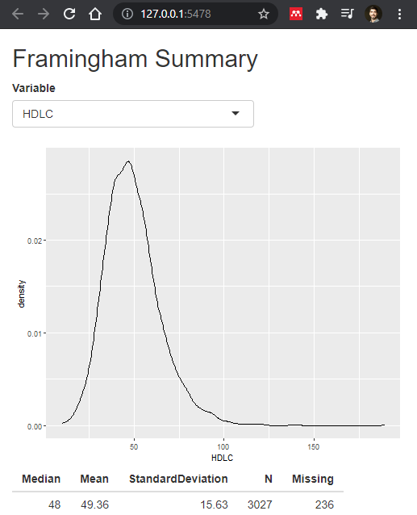
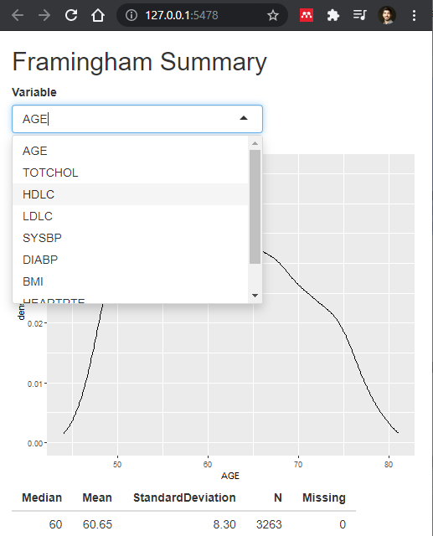
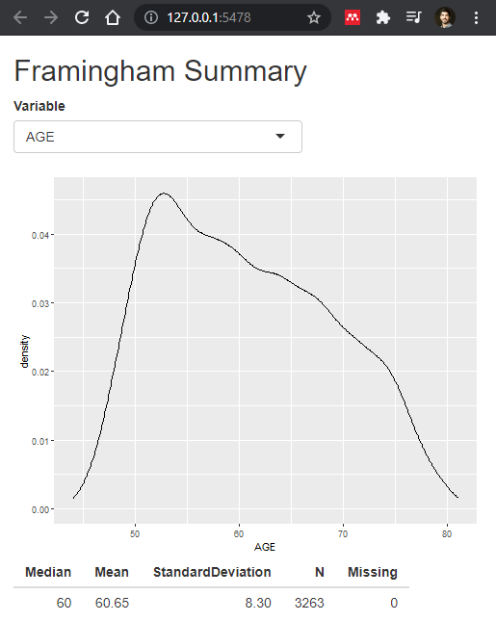
App walkthrough

Slide 6
Setting up
library(shiny)
library(ggplot2)
framingham <- read.csv("framingham.csv")
quantvars <- c("AGE", "TOTCHOL", "HDLC", "LDLC", "SYSBP", "DIABP", "BMI", "HEARTRTE", "GLUCOSE")
framingham <- framingham[, quantvars]
Data can be imported before Shiny functions
We only want to keep some variables from the “framingham” dataset

Slide 7
UI
1
ui <- fluidPage(
# Specify title of app
titlePanel("Framingham Summary"),
# *Input() functions define input type
selectInput(inputId = "var", label = "Variable",
choices = names(framingham)),
plotOutput('plot1'),
tableOutput('table1')
)
1
2
2
This input will be stored in the object input$var
3
3
4
4
See https://shiny.rstudio.com/images/shiny-cheatsheet.pdf for other *Input functions

Slide 8
Server
server <- function(input, output) {
output$plot1 <- renderPlot({
framingham_plot <- framingham[which(!is.na(framingham[, input$var])),]
ggplot(data = framingham_plot, aes(x = .data[[input$var]])) +
geom_density()
})
output$table1 <- renderTable({
data.frame(Median = median(framingham[, input$var], na.rm = TRUE),
Mean = mean(framingham[, input$var], na.rm = TRUE),
StandardDeviation = sd(framingham[, input$var], na.rm = TRUE),
N = sum(!is.na(framingham[, input$var])),
Missing = sum(is.na(framingham[, input$var])))
})
}

Slide 9

Server
server <- function(input, output) {
# render*() functions define output type
output$plot1 <- renderPlot({
framingham_plot <- framingham[which(!is.na(framingham[, input$var])),]
ggplot(data = framingham_plot, aes(x = .data[[input$var]])) +
geom_density()
})
…
}
See https://shiny.rstudio.com/images/shiny-cheatsheet.pdf for other render*() functions
From UI
aes(x = input$var)
aes(x = .data[[input$var]])

Slide 10
Server
server <- function(input, output) {
…
output$table1 <- renderTable({
data.frame(Median = median(framingham[, input$var], na.rm = TRUE),
Mean = mean(framingham[, input$var], na.rm = TRUE),
StandardDeviation = sd(framingham[, input$var], na.rm = TRUE),
N = sum(!is.na(framingham[, input$var])),
Missing = sum(is.na(framingham[, input$var])))
})
}

Slide 11
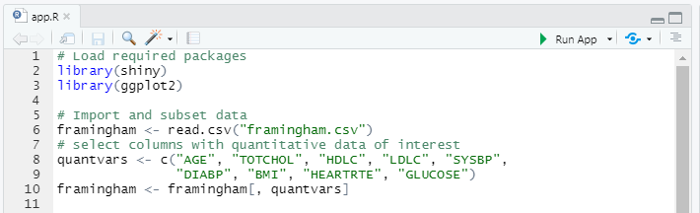
Wrapping up and running the app
# Final line of code in app.R
shinyApp(ui = ui, server = server)
Click here to run app
Adjust settings here

Slide 12
Reaching a wider audience

Slide 13
Final Notes
Useful resources for further learning:
https://shiny.rstudio.com/tutorial/
https://shiny.rstudio.com/images/shiny-cheatsheet.pdf
Practice making Shiny apps for your own analyses
Start with the template provided
Figure out which input/output functions you will need to use by looking at the Shiny cheat-sheet
Troubleshoot with the help of the shiny package help documentation (e.g. by typing “?renderPlot” into the R console after loading the package)

