Slide 1
Developing Shiny apps for decision models
Decision Modeling for Public Health
November 2020

Slide 2
Overview
Introduction to Shiny
What is it, what can it do , how can it do it, how does it conceptually work
Illustration of simple Shiny example
Basic Shiny structure, Input vs Output, tools to communicate with the user (dropdowns , TextInput, etc)
Handling and manipulating input
Embed plotting
Deploying and embedding the app
General Advice

Slide 3
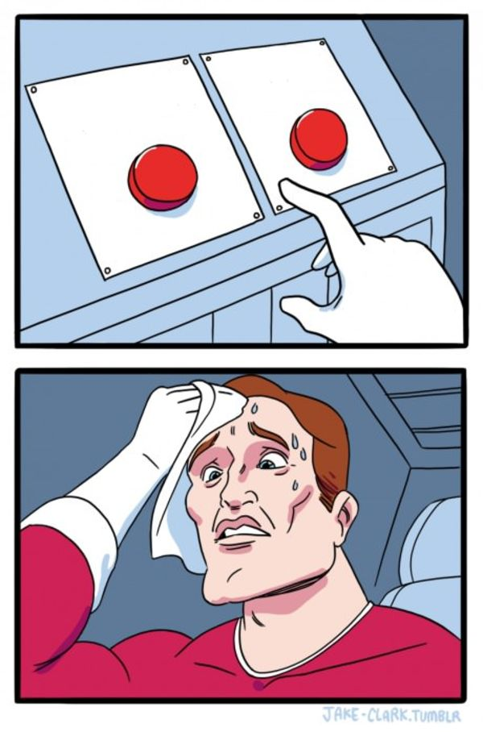
Let’s make some decisions!!

Slide 4
What is R Shiny
Tool to build simple interactive Web-based interfaces for R scripts
Developed in 2012 by Rstudio – comes with the basic Rstudio version
More info: shiny.rstudio.com
Built entirely using R code with Java on the back end
Apps can also be deployed locally as opposed to the Web

Slide 5
What can it do
Visualization
Interaction
Quick access / sensitivity analysis
Server Capacity (indirectly)
Smooth integration with HTML, JAVA, Python etc

Slide 6
How does it do it
Majority of functionality in “shiny” library
The Shiny function - shinyApp() - relies on two R scripts:
ui.R (User interface)
ui <- fluidPage()
server.R (the server or “engine” of the app)
server <- function(input, output)

Slide 7
An R note
When code is embedded in {}, R understands that this needs to be executed as a whole chunk
mu_Y <- mean(x= {
X <- 1:10
Y <- X * 2
Y
}
)

Slide 8
Useful functions
Structure & Layout
titlePanel()
sidebarLayout()
sidebarPanel()
tabPanel()
Input
numericInput()
textInput()
checkboxInput()
sliderInput()

Slide 9
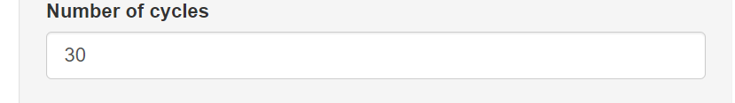
Useful functions
Structure & Layout
titlePanel()
sidebarLayout()
sidebarPanel()
tabPanel()
Input
numericInput()
textInput()
checkboxInput()
sliderInput()

Slide 10
Input Example
NumericInput(
inputId = , # what should the variable be named
label = , # what should the title of the input box say?
min = , # what is the minimum value allowed
max = , # what is the maximum value allowed
value = # what is the default value
)

Slide 11
Shiny R CheatSheet
https://github.com/rstudio/cheatsheets/raw/master/shiny.pdf

Slide 12


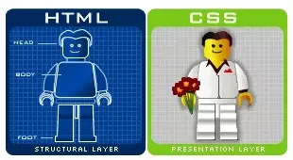
HTML and Shiny
(Strictly speaking) No need for HTML / CCS
BUT

Slide 13
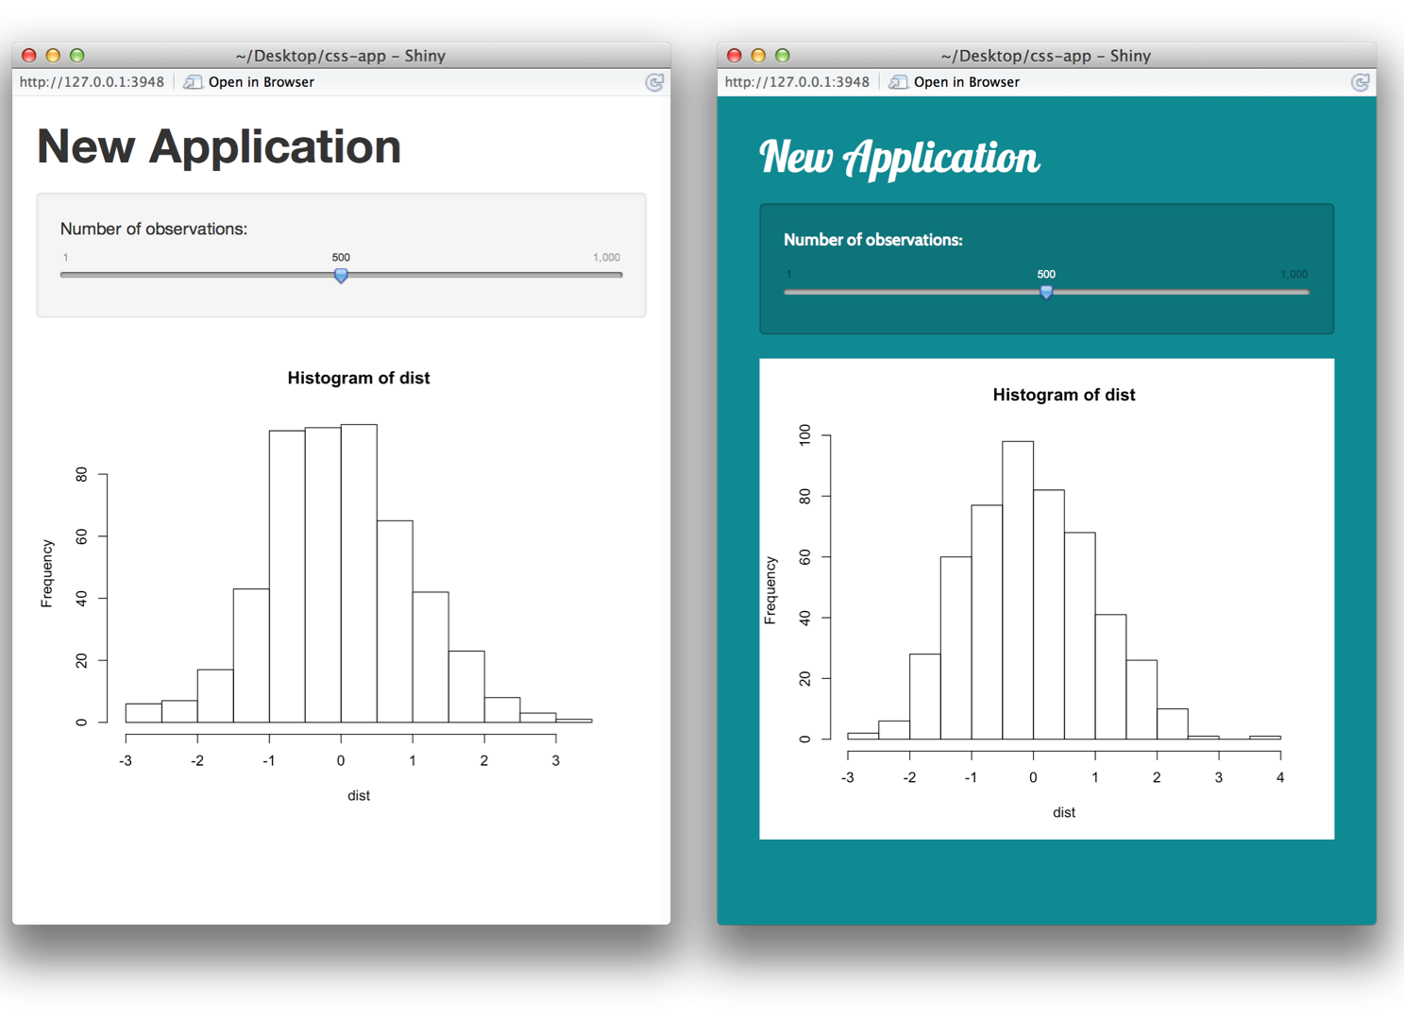
CSS and Shiny

Slide 14
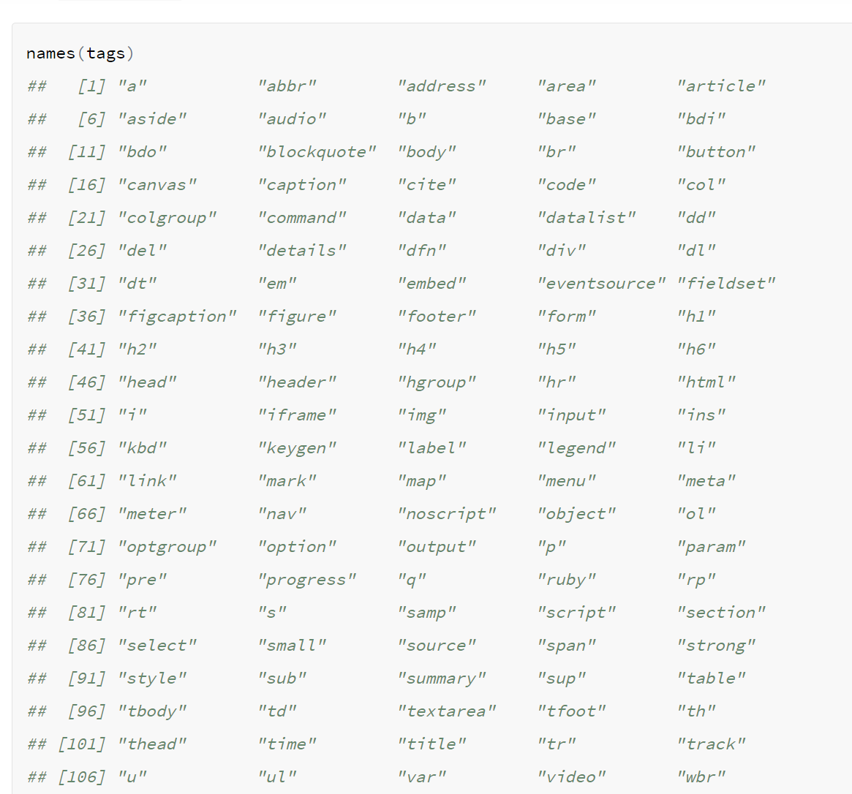
Shiny & HTML tags

Slide 15
Publishing your shiny App
https://github.com/rstudio/cheatsheets/raw/master/shiny.pdf

Slide 16
R Shiny and decision modeling
Shiny applications can help end users
Visualize the results of a DAM
Experiment with different scenarios/modify input
Understand how a DAM works through testing
Maintain privacy on DAM code while allowing access of use
Perform extensive model validation
Overall knowledge translation

Slide 17
Disadvantages
Extending the “Black box” nature of models
Although powerful, it can be time consuming to develop
Privacy processes need to be carefully designed
Challenging to use for gathering and saving data to the database.
Not a complete software (ie relying on a web server ) NOTE: RInno is changing that!

Slide 18
Examples & Resources
Tutorial on Shiny and decision modeling
DARTHpack : Need for change
https://pubmed.ncbi.nlm.nih.gov/31549359/
R. Smith tutorial in Decision modeling and Shiny
https://pubmed.ncbi.nlm.nih.gov/32904933/
R.Hart tutorial in CEA and Shiny
https://pubmed.ncbi.nlm.nih.gov/32236891/
https://bresmed-intrface-hypothetical-car-t-model.shinyapps.io/IntRface_Model-PharmacoEconomics/

