Slide 1
R Shiny Introduction
Decision Modeling for Public Health
April 2022
Notes:
.

Slide 2
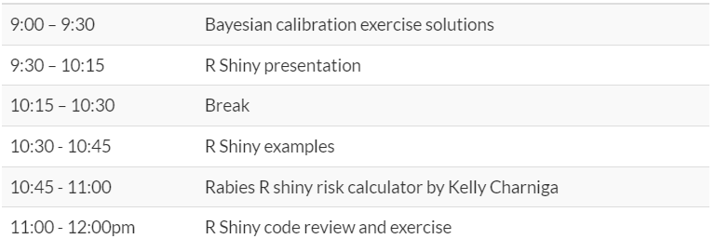
Agenda
Slack support available 9:00am - 4:00pm Eastern Time

Slide 3
Overview
Introduction to Shiny
What is it and why should you use it?
How to make a Shiny app
Start from a template
Walkthrough the creation of a relatively simple example

Slide 4
What is R Shiny?
Tool to build simple interactive web-based interfaces for R scripts
Developed in 2012 by RStudio
Built entirely using R code with Java on the back end
Apps can also be deployed locally OR on the web
More info: shiny.rstudio.com

Slide 5
What is R Shiny?
Standalone R script
Typically executed only once
Inputs are fixed by the programmer
Interaction requires knowledge of R
Shiny app
Server runs R code continuously, updating outputs in response to changes in inputs
Inputs are interactive
Interaction does not require knowledge of R

Slide 6
Why should modelers use Shiny?
Strengths of decision-analytic modeling:
Encourages “what if” analyses
Explicit assumptions are translated into policy recommendations
Weaknesses of decision-analytic modeling:
Data to inform input parameter values may be lacking or of poor quality
The “black box” lacks transparency, which threatens trust
Shiny enables decision-makers to quickly assess how results change in response to different explicit assumptions
Users can play with the inputs and gain intuition about how the “black box” works. This interactivity can make the model feel more transparent and trustworthy

Slide 7
Probability
of disease
Health-related
quality of life
Efficacy of treatment
Risks of treatment
Decision
model
Risk of future events
Adherence
Costs
Test characteristics
Health & economic
outcomes for
alternative strategies
Policy
Implications

Slide 8
Getting started with a template
# Load required packages
library(shiny)
# Sets up appearance of app and fields user input
ui <- fluidPage( )
# Takes the inputs and creates the outputs
server <- function(input, output) { }
# Creates the final Shiny app object
shinyApp(ui = ui, server = server)
install.packages(“shiny”) first, if necessary
Instructions go here
Instructions go here

Slide 9
An R note
When code is embedded in {}, R understands that this needs to be executed as a whole chunk
mu_Y <- mean(x= {
X <- 1:10
Y <- X * 2
Y
}
)
server <- function(input, output) { }

Slide 10
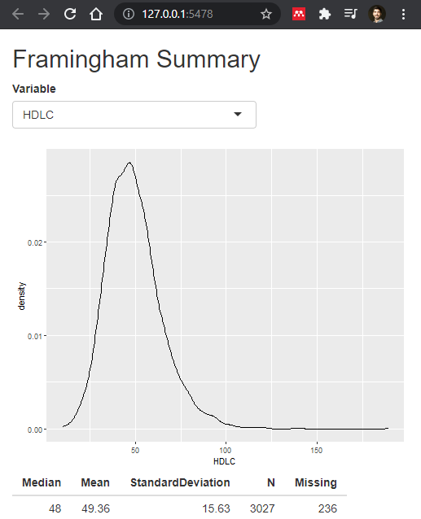
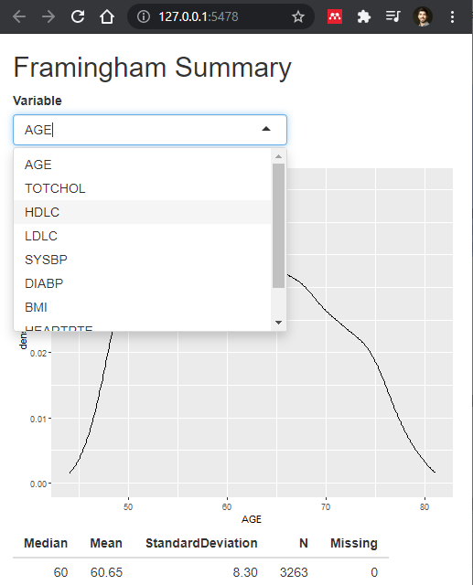
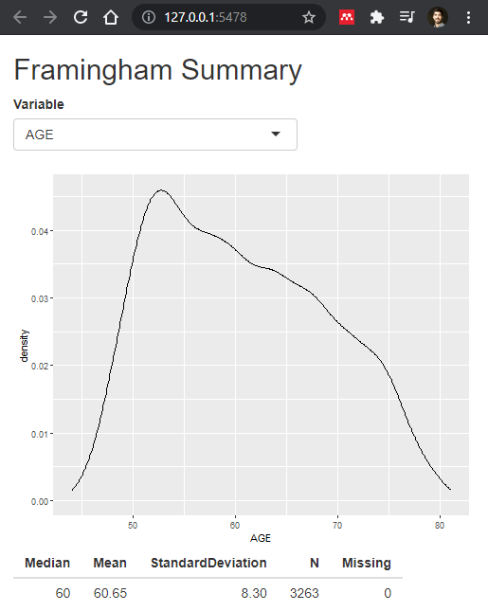
App walkthrough

Slide 11
Setup
library(shiny)
library(ggplot2)
framingham <- read.csv("framingham.csv")
quantvars <- c("AGE", "TOTCHOL", "HDLC", "LDLC", "SYSBP", "DIABP", "BMI", "HEARTRTE", "GLUCOSE")
framingham <- framingham[, quantvars]
Data can be imported before Shiny functions
We only want to keep some variables from the “framingham” dataset

Slide 12
UI
1
ui <- fluidPage(
# Specify title of app
titlePanel("Framingham Summary"),
# *Input() functions define input type
selectInput(inputId = "var", label = "Variable",
choices = names(framingham)),
plotOutput('plot1'),
tableOutput('table1')
)
1
2
2
This input will be stored in the object input$var
3
3
4
4
See https://shiny.rstudio.com/images/shiny-cheatsheet.pdf for other *Input functions

Slide 13
Server
server <- function(input, output) {
output$plot1 <- renderPlot({
framingham_plot <- framingham[which(!is.na(framingham[, input$var])),]
ggplot(data = framingham_plot, aes(x = .data[[input$var]])) +
geom_density()
})
output$table1 <- renderTable({
data.frame(Median = median(framingham[, input$var], na.rm = TRUE),
Mean = mean(framingham[, input$var], na.rm = TRUE),
StandardDeviation = sd(framingham[, input$var], na.rm = TRUE),
N = sum(!is.na(framingham[, input$var])),
Missing = sum(is.na(framingham[, input$var])))
})
}

Slide 14

Server
server <- function(input, output) {
# render*() functions define output type
output$plot1 <- renderPlot({
framingham_plot <- framingham[which(!is.na(framingham[, input$var])),]
ggplot(data = framingham_plot, aes(x = .data[[input$var]])) +
geom_density()
})
…
}
See https://shiny.rstudio.com/images/shiny-cheatsheet.pdf for other render*() functions
From UI
aes(x = input$var)
aes(x = .data[[input$var]])

Slide 15
Server
server <- function(input, output) {
…
output$table1 <- renderTable({
data.frame(Median = median(framingham[, input$var], na.rm = TRUE),
Mean = mean(framingham[, input$var], na.rm = TRUE),
StandardDeviation = sd(framingham[, input$var], na.rm = TRUE),
N = sum(!is.na(framingham[, input$var])),
Missing = sum(is.na(framingham[, input$var])))
})
}

Slide 16
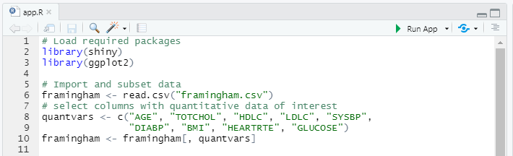
Wrapping up and running the app
# Final line of code in app.R
shinyApp(ui = ui, server = server)
Click here to run app
Adjust settings here

Slide 17
Reaching a wider audience

Slide 18
Making your own app
Useful resources for further learning:
https://shiny.rstudio.com/tutorial/
https://shiny.rstudio.com/images/shiny-cheatsheet.pdf
Practice making Shiny apps for your own analyses
Start with the template provided
Figure out which input/output functions you will need to use by looking at the Shiny cheat-sheet
Troubleshoot with the help of the shiny package help documentation (e.g. by typing “?renderPlot” into the R console after loading the package)

Slide 19
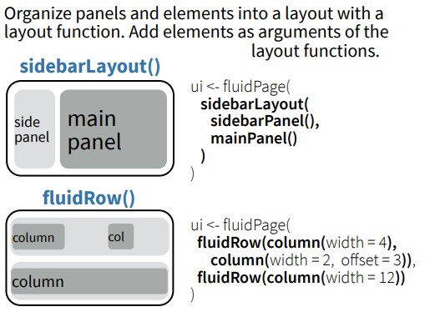
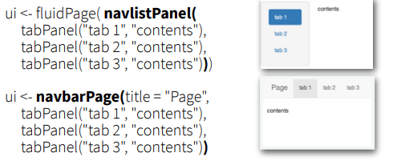
More UI functions

Slide 20
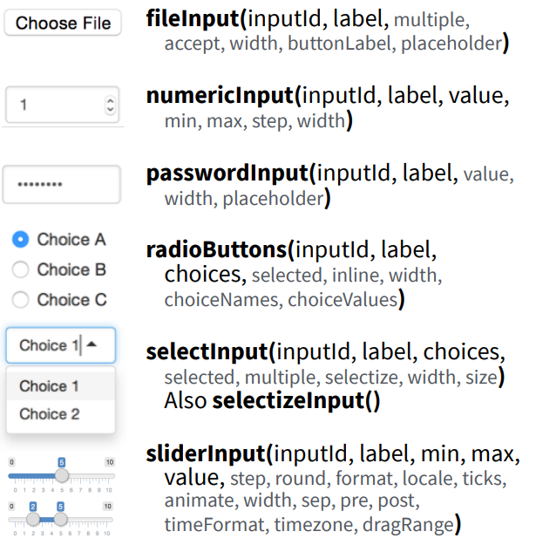
More UI functions

Slide 21
Input Example
NumericInput(
inputId = , # what should the variable be named
label = , # what should the title of the input box say?
min = , # what is the minimum value allowed
max = , # what is the maximum value allowed
value = # what is the default value
)

Slide 22
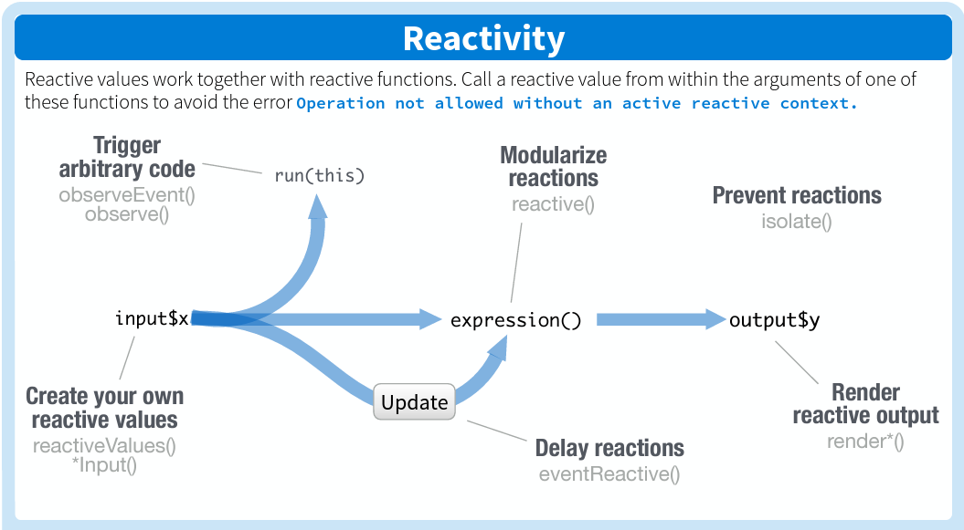
Advanced Reactivity

Slide 23
Additional Tips
What if your model takes a long time to run?
It might be impossible for server to quickly update results
Interactivity of the app would suffer!
Possible solutions:
Host app on a faster server? (likely not worth it)
Run model/app ahead of time for all combinations of inputs that could be provided to the ui() function and cache the results.
Instruct the server to load the preemptively calculated results rather than calculate them on-the-fly, conditional on what the end user requests
Easiest to accomplish if you limit input options slightly

Slide 24
Examples & Resources
Tutorial on Shiny and decision modeling
DARTHpack : Need for change
https://pubmed.ncbi.nlm.nih.gov/31549359/
R. Smith tutorial in Decision modeling and Shiny
https://pubmed.ncbi.nlm.nih.gov/32904933/
R.Hart tutorial in CEA and Shiny
https://pubmed.ncbi.nlm.nih.gov/32236891/

