Slide 1
R Shiny Tutorial
Decision Modeling for Public Health
November 2021

Slide 2
Overview
Introduction to Shiny
What is it and why should you use it?
How to make a Shiny app
Start from a template
Walkthrough the creation of a relatively simple example

Slide 3
What is R Shiny
Tool to build simple interactive Web-based interfaces for R scripts
Developed in 2012 by Rstudio – comes with the basic Rstudio version
More info: shiny.rstudio.com
Built entirely using R code with Java on the back end
Apps can also be deployed locally as opposed to the Web

Slide 4
R script vs Shiny
Standalone R script
Typically executed only once
Inputs are fixed by the programmer
Interaction requires knowledge of R
Shiny app
Server runs R code continuously, updating outputs in response to changes in inputs
Inputs are interactive
Interaction does not require knowledge of R

Slide 5
Getting started with a template
# Load required packages
library(shiny)
# Sets up appearance of app and fields user input
ui <- fluidPage( )
# Takes the inputs and creates the outputs
server <- function(input, output) { }
# Creates the final Shiny app object
shinyApp(ui = ui, server = server)
install.packages(“shiny”) first, if necessary
Instructions go here
Instructions go here

Slide 6
An R note
When code is embedded in {}, R understands that this needs to be executed as a whole chunk
mu_Y <- mean(x= {
X <- 1:10
Y <- X * 2
Y
}
)

Slide 7
Useful functions
Structure & Layout
titlePanel()
sidebarLayout()
sidebarPanel()
tabPanel()
Input
numericInput()
textInput()
checkboxInput()
sliderInput()

Slide 8
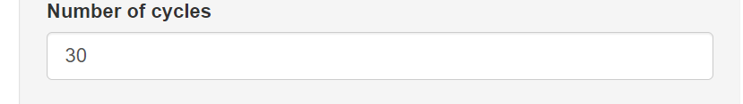
Useful functions
Structure & Layout
titlePanel()
sidebarLayout()
sidebarPanel()
tabPanel()
Input
numericInput()
textInput()
checkboxInput()
sliderInput()

Slide 9
Input Example
NumericInput(
inputId = , # what should the variable be named
label = , # what should the title of the input box say?
min = , # what is the minimum value allowed
max = , # what is the maximum value allowed
value = # what is the default value
)

Slide 10
Shiny R CheatSheet
https://github.com/rstudio/cheatsheets/raw/master/shiny.pdf

Slide 11


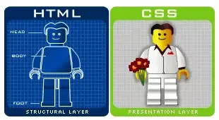
CSS and Shiny
(Strictly speaking) no need for HTML / CCS
BUT

Slide 12
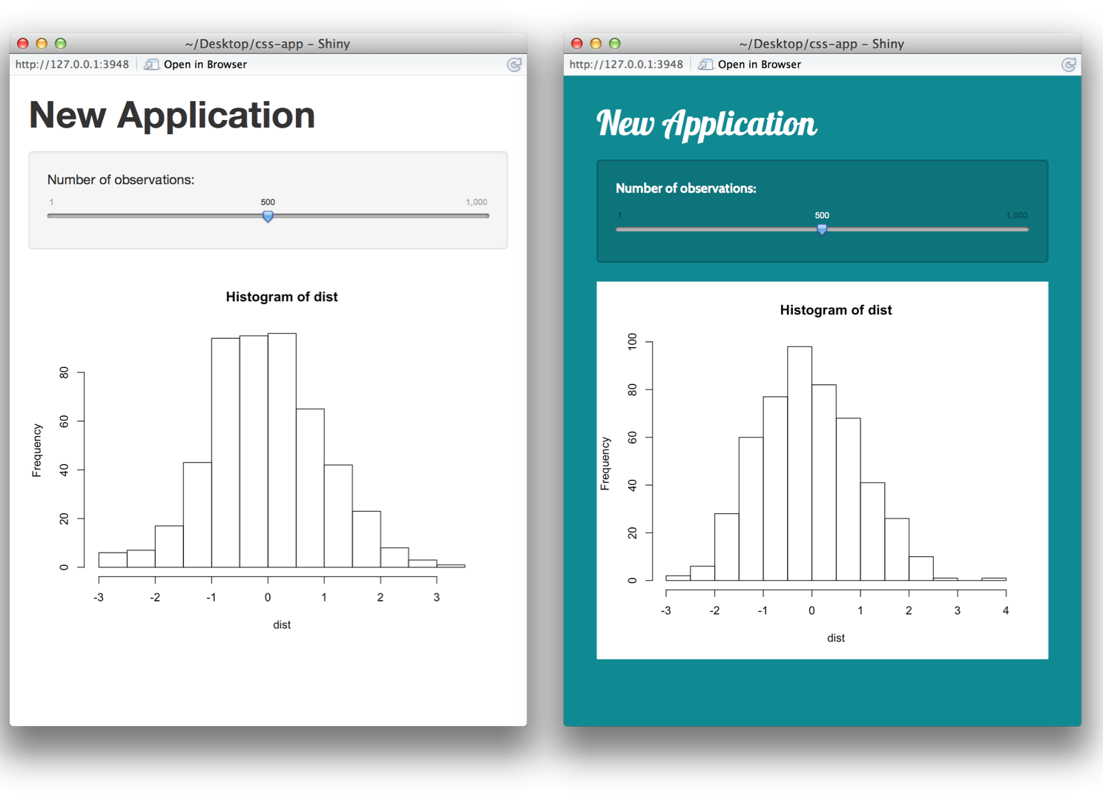
CSS and Shiny

Slide 13
Reaching a wider audience

Slide 14
Final Notes
Useful resources for further learning:
https://shiny.rstudio.com/tutorial/
https://shiny.rstudio.com/images/shiny-cheatsheet.pdf
Practice making Shiny apps for your own analyses
Start with the template provided
Figure out which input/output functions you will need to use by looking at the Shiny cheat-sheet
Troubleshoot with the help of the shiny package help documentation (e.g. by typing “?renderPlot” into the R console after loading the package)

