Slide 1

Getting Ready
Intro to R

Slide 2
Outline
Introduction to R and RStudio
Introduction to markdown documents
Using worksheet 01_getting_ready.Rmd

Slide 3
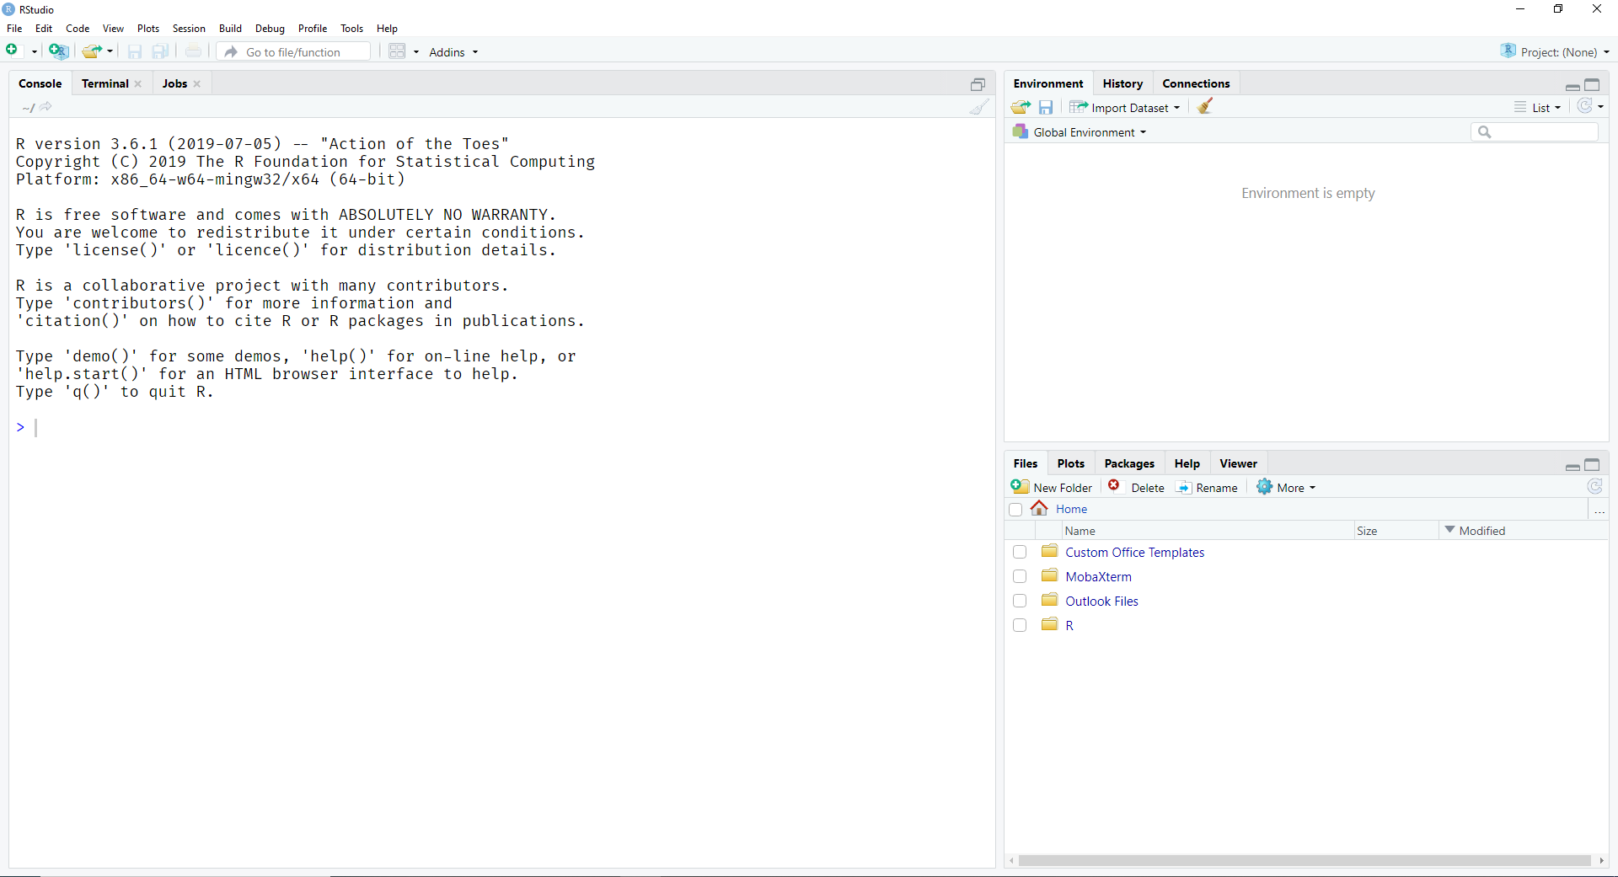
RStudio – First Open
Environment
&
History
Console
Files
Plots
Packages
Help

Slide 4
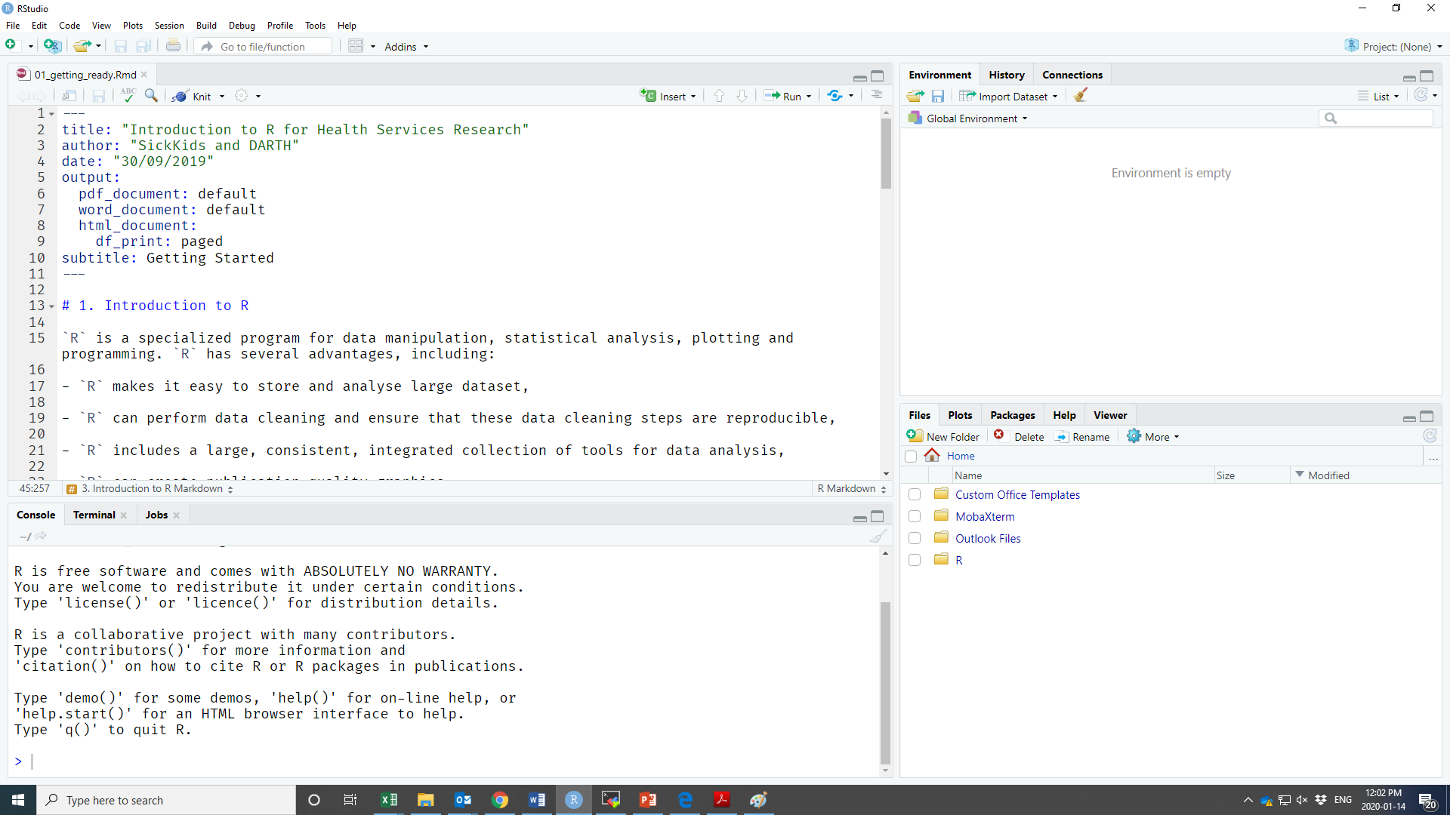
RStudio – Opening a Markdown file
Environment
&
History
Files
Plots
Packages
Help
Console

Slide 5
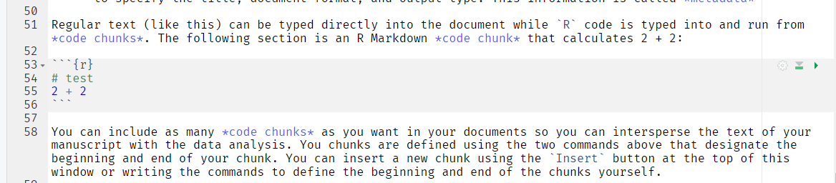
Running R chunks
Run all the code in the chunk using the green arrow, or ctrl+shift+enter.
Run a single line of code using Ctrl + Enter
Notes:
Highlight that R chunks start using ```{r} and end with ```

