Slide 1
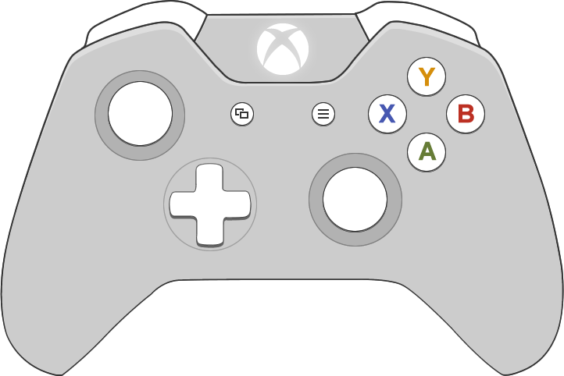
LT: Yaw Left
RT: Yaw Right
LB: Up
Pilot
RB: Down
Max Throttle
Move X, Y
Kill Throttle
Click: undefined
Zero Out Motors
undefined
Up/Down: Throttle
Left/Right: undefined
Up/Down: Pitch
Left/Right: Roll
Click: undefined

Slide 2
LT: Claw Open
RT: Claw Close
LB: undefined
Captain
RB: undefined
undefined
Move Camera
undefined
Click: Reset Camera
undefined
undefined
Up/Down: Throttle
Left/Right: undefined
Up/Down: undefined
Left/Right: undefined
Click: undefined

