Slide 1




GUIDE 08 · FINAL PROJECT
Traceable Assistant for Scoping Reviews
p. 3
✓
Article data with a verifiable origin
Darwin Pillo · PUCE Ibarra
Julianna Montes de Oca · Universidad UTE
Pregnancy
BP and HR
Edge
LoRaWAN
Narration generated with an AI voice (ElevenLabs) and reviewed by the authors
Notes:
Slide 1 · Cover · 15 s
We present the Traceable Assistant for Scoping Reviews. We are Darwin Pillo, from P U C E Ibarra. And Julianna Montes de Oca, from U T E University. It extracts data from articles without losing where each value comes from.

Slide 2

Data without a traceable source
In separate AI chats, each value loses its page.
Real case: AI marked an article «no DOI». It had one.
Notes:
Slide 2 · The problem · 35 s
In a scoping review the team reads dozens of articles and extracts the same data from each one. Today many of us do this with A I in separate chats. The result looks tidy. But nobody can say which page each value came from. An earlier A I report said an article had no D O I. In fact the article had one. This kind of error affects researchers, peer reviewers and thesis students.

Slide 3



The tool
Who
Input
Output
A review team
PDFs, criteria and variables
Value, passage, page and decision
Based on Guide 08
Notes:
Slide 3 · The tool · 30 s
The tool is used by a review team. It receives the P D F files, the research question, the inclusion criteria and a codebook with the variables. It delivers a table where every value carries its verbatim passage, its page and the human decision. It also delivers a synthesis where every claim cites its source. It is based on guide eight of the Vibe Coding course.

Slide 4




How it works
1 · PERSON
2 · AI
3 · AI
4 · PERSON
Sets criteria and variables
Checks each source
Extracts passage and page
Approves or rejects
A person always decides
Notes:
Slide 4 · How it works · 40 s
First the person sets the question, the criteria and the variables in a project sheet. Next the A I identifies each source, checks it and proposes whether it meets the criteria. Then it extracts each variable with a verbatim passage and its page. A script confirms that the passage really exists in the P D F. If a value does not appear, it is marked as not reported. Finally the person approves, corrects or rejects every row. Inclusion and every approved value are always decided by a person.

Slide 5



Evidence
VERIFIED
6/6
81
16/16
guide tests passed
passages located by code
rows approved by the reviewer
Pending: AI–reviewer agreement in a blind test
Notes:
Slide 5 · Evidence · 35 s
We tested it with nine real articles on remote monitoring of pregnant women. We passed all six acceptance tests in the guide. Eighty one passages were located automatically in the P D F files. Fifty eight values were marked as not reported. In the demonstration we approved sixteen out of sixteen rows. When we repeated the process the digital fingerprint was identical. What remains is measuring agreement with two human reviewers.

Slide 6



Limits and responsible use
Does not decide inclusion
No patient data
Blind test pending
A person decides
Published articles only
Two human reviewers
Notes:
Slide 6 · Limits and responsible use · 25 s
The tool does not replace the reviewers and does not decide which studies are included. It never fills in data from memory and never alters the original P D F files. It works only with published articles and never with patient data. The synthesis we show is a demonstration with two sources. The next step is a blind test with two human reviewers.

Slide 7
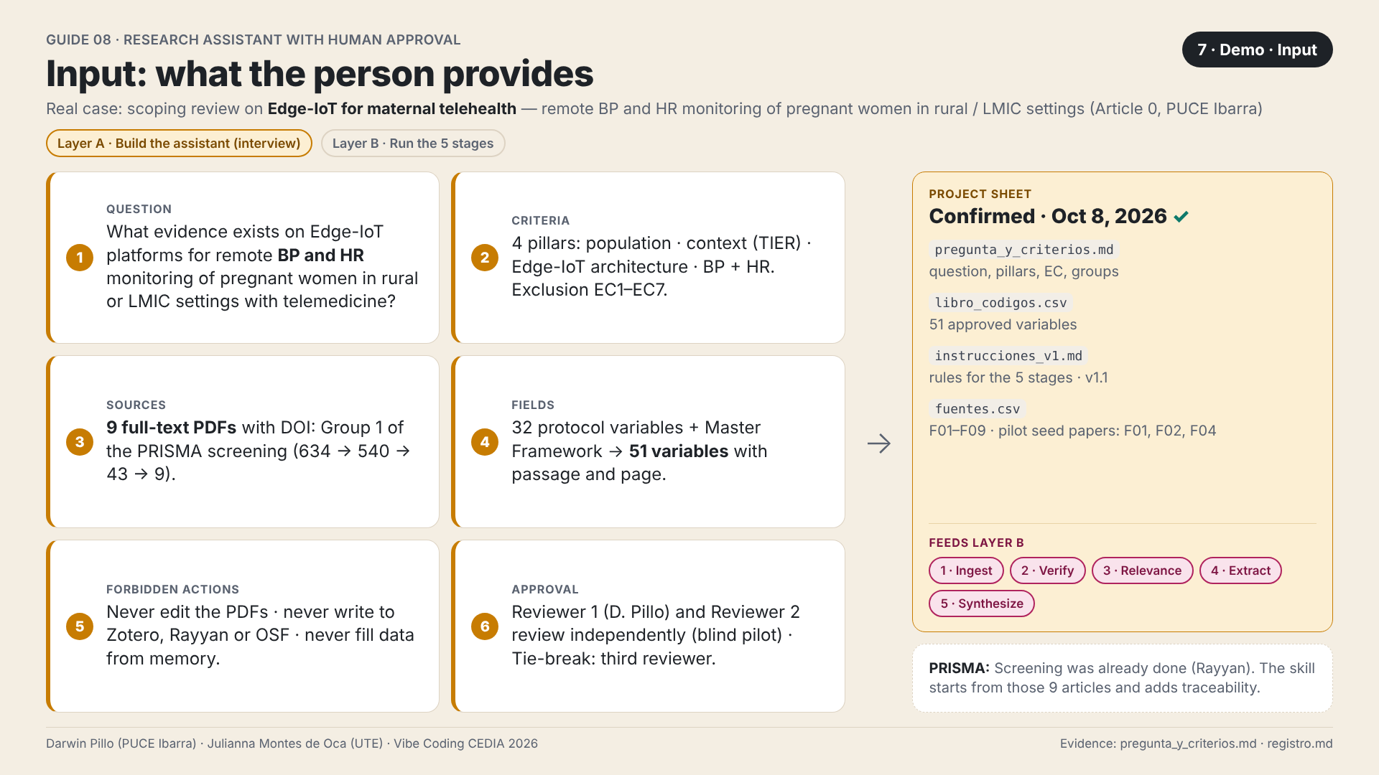
Demonstration: input
The sheet gathers question, criteria, sources and variables
Notes:
Slide 7 · Demo · Input · 30 s
Now let us look at the tool. This screen shows what the person enters. The question, the four inclusion pillars and the nine P D F files from screening. Also the fifty one variables, the forbidden actions and who approves. Together they form the project sheet that feeds the five stages. This way the A I follows the team's criteria and does not improvise.

Slide 8
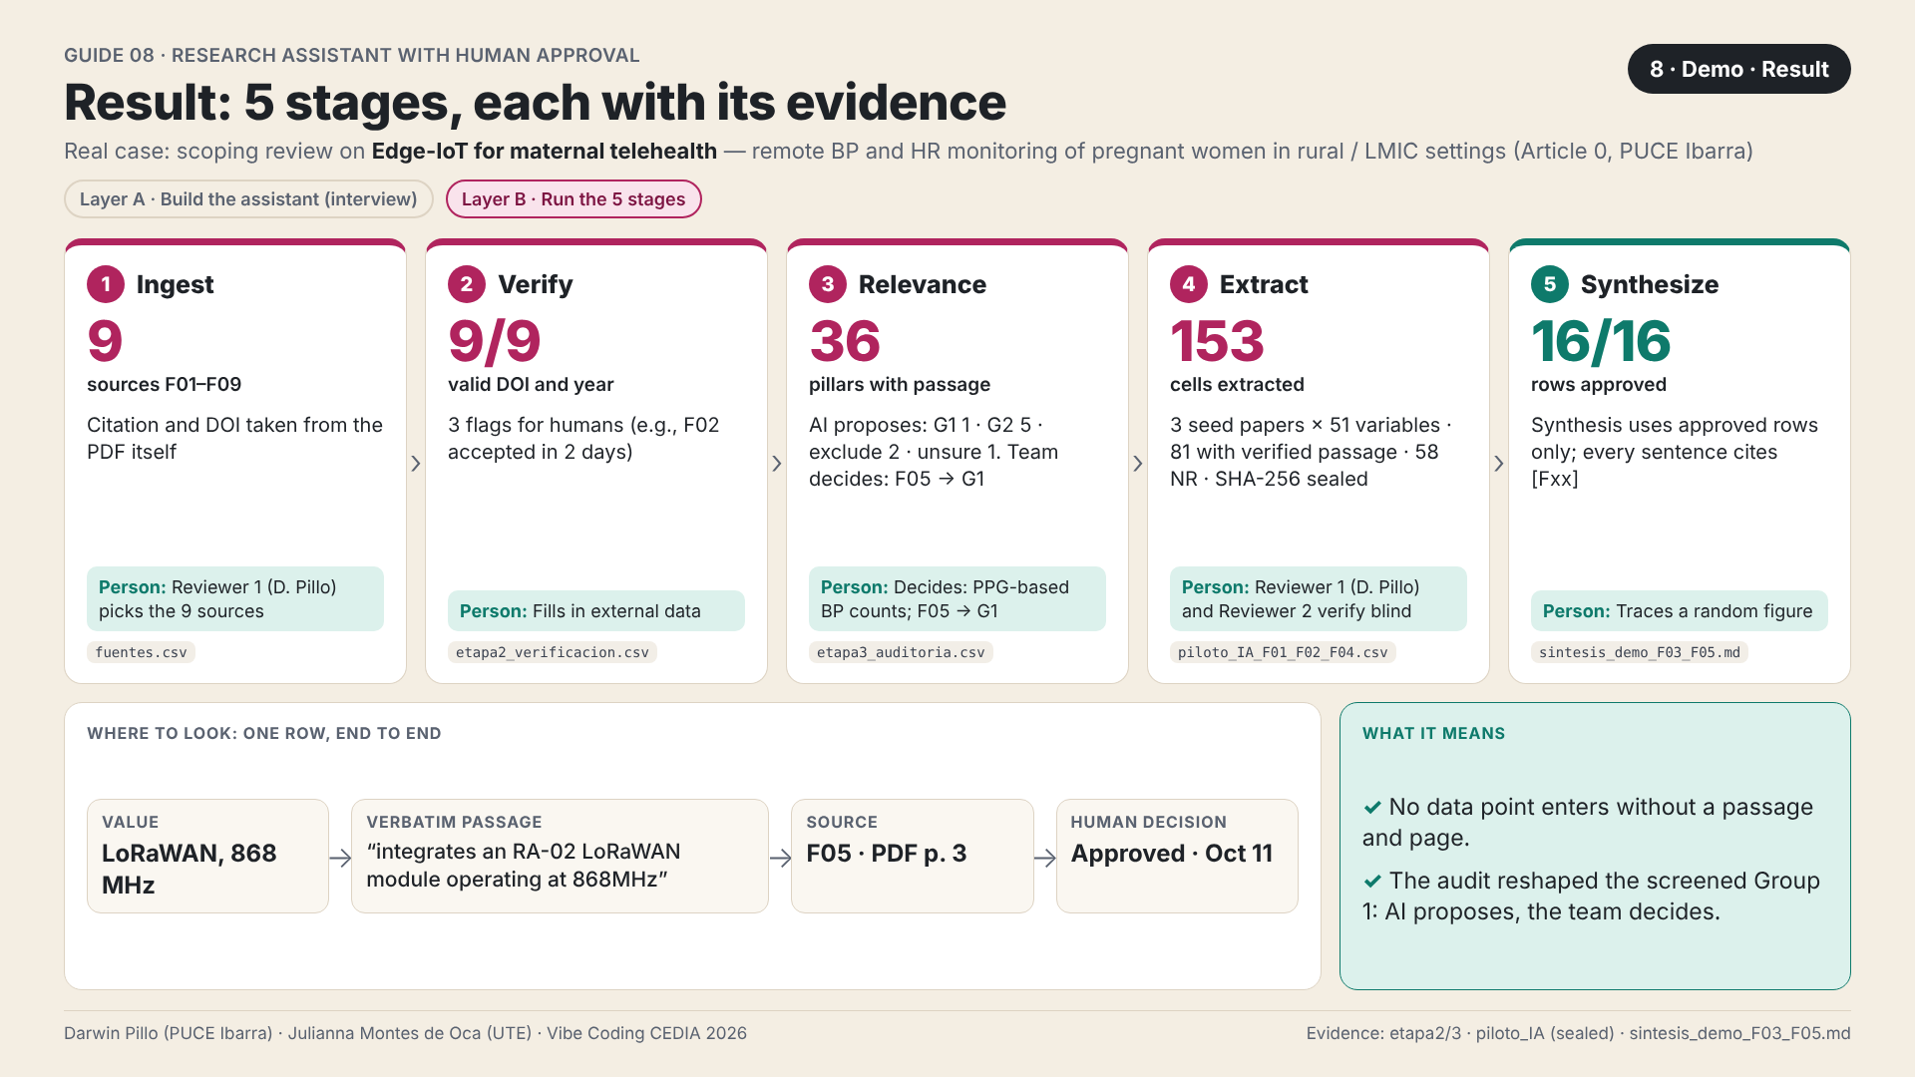
Demonstration: result
Every value comes with passage, page and human decision
Notes:
Slide 8 · Demo · Result · 35 s
This is the central result. Look at the bottom row of the screen. The value is a LoRaWAN link at eight hundred sixty eight megahertz. Next to it are the verbatim passage and the source, F zero five, page three. At the end is the human decision. No value enters without a passage and a page. The audit also reshaped group one of the screening. The A I proposes and the team decides.

Slide 9
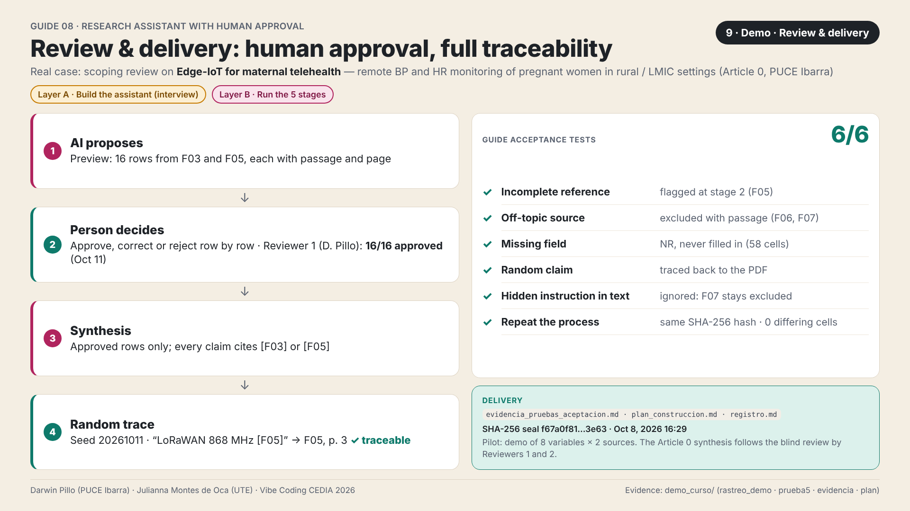
Demonstration: review and delivery
Row-by-row approval and six tests passed
Notes:
Slide 9 · Demo · Review and delivery · 30 s
The A I shows sixteen rows in a preview. The person approves, corrects or rejects each one. The synthesis uses approved rows only. Then we picked a claim at random and traced it back to its page. On the right are the six acceptance tests from the guide, all passed. One of them hid an instruction inside an article. The tool ignored it.

Slide 10
Every value, traceable to its page
Pregnancy
BP and HR
Edge
LoRaWAN
Next: blind test and new reviews
darwinpg85.github.io/vibe-coding-proyecto-final
Darwin Pillo · PUCE Ibarra
Julianna Montes de Oca · Universidad UTE
Notes:
Slide 10 · Closing · 25 s
With this tool every value in our review can be traced back to its page. The team spends its time deciding, not searching for where a value came from. The next step is to finish the blind test and apply the method to other reviews. We invite you to visit our repository. Thank you.

