Slide 1
DASISH Web Annotation Framework
DWAN Annotator
front- and backend

Slide 2
Task 5.6: motivation for DWAN
Researchers need to be able to store the results of intellectual work
either as an annotation of a single fragment
or in the form of typed relations between a number of fragments. (Description of Work, 2011-08-15)

Slide 3
Framework for collaborative annotation
Different types of annotations will be covered ranging from simple free-text notes to specialized linguistic markups
What is annotated: documents available via the internet.
Architecture: one DB&server - multiple clients (different use cases)
Distinguishing feature: storing annotated copies of documents

Slide 4
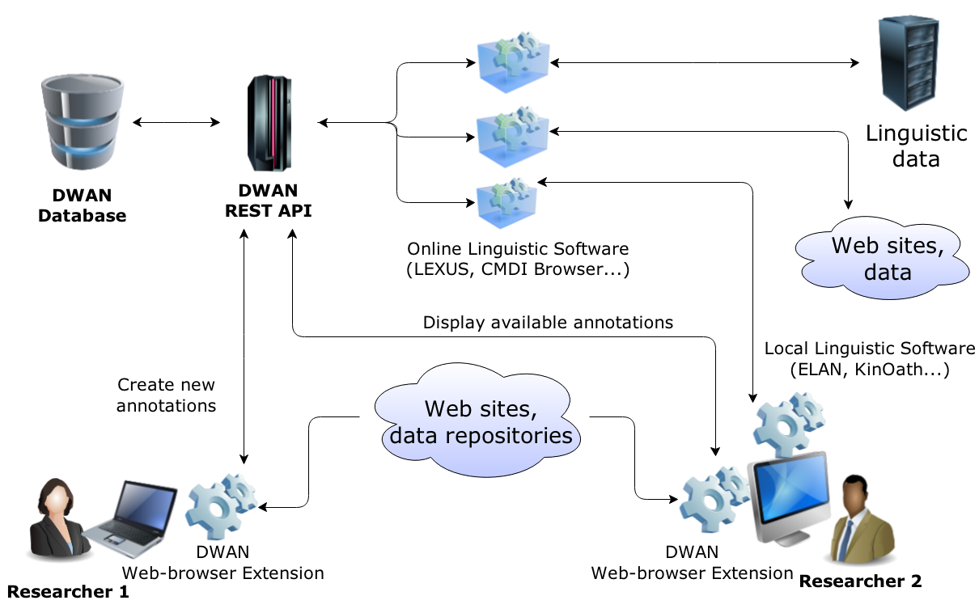
Framework for collaborative annotation

Slide 5
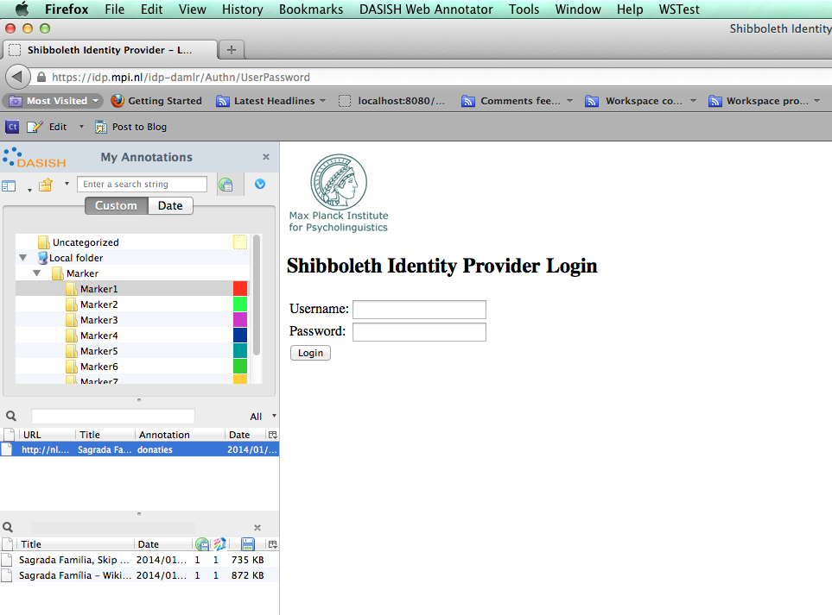
Authentication via Shibboleth

Slide 6
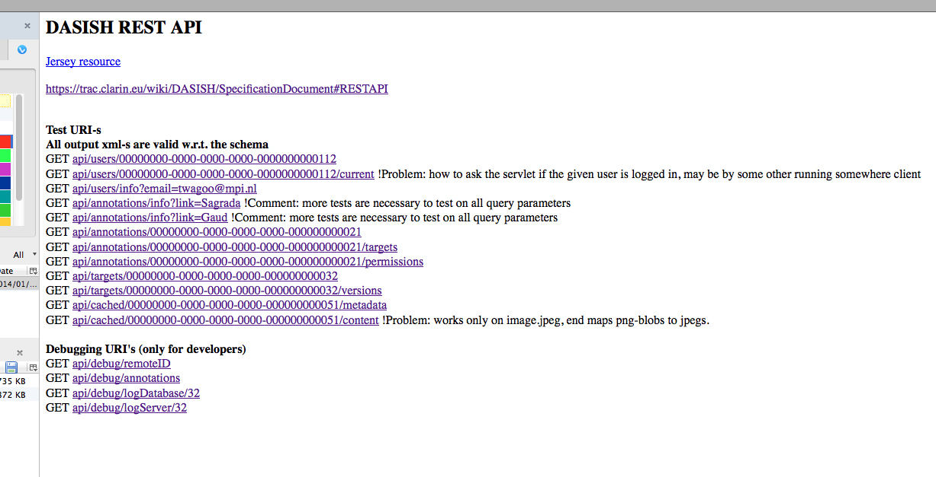
Backend API testing examples: GET

Slide 7
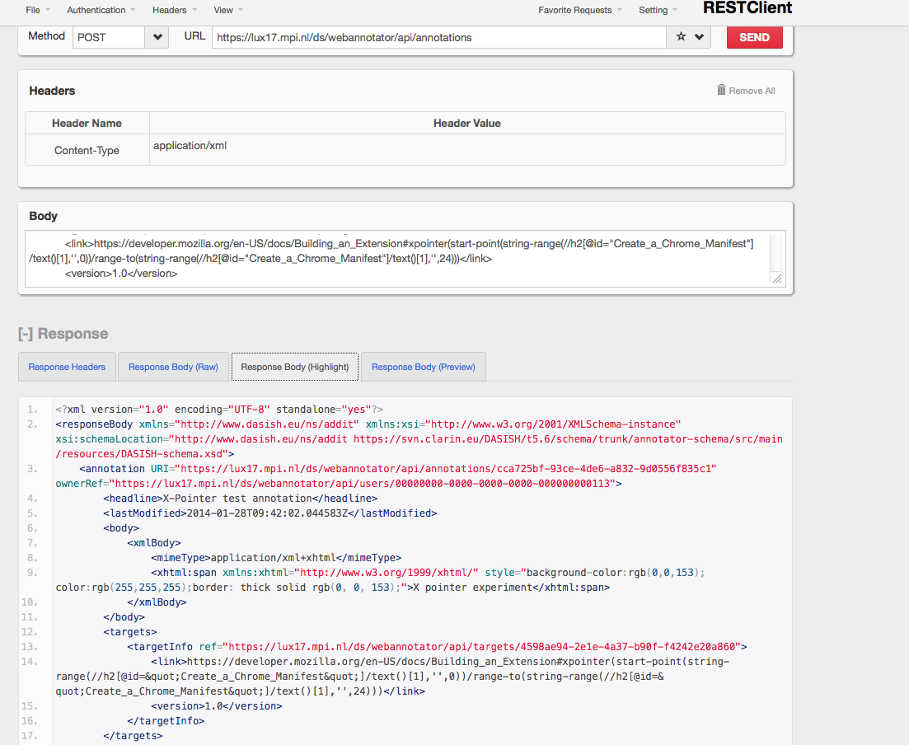
Backend API testing via Firefox RESTClient : POST

Slide 8
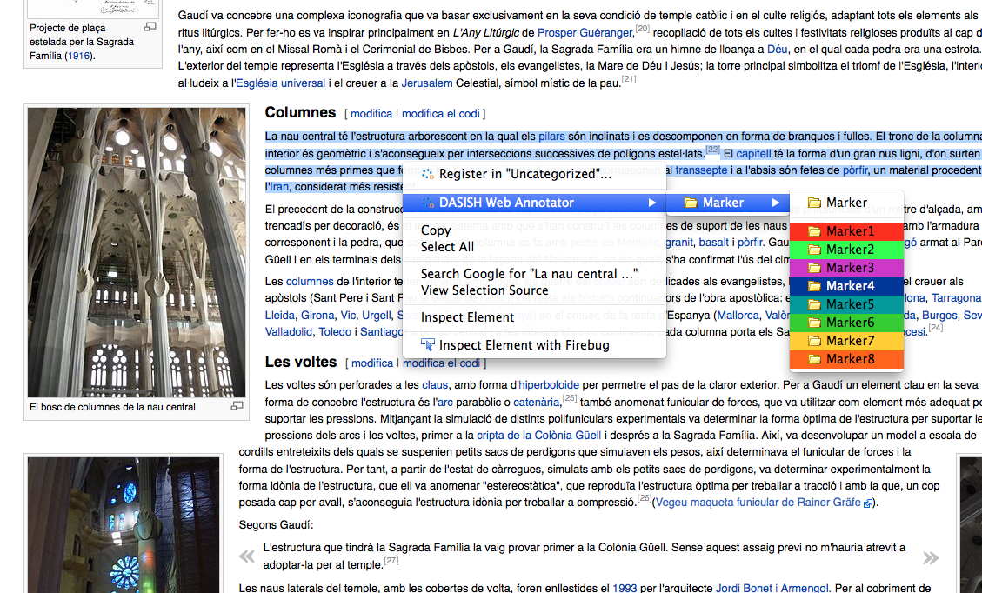
Frontend. Creating an annotation-1: selection

Slide 9
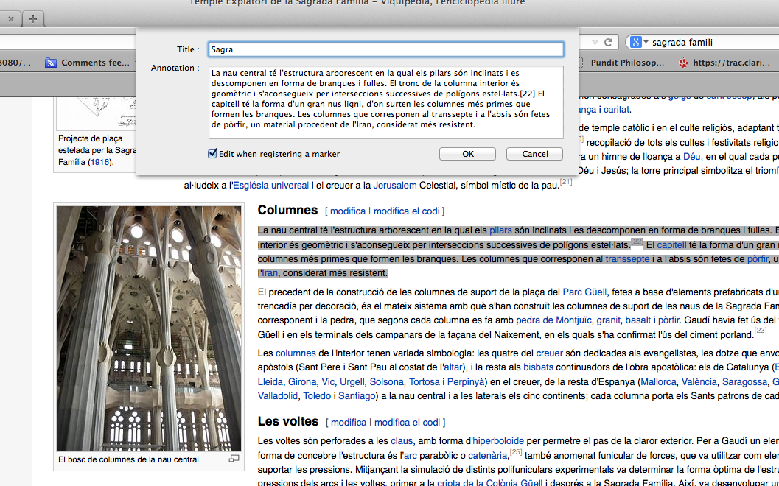
Frontend. Creating an annotation-2: editing

Slide 10
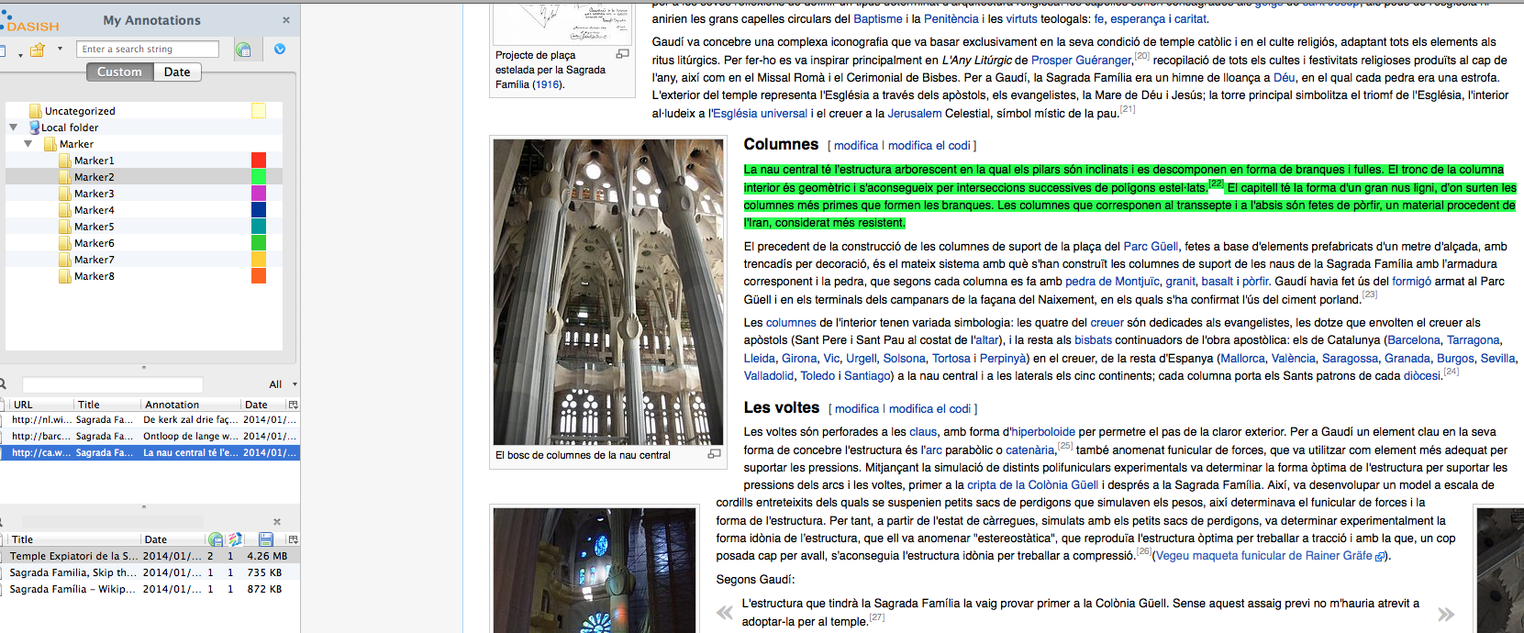
Frontend. Creating an annotation-3: posting

Slide 11
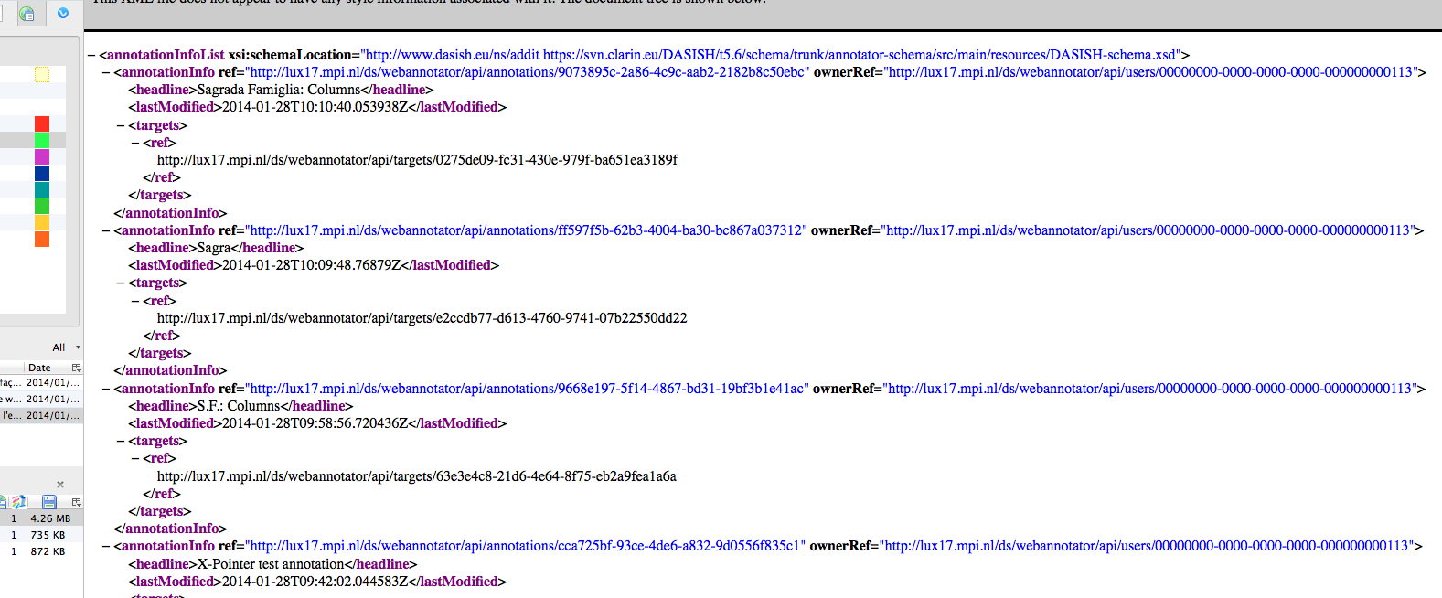
Creating an annotation-4. Technical check on the backend side

