Slide 1
DASISH Web Annotation Framework
DWAN Annotator
front- and backend

Slide 2
Task 5.6: motivation for DWAN
Researchers need to be able to store the results of intellectual work
either as an annotation of a single fragment
or in the form of typed relations between a number of fragments. (Description of Work, 2011-08-15)

Slide 3
Task 5.6: R&D plan
Specify the requirements for an annotation web-service
Analyze and compare existing annotation frameworks
Provide and test an annotation framework that covers essential functionality
Document and disseminate information

Slide 4
Framework for collaborative annotation
Different types of annotations will be covered ranging from simple free-text notes to specialized linguistic markups
What is annotated: documents available via the internet.
Architecture: one DB&server - multiple clients (different use cases)
Distinguishing feature: storing annotated copies of documents

Slide 5
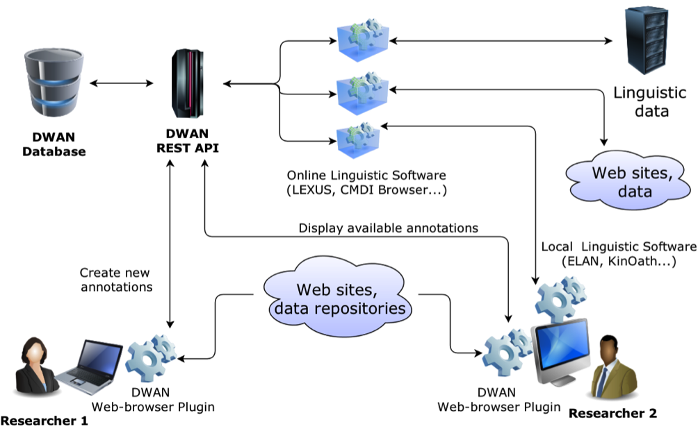
Framework for collaborative annotation

Slide 6
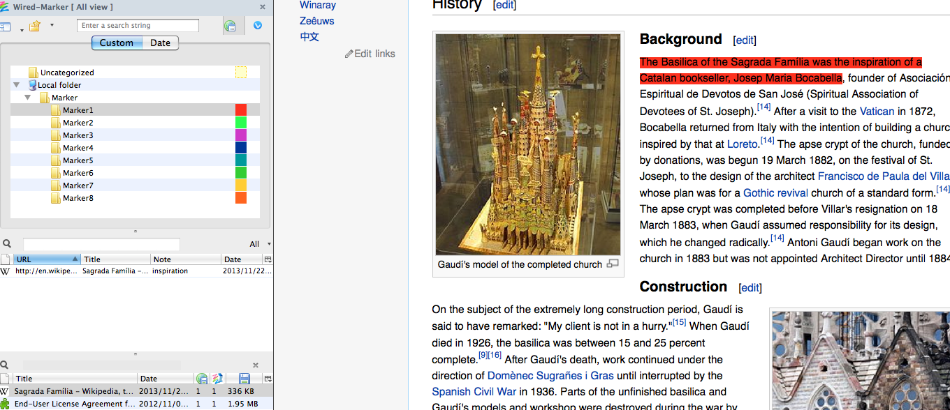
Example client: “Wired-Marker” based Firefox extension

Slide 7
DASISH Wired-Marker adjustments
Folder-structured chrome.manifest file for live proxy development
Standard Wired-Marker behavior during installation has been adjusted
database is created
GUI adjustments for front website view, about view
POST requests, GET (mock)

Slide 8
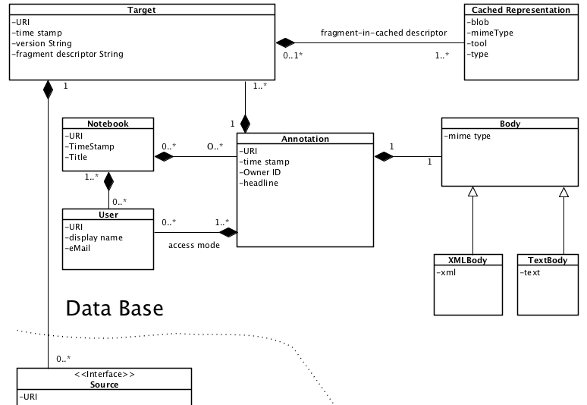
Server side in more detail: data model

Slide 9
Server side in more detail: Database
Hierarchy of main resources: users → annotations→ targets →
cached representations
Junction tables represent the connections between main resources

Slide 10
Server side (“backend”) in more detail: REST interface
GET api/users/<uid>
GET api/annotations?link=<URI>
POST api/annotations
PUT api/annotations/<aid>
DELETE api/annotations/<aid>
POST api/targets/<tid>/cached/<fragment>
GET api/cached/<cid>/content
GET api/cached/<cid>/metadata

Slide 11
Demo
create an annotation (DWAN)
retrieve an annotation by its ID (DWAN)
upload a cached representation (terminal)
retrieve a cached representation (JSP–page)

Slide 12
Related work: Pundit
http://www.thepund.it/ allows to
Create linked data
share and reuse them
Pundit Features
Web-browser independent
no need to install as a plugin/an extension
Bookmarklet provides easier configuration
EU project within 7th framework program

Slide 13
Pundit license
1.1 Pundit Server: under a dual license model.
1.1.1 The latest version of the Pundit Server is released under a commercial license (“Pundit Server Embargo License”).
1.1.2 Pundit Server previous versions are released under an AGPL 3.0. Contributors are asked to sign the Pundit Committer’s Agreement v1.0
Independently of the release cycle, a proprietary embargoed version (“latest version”) becomes a “previous version” after 6 months of its publication.
1.2 Pundit Client: under an AGPL 3.0 license. Contributors are asked to sign the Pundit Committer’s Agreement v1.0

Slide 14
Current status and outlook
Backend is implemented (except for notebooks)
Backend now: debugging an testing
Frontend soon: getting the whole CRUD cycle to work including synced databases and simple user authentication
Backend early 2014: adding notebooks
Frontend early 2014: trying other clients, possibly adjusting Pundit

