Slide 1
DASISH Web Annotation Framework
DWAN Annotator
front- and backend

Slide 2
Task 5.6: motivation for DWAN
Researchers need to be able to store the results of COLLABORATIVE intellectual work
either as an annotation of a single fragment
or in the form of typed relations between a number of fragments. (Description of Work, 2011-08-15)

Slide 3
Framework for collaborative annotation
Different types of annotations will be covered ranging from simple free-text notes to specialized linguistic markups
What is annotated: documents available via the internet.
Architecture: one DB&server - multiple clients (different use cases)
Distinguishing feature: storing annotated copies of documents

Slide 4
Framework for collaborative annotation

Slide 5
Dasish Data Model inspired by Open Annotation Data Model

Slide 6
DASISH Data Model inspired by Open Annotation Data Model
DB integrity service
Cached Representation DAO
Notebook DAO
Principal DAO
Annotation DAO
Target DAO
REST Services
Clients XML

Slide 7
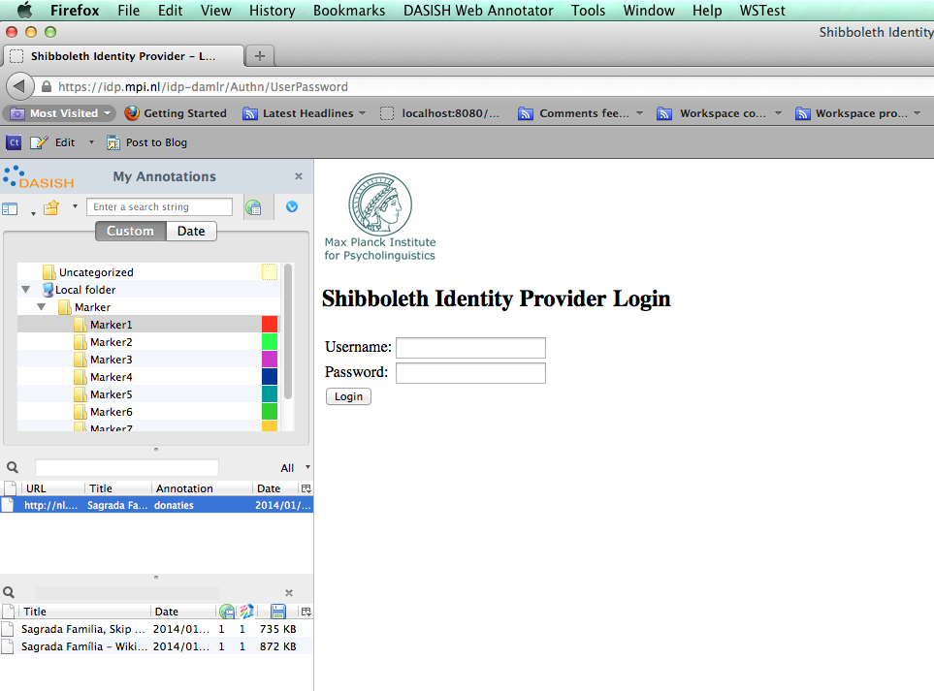
Authentication via Shibboleth

Slide 8
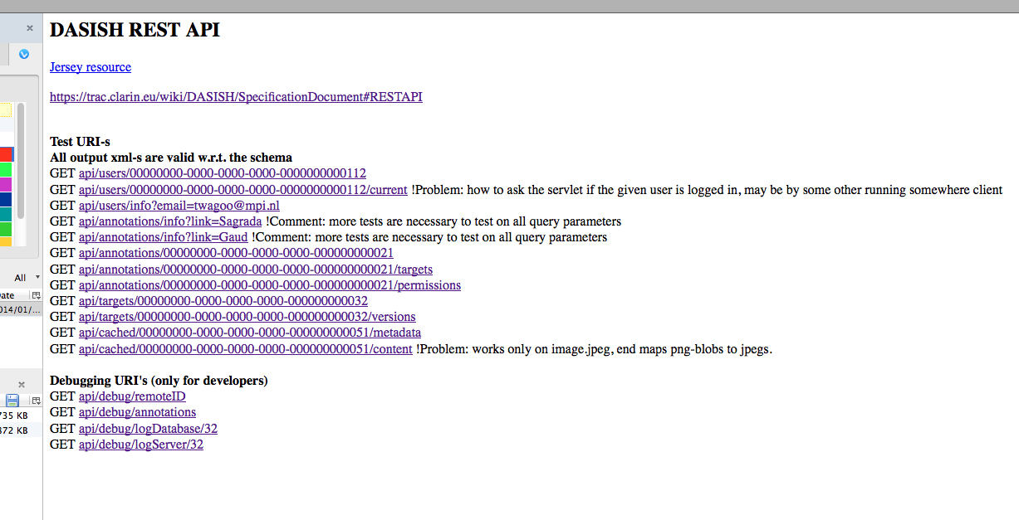
Backend API testing examples: GET

Slide 9
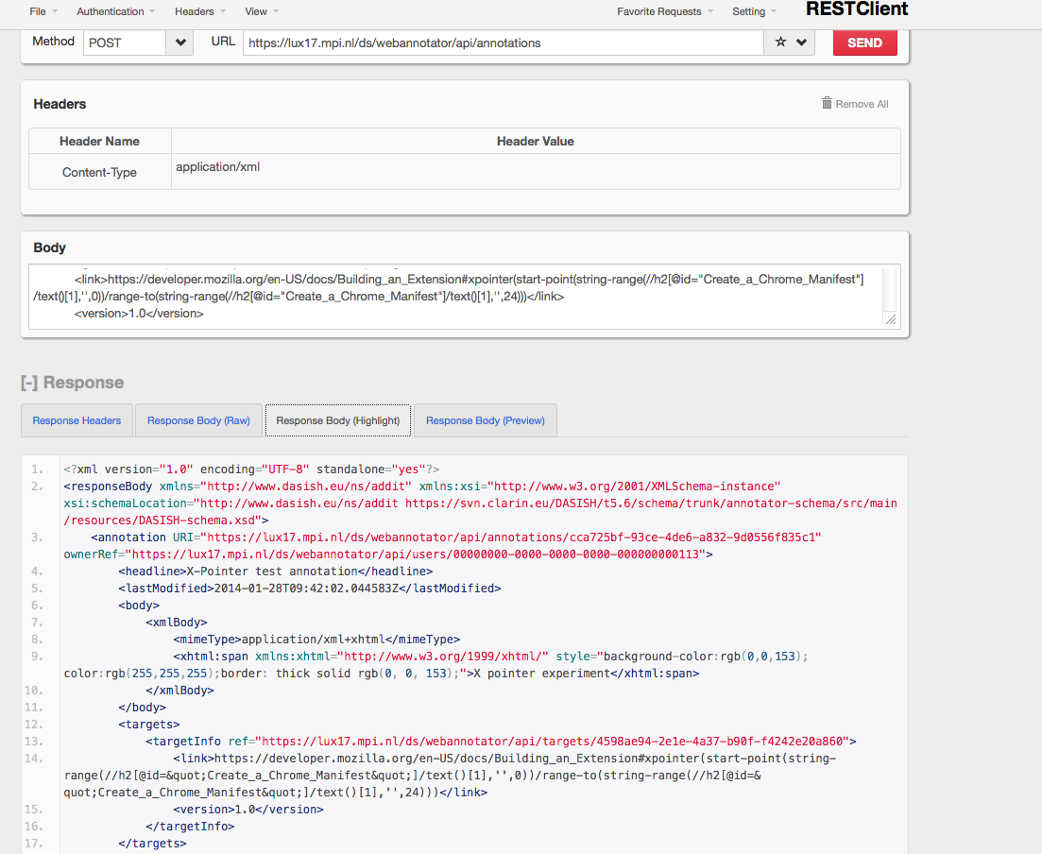
Backend API testing via Firefox RESTClient : POST

Slide 10
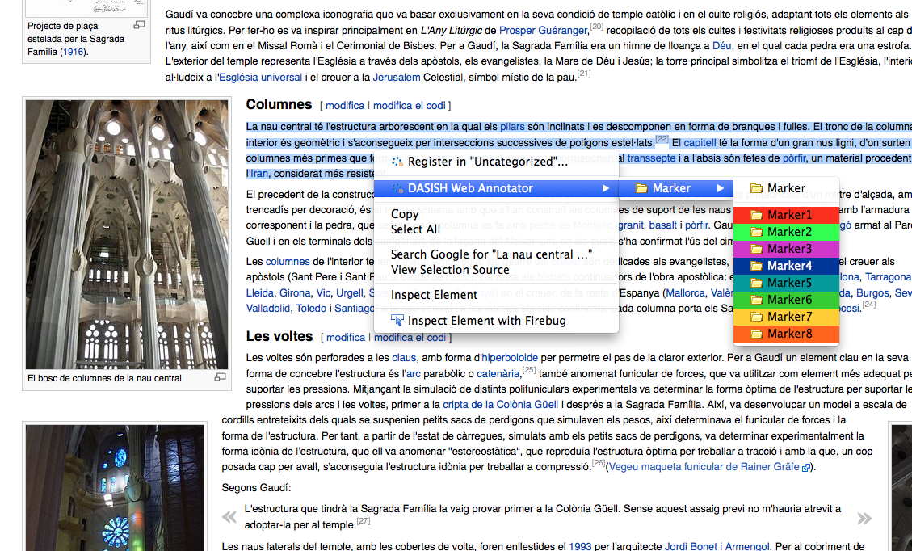
Frontend. Creating an annotation-1: selection

Slide 11
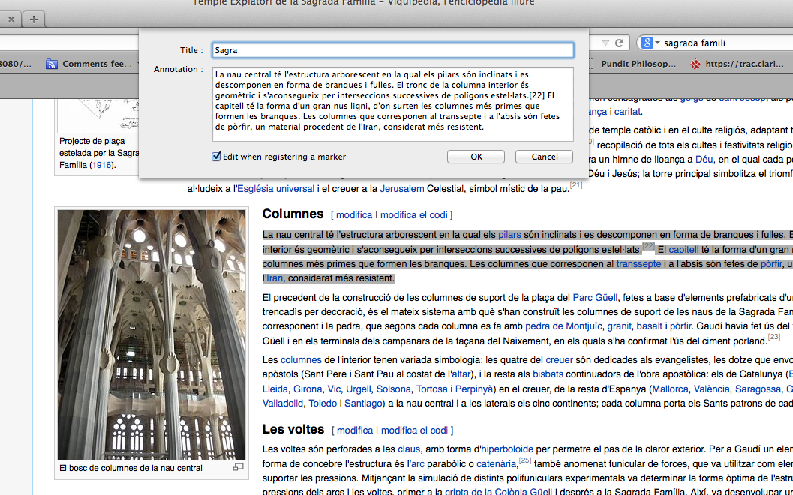
Frontend. Creating an annotation-2: editing

Slide 12
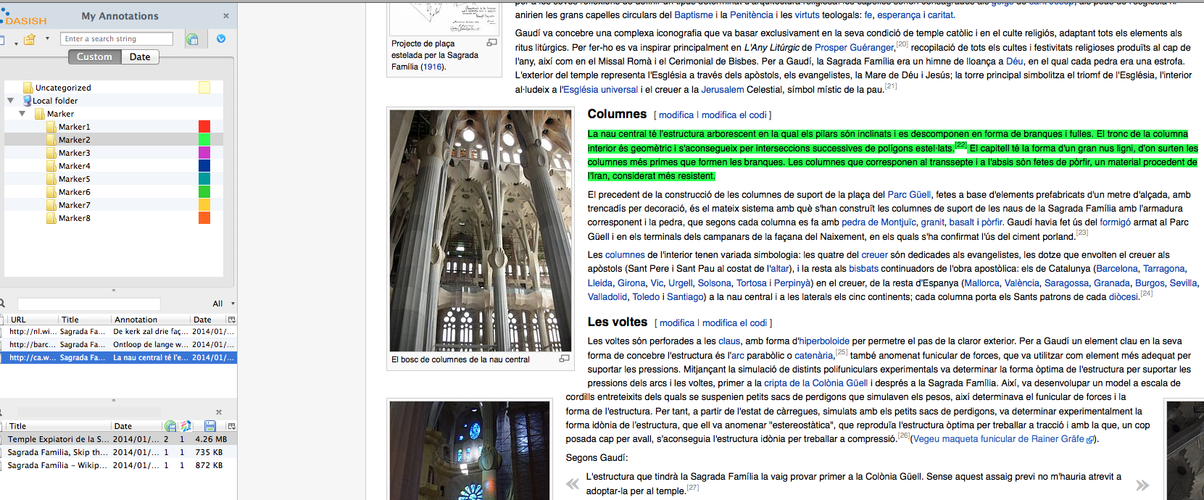
Frontend. Creating an annotation-3: posting

Slide 13
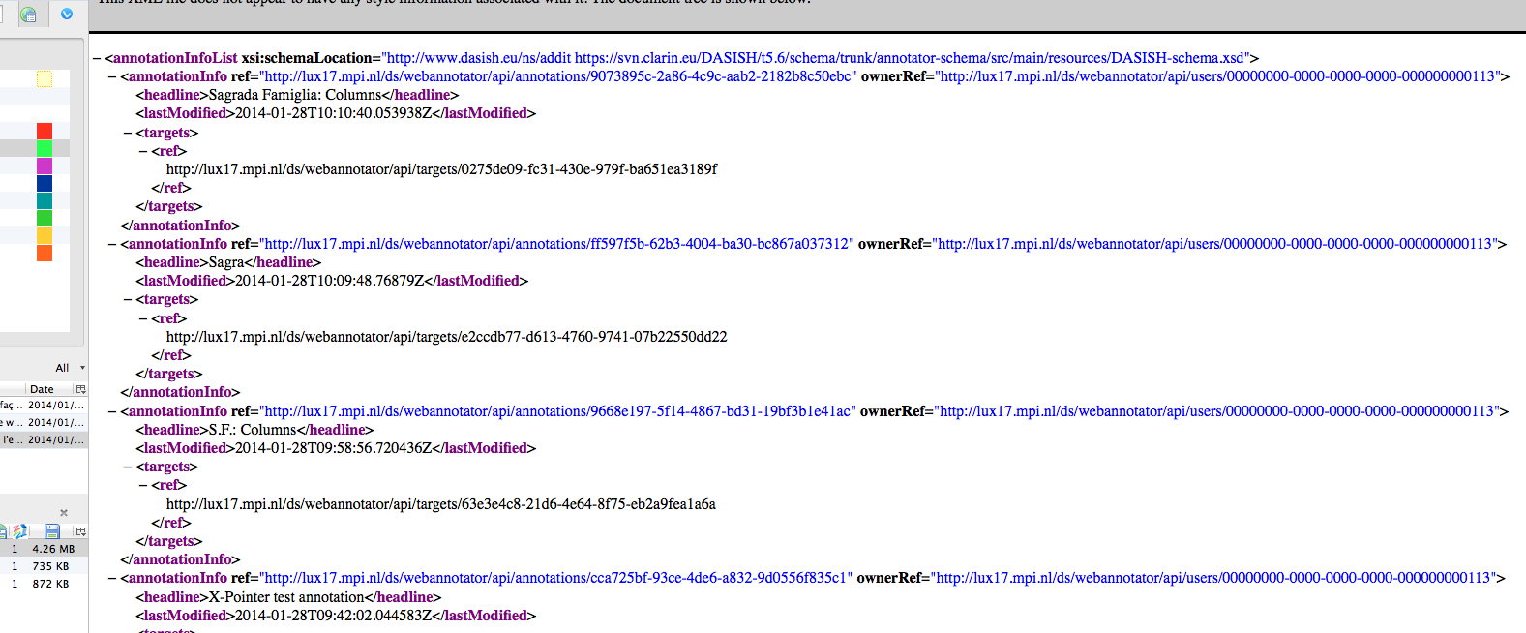
Creating an annotation-4. Technical check on the backend side

Slide 14
Work in progress 1: refactoring of REST service
“Higher-order” wrappers (3 sorts so far) that
takes a sequence of 1-2 calls to a DB as a higher-order parameter
wraps up access control and an exception (so far only “not found in the database”) around it.

Slide 15
Work in progress 2: two authentication mechanisms
Two applications: shibbolized and non-shibbolized authentication (-)
Non-shibbolized authentication: spring-security with two additional spring-specific tables in the database, “users” and “authorities” (+)

Slide 16
Todo’s and open issues
Add back-end validation of client-generated (implemented in component registry, cmdi-schema validation)
Replacement vs escaping “weird” (illegal xml) symbols in annotation bodies of any-xml type.
Notebooks.

