Slide 1
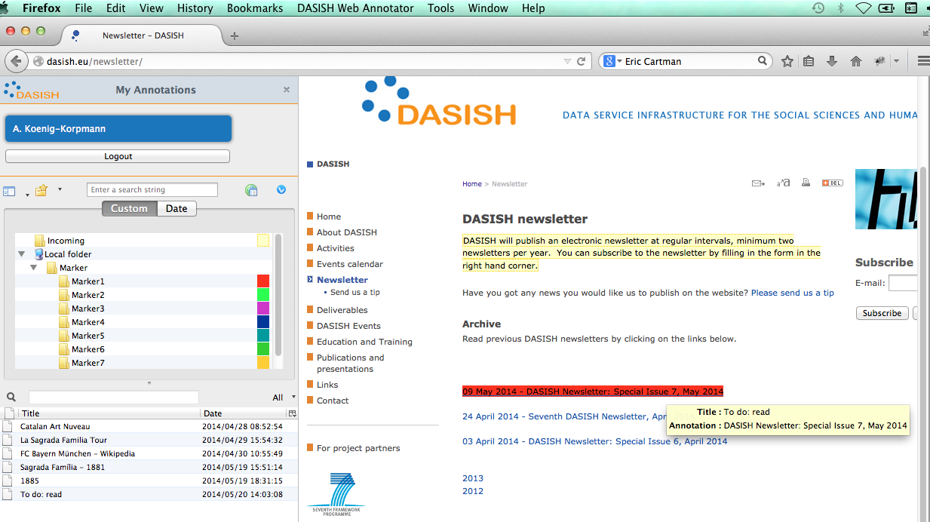

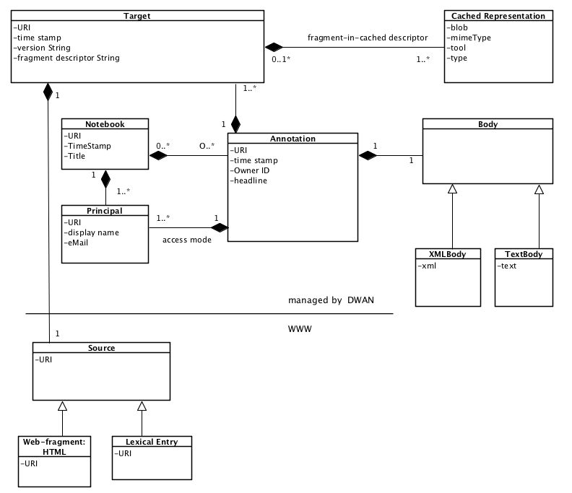
DWAN: DASISH Web Annotator
P. Lenkiewicz¹, O. Shkaravska¹ , T. Goosen², M. Windhouwer³, D. Broeder¹, S. Roth⁴, O. Olsson⁴
¹ Max Planck Institute for Psycholinguistics, ² CLARIN ERIC, ³ Data Archiving and Networked Services, the Netherlands. ⁴ University of Gothenburg, Sweden.
DWAN is a framework for software annotation clients working together with a single backend. The backend consists of a database and a Representational State Transfer (REST) web service implemented in Java.
ELAN¹ DWAN-client (work in progress)
Wired-Marker DWAN-client
Your DWAN client ?..
e.g. a tool for your linguitic resources
Annotations are saved in the database together with cached copies of their annotated sources, in the case the www-sources have changed.
The DWAN backend incl. relational database hosted at TLA-MPI
Client
POST <server>/api/annotations
Server
To be able to talk to the server, a client must: 1) use one of DWAN’s REST API requests while getting, deleting, updating or posting annotations; 2) send request’s body as an XML, which must be valid w.r.t the DWAN schema; 3) be able to read responses compliant with the DWAN schema.
<?xml version="1.0" encoding="UTF-8"?>
<annotation xmlns=http://www.dasish.eu/ns/addit xmlns:xsi=http://www.w3.org/2001/XMLSchema-instance xmlns:xhtml="http://www.w3.org/1999/xhtml/"
xsi:schemaLocation=“http://lux17.mpi.nl/schemacat/schemas/s15/files/dwan.xsd" URI="xxx” ownerRef="yyy">
<headline>How to build an extension</headline>
<lastModified>2013-09-29T19:52:28.969+02:00</lastModified>
<body> <xmlBody> <mimeType>application/xml+xhtml</mimeType>
<xhtml:span style="background-color:rgb(0,0,153);color:rgb(255,255,255);border: thick solid rgb(0, 0, 153);”> Read from here</xhtml:span> </xmlBody> </body>
<targets> <targetInfo ref="tmpTarget">
<link>https://developer.mozilla.org/en-US/docs/Building_an_Extension#xpointer(start-point(string-range(//h2[@id="Create_a_Chrome_Manifest"]/text()[1],'',0))/range-to(string-range(//h2[@id="Create_a_Chrome_Manifest"]/text()[1],'',24)))</link>
<version>1.0</version>
</targetInfo></targets>
<permissions public="read”><permission level = "write" principalRef=”<server>/api/principals/00000000-0000-0000-0000-000000000112"/> </permissions>
</annotation>
The schema formalises the DWAN data model. Its core is the Annotation class with the key relations: Annotation-Body, Annotation-Target, Target-Source, Target-Cached Representation.
DWAN data model strives to be compliant with the Open Annotation Data Model².
References ¹Wittenburg, P., Brugman, H., Russel, A., Klassmann, A., Sloetjes, H. (2006). ELAN: a Professional Framework for Multimodality Research. In: Proceedings of LREC 2006, Fifth International Conference on Language Resources and Evaluation.
²The Open Annotation Collaboration and the Board of Trustees of the University of Illinois. (2014, March 13). Open Annotation Collaboration. Retrieved March 18, 2014 from http://www.openannotation.org/
More information: olhsha@mpi.nl

