Slide 1

Chapter 9
Spatial Statistics
Notes:
This chapter presents a range of statistics and algorithms that can be used to compare two spatial data sets. These are important for modelling because, at some point, it will be necessary to compare a model outcome to some real-world data in order to assess the reliability of the model. This chapter examines the statistics themselves, before Chapter 10 elaborates on how to evaluate the success of a model more broadly, part of which includes making use of the methods discussed here.

Slide 2
Learning Objectives
By the end of this chapter, students will be able to:
Identify some commonly-used statistics that can be used to quantify the difference between spatial data sets.
Explain which are the most appropriate statistics for use in comparing aggregate data and point data.
Explain four different ways of identifying the differences in spatial data sets: visual comparison; descriptions of point patterns; global difference; local difference.
Calculate the value of these statistics.

Slide 3
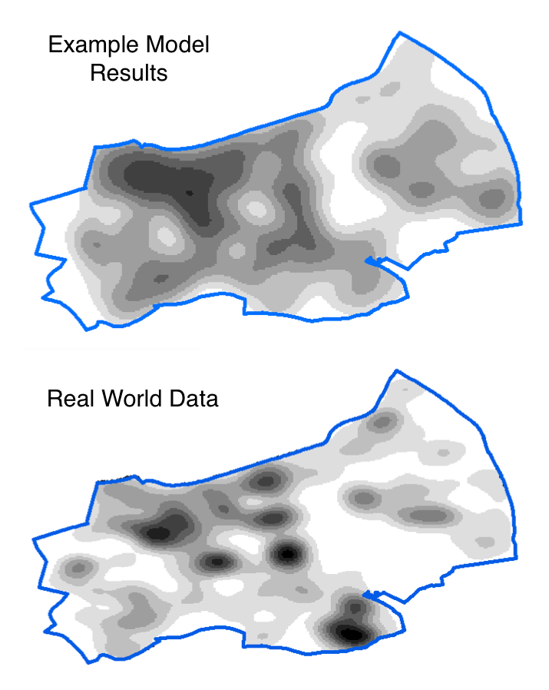
Introduction
All models are wrong, but some are useful (Box, 1979)
We often need to compare two spatial data sets:
For example: Model results compared to real-world data
There are many ways to do this
Choosing the most appropriate method is vital
This lecture will introduce and compare a number of different ‘goodness of fit’ statistics.

Slide 4
Overview
Goodness of fit and hypothetical data
Global Statistics
Visual Comparisons
Point Pattern Statistics
Local Statistics (LISA)
Multi-Scale Error Analysis

Slide 5
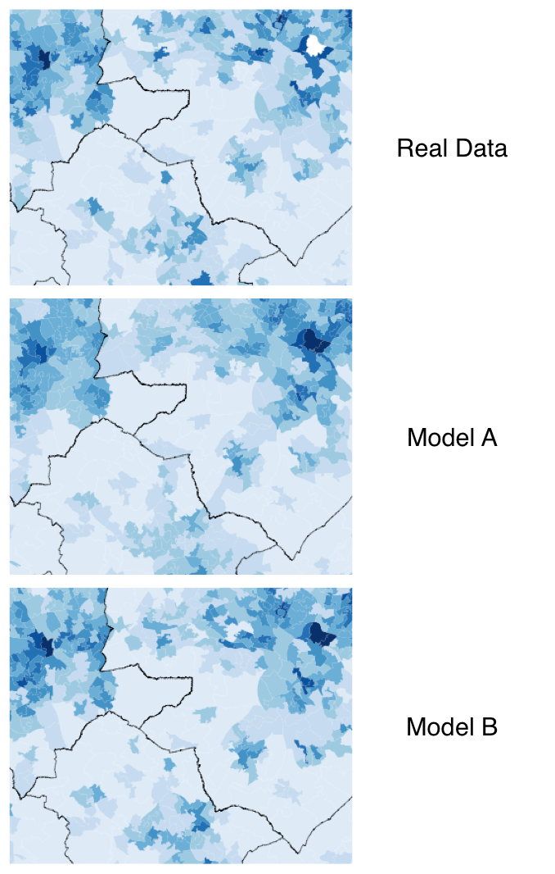
Goodness of Fit
Assessment of how well a model fits a set of observations
Humans are quite good at comparing patterns visually
But often it is better to use quantitative methods
E.g.: which of the two models on the right is better – A or B?

Slide 6
Statistics that will be introduced
Notes:
● Global statistics (Section 9.3) – statistics that calculate the overall difference
between two data sets (e.g. the total error);
● Visual comparisons (Section 9.4) – methods that provide visual outputs and allow spatial data sets to be compared visually;
● Description of point data (Section 9.5) – statistics that describe the properties of point data, such as the degree of clustering;
● Local indicators of spatial association (Section 9.6) – statistics that calculate the difference between two data sets at a local spatial level.

Slide 7
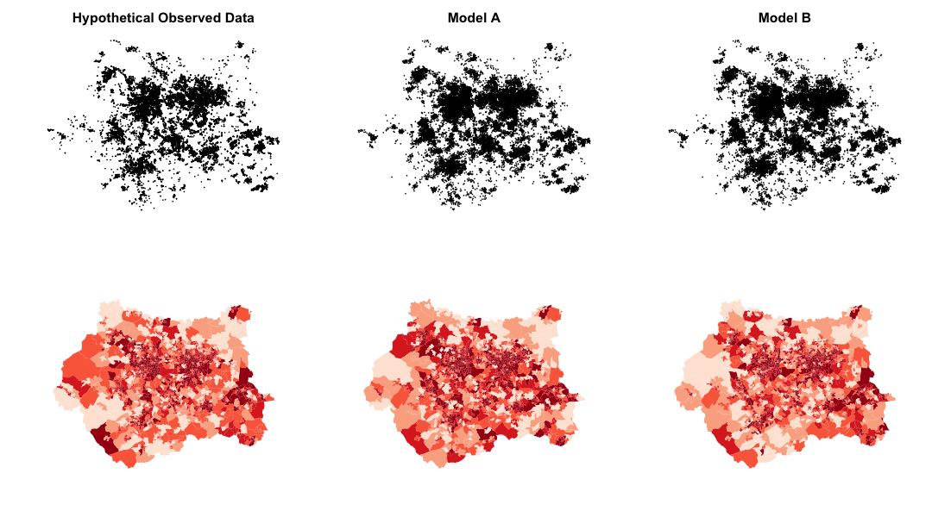
Hypothetical Data
To experiment with the different statistics, three datasets will be used. They are all point patterns.
‘Observed’ data – real data
(This is actually some real crime data for Leeds, UK)
Model A – data that could have come from a simulation
Model B – data that could have come from a simulation with slightly different parameters

Slide 9
Hypothetical Data
When the data were created, the points in Model B data were deliberately made more similar to the real data than those from Model A.
In other words, Model B is ‘better’ than Model A.
The statistics used throughout this chapter later should show this.
The results of two hypothetical models (A and B) plotted against observed data. The lines of best fit (y = x) illustrate the locations of ‘perfect’ model results. In this example, model B is a better fit to the observed data than model A.

Slide 10
Overview
Goodness of fit and hypothetical data
Global Statistics
Visual Comparisons
Point Pattern Statistics
Local Statistics (LISA)
Multi-Scale Error Analysis

Slide 11
Global Statistics

Slide 13
Overview
Goodness of fit and hypothetical data
Global Statistics
Visual Comparisons
Point Pattern Statistics
Local Statistics (LISA)
Multi-Scale Error Analysis

Slide 14
Visual Comparisons

Slide 16
Overview
Goodness of fit and hypothetical data
Global Statistics
Visual Comparisons
Point Pattern Statistics
Local Statistics (LISA)
Multi-Scale Error Analysis

Slide 17
Point Pattern Statistics

Slide 19
Overview
Goodness of fit and hypothetical data
Global Statistics
Visual Comparisons
Point Pattern Statistics
Local Statistics (LISA)
Multi-Scale Error Analysis

Slide 20
Local Indicators of Spatial Association (LISA)
Local Statistics

Slide 22
Overview
Goodness of fit and hypothetical data
Global Statistics
Visual Comparisons
Point Pattern Statistics
Local Statistics (LISA)
Multi-Scale Error Analysis

Slide 23
Multi-Scale Error Analysis

Slide 25
Conclusion

Slide 26
Summary
Goodness of fit and hypothetical data
Global Statistics
Visual Comparisons
Point Pattern Statistics
Local Statistics (LISA)
Multi-Scale Error Analysis

Slide 28
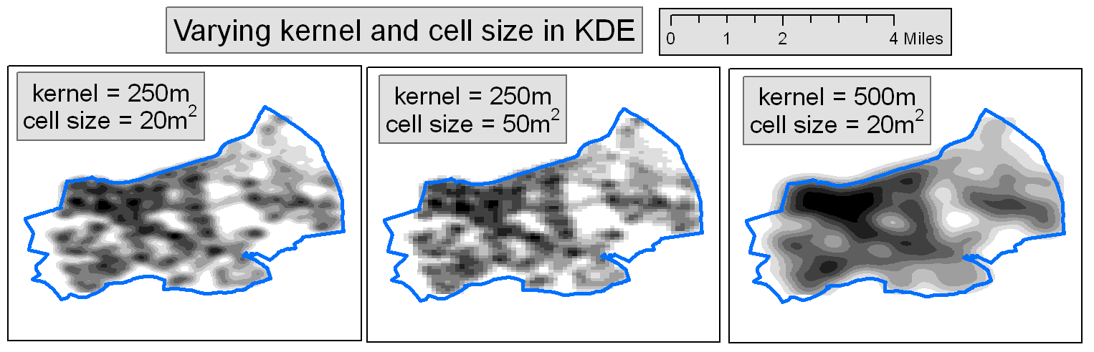

Slide 30
Glossary
Goodness of fit – a broad description for statistics that quantify how well a model fits a set of real-world observations.
RSS – residual sum of squares; a statistic that estimates the overall difference between two data sets by summing the square of the errors.
R2 – ‘R squared’; a statistic that estimates the overall difference between two data sets.
(S)RMSE – (standardised) root mean square error; a statistic that esti- mates the overall difference between two data sets.
KDE – kernel density estimation; a means of estimating point density at a particular location. Often used to draw maps of point patterns.
LISA – local indicators of spatial association; statistics that can estimate the locations of local clusters (areas with a higher than expected point density).
NNI – nearest neighbour index; measures global spatial uniformity (i.e. the overall amount of clustering in a point pattern). Also known as the Clark and Evans R statistic (Clark and Evans, 1954).
Ripley’s K function; another measure for global spatial uniformity (i.e. the overall amount of clustering in a point pattern).
GI* – a statistic that estimates the spatial locations of ‘hot’ (e.g. high) and ‘cold’ (e.g. low) spot

