Slide 1
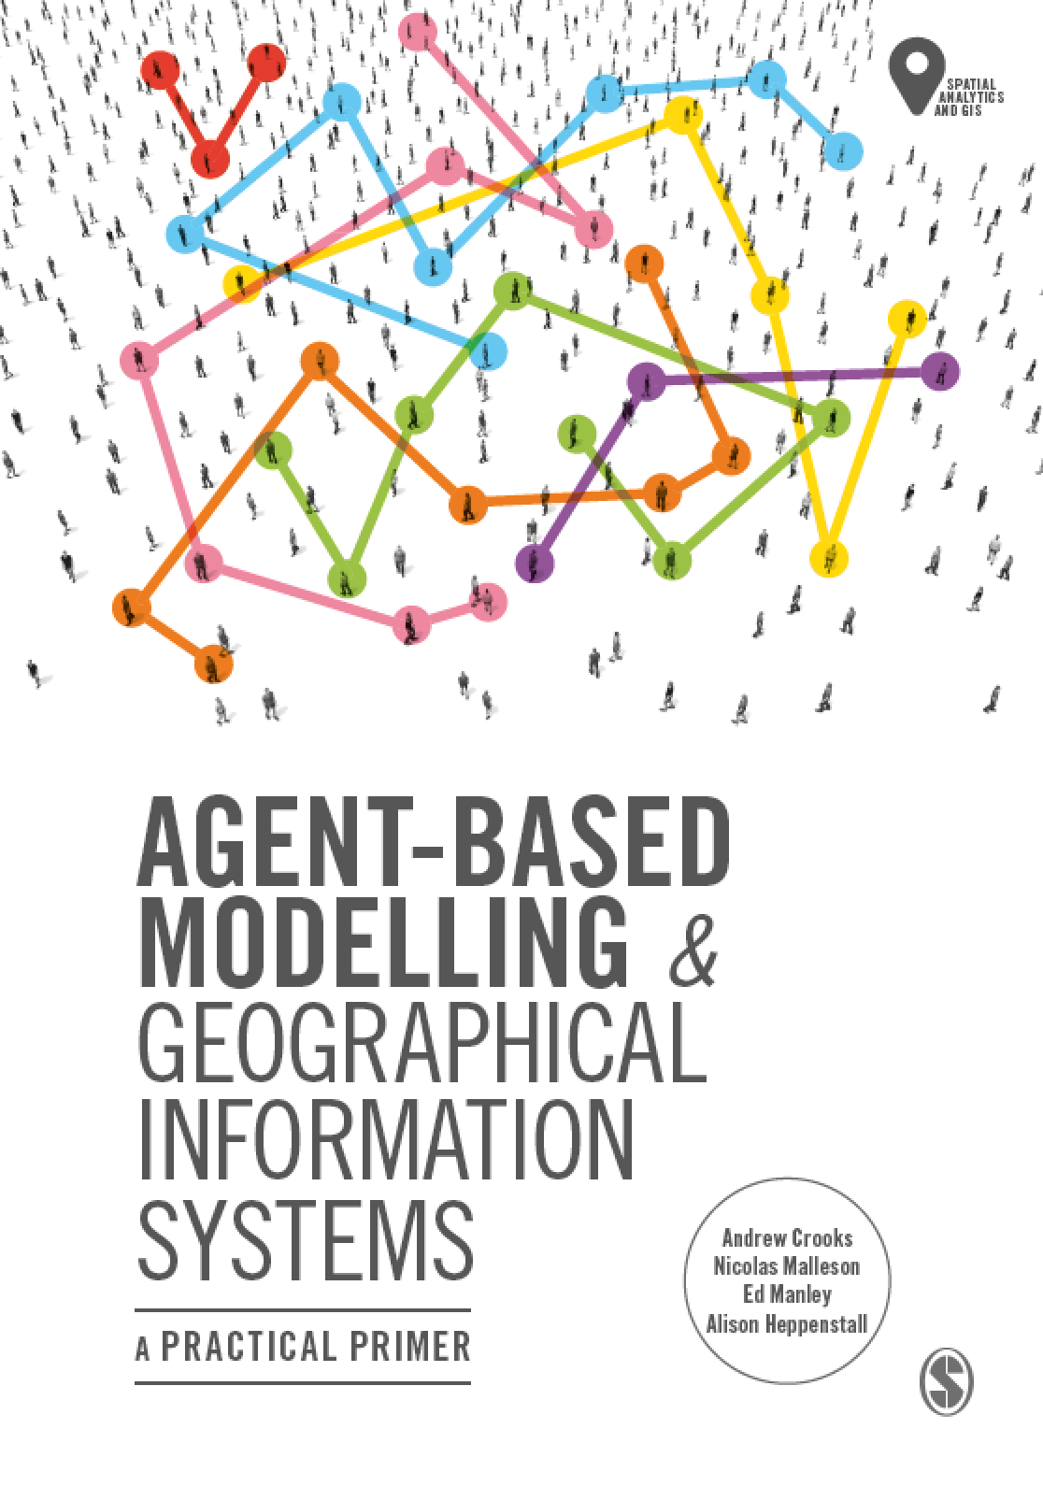
Chapter 12
Summary and Outlook
Notes:
This chapter reflects on the current state of the art of agent-based models and factors that may shape the future of this discipline. Specifically we will discuss the key challenges for developing robust agent-based models of geographical systems as well as potential solutions. We argue that we need to make progress on these challenges if these models are to be used to offer insight into key societal challenges, for example climate change, urban growth and migration.

Slide 2
Learning Objectives

Slide 3
Introduction

Slide 4
Remaining Challenges
The challenges include:
Reasons for Modelling
Theory and Models
Inter-Model Comparison
Replication and Experiment
Verification and Validation
Agent Representation, Aggregation and Dynamics
Behaviour
Sharing and Dissemination of the Model
Data Challenges

Slide 5
Challenge 1: Reasons for Modelling

Slide 6
Challenge 2: Theory and Models

Slide 7
Challenge 3: Inter-Model Comparison

Slide 8
Challenge 4: Replication and Experiment

Slide 9
Challenge 5: Verification and Validation

Slide 10
Challenge 6: Agent Representation, Aggregation and Dynamics

Slide 11
Challenge 7: Behaviour

Slide 12
Challenge 8: Sharing and Dissemination of the Model

Slide 13
Challenge 9: Data Challenges

Slide 14
Looking Ahead

Slide 15
Big Data and Agent-based Modeling

Slide 16
Model Integration

Slide 17
Uncertainty and Ensembles

Slide 18
Data Assimilation

Slide 19
Spatially Learning Agents

Slide 20
Discussion

Slide 21
Summary

Slide 22
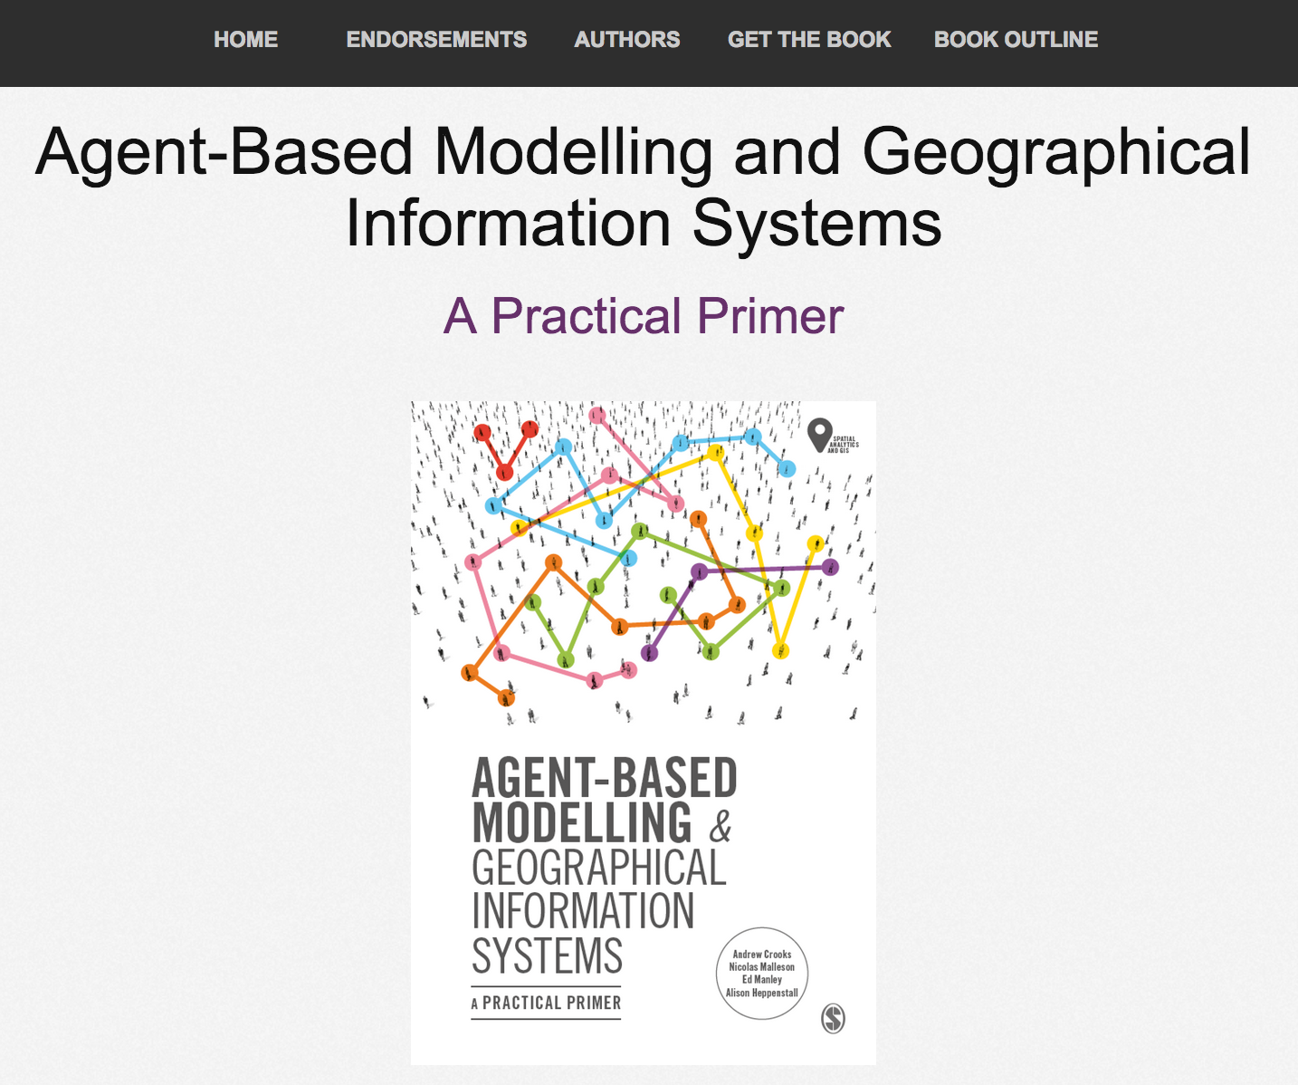
Online Resources
Visit: https://github.com/abmgis/abmgis/tree/master/Chapter12-SummaryAndOutlook for a selection of models to highlight core concepts introduced in this chapter

