Slide 1
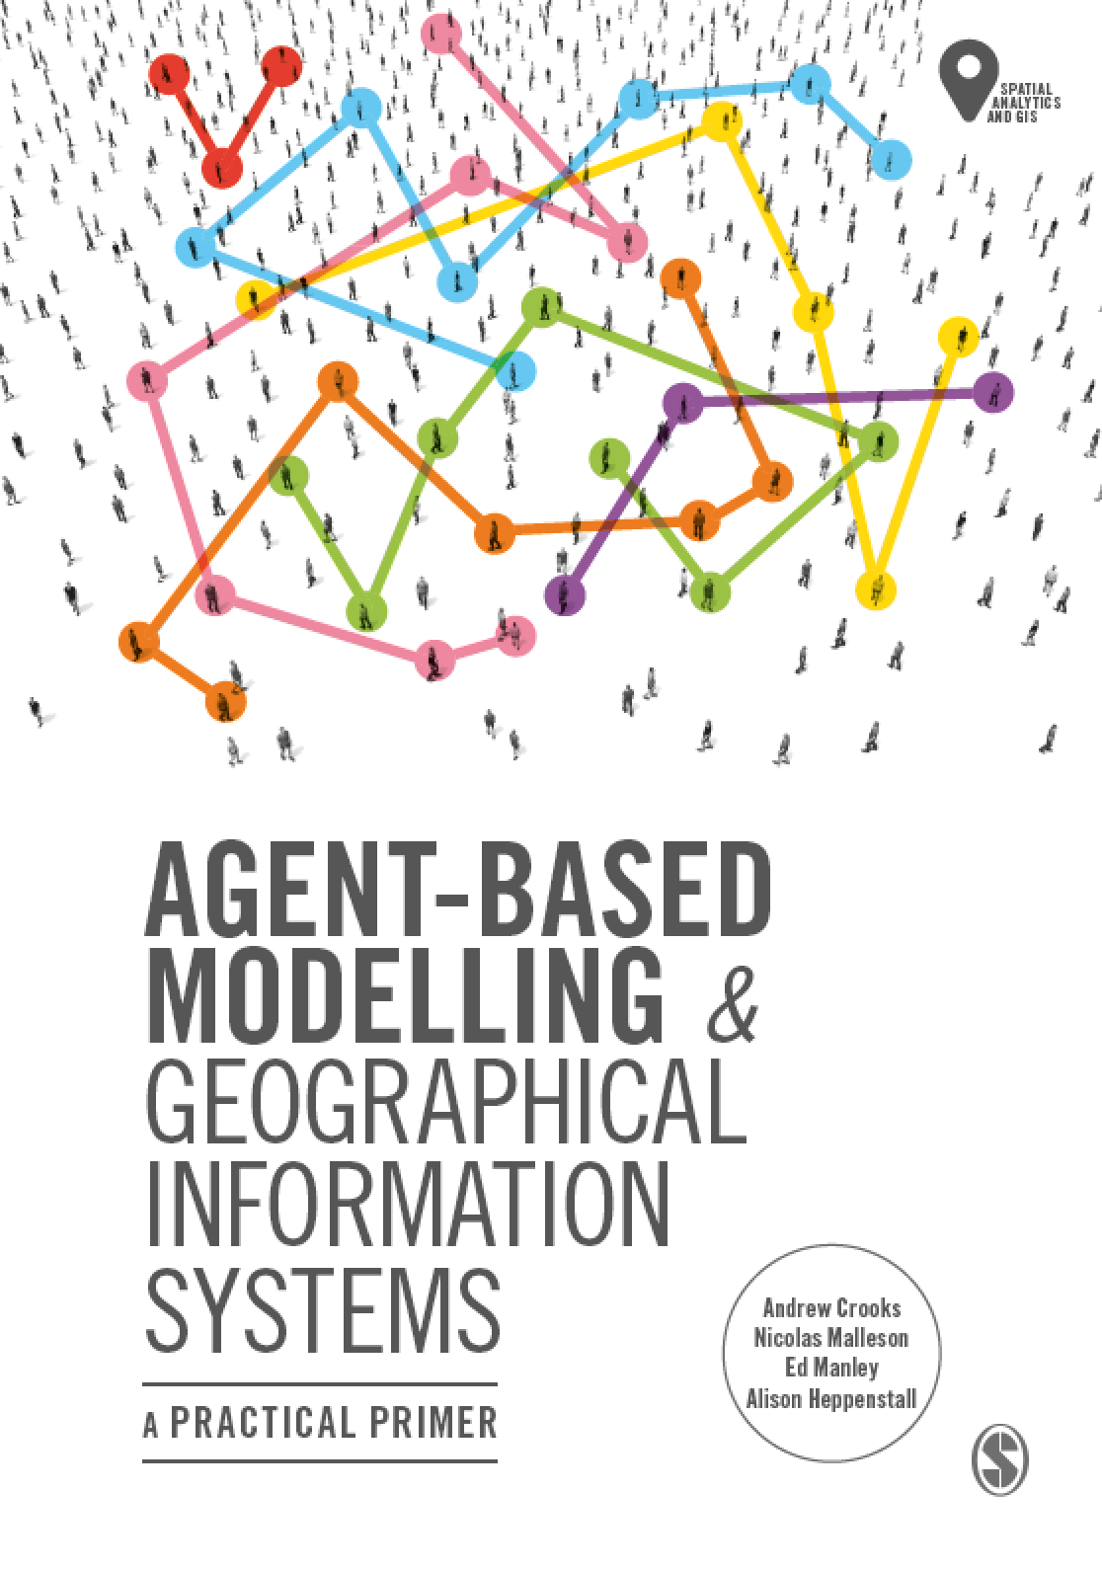
Chapter 10 Tutorial
Evaluating Our Models: Verification, Calibration, Validation
Notes:
Model evaluation is one of the central challenges associated with agent-based models. A key question that all modelers face is “how well does this model simulate the phenomenon of interest?”. While there are no universally accepted methods for evaluating agent-based models, researchers often adopt the same three stage process of verification, calibration and validation. This chapter presents an overview of the methods that are commonly used within each of these stages. The overarching aim of this chapter is to provide the reader with the knowledge to design their own approach to evaluating agent-based models.

Slide 2
Recap: The Model Development Process
After a model has been designed and implemented, evaluation can begin
Verification: Check that the model implementation (i.e. code) matches the design
Calibration: Find optimal parameter values given some real-world observations
Validation: Test the model on some new real-world data to make sure that it has not been over-fitted

Slide 3
Outline for this tutorial
Three examples to explore how to evaluate models:
Verification: an example with the Rainfall model
Parameter sweep using Behaviour Space
Calibration: an example with the Walk This Way model

Slide 4
Verification: an example with the Rainfall model
There are many ways to verify that the model’s implementation fits with the design
Code testing (e.g. unit testing, pair programming)
Docking (implementing a model twice using different libraries or programming languages)
Manual inspection of the model (e.g. checking that agent variables change as they should do)
Also: experimenting with simplified environments
Apply the model to a simple environment to make sure the agents behave as they should do.
The simple environments make it easy to understand what behaviour should take place.

Slide 5
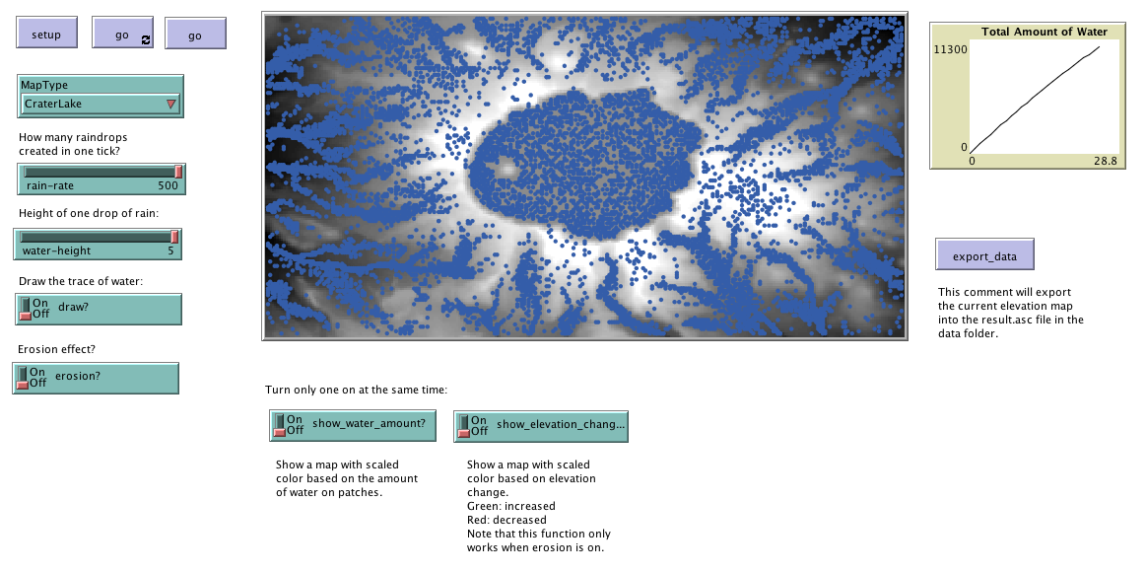
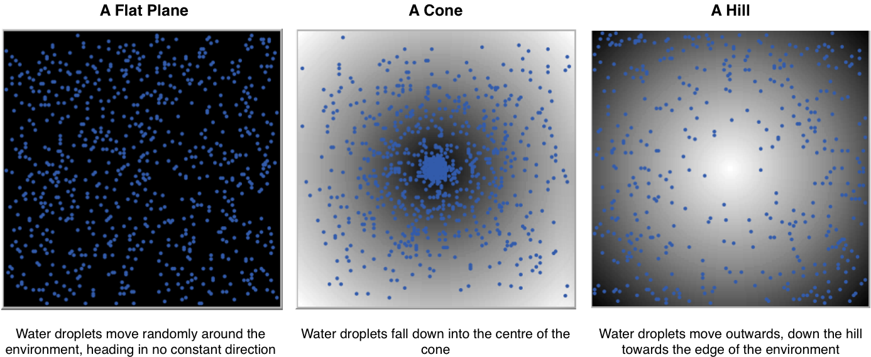
Verification using the Rainfall model
The Rainfall model
Initially introduced in Chapter 6 of the book
Available in the accompanying resources for Chapter 10.
Agents represent drops of water that move across a hilly environment and pool in a lake
Also has three simple environments:
A flat plane (all cells are same height)
A cone (low in the middle)
A hill (high in the middle)

Slide 6
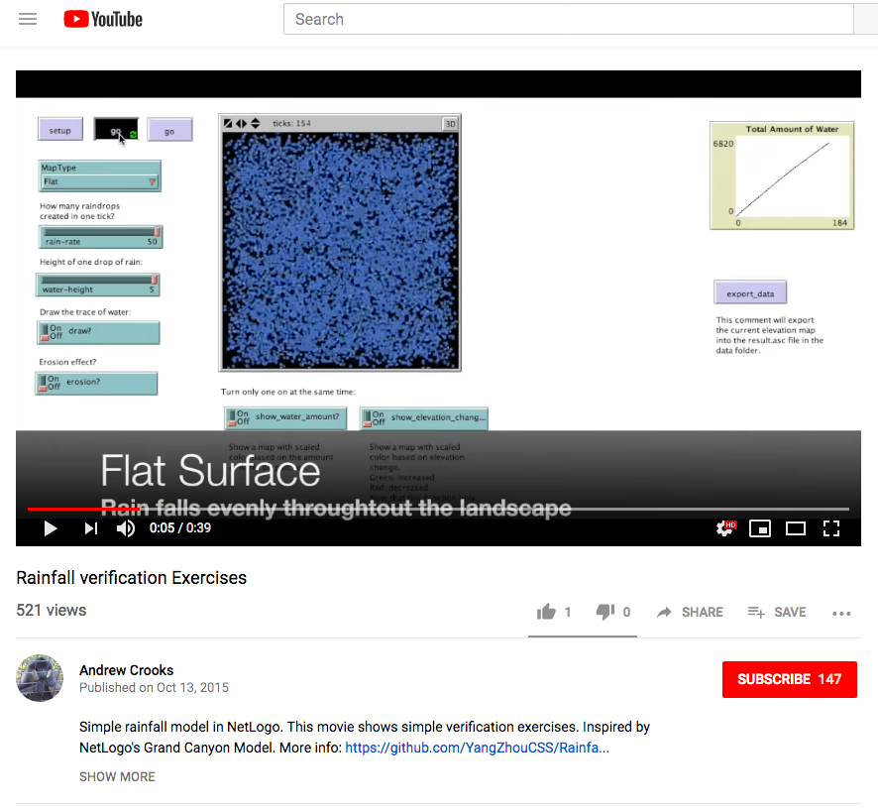
Practice: Test the simple environments
Run the Rainfall model (called rainfall.nlogo), available in the accompanying resources for Chapter 10.
Change the landscape (MapType) to:
Flat
Cone
Hill
Each time you change the environment, does the model behave as expected?
Check your results against this video.

Slide 7
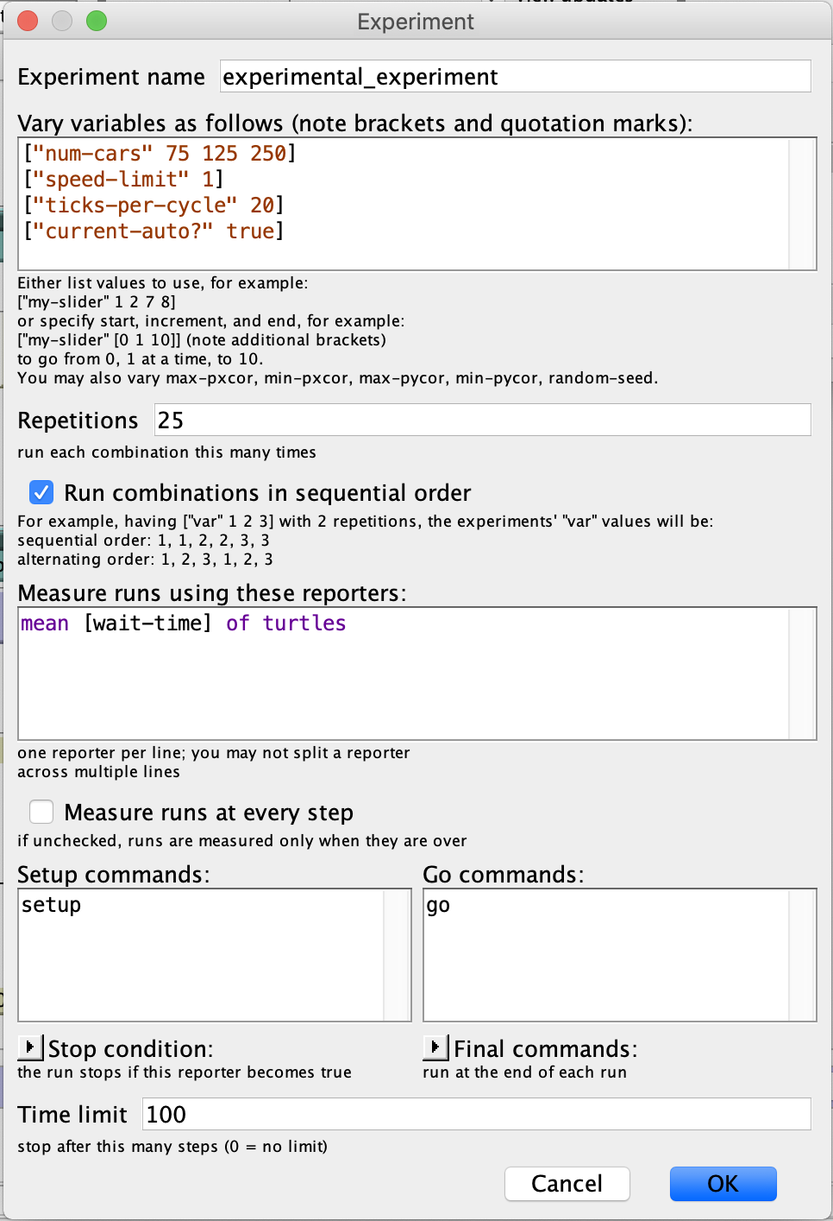
Parameter sweep using Behaviour Space – Setting up an Experiment Example: TrafficGrid Model
Set a meaningful experiment name
The number of car agents will range from 75 to 125 to 250 in our simulations
Speed Limit and other variables (including those not shown) are held constant
Set the variables and their ranges you’d like to test
Define how many repetitions of each combination you’ll test
This helps control for random variation, 25 should be enough here given the low model complexity
Set the measure you’ll use to report model performance
We’ve picked the mean wait time for the cars here
Tell BehaviorSpace the commands used to setup and run the model
Give a cut off for when the model should finish by
As determined by the tick box above, we’ll just take the wait time mean at the end of the simulation

Slide 8
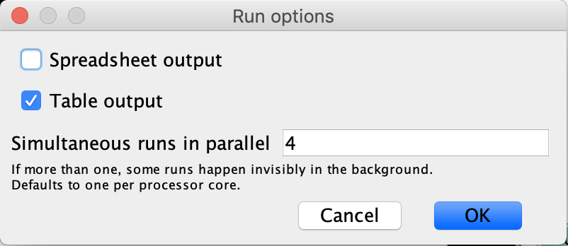
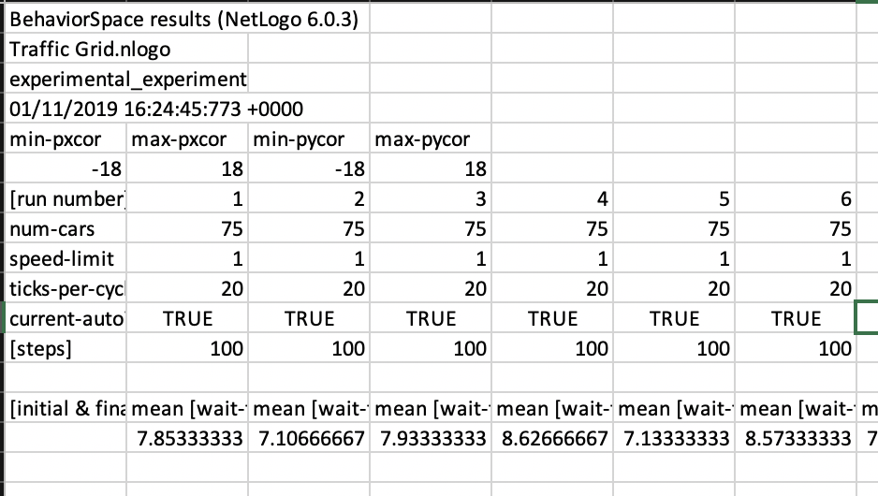
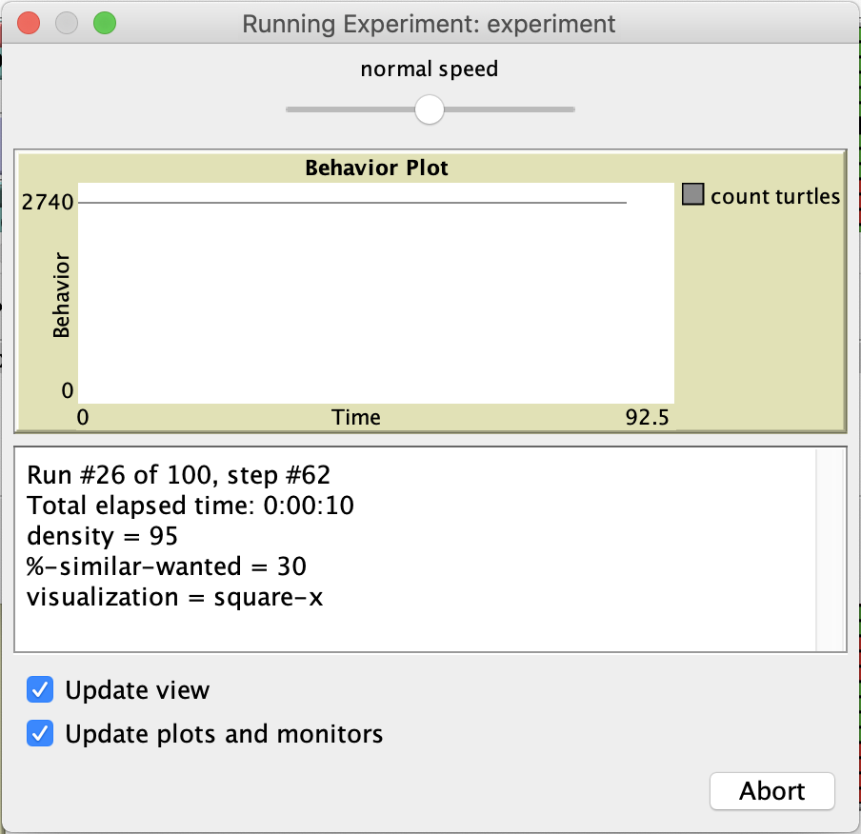
Parameter sweep using Behaviour Space – Running an Experiment Example: TrafficGrid Model
You can export results to output files, either a spreadsheet or text file, and process these later to identify the best parameter combination
The simulations will run on screen, and this reporting window will feedback how the simulations are progressing. Once finished, the window will disappear.
On analysing my results in Excel, I find wait times vary with number of agents (no surprise there), with the following results averaged over all runs:
75 agents = 8.24
125 agents = 8.63
250 agents = 28.47
As we can see, at 250 agents the traffic is considerably worse. This begs the question – what is the largest number of agents that travel on this road network? Can you find out through BehaviorSpace?

Slide 9
Calibration: The Walk This Way model
Calibration is the process of adjusting the model parameters to meet observations within a dataset
It is the final stage in refining the model definitions to best meet observed behaviour
The Walk This Way model shows how we might compare observed behaviour against a variety of modelling assumptions
The ABM uses four potential model configurations, and offers a direct point of evaluation against observation data
This model is from an academic paper, which you can read here

Slide 10
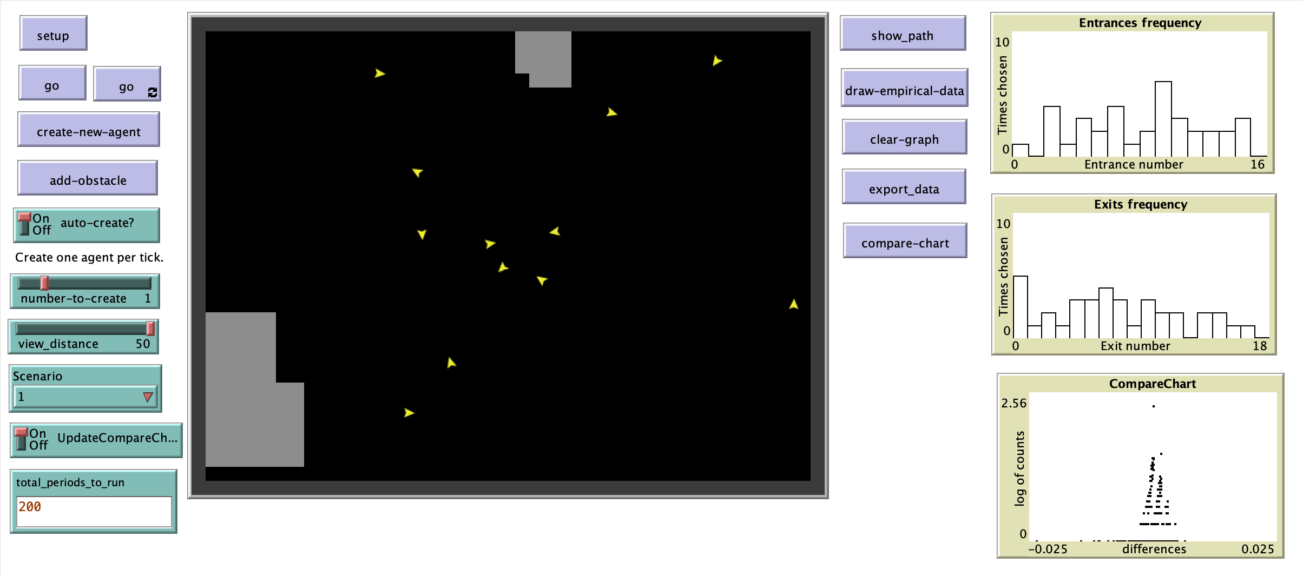
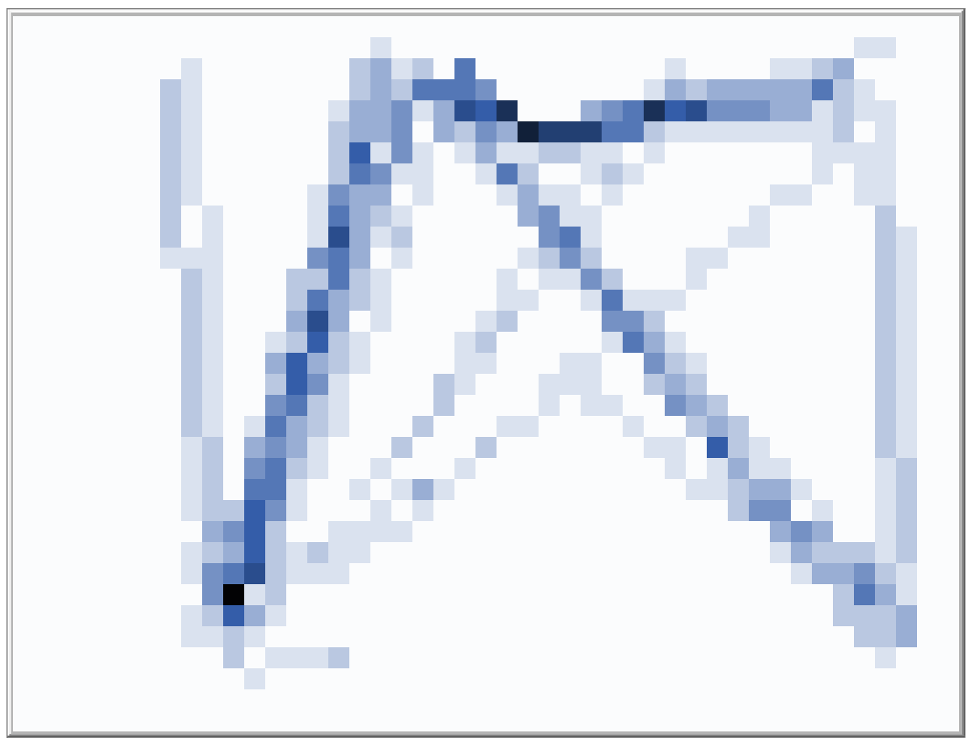
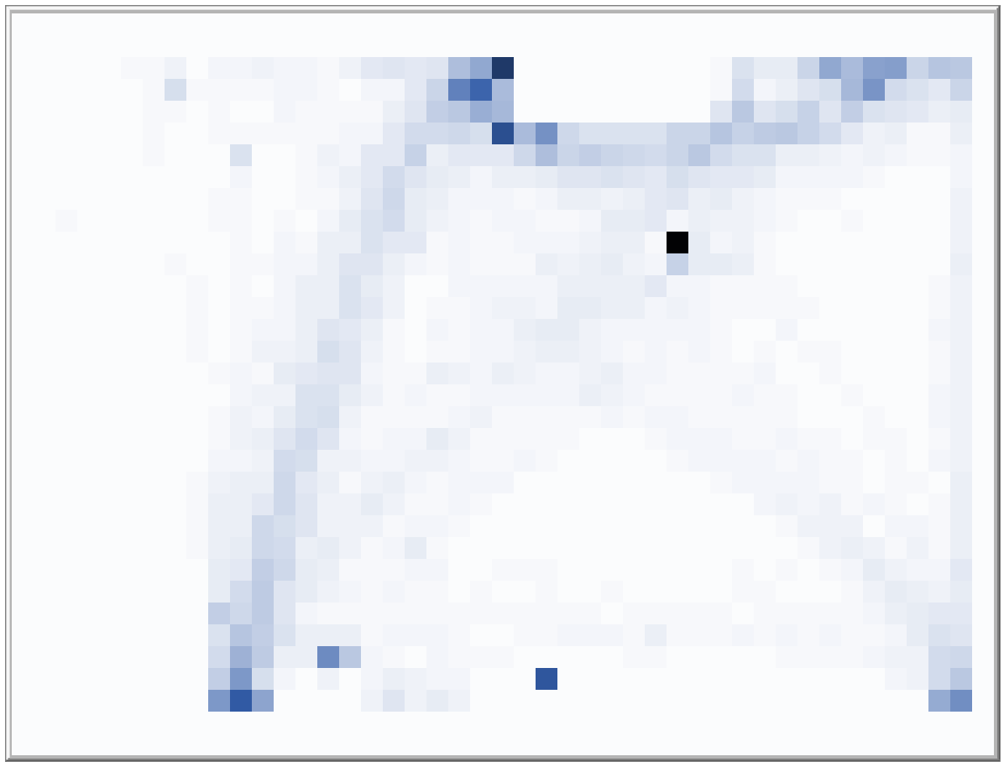
Calibrating the Walk This Way model
Calibration can be performed by assessing model similarity against observed data
The observation data is provided in a separate file, but it read in by NetLogo for comparison
These comparisons are made through the chart, which compares relative differences in counts at each entry and exit
And through comparison of path maps, which show the distribution of agent paths across the space, as shown below
The model interface shows agents navigating across an open space
In this simulation, we are trying to match the observed trajectories of people navigating a similar shaped space
There are four potential model configurations to test – these permit and limit access to information to agents, and adjust the flow of agents entering and exiting at different locations the space
Simulated paths
Observed paths
Task: Run the models, and find which scenario and parameters best match observed patterns

