Slide 1
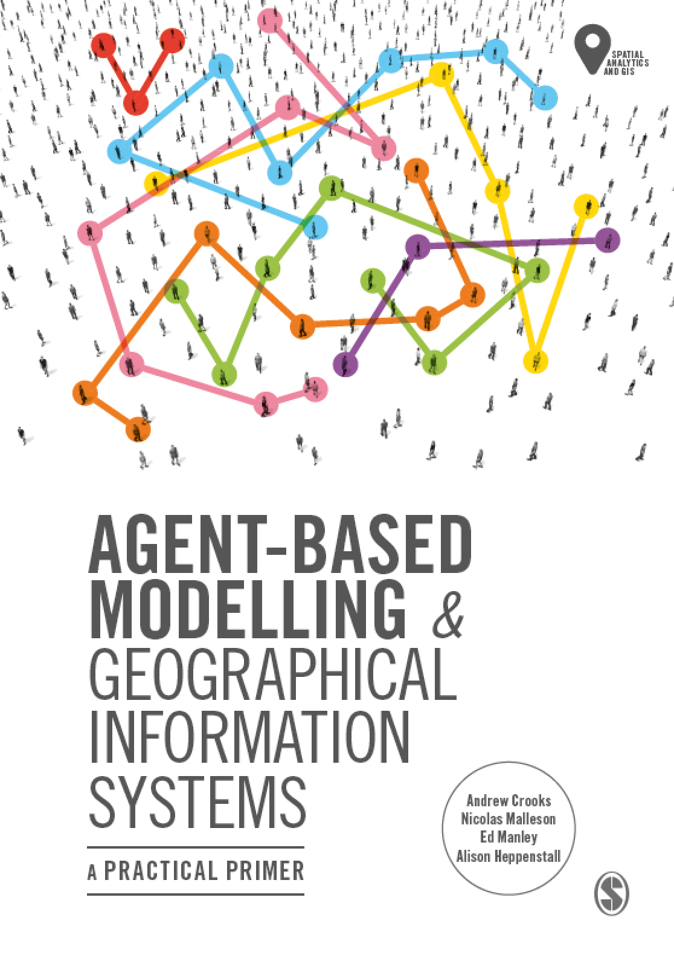
Chapter 10 Tutorial
Evaluating Our Models: Verification, Calibration, Validation
Notes:
Model evaluation is one of the central challenges associated with agent-based models. A key question that all modelers face is “how well does this model simulate the phenomenon of interest?”. While there are no universally accepted methods for evaluating agent-based models, researchers often adopt the same three stage process of verification, calibration and validation. This chapter presents an overview of the methods that are commonly used within each of these stages. The overarching aim of this chapter is to provide the reader with the knowledge to design their own approach to evaluating agent-based models.

Slide 2
Outline
Verification: an example with the Rainfall model
Parameter sweep using Behaviour Space
Calibration: an example with the Walk This Way model

Slide 3
Verification: an example with the Rainfall model
XX NICK TO DO

Slide 4
Parameter sweep using Behaviour Space
XX ED TO DO

Slide 5
Calibration: an example with the Walk This Way model
XX ED TO DO

