Slide 1
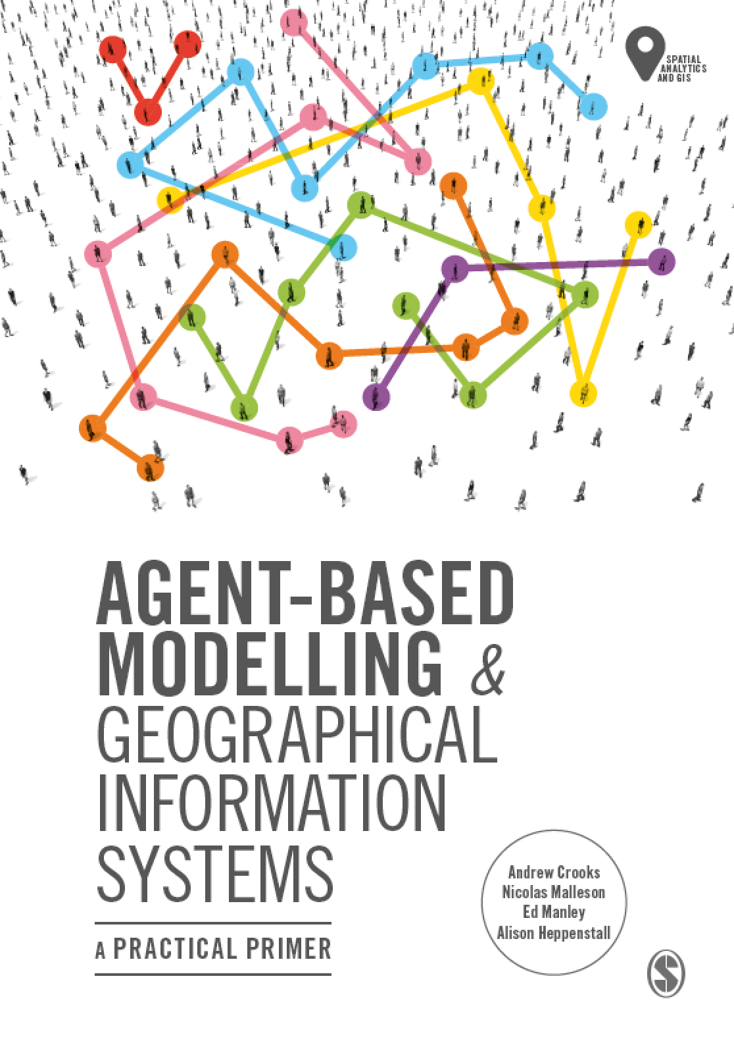
Chapter 2
Introduction to Agent-Based Modelling
Notes:
In this Chapter we introduce the key concepts behind agent-based modelling. What is an agent, and what are rules? These are discussed along with a consideration of the main advantages and disadvantages for simulating spatial systems. A range of established applications are presented to give a flavour of how agent-based models can be successfully applied. The overarching aim of this chapter is to give the reader an understanding of what an agent-based model is. This knowledge will be built upon in subsequent chapters.

Slide 2
Learning Objectives
The overarching aim of this chapter is to give the reader an understanding of what an agent-based model is.
Set the scene for the following chapters which go into more details about agent-based modeling.
Introduce key concepts behind agent-based models
E.g., What is an agent, and what are rules?
Outline the main advantages and disadvantages for simulating spatial systems.
Demonstrate how agent-based models can be successfully applied to a range applications.

Slide 3
Introduction

Slide 4
What is an Agent?

Slide 5
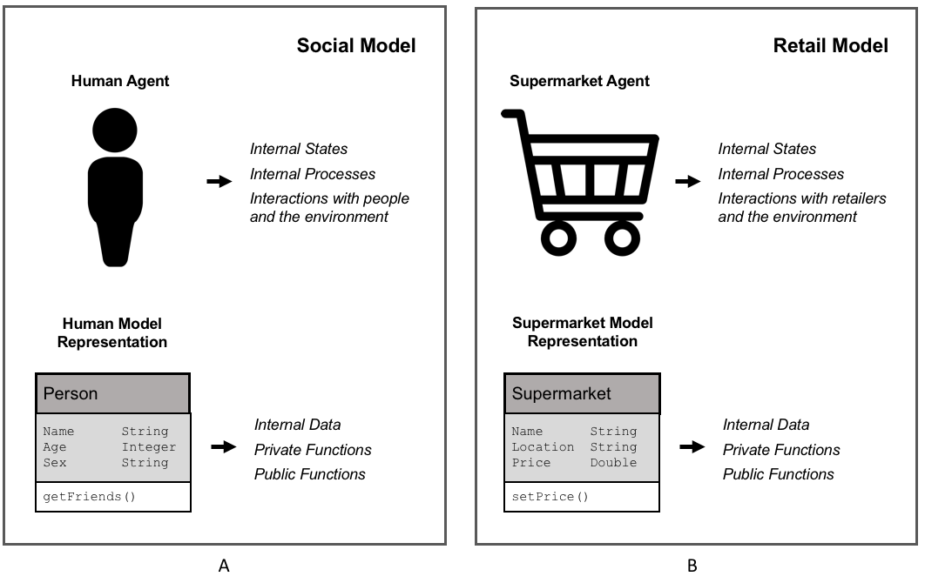
Agent Representation
Figure 2.1: Representation of (A) human agent and (B) supermarket retailer agent alongside that of representation within an object-orientated environment.

Slide 6
Agent Rules

Slide 7
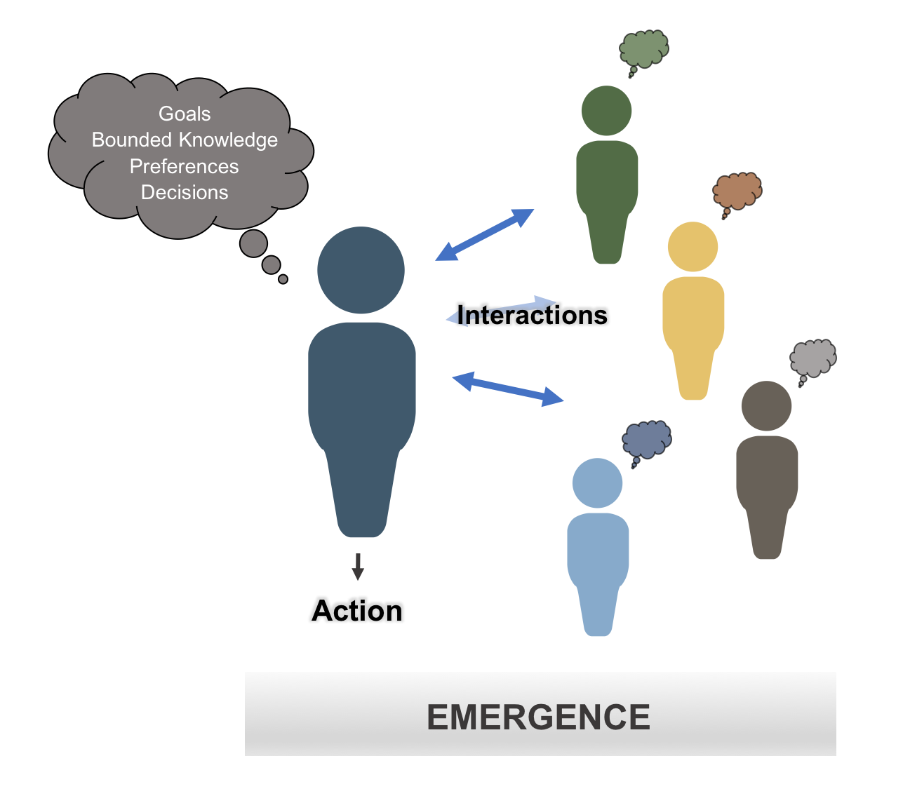
Main Components of an Agent
Figure 2.2: Schematic illustrating some of the main components of an agent.

Slide 8
An Agent’s World

Slide 9
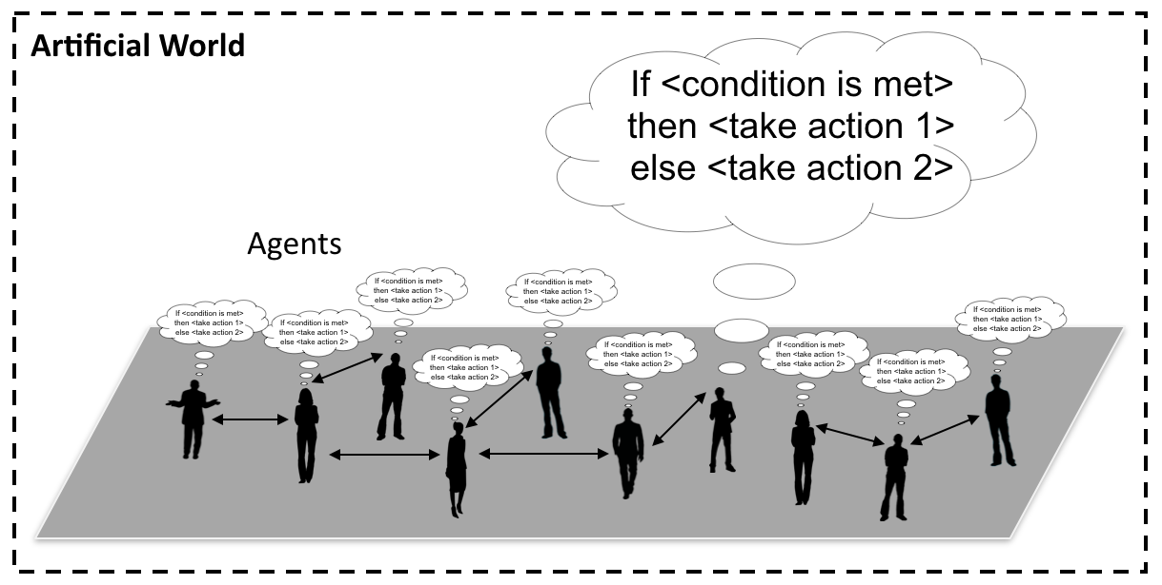
Agents and their “World”
Figure 2.3: Conceptualization of an agent-based model where people are connected to each other and take actions when a specific condition is met.

Slide 10
Advantages of Agent-based Modelling

Slide 11
Limitations of Agent-based Modelling

Slide 12
A Gallery of Applications

Slide 13
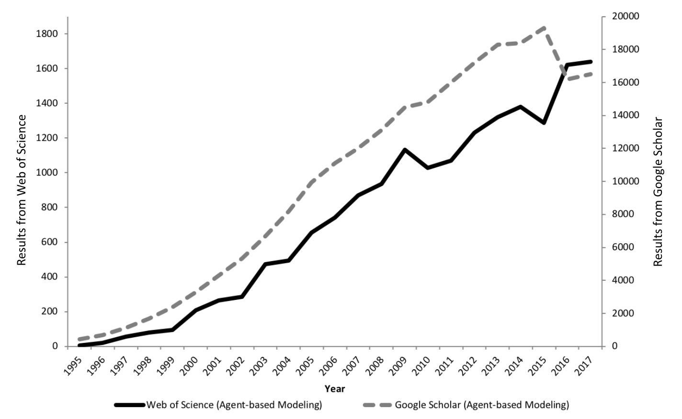
The Growth of Agent-based Modelling
Figure 2.4: The growth in agent-based modelling: from search results of Web of Science and Google Scholar.

Slide 14
Segregation

Slide 15
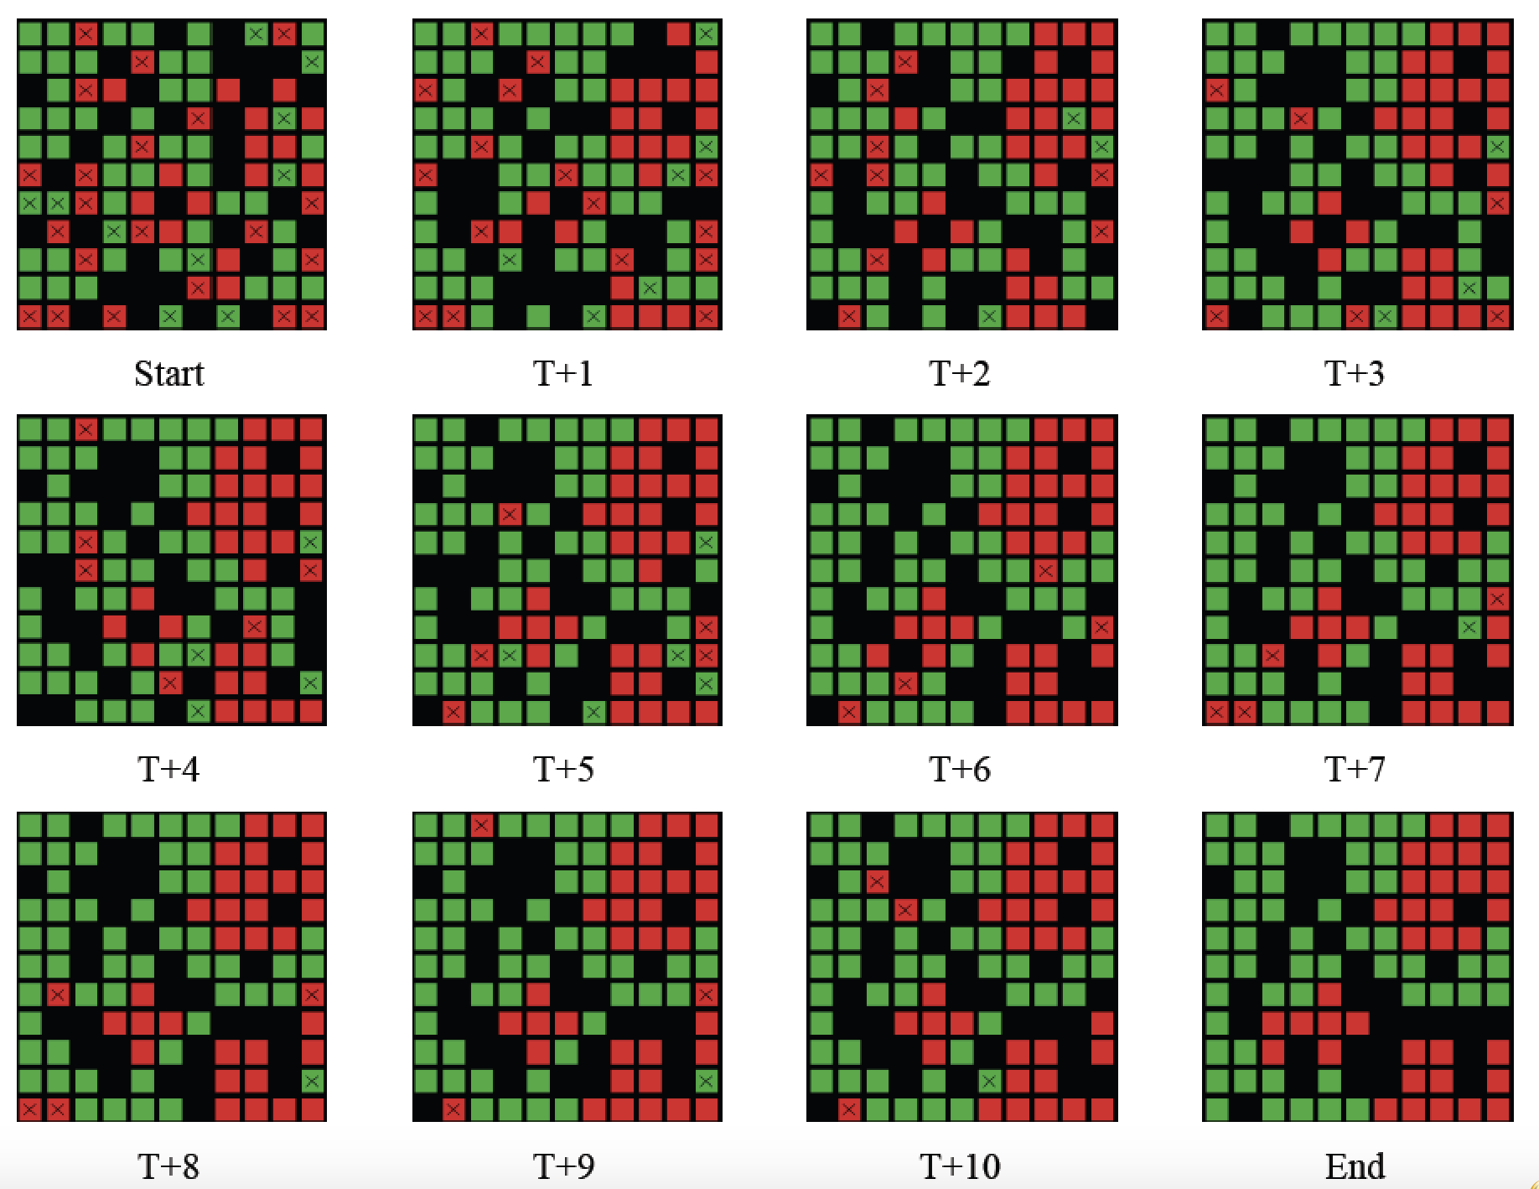
Progression of Segregation over Time
Figure 2.5: Progression of segregation over time: Agents what to live in a neighborhood where 40% are of the same color.

Slide 16
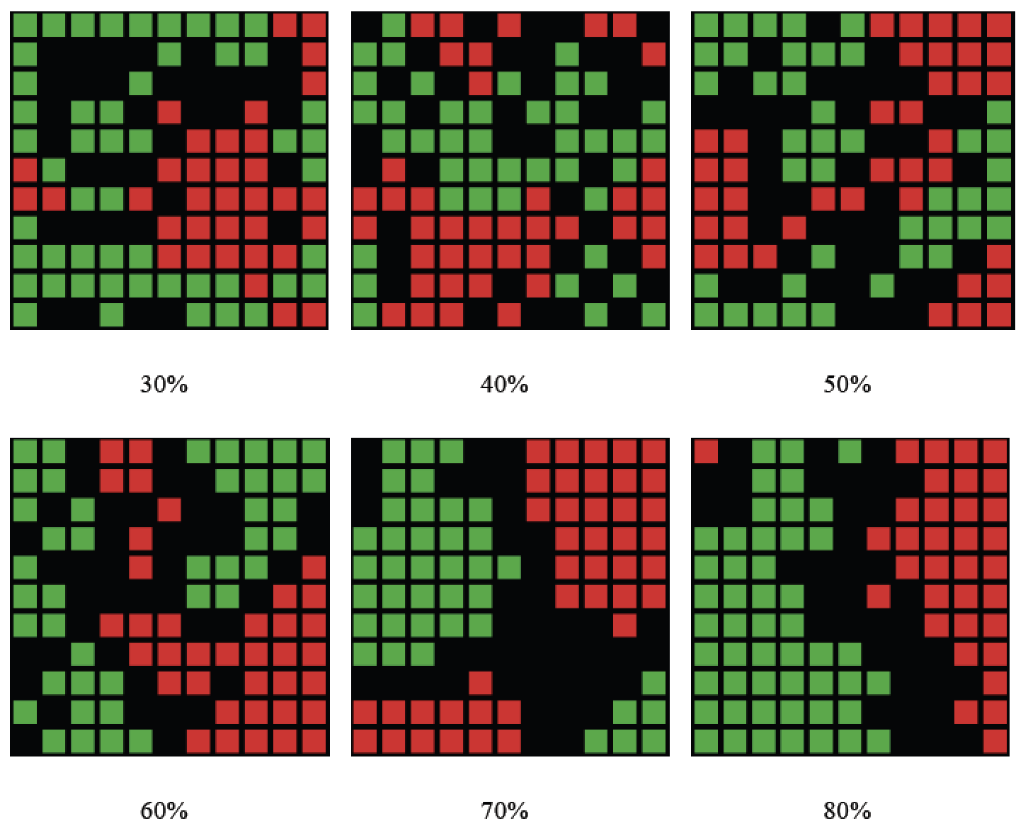
Changing Agents Preferences
Figure 2.6: Examples of how changing agents neighborhood preference levels leads to different patterns of segregation emerging.

Slide 17
From Abstract to Real World Applications
Add details about Benenson et al., 2002

Slide 18
SugarScape

Slide 19
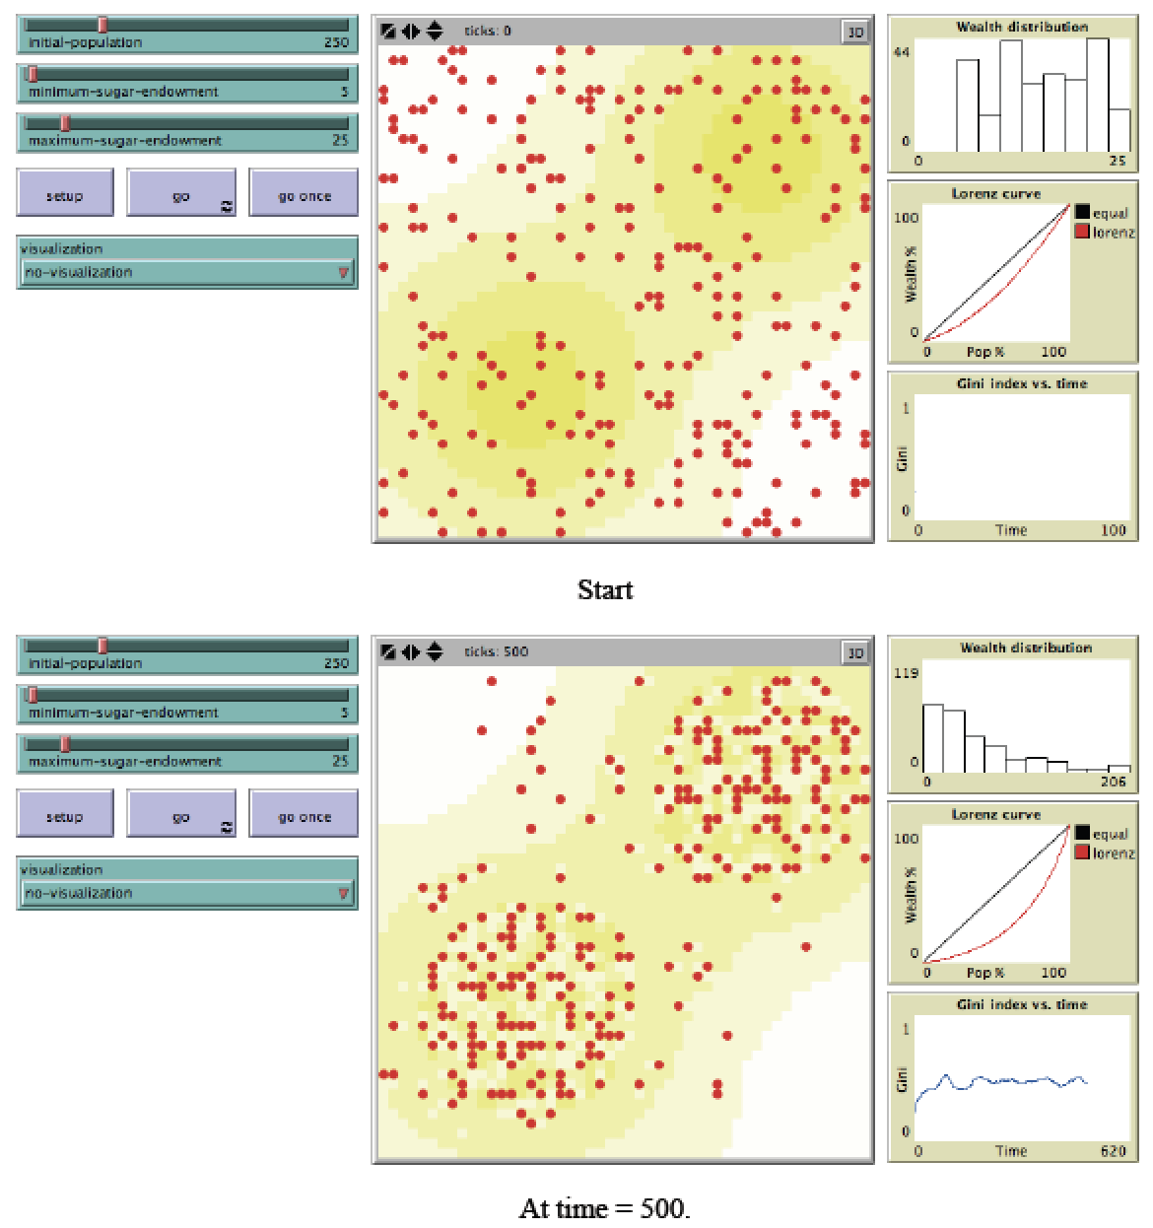
Graphical User Interface of Sugarscape Model
Figure 2.7: Sugarscape wealth distribution model (Source: Li and Wilensky, 2009).

Slide 20
Transportation Modelling

Slide 21
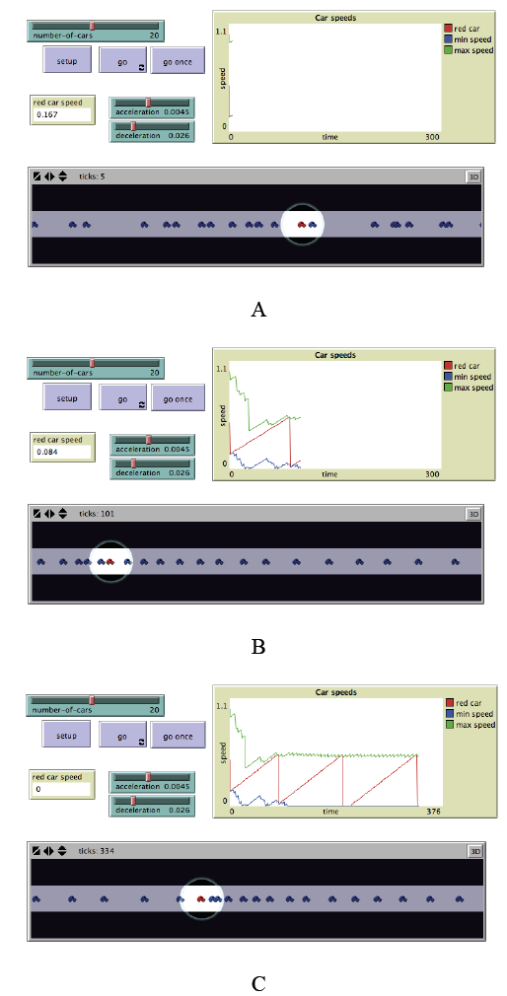
Traffic Modelling
Figure 2.8: Simple traffic model where each car is an agent. In A, B and C from top left clockwise, model parameters, a chart of car speeds and the spatial agent-environment (source: Wilensky, 1997).

Slide 22
Agent-based Models Used for Decision Making
Southwest Airlines used an agent-based model to improve how it handled cargo.
Eli Lilly used an agent-based model for drug development.
Pacific Gas and Electric: Used an agent based model to see how energy flows through the power grid.
Procter and Gamble used an agent-based model to understand its consumer markets.
NASDAQ used and agent based model to explore changes to Stock Market's decimalization.
Macy’s have used agent-based models for store design.
InSTREAM: Explores how river salmon populations react to changes in water conditions.

Slide 23
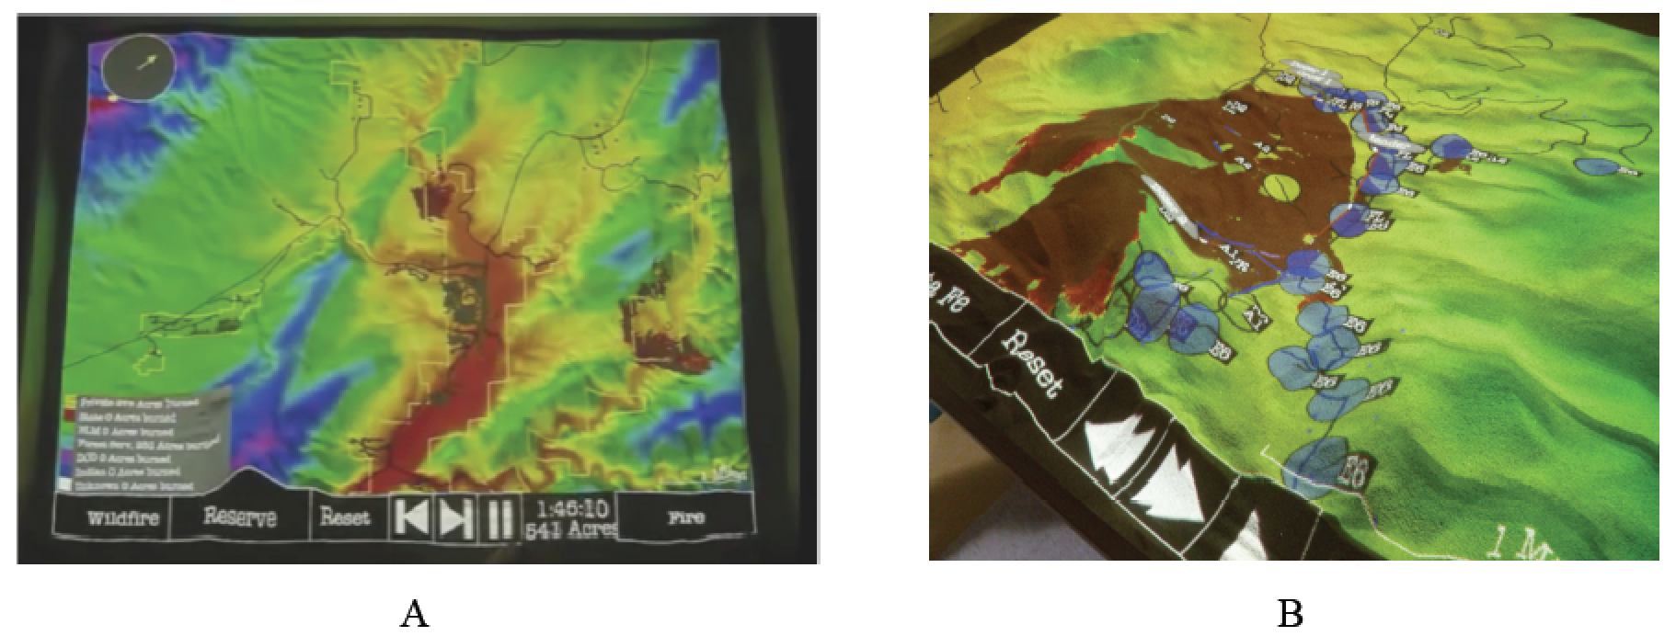
Real World Decision Making
Agent-based modeling has also been used for wild fire training, incident command and community outreach. For example SimTable was used in the 2016 Sand Fire in California.
Figure 2.9: User interface of SimTable: (A) Entire study area, (B): an active fire model (source: SimTable, 2017).
Notes:
Click on image to see a movie on YouTube. Or see https://youtu.be/aLmOxnPKUqk

Slide 24
Summary

