Slide 1
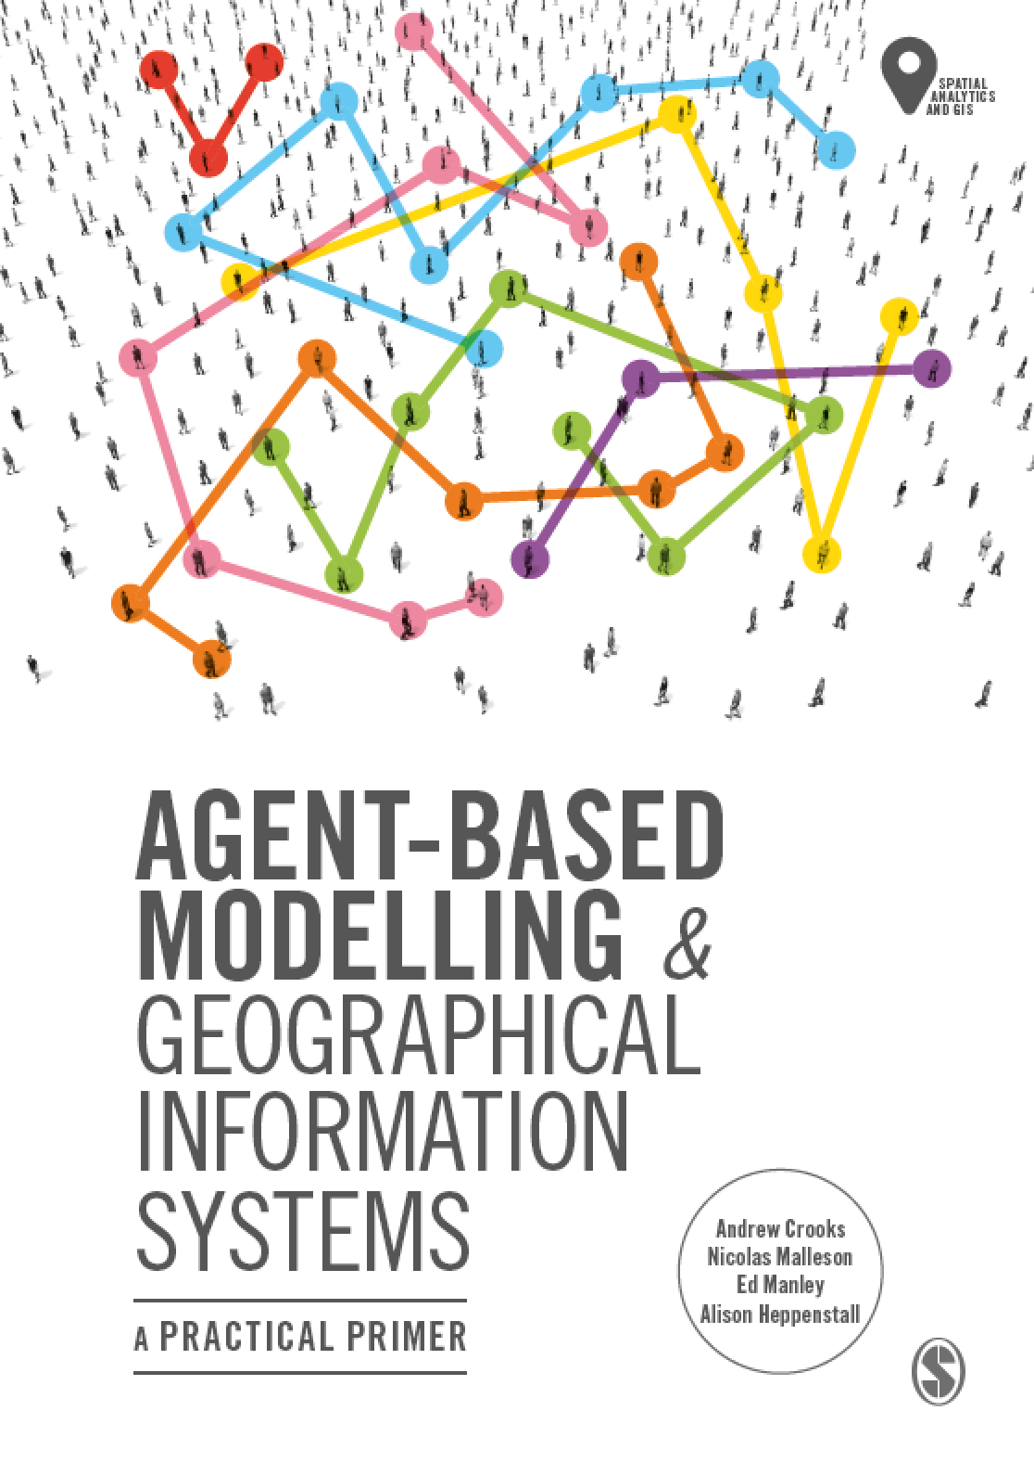
Chapter 11
Alternative Modelling Approaches
Notes:
Agent-based modelling is one of the most popular approaches used in social and spatial simulation. However, there are several other alternative approaches that are available to the researcher including Cellular Automata, Microsimulation, Discreet Event Simulation, System Dynamics and Spatial Interaction models. This chapter presents an overview of these other approaches giving simple examples on how they can be used and summarizing the main differences between them. To compare these models, they are applied to the same issue, the spread of a disease using a Susceptible-Infected-Recovered (SIR) epidemic model. This shows that while the same general patterns emerge, the reasons for this are very different. The chapter ends with a discussion and summary.

Slide 2
Learning Objectives
By the end of this lecture, students will be able to:
Discuss alternative modeling approaches to social and spatial simulation:
I.e. Cellular Automata, Microsimulation, Discreet Event Simulation, System Dynamics and Spatial Interaction models
Be able to discuss the main differences between each and their relative pros and cons.
Provide a basis for why agent-based models are a more suitable means for modeling geographical systems.

Slide 3
Introduction
Agent-based modelling is one of the most popular approaches used in social and spatial simulation.
However, there are several other alternative approaches that are available to the researcher including
Cellular Automata (CA), Microsimulation (MSM), Discreet Event Simulation (aka. Queuing Models), System Dynamics (SD) and Spatial Interaction (SI) models.
It is important to know the differences between these in order to justify why one should use agent-based models over over techniques.
In this lecture we will introduce these models, give some applications and
To compare these models, they are applied to the same issue, the spread of a disease using a Susceptible-Infected-Recovered (SIR) epidemic model.

Slide 4
Cellular Automata
CA models are dynamic simulation models
Cell transitions are based on the state of the current cell and the states of neighboring cells.
“Neighbors” can be very broadly defined (and may include multi-scale influences)
Transitions may also depend on cell history
i.e. next cell states depends on current cell state as in game of life
Cellular structures are generally grids, but can be any cellular structure (e.g. irregular polygons)

Slide 5
Cellular Automata
CA are computer based simulations that use a static cell framework or lattice as the environment (model of space)
Each cell has a well-defined state at every specific discrete point in time (step)
Cell states may change over time according to state transition rules
Transition rules that are applied to cells depend upon their neighborhoods (i.e. the states of adjacent cells typically)

Slide 6
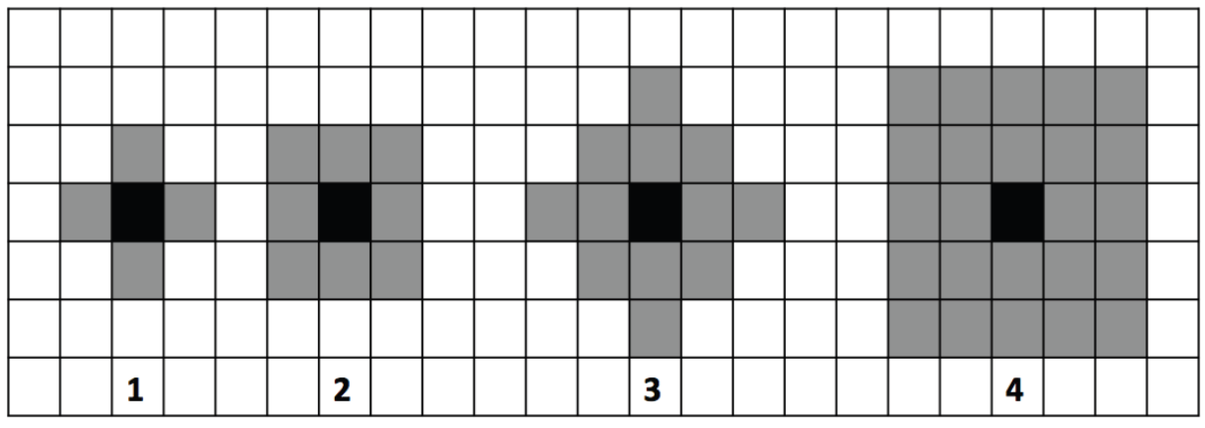
Different Neighborhood Configurations
Figure 11.1: Diagrammatic representation of 2D cellular automata and the most commonly used neighborhoods (1) von Neumann 1-neighbourhood, (2) Moore 1-neighbourhood, and extended (3) von Neumann and (4) Moore neighborhoods.

Slide 7
Game of Life
State variables: cells contain a 1 or a 0 (alive or dead)
Spatial framework: operates over a rectangular lattice (with square cells)
Neighborhood structure: 8 surrounding cells
State transition rules: time t_{n} -> _{tn+1}
Survival: if state=1 and in its neighborhood 2 cells have state=1 then state cell remains state 1 else state = 0
Reproduction: if state=0 but if the state of 3 neighboring cells =1 then state 1
Death (loneliness or overcrowding): if state=1 but has less than 2 neighbors with state 1 or if more than 3 neighbors are 1 then state = 0

Slide 8
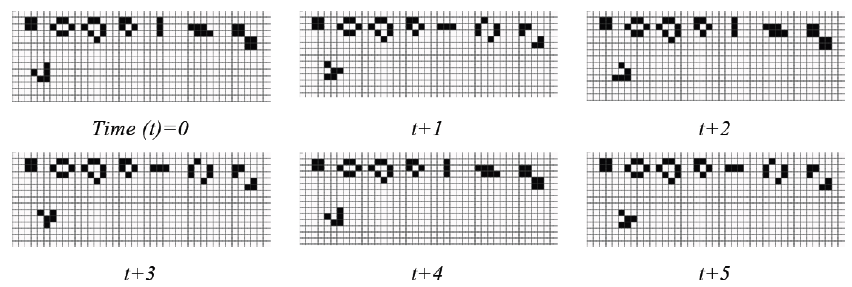
Cells Changing State in the Game of Life
Figure 11.2: Example of cells changing state from dead (white) to alive (black) over time depending on the states of its neighboring cells (modified from Wilensky, 1998).
Notes:
Add Link to Model

Slide 9
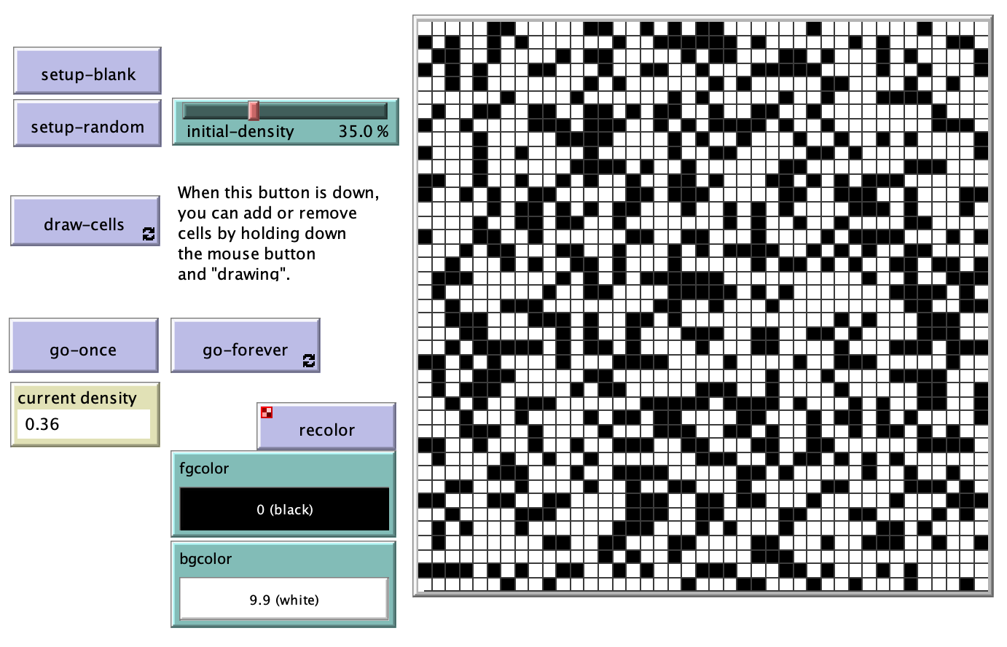
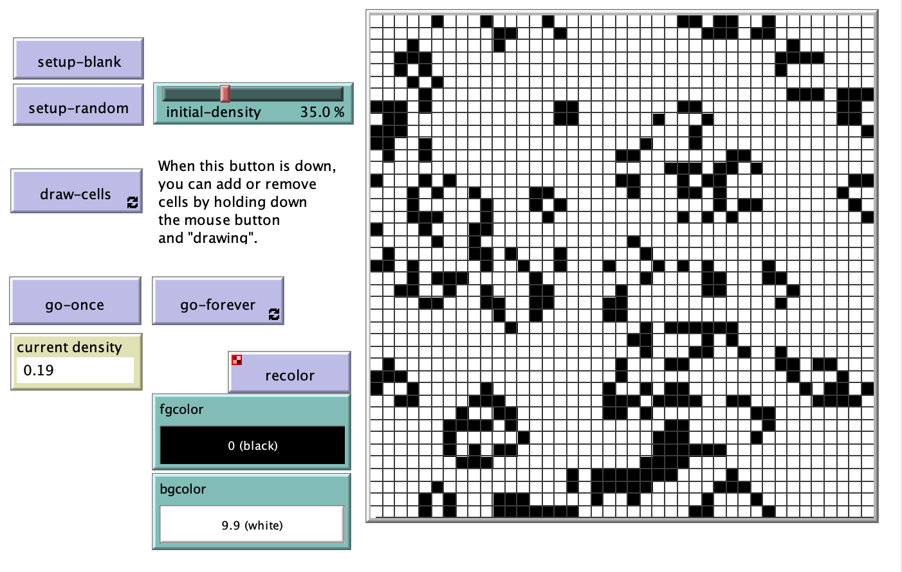
Game of Life Example: Run the Model
Random Starting Condition
Patterns after X Steps
Link to the model

Slide 10
Microsimulation Models (MSM)
Representative database of individuals
e.g. sex, age, marital status, education, employment....
Weighted to reflect aggregate characteristics
Have a number of transition probabilities
Subjected to model treatment
Aging, marriage etc.
Combined to generate aggregate predictions based on initial micro-units

Slide 11
Static vs. Dynamic Microsimulation Models
There are two types of Microsimulation Models
Static:
Creates a micro-level population from aggregate data
Uses measured characteristics,
Re-weights according to model treatment
Example: Change of tax code
Dynamic:
Moves a population through space and time
Ages sample
Uses measured or assumed transition probabilities
Example: Population projection, social security
MSMs have been widely used to study the impact of social, administrative, and environmental changes on population

Slide 12
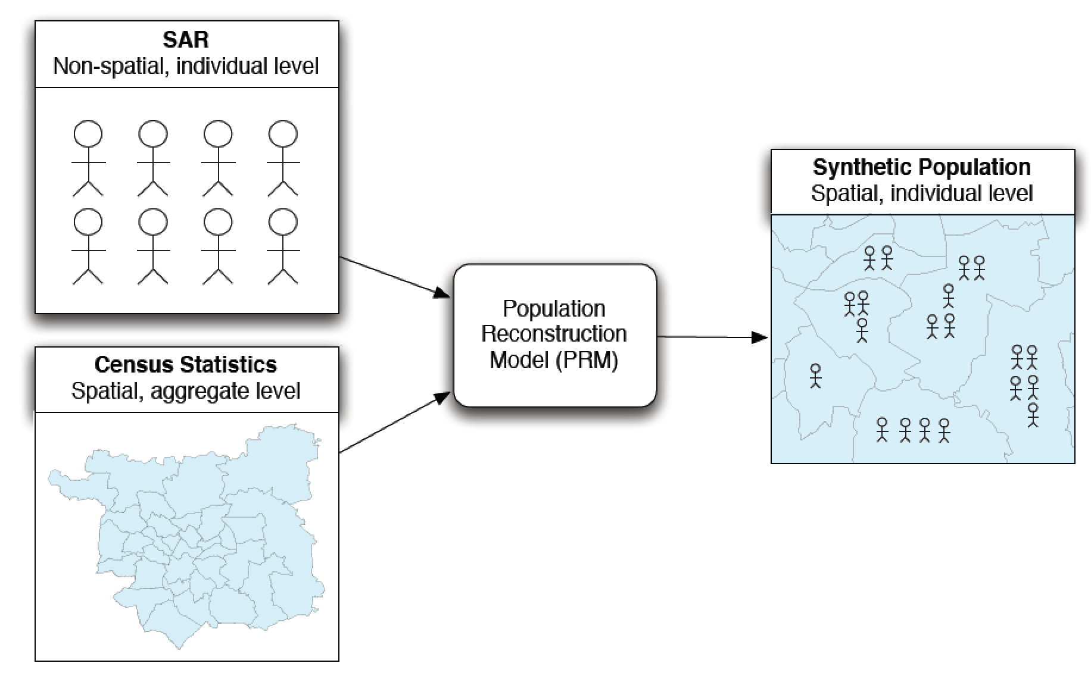
Creating a Synthetic Population using Microsimulation
Figure 11.3: Schematic outlining the basic process of creating a synthetic population using microsimulation.

Slide 13
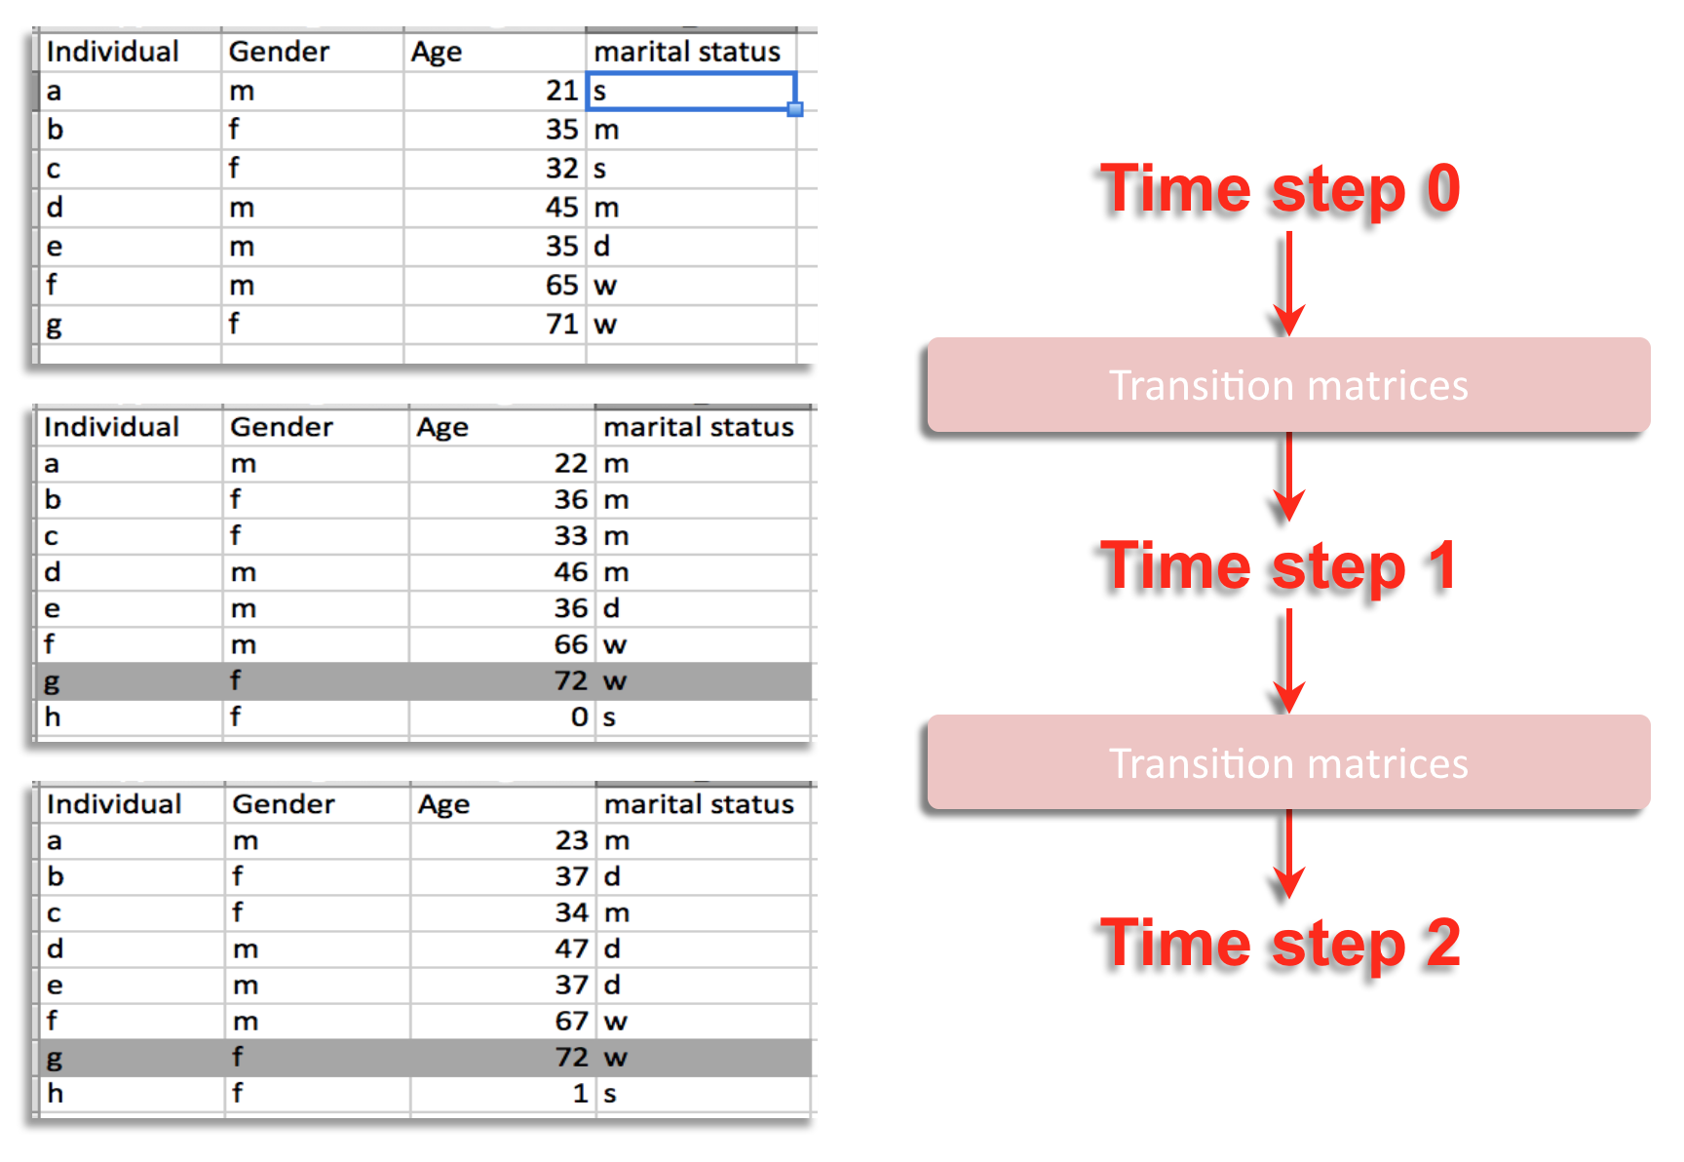
Changing the Population Over Time
Figure 11.4: A simple example of dynamic microsimulation process where individuals change over time (m = married, d = divorced, w = widowed).

Slide 14
Discreet Event Simulation (DES) (aka Queuing Models)
Abstracts the world into three abstract types of objects:
1) Servers, 2) customers, 3) queues
Example: DMV clerks, Drivers, Lines (or lists)
Aim is to create efficient process with minimum resources
Identify bottlenecks
Makes use of stochastic arrival and service times
Generally based on observed behavior of target system (or similar system used as proxy)

Slide 15
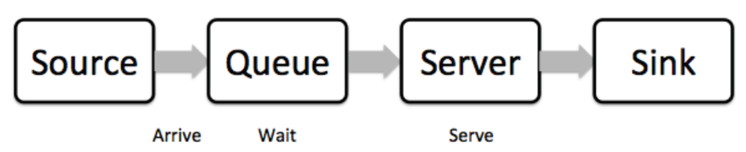
Basic Properties of a Discrete Event Simulation
Figure 11.5: Simple example of a Discreet Event Simulation.

Slide 16
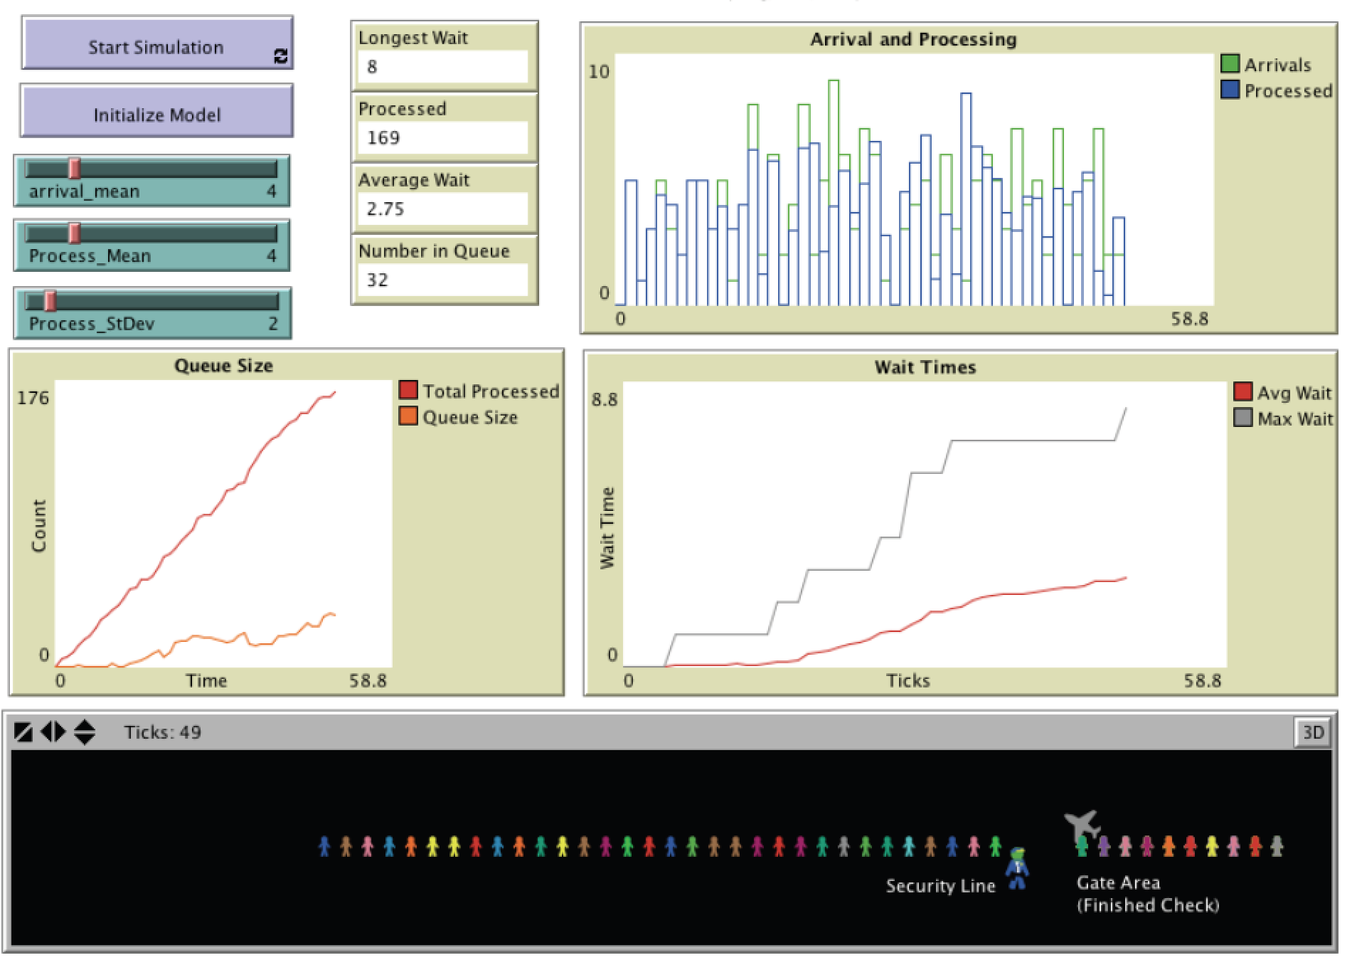
Airport Security via a Discrete Event Simulation Model
Simulating the waiting time of passengers as they go through a security checkpoint at an airport
Servers are Transportation Security Administration employees,
Customers are passengers,
Queue is the security lines.
Figure 11.6: Airport security line simulation (Source: Bybee and Eng, 2012).
Notes:
URL Takes you to the model.

Slide 17
System Dynamics
System dynamics is an approach to understanding the behavior of the entire system over time.
Abstraction within the model is organized around breaking the system down into functional aspects.
Small number of element types:
Stocks
Flows
Constants
Converters (NetLogo calls these Variables)
Allows for treatment of systems of Differential equations that can not be handled analytically.

Slide 18
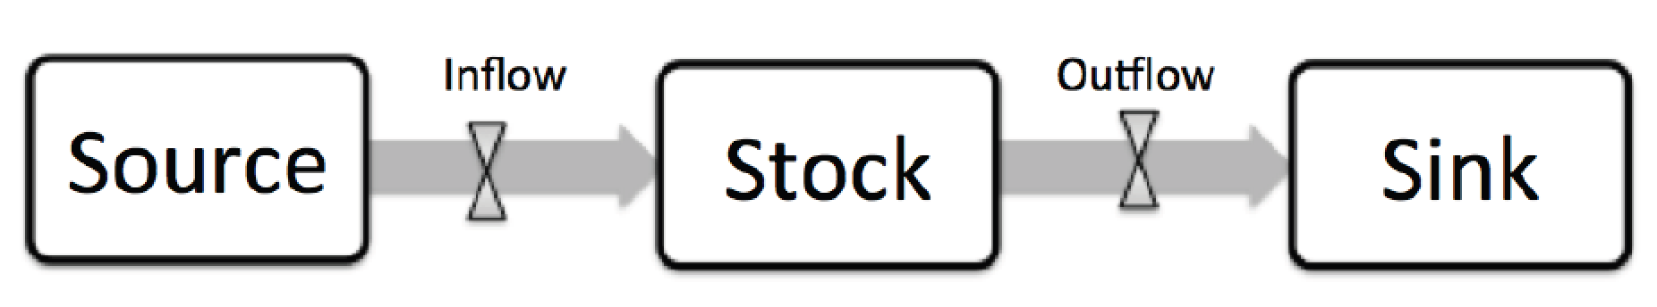
Basic Elements of a System Dynamics Model.
Figure 11.7 Basic elements of a system dynamics model

Slide 19
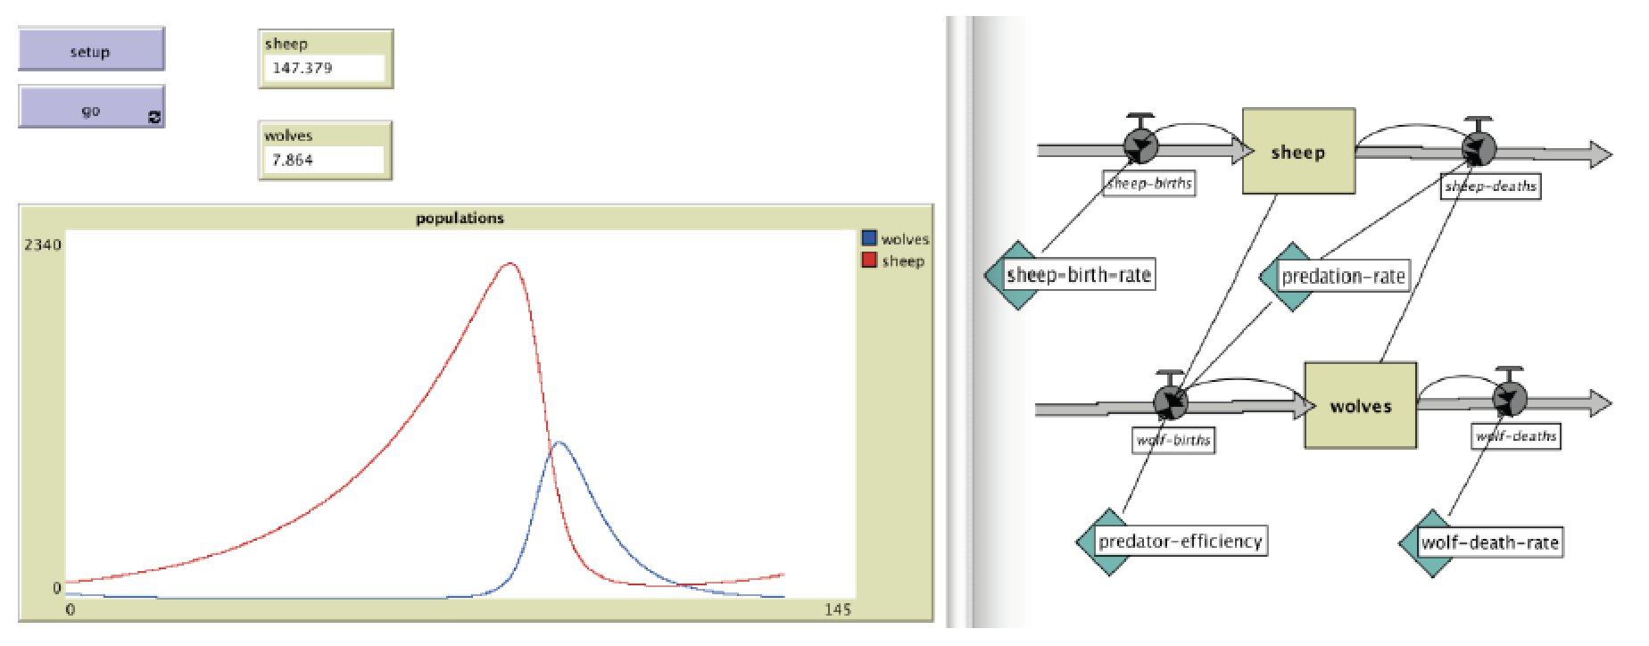
Wolf Sheep Predation implemented as a System Dynamics Model
Figure 11.8: An Example of a Wolf Sheep Predation model implemented as a system dynamics model (source: Wilensky, 2005a).

Slide 20
Spatial Interaction Models
A mathematical model for simulating / predicting the interaction between two geographical features.
Interaction between features can be measured in:
goods,
information,
money; or
People …..
Applications range from the study migration and retail trade (e.g. Reilly’s ‘law of retail gravitation’), traffic-flow and newspaper circulation.
Notes:
These models were based on mathematical assumptions analogous to
Newton’s law of universal gravitational attraction. The gravitational model has a
direct analogy in geography: the greater the distance, the less travel occurs because
of the distance decay effect which discourages flows over longer distances.

Slide 21
Spatial Interaction Models
A spatial interaction model has three key components:
origins or origin masses,
destinations or destination masses; and
a representation of the relationship between each origin-destination pairs physical locations in geographical space
distance (network / Euclidean)
cost of travel
time etc…
They are aggregate models and thus individuals are poorly represented

Slide 22
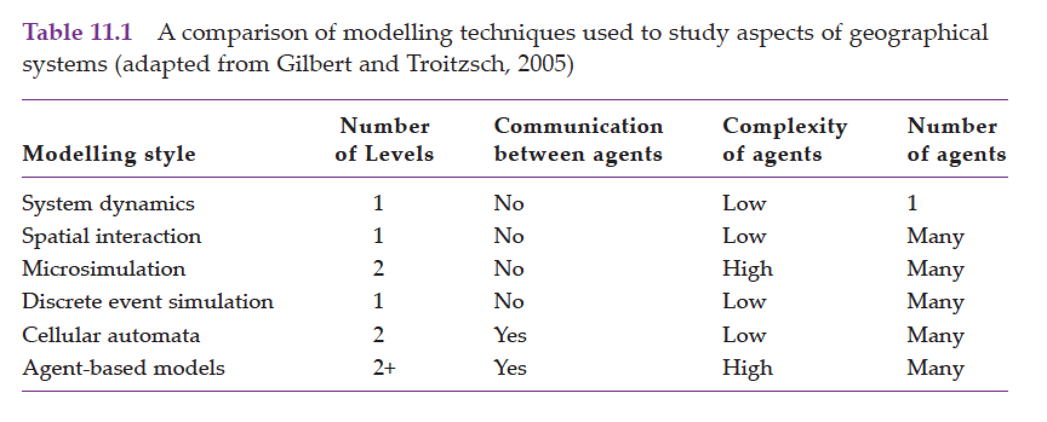
Comparing Different Modelling Approaches

Slide 23
A Practical Comparison: The SIR Model
Disease modeling has a long history.
One common approach to modeling a disease spread is via a susceptible–infected–recovered (SIR) epidemic model
Here we explore the same problem via different modeling approaches to show how modeling techniques differ.
To compare different modeling approaches to the same issue there are 4 models:
Cellular Automata (SIR_CA.nlogo)
Discreet Event Simulation (SIR_DES.nlogo)
System Dynamics Model (SIR_SD.nlogo)
Agent-based Model (SIR_ABM.nlogo)

Slide 24
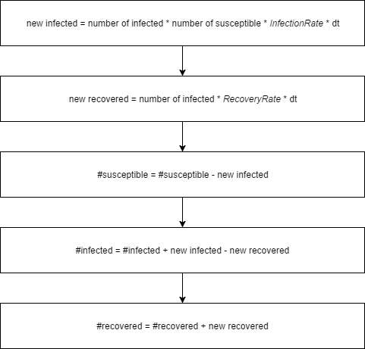
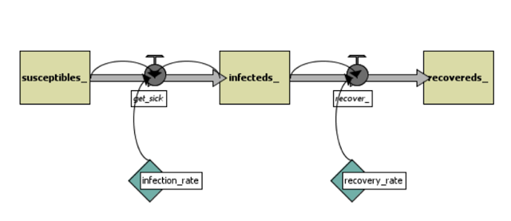
The System Dynamics Approach
Figure 11.9: System Dynamics process (source: Shiflet and Shiflet, 2014).
Figure 11.10: System Dynamics flowchart.

Slide 25
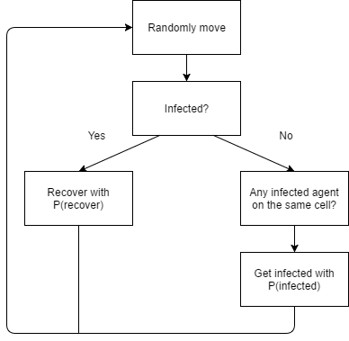
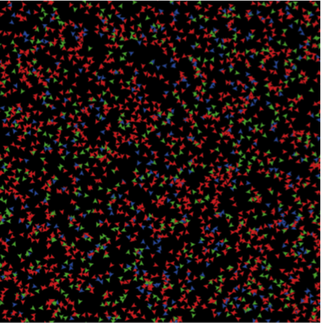
The Agent-Based Approach
Figure 11.12: Display of the agent-based model. Green = susceptible. Red = infected. Blue = recovered.
Figure 11.11: Agent-based Modelling: agent decision process.

Slide 26
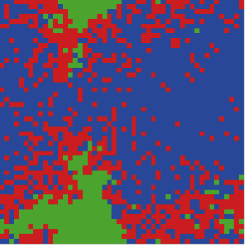
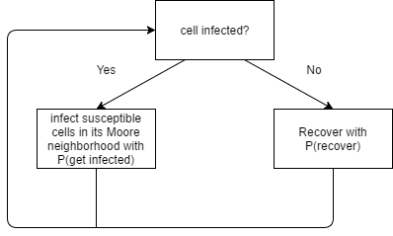
The Cellular Automata Approach
Figure 11.14: Display of the CA model. Green = susceptible. Red = infected. Blue = recovered.
Figure 11.13: Cellular Automata cell changing process.

Slide 27
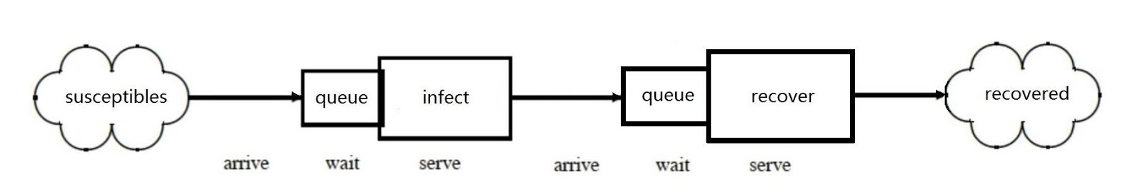
The Discrete Event Simulation Approach
Figure 11.15: Discrete event simulation process.

Slide 28
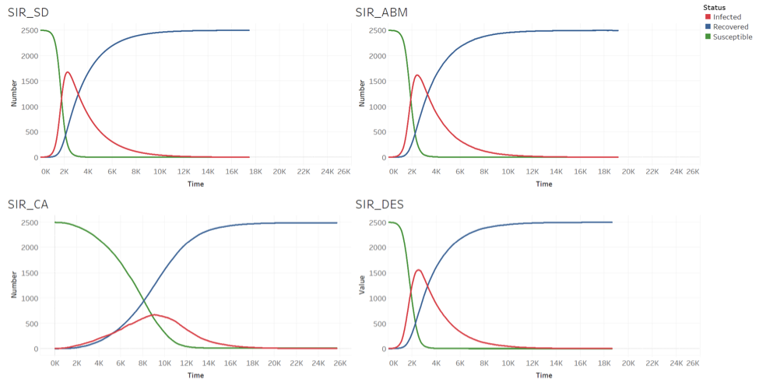
Comparative Analysis
The default parameters used in each model are:
Number of susceptible people at set-up = 2500,
Infection rate = 0.002,
Recovery rate = 0.5,
Change in time (dt) = 0.001;
The models record the number of people in each status are recorded.
Figure 11.16: Results for the different models. Clockwise from top left: SD model, agent-based model, DES and CA.
Notes:
The default parameters used in each model are:
Number of susceptible people at set-up = 2500,
Infection rate = 0.002,
Recovery rate = 0.5,
Change in time (dt) = 0.001;
The models record the number of people in each status are recorded.

Slide 29
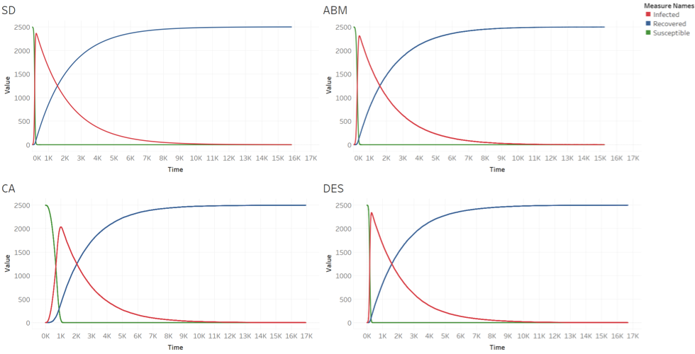
Comparative Analysis
By changing the infection rate to 0.02. The models produce different curves.
Figure 11.17: Results for the different models with infection rate = 0.02. Clockwise from top left: SD model, agent-based model, DES and CA.

Slide 30
Discussion
This lecture has presented the most commonly used styles of model that can be found within the social sciences.
These models typically operate at either the aggregate (e.g. SD and spatial interaction models) or disaggregate (e.g. CA, DES, MSM and ABM) level.
Unlike the other approaches, ABM has the ability to incorporate direct agent–agent interaction and create heterogeneous agents.
In agent-based models, patterns emerge from the direct interaction of multiple heterogeneous agents from the 'bottom up’ as shown via the SIR models.

Slide 31
Further Reading
Lastly, for a more detailed discussion of all the techniques discussed in this chapter and their history, readers are referred to the following excellent resources:
Gilbert, N. and Troitzsch, K.G. (2005) Simulation for the Social Scientist (2nd ed.). Maidenhead: Open University Press.
Shiflet, A.B. and Shiflet, G.W. (2014) Introduction to Computational Science: Modeling and Simulation for the Sciences (2nd ed). Princeton, NJ: Princeton University Press.
Sterman, J.D. (2000) Business Dynamics: Systems Thinking and Modeling for a
Complex World. Boston: McGraw-Hill.
Wolfram, S. (2002) A Knew Kind of Science. Champaign, IL: Wolfram Media.

Slide 32
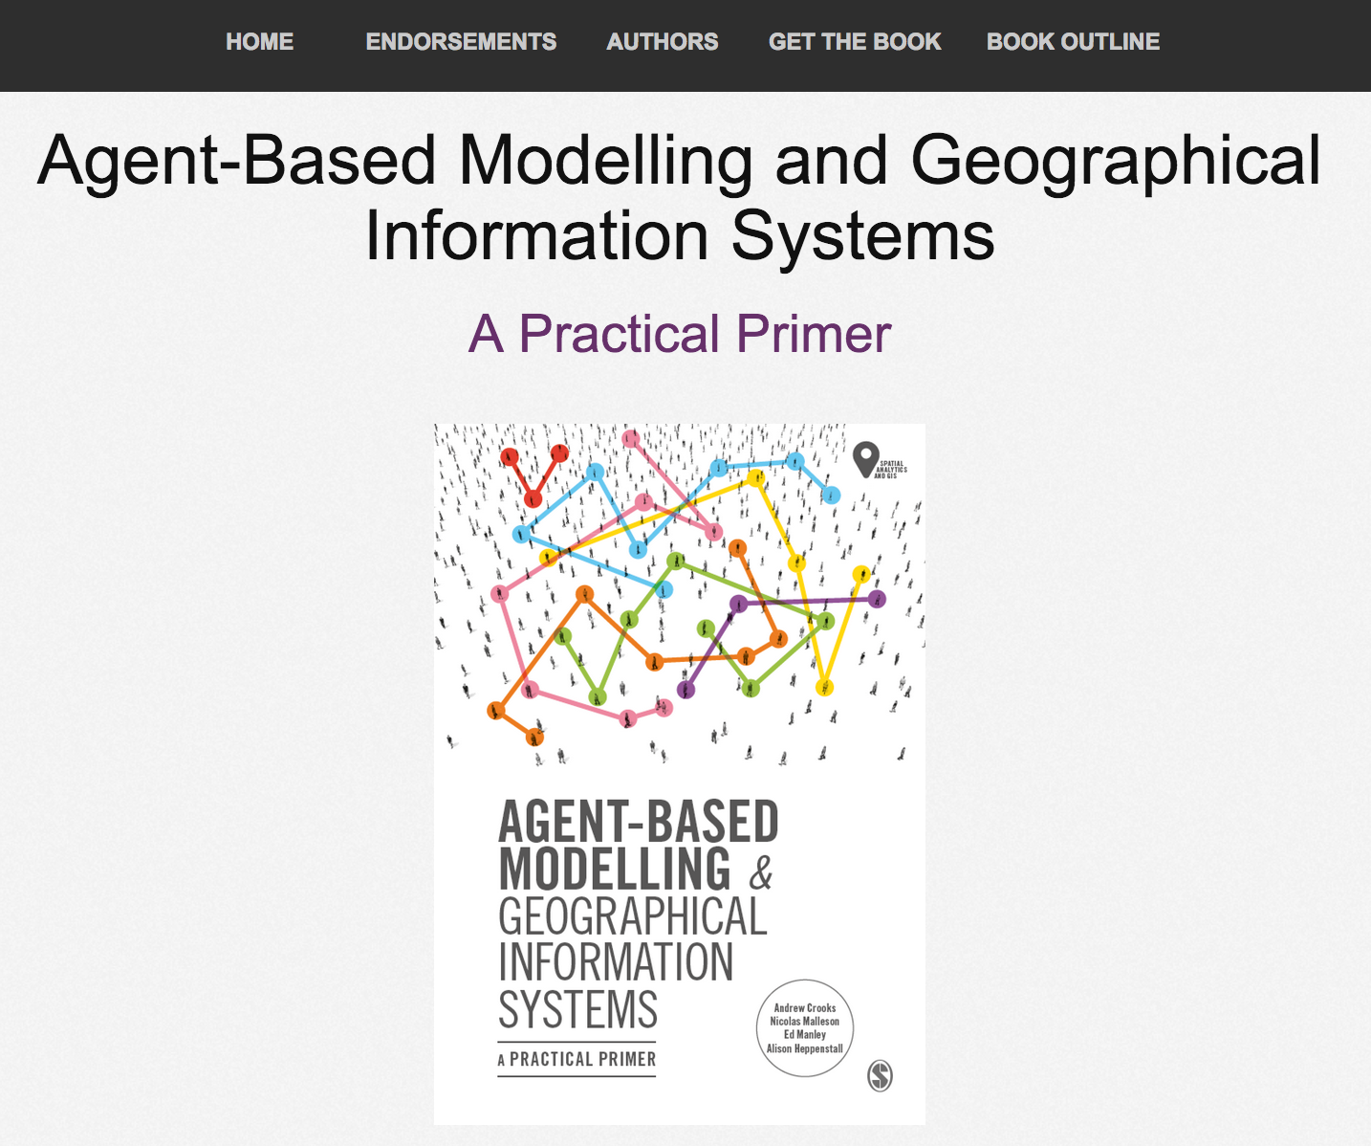
Online Resources
Visit: https://github.com/abmgis/abmgis/tree/master/Chapter11-AlternativeModellingApproaches for a selection of models to highlight core concepts introduced in this chapter

