Slide 1
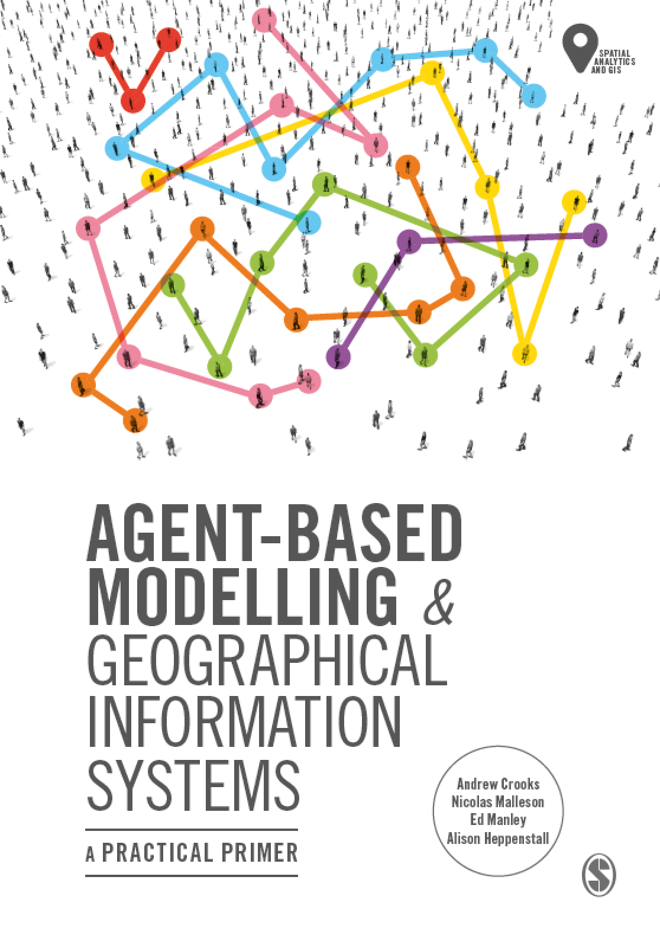
Chapter 2
Introduction to Agent-Based Modelling
Notes:
In this Chapter we introduce the key concepts behind agent-based modelling. What is an agent, and what are rules? These are discussed along with a consideration of the main advantages and disadvantages for simulating spatial systems. A range of established applications are presented to give a flavour of how agent-based models can be successfully applied. The overarching aim of this chapter is to give the reader an understanding of what an agent-based model is. This knowledge will be built upon in subsequent chapters.

Slide 2
Learning Objectives

Slide 3
Chapter 1
Agent-based Modelling and Geographical Information Systems
Notes:
The overarching aim of this chapter is to give the reader a contextual background and general overview of the major developments in geographical modelling for the simulation of the individual. The reader is introduced to a discussion around the purpose of modelling as well how complexity theory has influenced the way that we view (and simulate) geographical systems. We end the chapter by discussing the benefits of bringing together agent-based modelling and GIS.

Slide 4
Introduction

Slide 5
What is an Agent?

Slide 6
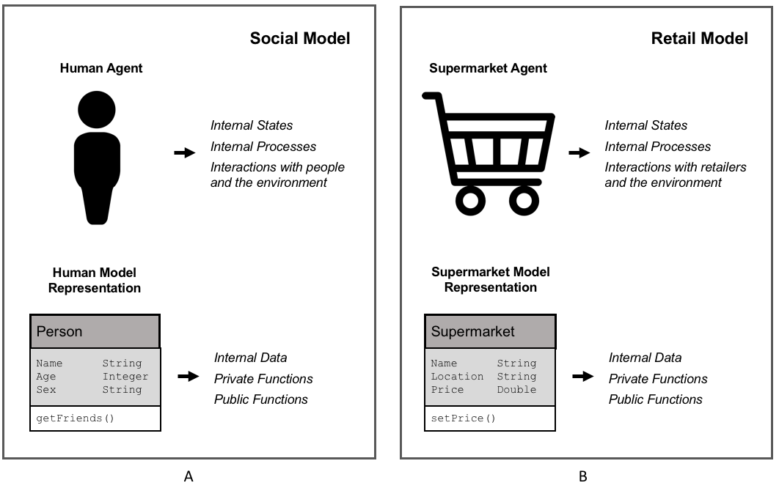
Agent Representation
Figure 2.1: Representation of (A) human agent and (B) supermarket retailer agent alongside that of representation within an object-orientated environment.

Slide 7
Agent Rules

Slide 8
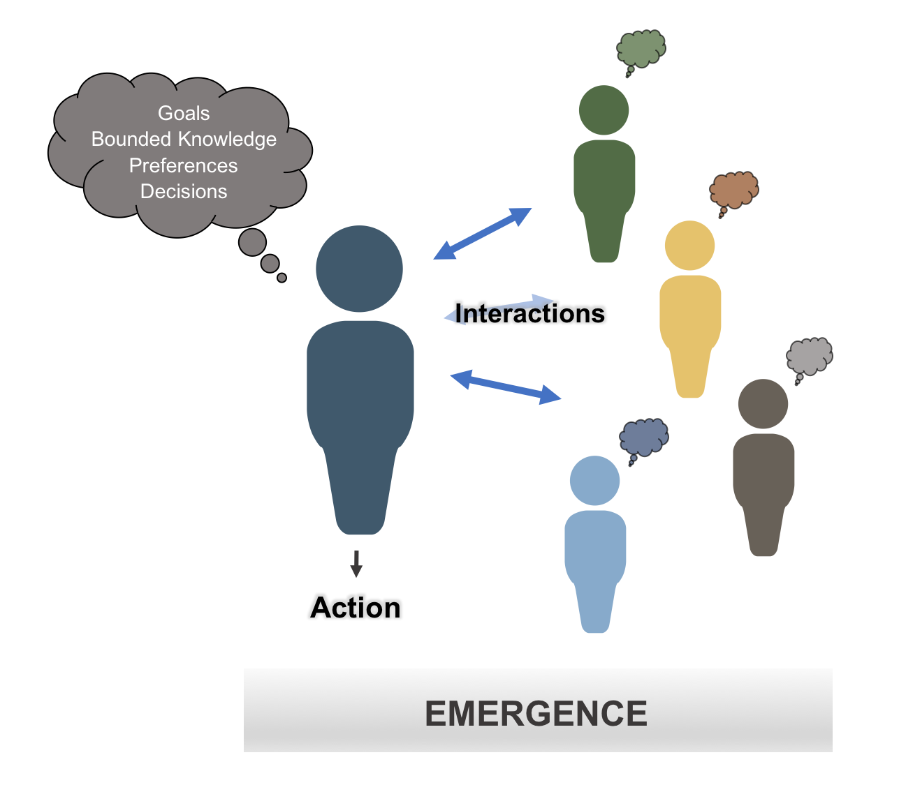
Main Components of an Agent
Figure 2.2: Schematic illustrating some of the main components of an agent.

Slide 9
An Agent’s World

Slide 10
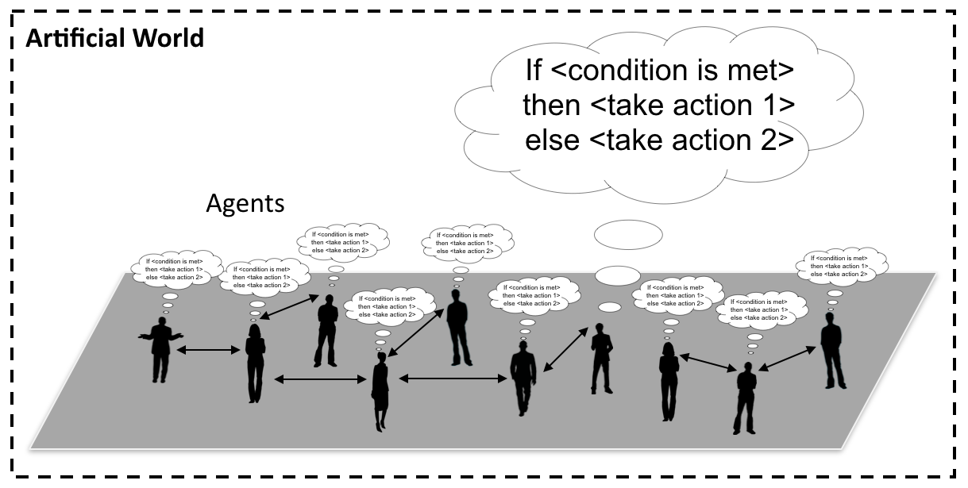
Agents and their “World”
Figure 2.3: Conceptualization of an agent-based model where people are connected to each other and take actions when a specific condition is met.

Slide 11
Advantages of Agent-based Modelling

Slide 12
Limitations of Agent-based Modelling

Slide 13
A Gallery of Applications

Slide 14
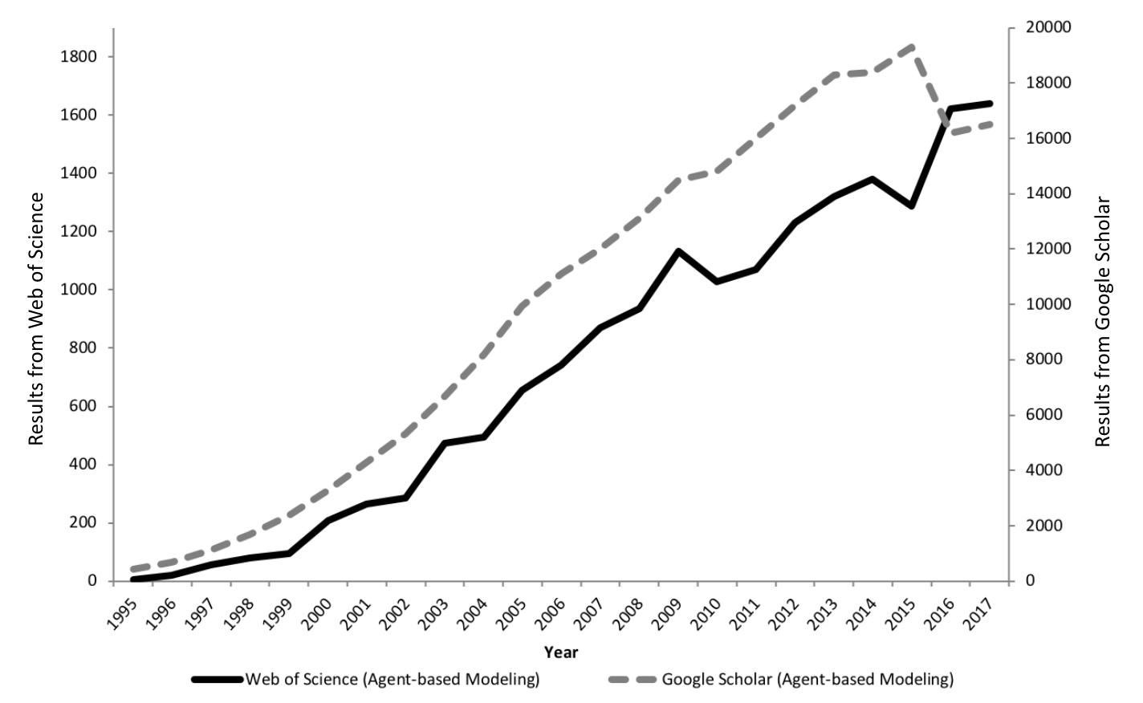
The Growth of Agent-based Modelling
Figure 2.4: The growth in agent-based modelling: from search results of Web of Science and Google Scholar.

Slide 15
Segregation

Slide 16
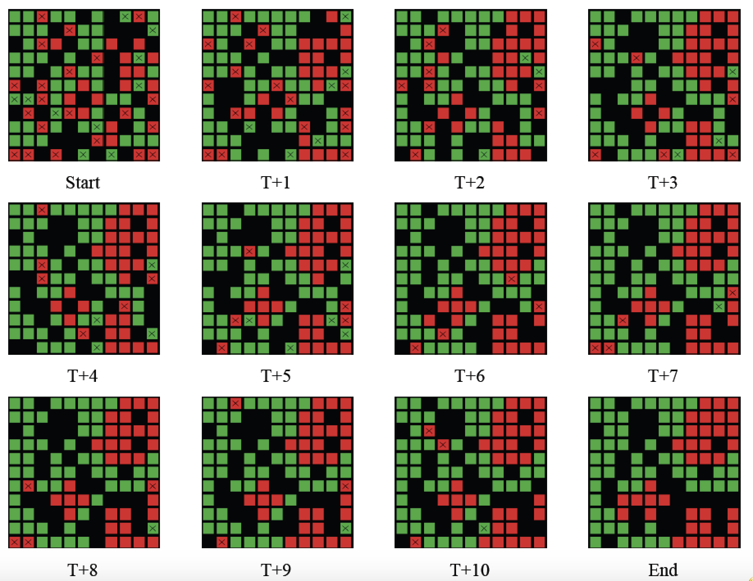
Progression of Segregation over Time
Figure 2.5: Progression of segregation over time: Agents what to live in a neighborhood where 40% are of the same color.

Slide 17
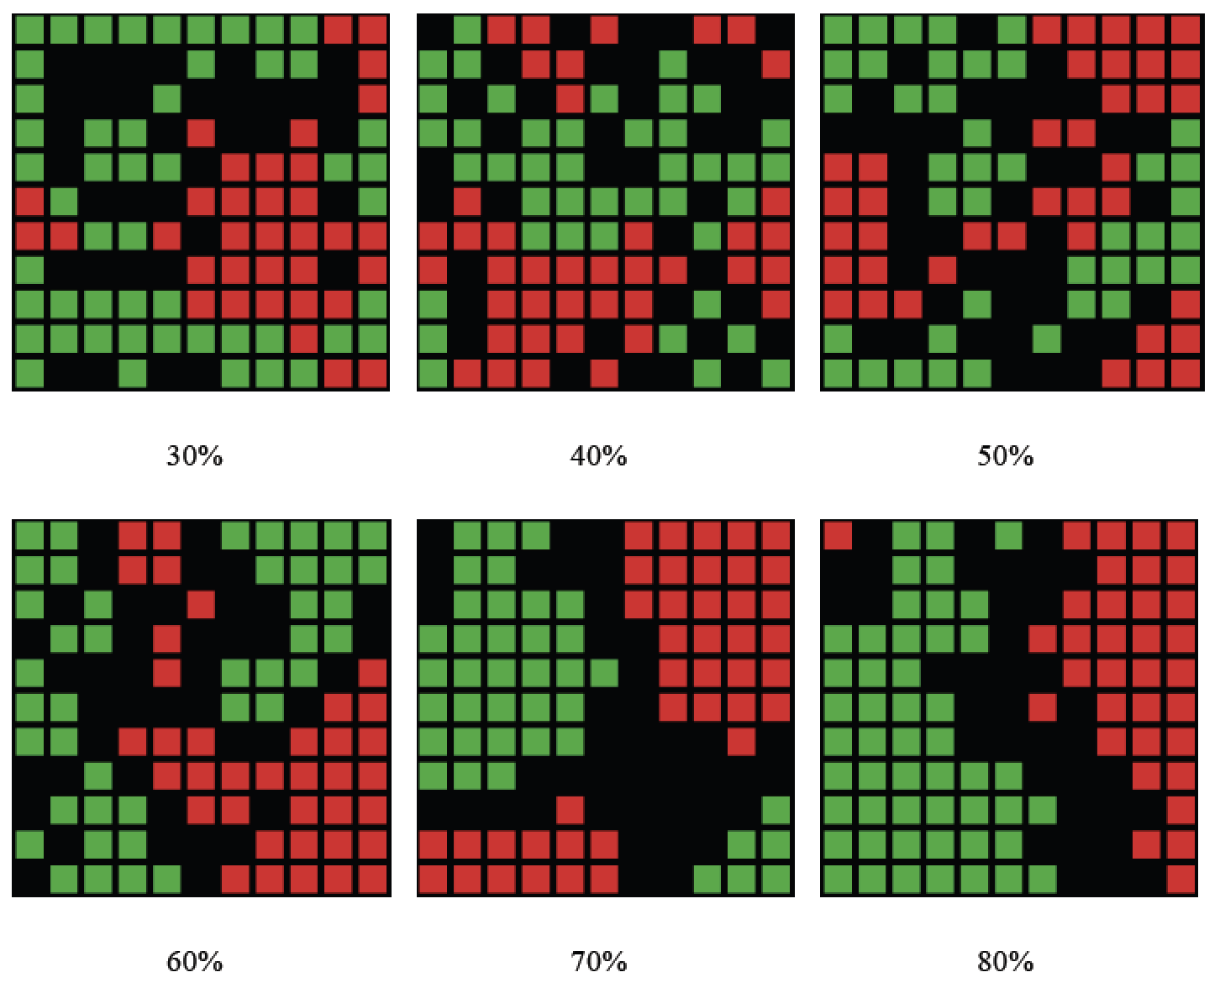
Changing Agents Preferences
Figure 2.6: Examples of how changing agents neighborhood preference levels leads to different patterns of segregation emerging.

Slide 18
From Abstract to Real World Applications
Add details about Benenson et al., 2002

Slide 19
SugarScape

Slide 20
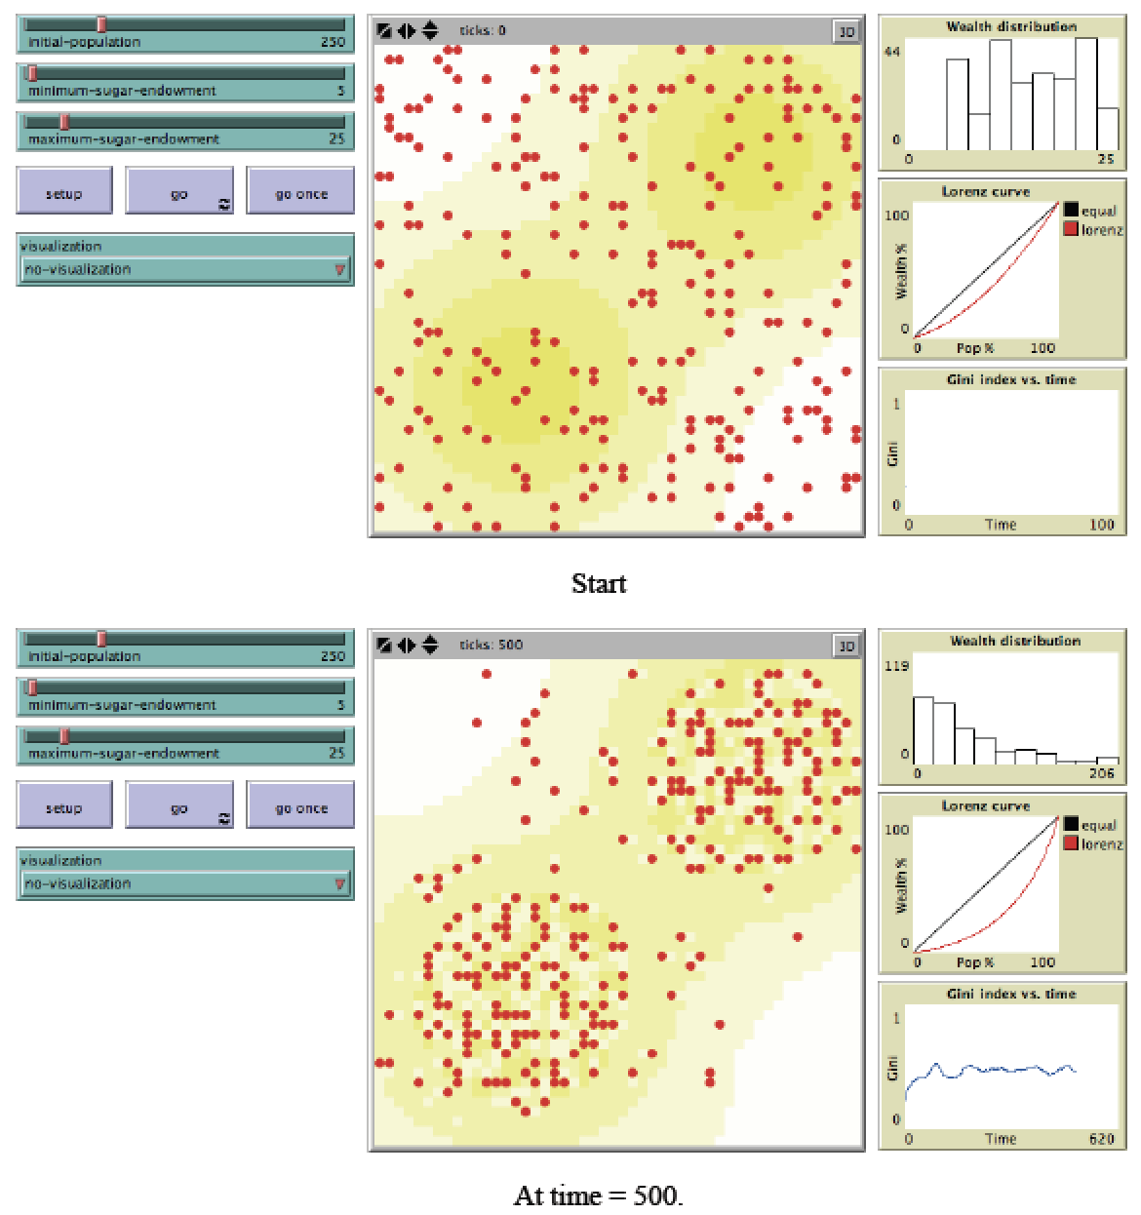
Graphical User Interface of Sugarscape Model
Figure 2.7: Sugarscape wealth distribution model (Source: Li and Wilensky, 2009).

Slide 21
Transportation Modelling

Slide 22
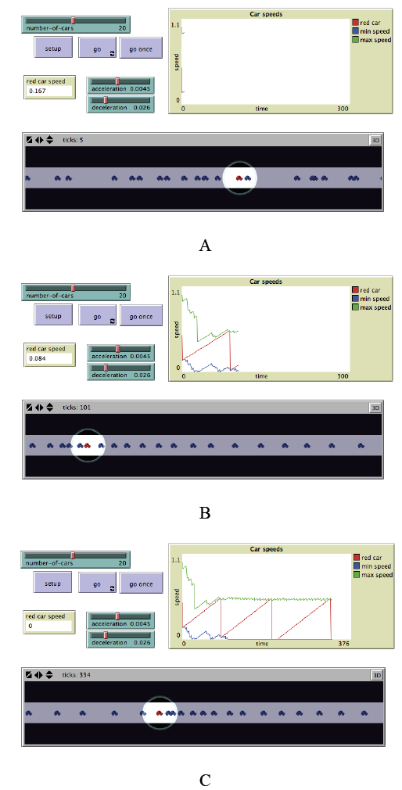
Traffic Modelling
Figure 2.8: Simple traffic model where each car is an agent. In A, B and C from top left clockwise, model parameters, a chart of car speeds and the spatial agent-environment (source: Wilensky, 1997).

Slide 23
Show Real World Example.

Slide 24
Agent-based Models Used for Decision Making

Slide 25
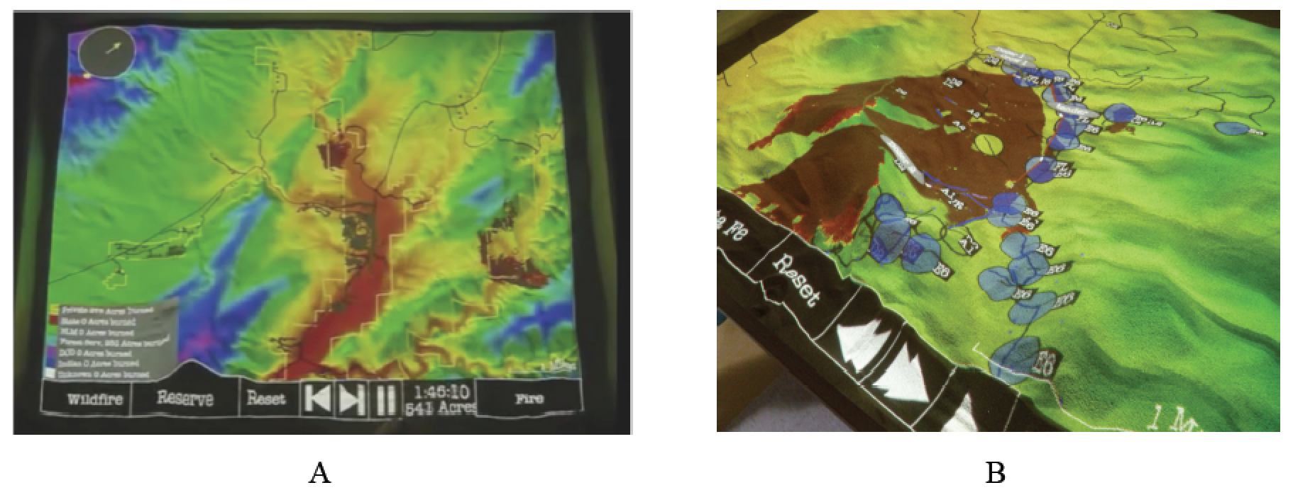
Real World Decision Making
Figure 2.9: User interface of SimTable: (A) Entire study area, (B): an active fire model (source: SimTable, 2017).
More information about SimTable see: https://www.simtable.com
Notes:
Click on image to see a movie on YouTube. Or see https://youtu.be/aLmOxnPKUqk

