Slide 1
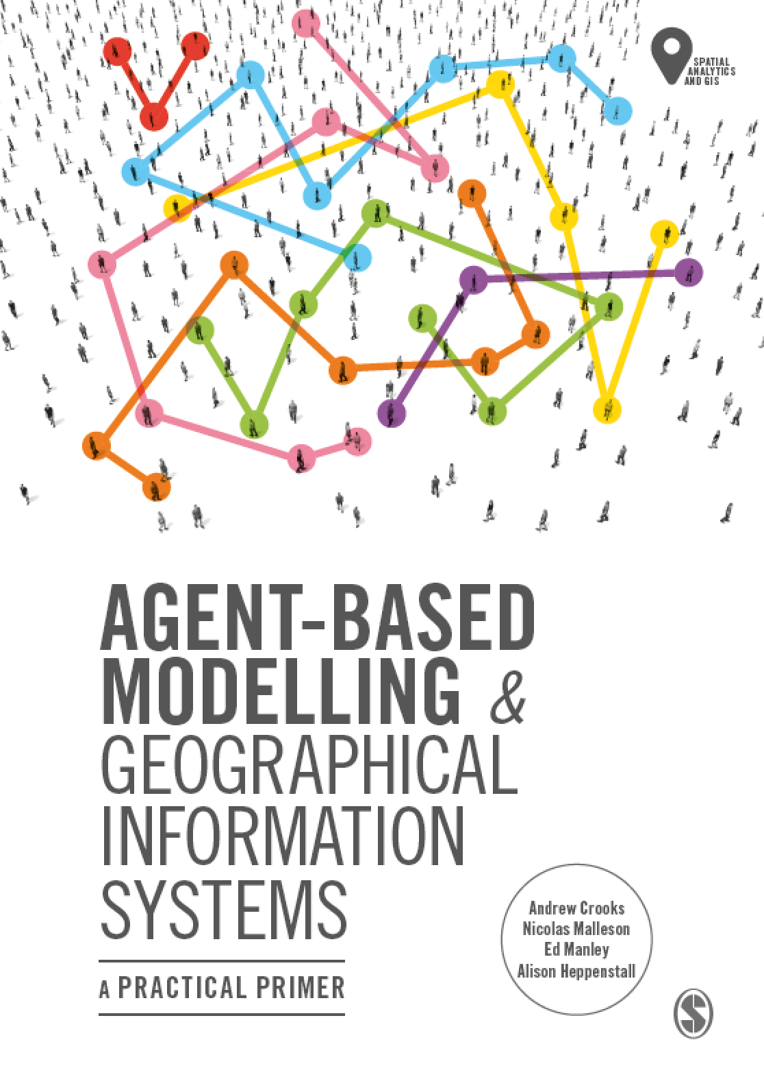
Chapter 3
Designing and Developing an Agent-based
Model

Slide 2
Learning Objectives

Slide 3
Summary

