Slide 1
Chapter 2
Introduction to Agent-Based Modelling
Notes:
In this Chapter we introduce the key concepts behind agent-based modelling. What is an agent, and what are rules? These are discussed along with a consideration of the main advantages and disadvantages for simulating spatial systems. A range of established applications are presented to give a flavour of how agent-based models can be successfully applied. The overarching aim of this chapter is to give the reader an understanding of what an agent-based model is. This knowledge will be built upon in subsequent chapters.

Slide 2
Introduction

Slide 3
What is an Agent?

Slide 4
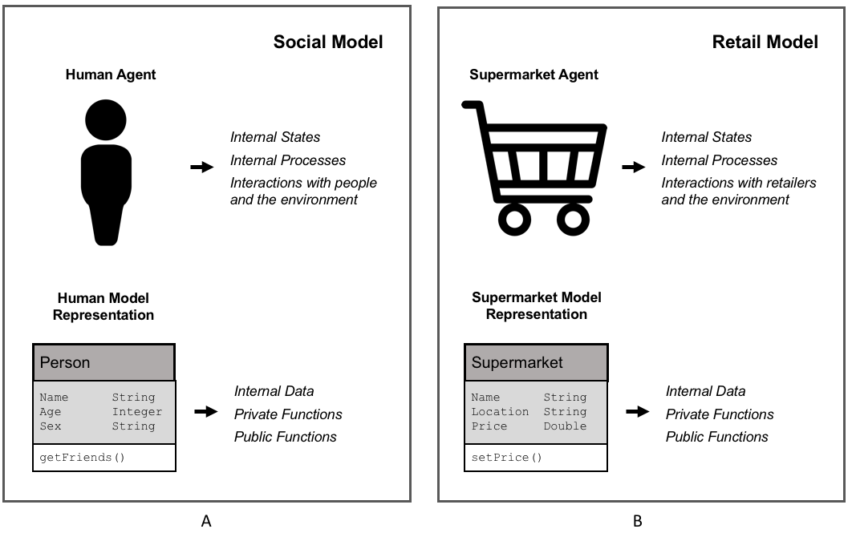
Agent Representation
Figure 2.1: Representation of (A) human agent and (B) supermarket retailer agent alongside that of representation within an object-orientated environment.

Slide 5
Agent Rules

Slide 6
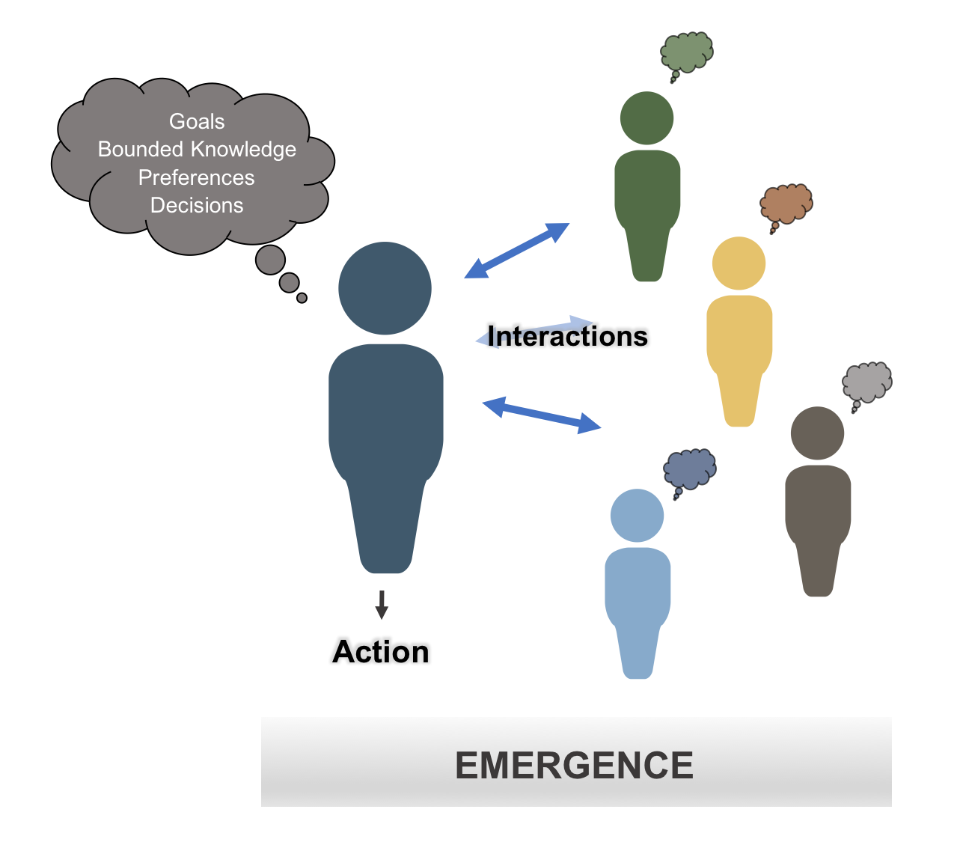
Main Components of an Agent
Figure 2.2: Schematic illustrating some of the main components of an agent.

Slide 7
An Agent’s World

Slide 8
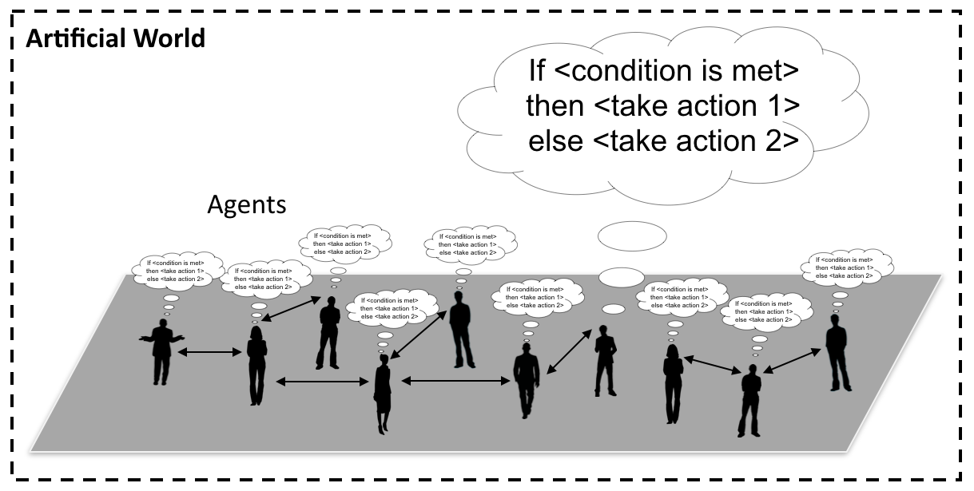
Agents and their “World”
Figure 2.3: Conceptualization of an agent-based model where people are connected to each other and take actions when a specific condition is met.

Slide 9
Advantages of Agent-based Modelling

Slide 10
Limitations of Agent-based Modelling

Slide 11
A Gallery of Applications

Slide 12
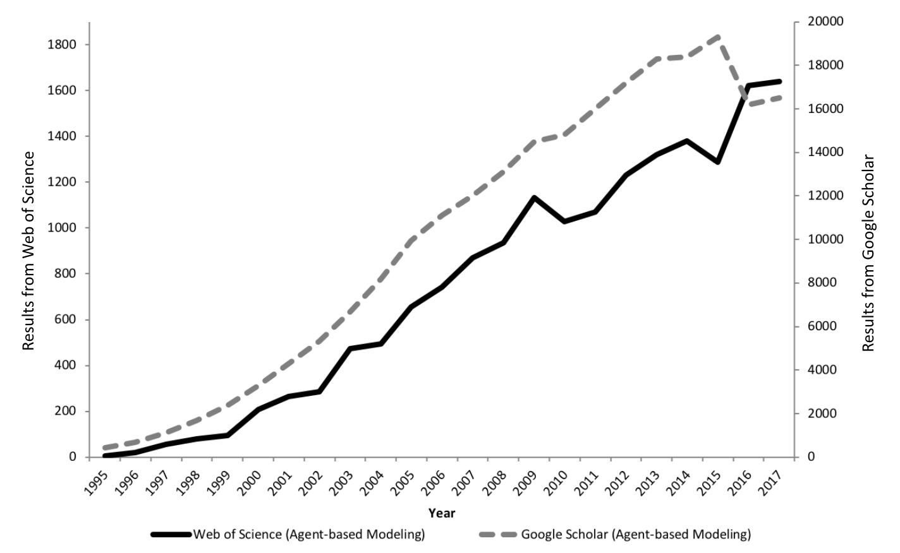
The Growth of Agent-based Modelling
Figure 2.4: The growth in agent-based modelling: from search results of Web of Science and Google Scholar.

Slide 13
Segregation

Slide 14
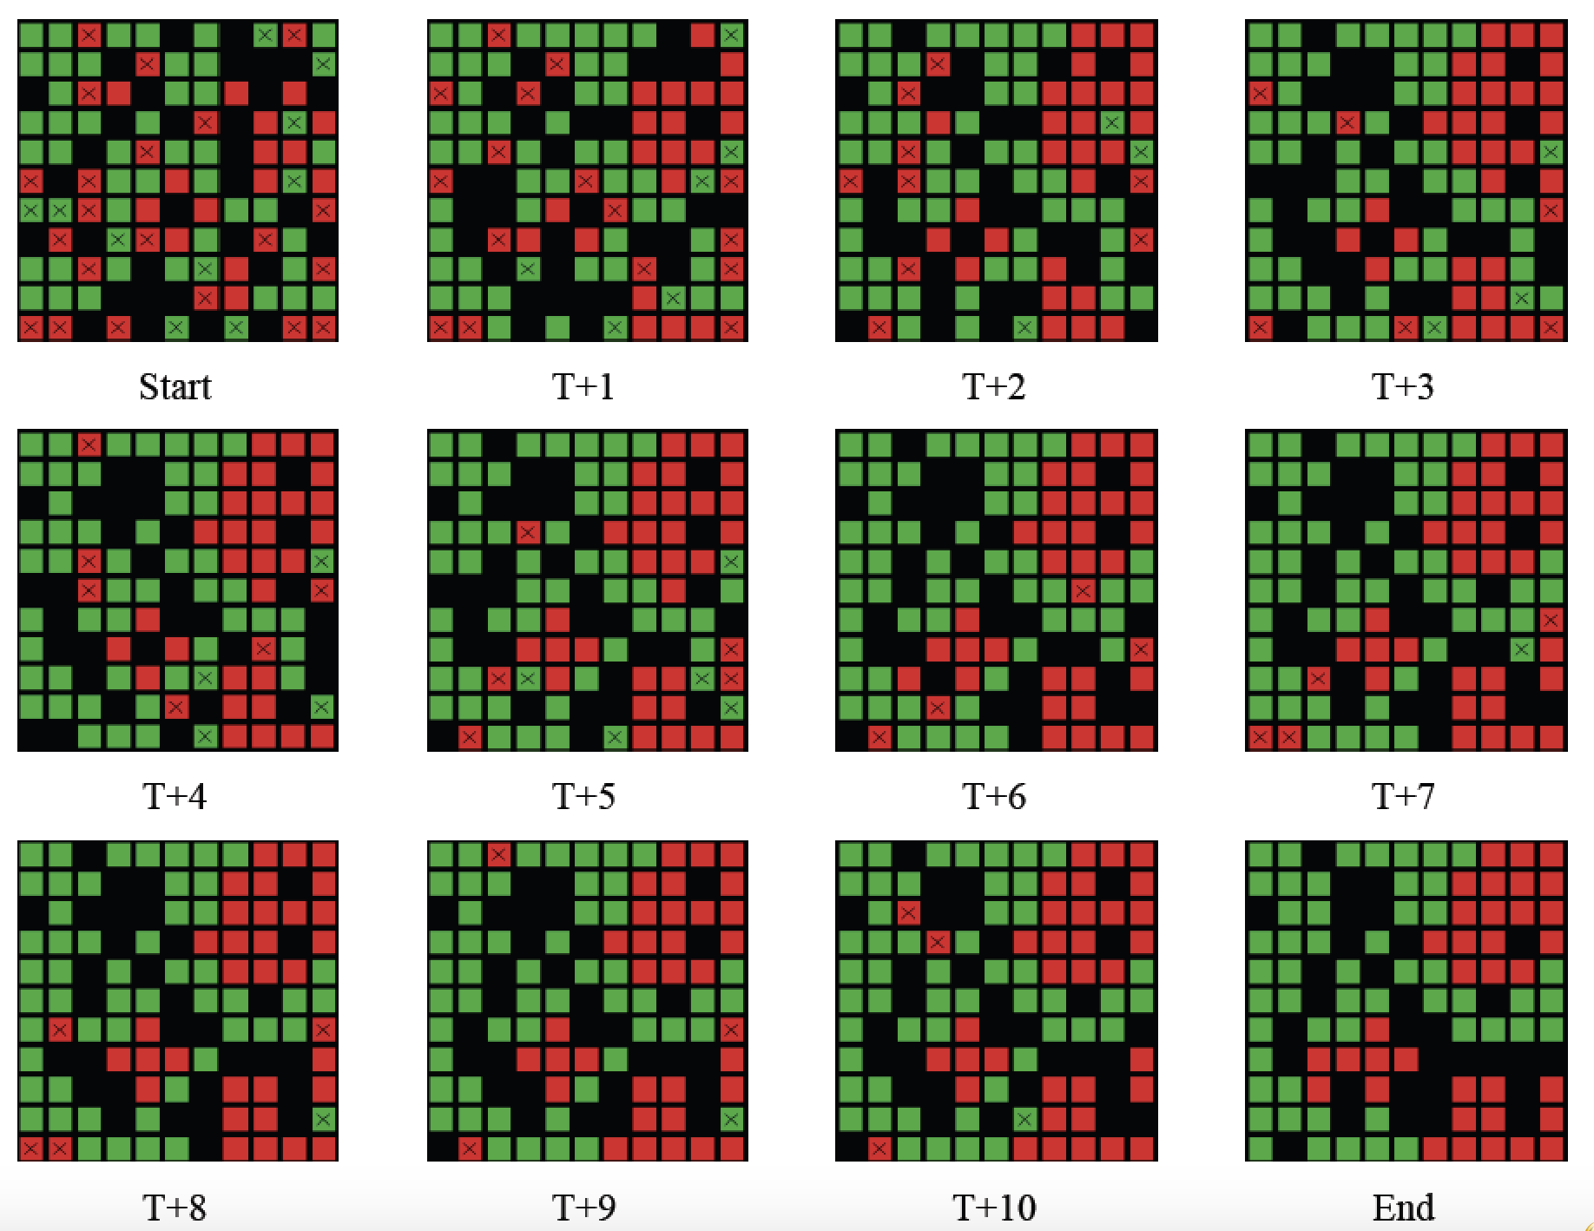
Progression of Segregation over Time
Figure 2.5: Progression of segregation over time: Agents what to live in a neighborhood where 40% are of the same color.

Slide 15
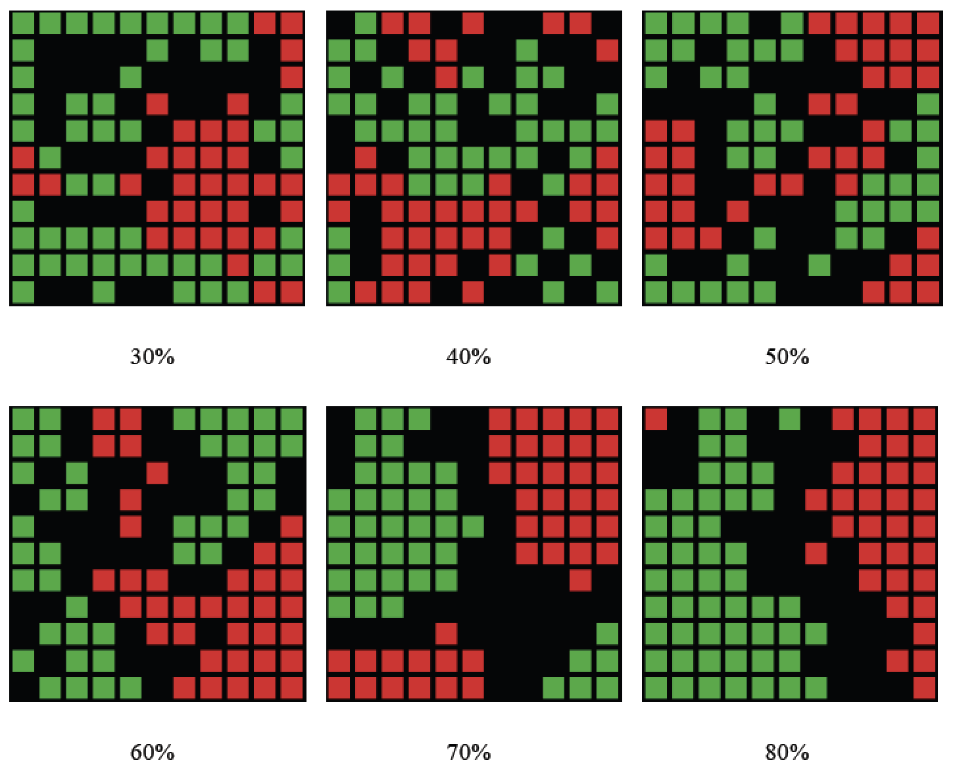
Changing Agents Preferences
Figure 2.6: Examples of how changing agents neighborhood preference levels leads to different patterns of segregation emerging.

Slide 16
From Abstract to Real World Applications
Add details about Benenson et al., 2002

Slide 17
SugarScape

Slide 18
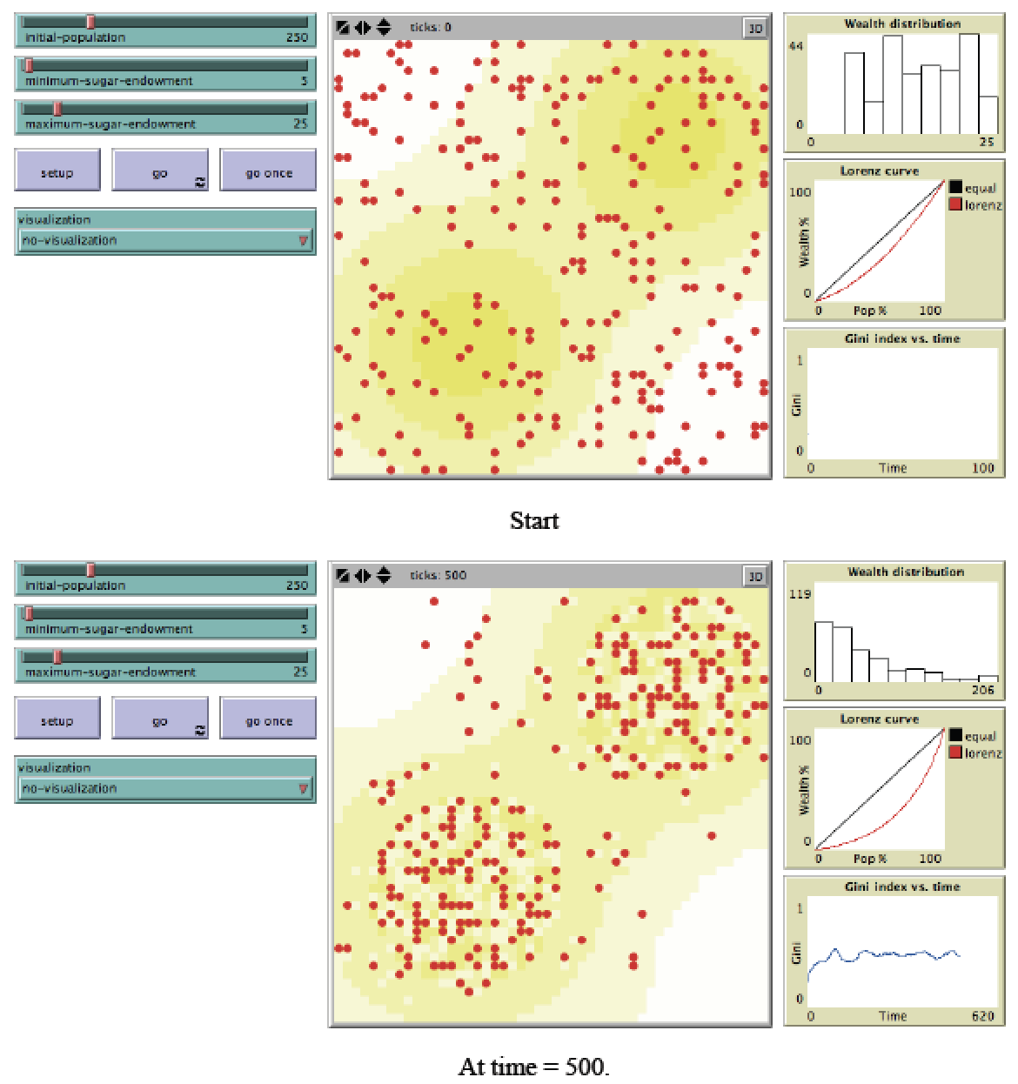
Graphical User Interface of Sugarscape Model
Figure 2.7: Sugarscape wealth distribution model (Source: Li and Wilensky, 2009).

Slide 19
Transportation Modelling

Slide 20
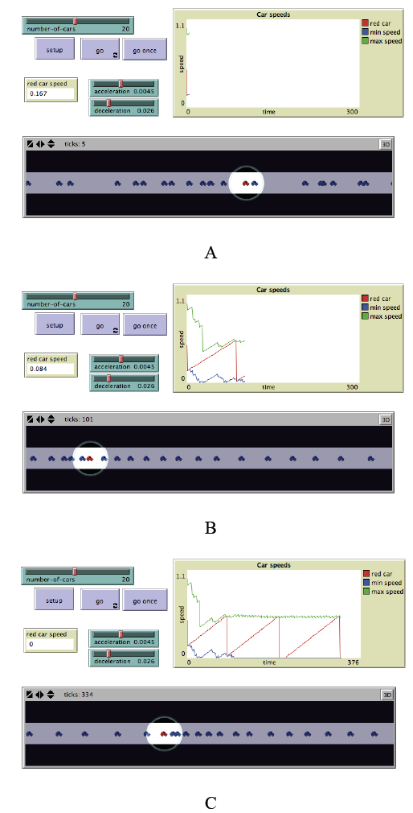
Traffic Modelling
Figure 2.8: Simple traffic model where each car is an agent. In A, B and C from top left clockwise, model parameters, a chart of car speeds and the spatial agent-environment (source: Wilensky, 1997).

Slide 21
Show Real World Example.

Slide 22
Agent-based Models Used for Decision Making

Slide 23
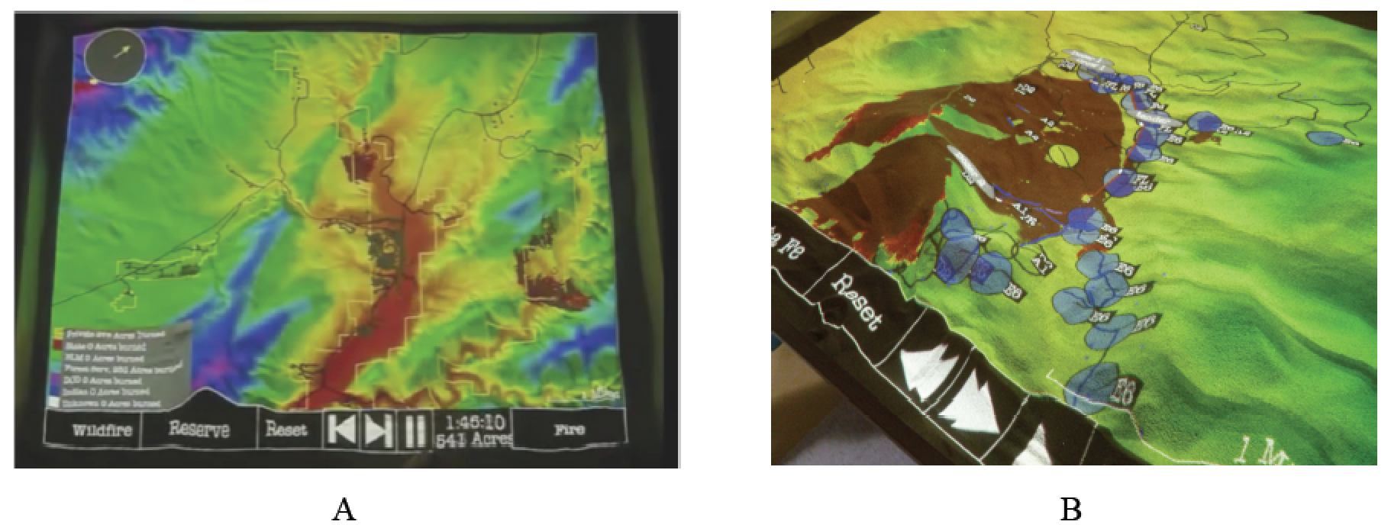
Real World Decision Making
Figure 2.9: User interface of SimTable: (A) Entire study area, (B): an active fire model (source: SimTable, 2017).
More information about SimTable see: https://www.simtable.com
Notes:
Click on image to see a movie on YouTube. Or see https://youtu.be/aLmOxnPKUqk

