Slide 1

Chapter 9
Spatial Statistics
Notes:
This chapter presents a range of statistics and algorithms that can be used to compare two spatial data sets. These are important for modelling because, at some point, it will be necessary to compare a model outcome to some real-world data in order to assess the reliability of the model. This chapter examines the statistics themselves, before Chapter 10 elaborates on how to evaluate the success of a model more broadly, part of which includes making use of the methods discussed here.

Slide 2
Learning Objectives
By the end of this chapter, students will be able to:
Identify some commonly-used statistics that can be used to quantify the difference between spatial data sets.
Explain which are the most appropriate statistics for use in comparing aggregate data and point data.
Explain four different ways of identifying the differences in spatial data sets: visual comparison; descriptions of point patterns; global difference; local difference.
Calculate the value of these statistics.

Slide 3
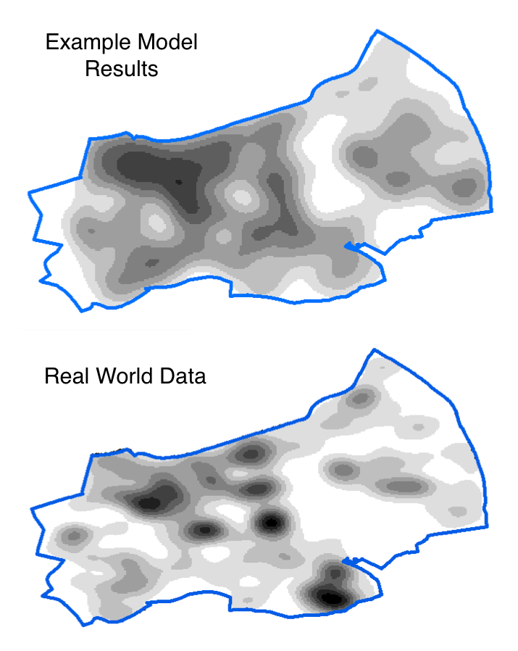
Introduction
All models are wrong, but some are useful (Box, 1979)
We often need to compare two spatial data sets:
For example: Model results compared to real-world data
There are many ways to do this
Choosing the most appropriate method is vital
This lecture will introduce and compare a number of different ‘goodness of fit’ statistics.

Slide 4
Overview
Goodness of fit and hypothetical data
Global Statistics
Visual Comparisons
Point Pattern Statistics
Local Statistics (LISA)
Multi-Scale Error Analysis

Slide 5
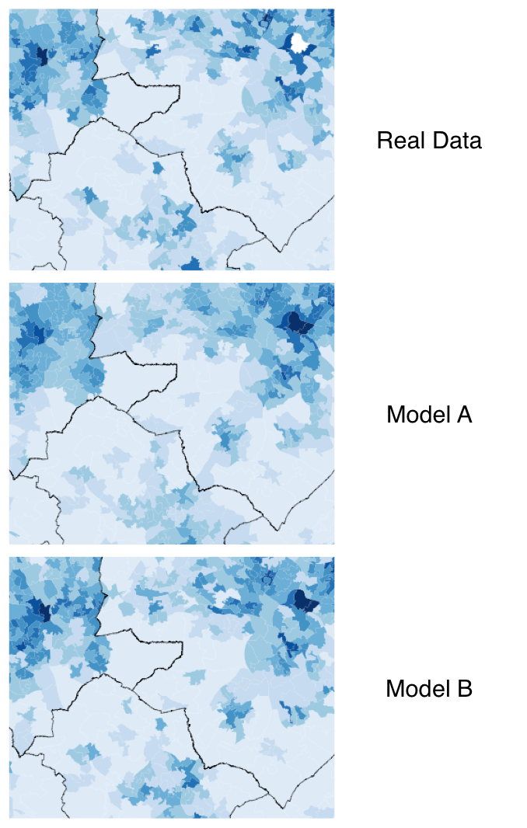
Goodness of Fit
Assessment of how well a model fits a set of observations
Humans are quite good at comparing patterns visually
But often it is better to use quantitative methods
E.g.: which of the two models on the right is better – A or B?

Slide 6
Statistics that will be introduced
Notes:
● Global statistics (Section 9.3) – statistics that calculate the overall difference
between two data sets (e.g. the total error);
● Visual comparisons (Section 9.4) – methods that provide visual outputs and allow spatial data sets to be compared visually;
● Description of point data (Section 9.5) – statistics that describe the properties of point data, such as the degree of clustering;
● Local indicators of spatial association (Section 9.6) – statistics that calculate the difference between two data sets at a local spatial level.

Slide 7
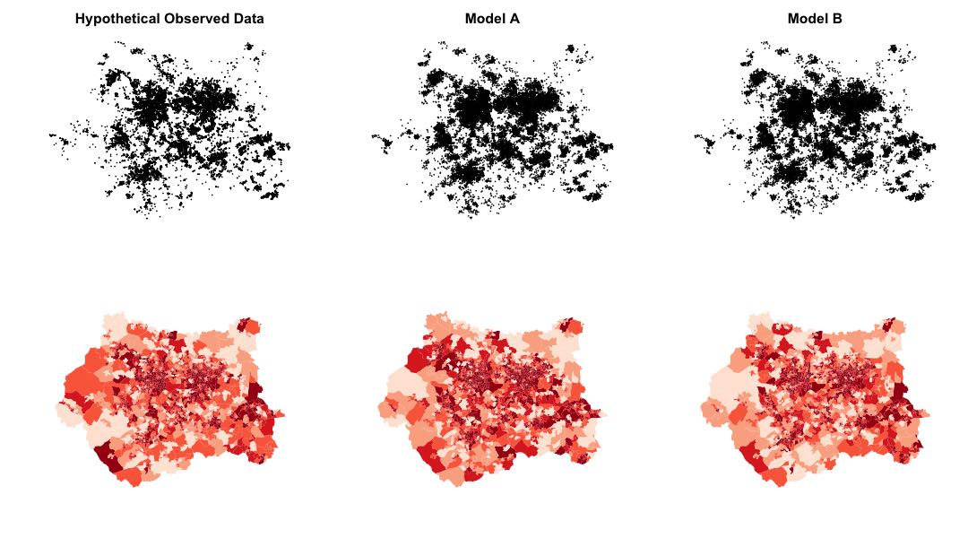
Hypothetical Data
To experiment with the different statistics, three datasets will be used. They are all point patterns.
‘Observed’ data – real data
(This is actually some real crime data for Leeds, UK)
Model A – data that could have come from a simulation
Model B – data that could have come from a simulation with slightly different parameters

Slide 9
Hypothetical Data
When the data were created, the points in Model B data were deliberately made more similar to the real data than those from Model A.
In other words, Model B is ‘better’ than Model A.
The statistics used throughout this chapter later should show this.
The results of two hypothetical models (A and B) plotted against observed data. The lines of best fit (y = x) illustrate the locations of ‘perfect’ model results. In this example, model B is a better fit to the observed data than model A.

Slide 10
Overview
Goodness of fit and hypothetical data
Global Statistics
Visual Comparisons
Point Pattern Statistics
Local Statistics (LISA)
Multi-Scale Error Analysis

Slide 11
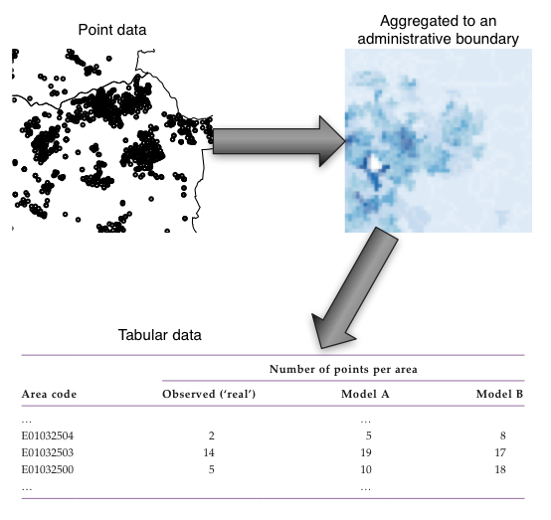
Global Statistics
There are many statistics that can quantify the difference between two datasets
Typically they are applied to tables or matrices
They can be applied to spatial data if the points are aggregated to some boundary to create a table.
Common to use administrative boundaries (e.g. from a population census).

Slide 12
Global Statistics: Residual Sum of Squares
Add together the square of the differences between the observed and simulated values
Y_{i}’ is the simulated value in cell i
Y_{i} is the real value in cell i
Disadvantages:
Large errors can be inflated
The magnitude of the cell count influences the statistic
A small percentage differences in cells with lots of points is given a very large error value

Slide 13
Global Statistics: Root Mean Square Error (RMSE)
Standardised Root Mean Square Error (SRMSE) was found to be the best performing (Knudsen and Fotheringham, 1986)
RMSE is similar, but more readily available
Range
0 - identical data
1 (or greater) – difference between data
Drawback: difficult to understand
What does RMSE = 0.34 mean?
How much better is a model with RMSE=0.30 than one with RMSE=0.35 ?

Slide 14
Global Statistics: R²
The proportion of agreement between a model and the observed data
R²=0.34 means the model is able to explain 34% of the variation in the real data
Range
0 – no agreement (big differences)
1 – identical data
Drawbacks:
Insensitive to overall amount of error
Unreliable for non-linear models

Slide 15
Results: RSS, R², RMSE
All agree that Model B is a closer fit to the real data than Model A.
lower SRMSE values indicate greater agreement, whereas higher R2 values indicate greater agreement
Main lesson: the choice of statistic matters for error calculation!

Slide 16
Overview
Goodness of fit and hypothetical data
Global Statistics
Visual Comparisons
Point Pattern Statistics
Local Statistics (LISA)
Multi-Scale Error Analysis

Slide 17
Visual Comparisons

Slide 19
Overview
Goodness of fit and hypothetical data
Global Statistics
Visual Comparisons
Point Pattern Statistics
Local Statistics (LISA)
Multi-Scale Error Analysis

Slide 20
Point Pattern Statistics

Slide 22
Overview
Goodness of fit and hypothetical data
Global Statistics
Visual Comparisons
Point Pattern Statistics
Local Statistics (LISA)
Multi-Scale Error Analysis

Slide 23
Local Indicators of Spatial Association (LISA)
Local Statistics

Slide 25
Overview
Goodness of fit and hypothetical data
Global Statistics
Visual Comparisons
Point Pattern Statistics
Local Statistics (LISA)
Multi-Scale Error Analysis

Slide 26
Multi-Scale Error Analysis

Slide 28
Conclusion
XXXX
R2 is not ideal for non-linear models, but (S)RMSE is difficult to interpret. Solution: use both!

Slide 29
Summary
Goodness of fit and hypothetical data
Global Statistics
Visual Comparisons
Point Pattern Statistics
Local Statistics (LISA)
Multi-Scale Error Analysis

Slide 31
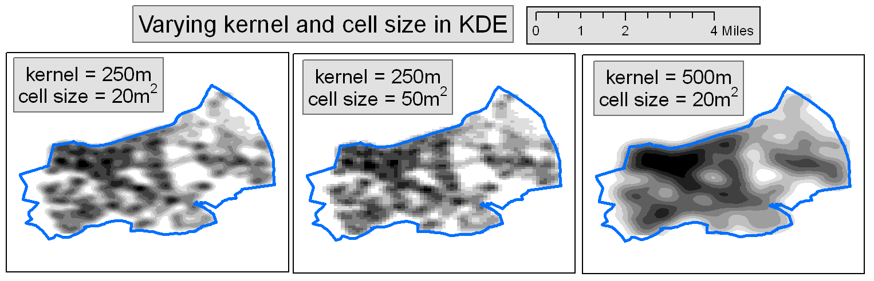

Slide 32
Further Reading
For a detailed review a range of spatial statistics and to learn more about the meth- ods presented here, readers are referred to:
● O’Sullivan, D. and Unwin, D. (2010) Geographic Information Analysis (2nd edn). Hoboken, NJ: John Wiley & Sons.
For more details about the pros and cons of a number of the goodness-of-fit statistics discussed here, including the root mean square error and R2, readers are referred to the seminal paper:
● Knudsen, D.C. and Fotheringham,A.S. (1986) Matrix comparison, goodness- of-fit, and spatial interaction modelling. International Regional Science Review, 10(2), 127–147.
While targeted mainly at a crime analyst audience, the following book discusses a number of useful methods that can be used for mapping spatial data:
● Chainey, S. and Ratcliffe, J. (2005) GIS and Crime Mapping. Chichester: John Wiley & Sons.
For a broad and up-to-date review of the difficulties in analysing agent-based model outputs and in particular the analysis of time, readers are referred to:
● Lee, J.-S., Filatova,T., Ligmann-Zielinska,A., Hassani-Mahmooei, B., Stonedahl, F., Lorscheid, I.,Voinov, A., Polhill, G., Sun, Z. and Parker, D.C. (2015) The complexities of agent-based modelling output analysis. Journal of Artificial Societies and Social Simulation, 18(4), 4. Available at http:// jasss.soc.surrey.ac.uk/18/4/4.html.
Much of the statistical analysis in this chapter was derived from the excellent textbook:
● Brunsdon, C. and Comber, L. (2015) An Introduction to R for Spatial Analysis and Mapping. London: Sage.

Slide 33
Glossary
Goodness of fit – a broad description for statistics that quantify how well a model fits a set of real-world observations.
RSS – residual sum of squares; a statistic that estimates the overall difference between two data sets by summing the square of the errors.
R2 – ‘R squared’; a statistic that estimates the overall difference between two data sets.
(S)RMSE – (standardised) root mean square error; a statistic that esti- mates the overall difference between two data sets.
KDE – kernel density estimation; a means of estimating point density at a particular location. Often used to draw maps of point patterns.
LISA – local indicators of spatial association; statistics that can estimate the locations of local clusters (areas with a higher than expected point density).
NNI – nearest neighbour index; measures global spatial uniformity (i.e. the overall amount of clustering in a point pattern). Also known as the Clark and Evans R statistic (Clark and Evans, 1954).
Ripley’s K function; another measure for global spatial uniformity (i.e. the overall amount of clustering in a point pattern).
GI* – a statistic that estimates the spatial locations of ‘hot’ (e.g. high) and ‘cold’ (e.g. low) spot

