Slide 1
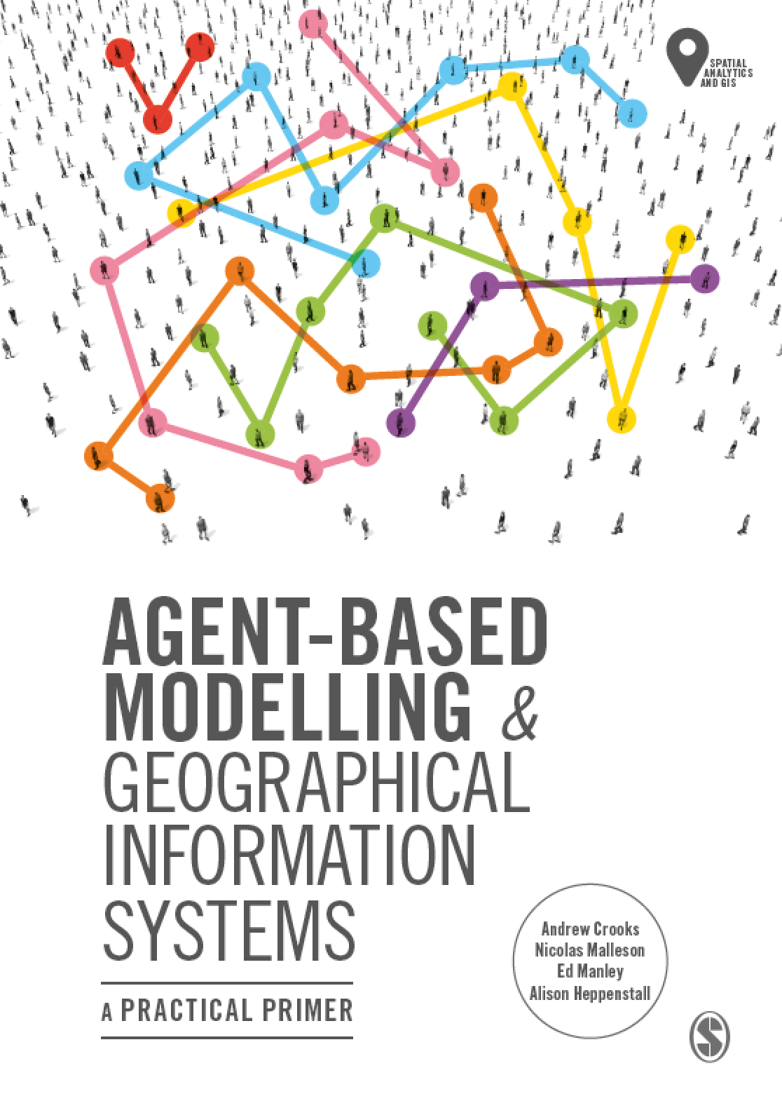
Chapter 10
Evaluating Our Models: Verification, Calibration, Validation
Notes:
Model evaluation is one of the central challenges associated with agent-based models. A key question that all modelers face is “how well does this model simulate the phenomenon of interest?”. While there are no universally accepted methods for evaluating agent-based models, researchers often adopt the same three stage process of verification, calibration and validation. This chapter presents an overview of the methods that are commonly used within each of these stages. The overarching aim of this chapter is to provide the reader with the knowledge to design their own approach to evaluating agent-based models.

Slide 2
Learning Objectives
By the end of this lecture, students will…
Understand the importance of evaluation in ensuring wider acceptance and utility of the model
Learn methods for verifying the development of a model
Be able to apply approaches for parameterising and calibrating uncertain aspects of the model design
Understand approaches for validating the predictions from a model relative to observed real-world conditions

Slide 3
Lecture Outline
Evaluating Models
Verification
Calibration
Validation
Summary

Slide 4
Evaluating Models
Model evaluation should be considered at all points in the ABM development cycle
You should be able to explain and justify the design choices you make, relative to external observations, other evidence, or simply good practice
And, even it won’t be, you should develop your model to withstand external scrutiny
There are a variety of approaches you can take to ensure that your model is well designed and developed – these can be broadly divided into verification, calibration, and validation methods

Slide 5
Verification, Calibration, and Validation
Verification is the process of ensuring that model implementation matches model design
Calibration (or parameterisation) involves adjusting model parameters to meet observed patterns, there are a variety of established practices for calibrating an ABM
Validation relates to evaluating the performance of the model in relation to previously unobserved data

Slide 6
Lecture Outline
Evaluating Models
Verification
Calibration
Validation
Summary

Slide 7
Code Testing
While many IDEs will helpfully point out syntactic errors as your write your code, semantic errors are trickier to spot
These relate to logical inconsistencies in your code, such as incorrectly used variables, misplaced logic blocks, and so on.
Reading code through is a simple solution
A more formal approach is unit testing, whereby variable values are outputted during the simulation, allowing you to check whether they align with expected values

Slide 8
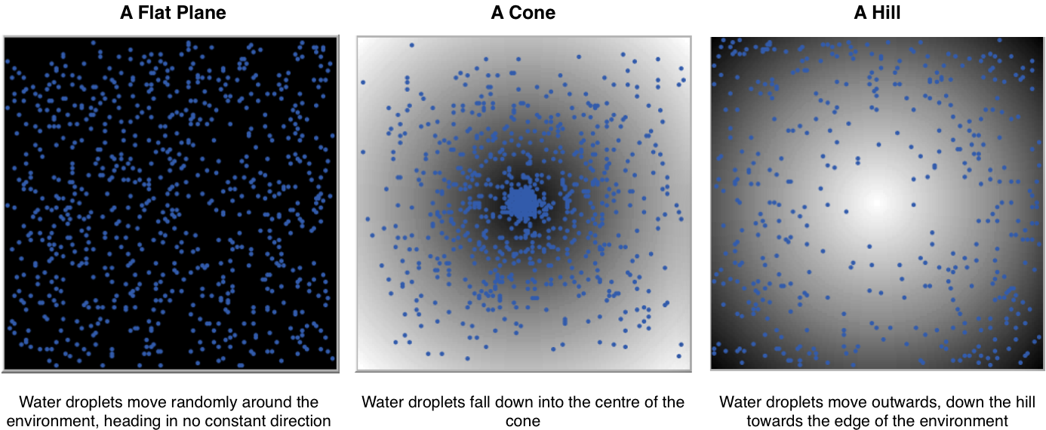
Simplified Environments
While your model will no doubt eventually be based within a real-world spatial environment, testing within other environments allows you to verify that agent behavior is as you expect
A simplified environment, such as those shown here, separate out agent behavior from the environment, so you can see if agents are adapting appropriately

Slide 9
Docking
Docking involves testing the behavior of your ABM against a completely different model
This could involve implementing your model within a different simulation environment (e.g. NetLogo vs Repast), or even comparing your model against another modelling methodology
Examples have included comparing ABMs against macroscopic and systems dynamics models
Similar patterns of behavior provide verification of your approach, but some differences (where within anticipated bounds) can be expected

Slide 10
Lecture Outline
Evaluating Models
Verification
Calibration
Validation
Summary

Slide 11
Qualitative Calibration
Qualitative calibration involves the simple ‘sense checking’ and adjustments that comes with setting up an ABM
By observing the behavior of your agents and the model outputs, you should be able to tell if your model matches your expectations, and define sensible parameter ranges on which to calibrate your model later
This does require that you have some knowledge and expectation of the behaviours you’re expecting to observe – this could even involve reading books!

Slide 12
Quantitative Calibration
Once you have a model that you’re mostly happy with, quantitative calibration methods more accurately define your model against observed behavior
Observed data should be representative of the population you want to simulate, ideally from a similar location or context
You don’t need to test every parameter, but make careful note of the assumptions you do make
A basic quantitative calibration should always incorporate a parameter space search and analysis of model sensitivity

Slide 13
Parameter Space Search
This process relates to exploring how the definition of each parameter affects model output
The model output should represent an observed indicator you’re wishing to replicate
Parameters are tested across a wide range of settings, with each varied one at a time, with model output reported for each configuration
The best performing settings (e.g. those closest to observed behavior) for each parameter are reported and can be taken forward
Potentially a number of candidate values will be identified as satisfactorily replicated observed behaviour

Slide 14
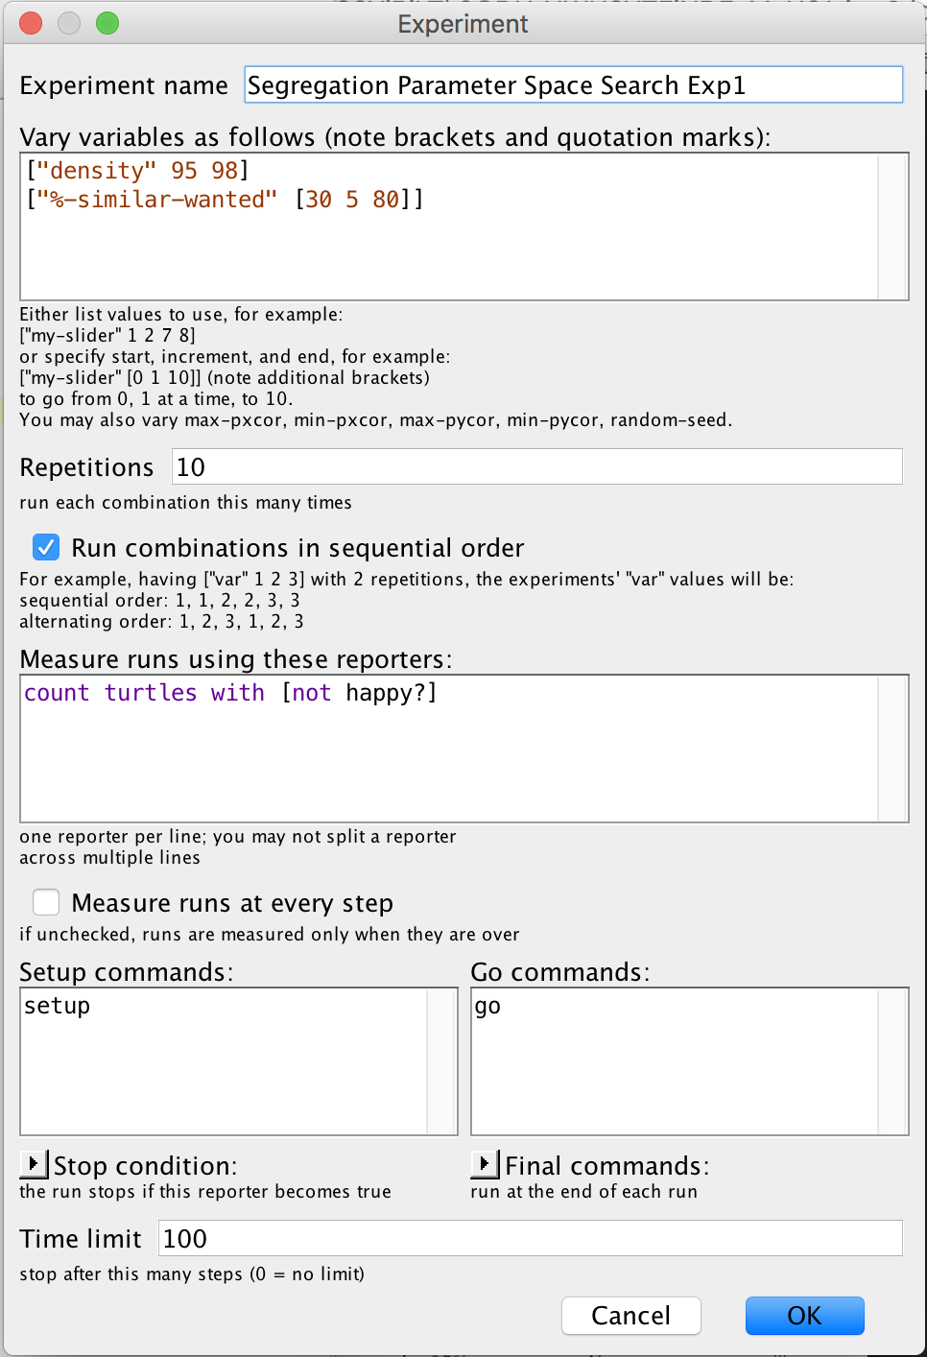
Parameter Space Search
NetLogo provides a really useful tool – BehaviorSpace – for exploring parameter settings
BehaviorSpace integrates directly with NetLogo, so make use of it!
And while it may be tempting to test a large variety of settings, remember this could potentially take a long time to run!

Slide 15
Sensitivity Testing
Once the parameter search has yielded a candidate model specification, sensitivity testing more accurately explores the robustness of the proposed solution
Through varying parameter values individually by 5% or 10%, a picture emerges of the most sensitive or important parameters
Wildly sensitive parameter should cause concern, since their design may indicate they have too large an impact on your simulation
Insensitive parameters, those that demonstrate little impact on the model outcomes, can be removed
These findings are important in explaining the behavior of your ABM

Slide 16
Lecture Outline
Evaluating Models
Verification
Calibration
Validation
Summary

Slide 17
Validation
Validation provides a final check of the model performance against unseen observation data
Calibration has a risk of overfitting a model against observed behavior, so validation provides a second assurance that this isn’t happening
The dataset clearly should differ from that used for calibration, while

Slide 18
Lecture Outline
Evaluating Models
Verification
Calibration
Validation
Summary

Slide 19
Summary
Evaluation remains one of the key challenges within agent-based modelling, but is increasingly well supported by established methods for verification, calibration, and validation
Verifying your code is important throughout the ABM development lifecycle, and your work should be compared against simplified or existing models
Tools such as BehaviorSpace enable quick testing of parameter ranges, and ensure the model is performing as well as it can do relative to observed behaviour
Sensitivity tests allow us to identify which parameters are dominating the behaviour of your agents, duly or unduly

Slide 20
Further Reading
For an excellent chapter summary on ‘Verification, Validation, and Replication’ see Wilensky and Rand (2015). Their work has more detail on some aspects of evaluating models than described here, particularly with respect to replicating models, but focusses less on the spatial aspects of validation.
Wilensky, U. and Rand, W. (2015), An Introduction to Agent-based Modeling: Modeling Natural, Social, and Engineered Complex Systems with NetLogo, MIT Press, Cambridge, MA.
While Railsback and Grimm (2011) contains a detailed discussion of Pattern Oriented Modelling and a valuable chapter on ‘Parametrisation and Calibration’ of models.
Railsback, S.F. and Grimm, V. (2011), Agent-Based and Individual-Based Modeling: A Practical Introduction, Princeton University Press, Princeton, NJ.
For a wider theoretical discussions of agent-based modelling, motivation, and validation, readers are directed towards:
Axtell, R. and Epstein, J.M. (1994), ’Agent-based Modelling: Understanding Our Creations’, The Bulletin of the Santa Fe Institute: Winter, 28-32.
Axtell, R. (2000), Why Agents? On the Varied Motivations for Agent Computing in the Social Sciences, Center on Social and Economic Dynamics (The Brookings Institute): Working Paper 17, Washington DC.
Not covered here is a discussion of ‘Empirical Validation’ methods, which is a dominant approach in economic agent-based modelling. For coverage of this area, readers are directed to:
Windrum, P., Fagiolo, G. and Moneta, A. (2007), ’Empirical Validation of Agent-based Models: Alternatives and Prospects’, Journal of Artificial Societies and Social Simulation, 10(2): 8, Available at http://jasss.soc.surrey.ac.uk/10/2/8.html.
While for a comparative analysis of ‘empirical’ and ‘companion’ validation approaches, readers are referred to:
Moss, S. (2008), ’Alternative Approaches to the Empirical Validation of Agent-based Models’, Journal of Artificial Societies and Social Simulation, 11(1): 5, Available at http://jasss.soc.surrey.ac. uk/11/1/5.html.

Slide 21
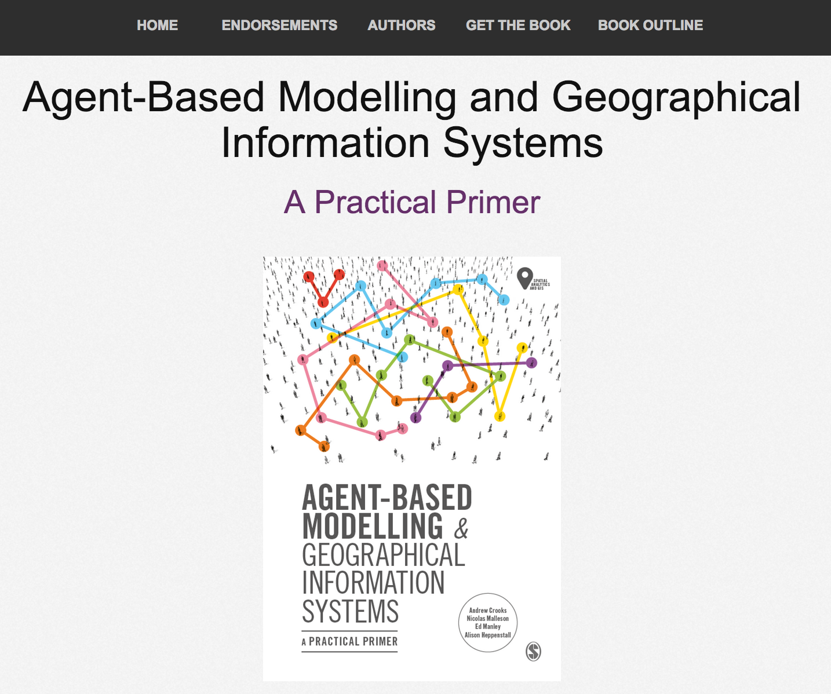
Online Resources
Visit: www.abmgis.org/Chapter10.html for a selection of models to highlight core concepts introduced in this chapter

