Slide 1
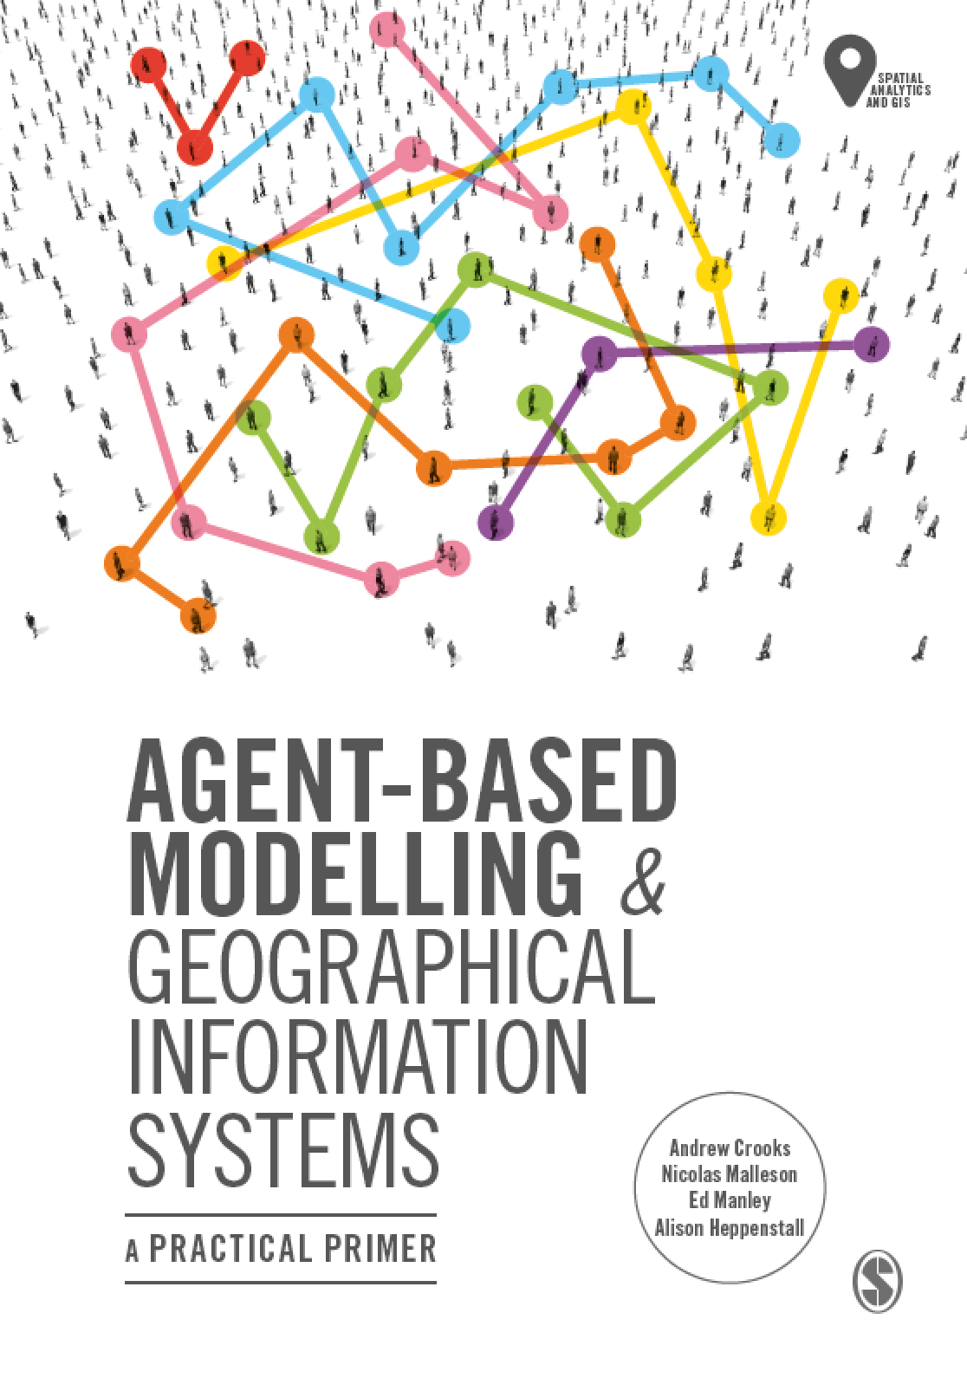
Chapter 11
Alternative Modelling Approaches
Notes:
Agent-based modelling is one of the most popular approaches used in social and spatial simulation. However, there are several other alternative approaches that are available to the researcher including Cellular Automata, Microsimulation, Discreet Event Simulation, System Dynamics and Spatial Interaction models. This chapter presents an overview of these other approaches giving simple examples on how they can be used and summarising the main differences between them. To compare these models, they are applied to the same issue, the spread of a disease using a Susceptible-Infected-Recovered (SIR) epidemic model. This shows that while the same general patterns emerge, the reasons for this are very different. The chapter ends with a discussion and summary.

Slide 2
Learning Objectives
By the end of this lecture, students will be able to:
Discuss alternative modeling approaches to social and spatial simulation:
I.e. Cellular Automata, Microsimulation, Discreet Event Simulation, System Dynamics and Spatial Interaction models
Be able to discuss the main differences between each and their relative pros and cons.
Provide a basis for why agent-based models are a more suitable means for modeling geographical systems.

Slide 3
Introduction
Agent-based modelling is one of the most popular approaches used in social and spatial simulation.
However, there are several other alternative approaches that are available to the researcher including
Cellular Automata (CA), Microsimulation (MSM), Discreet Event Simulation (aka. Queuing Models), System Dynamics (SD) and Spatial Interaction (SI) models.
It is important to know the differences between these in order to justify why one should use agent-based models over over techniques.
In this lecture we will introduce these models, give some applications and
To compare these models, they are applied to the same issue, the spread of a disease using a Susceptible-Infected-Recovered (SIR) epidemic model.

Slide 4
Cellular Automata
CA models are dynamic simulation models
Cell transitions are based on the state of the current cell and the states of neighboring cells.
“Neighbors” can be very broadly defined (and may include multi-scale influences)
Transitions may also depend on cell history
i.e. next cell states depends on current cell state as in game of life
Cellular structures are generally grids, but can be any cellular structure (e.g. irregular polygons)

Slide 5
Cellular Automata
CA are computer based simulations that use a static cell framework or lattice as the environment (model of space)
Each cell has a well-defined state at every specific discrete point in time (step)
Cell states may change over time according to state transition rules
Transition rules that are applied to cells depend upon their neighborhoods (i.e. the states of adjacent cells typically)

Slide 6
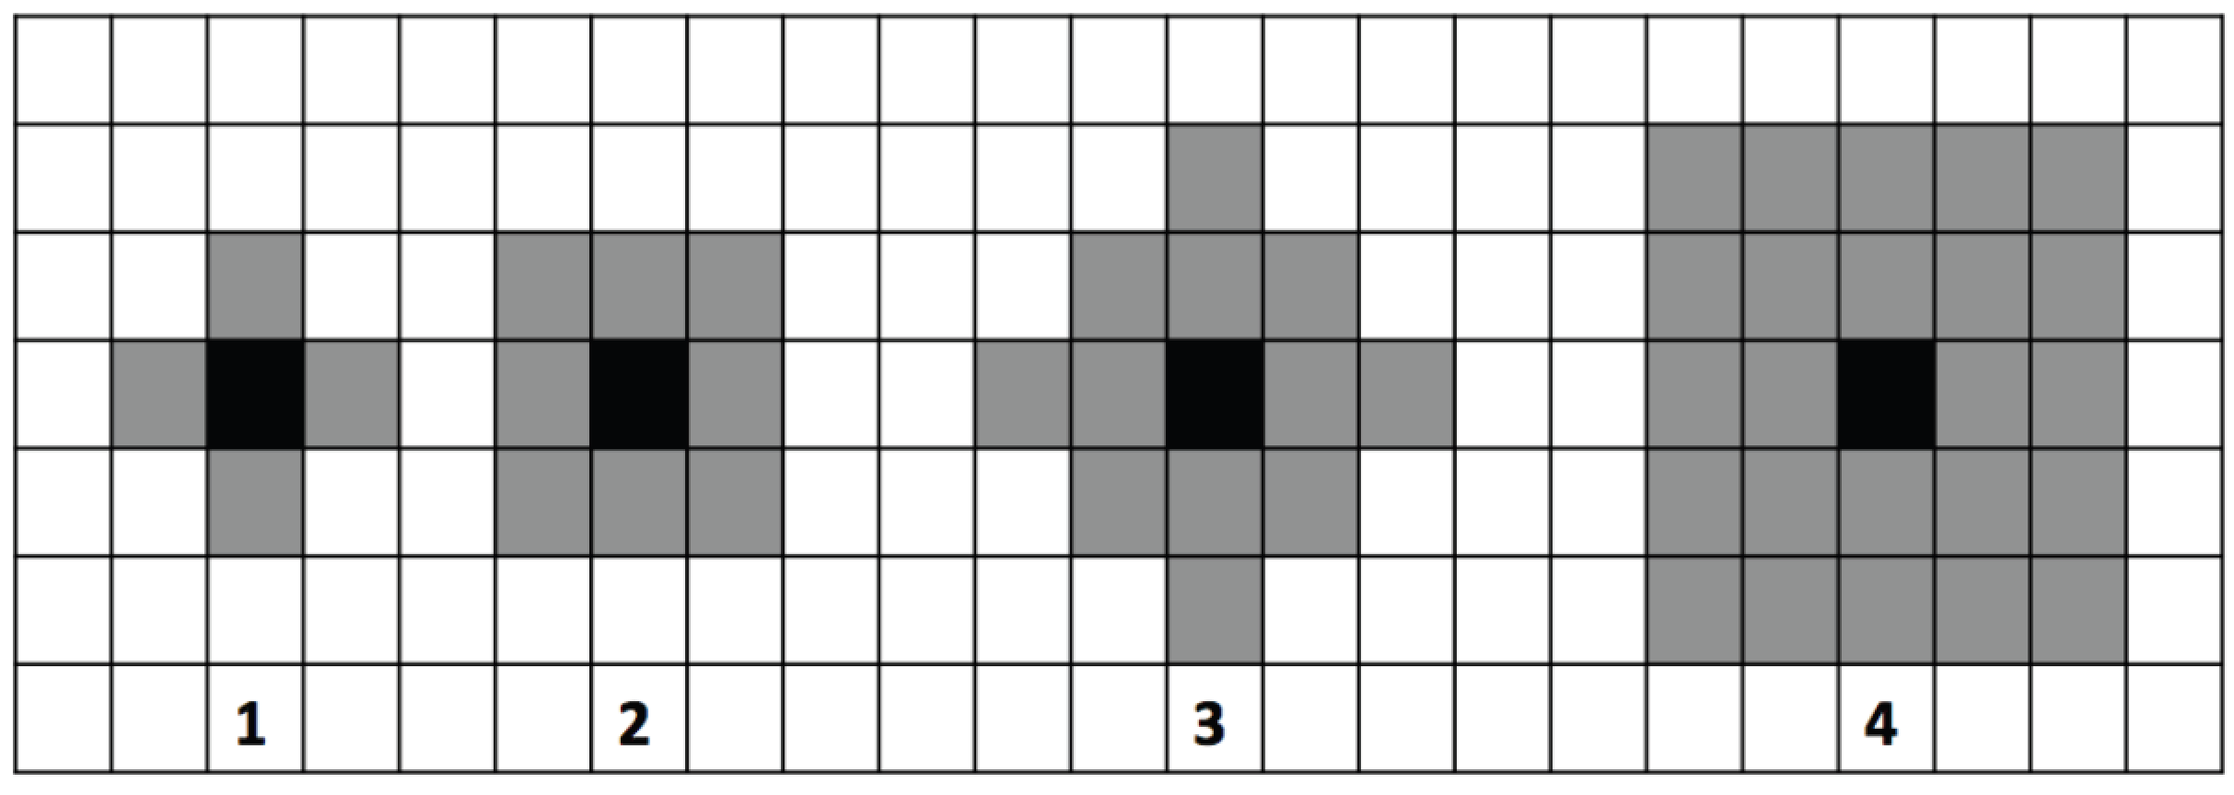
Different Neighborhood Configurations
Figure 11.1: Diagrammatic representation of 2D cellular automata and the most commonly used neighborhoods (1) von Neumann 1-neighbourhood, (2) Moore 1-neighbourhood, and extended (3) von Neumann and (4) Moore neighborhoods.

Slide 7
Game of Life
State variables: cells contain a 1 or a 0 (alive or dead)
Spatial framework: operates over a rectangular lattice (with square cells)
Neighborhood structure: 8 surrounding cells
State transition rules: time t_{n} -> _{tn+1}
Survival: if state=1 and in its neighborhood 2 cells have state=1 then state cell remains state 1 else state = 0
Reproduction: if state=0 but if the state of 3 neighboring cells =1 then state 1
Death (loneliness or overcrowding): if state=1 but has less than 2 neighbors with state 1 or if more than 3 neighbors are 1 then state = 0

Slide 8
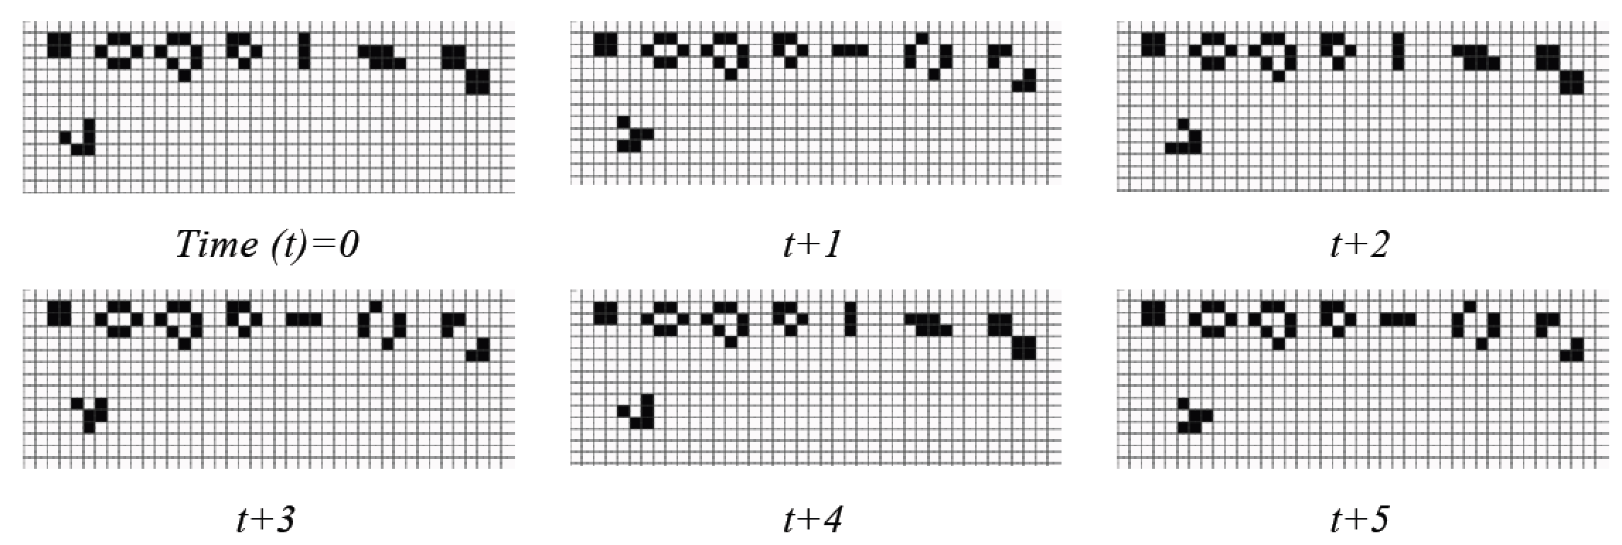
Cells Changing State in the Game of Life
Figure 11.2: Example of cells changing state from dead (white) to alive (black) over time depending on the states of its neighboring cells (modified from Wilensky, 1998).
Notes:
Add Link to Model

Slide 9
Microsimulation

Slide 10
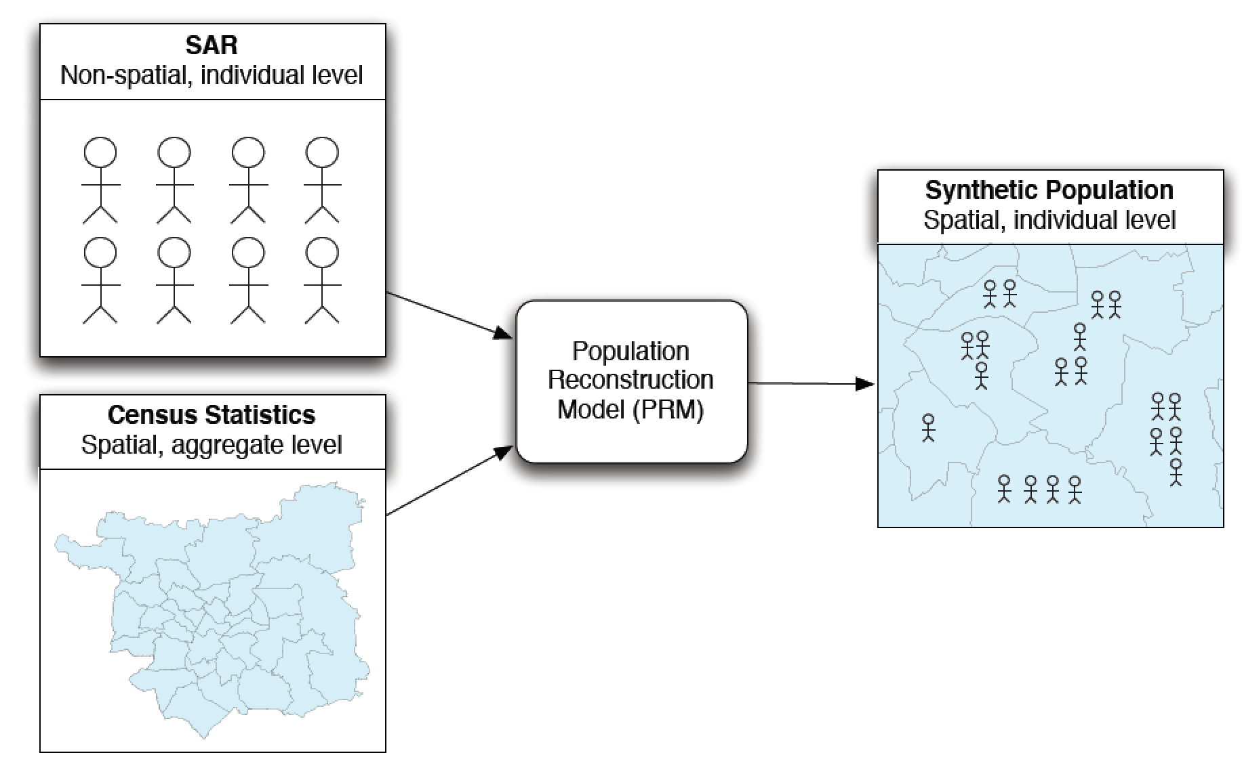
Creating a Synthetic Population using Microsimulation
Figure 11.3: Schematic outlining the basic process of creating a synthetic population using microsimulation.

Slide 11
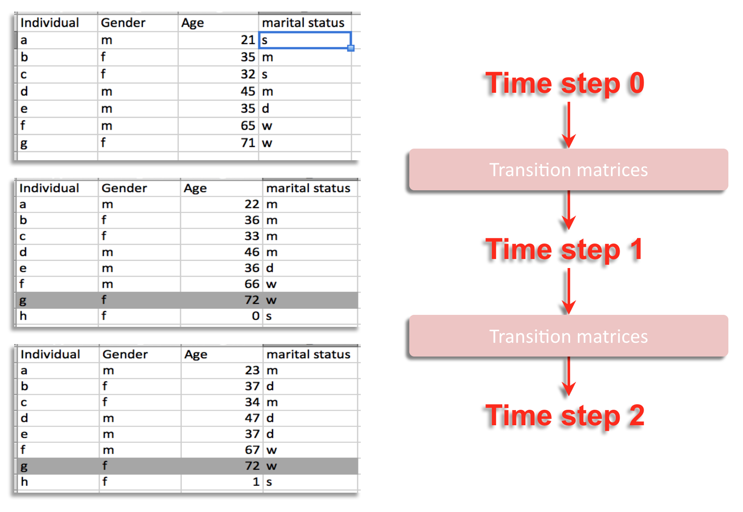
Changing the Population Over Time
Figure 11.4: A simple example of dynamic microsimulation process where individuals change over time (m = married, d = divorced, w = widowed).

Slide 12
Discreet Event Simulation

Slide 13
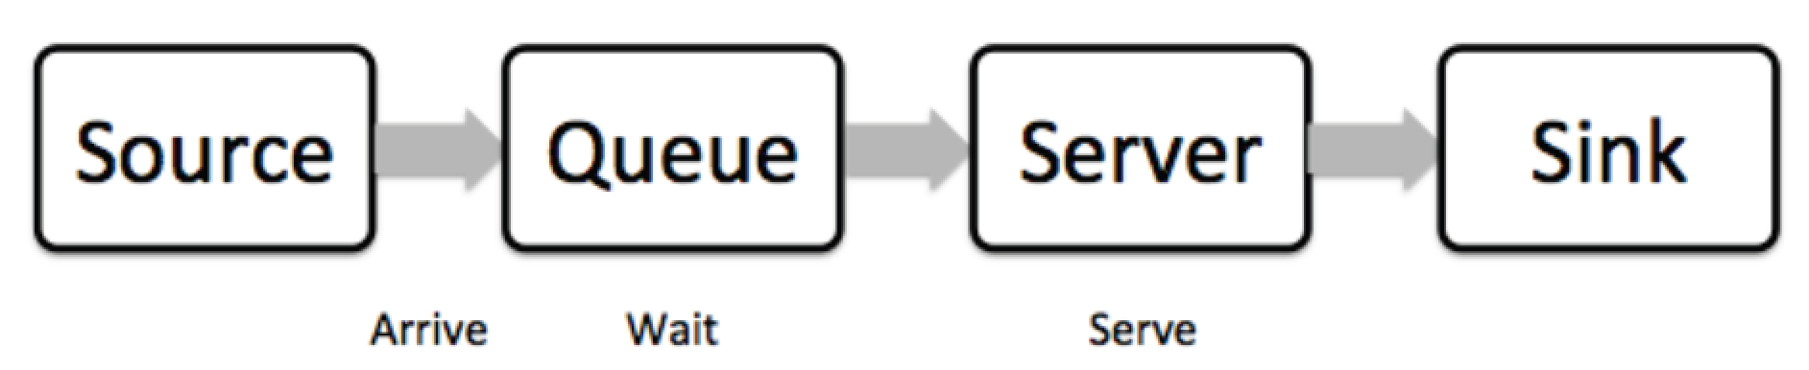
Basic Properties of a Discrete Event Simulation
Figure 11.5: Simple example of a Discreet Event Simulation.

Slide 14
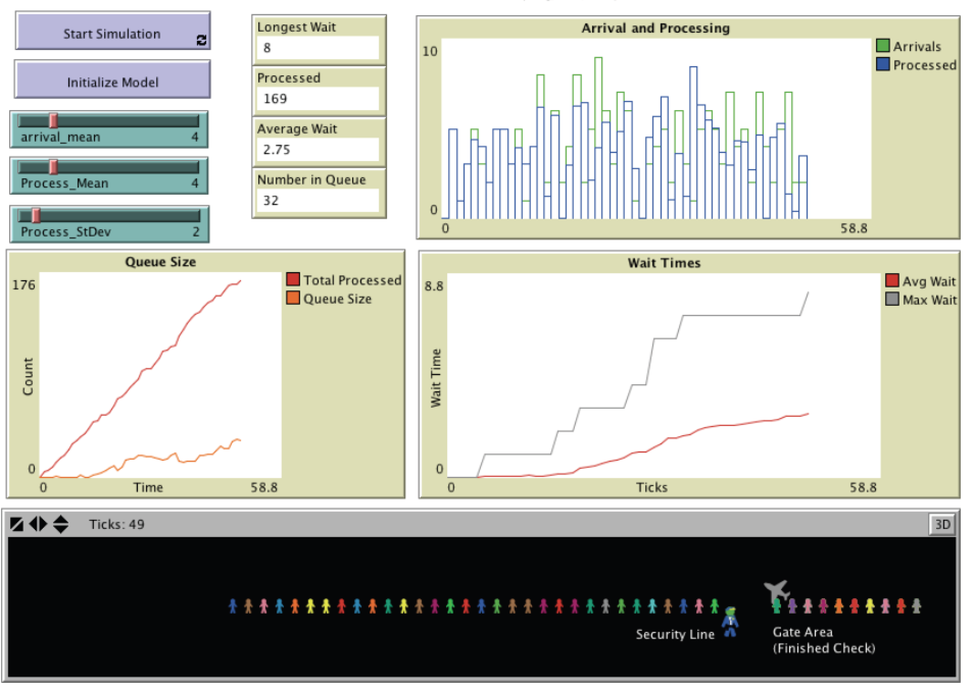
Airport Security via a Discrete Event Simulation Model
Figure 11.6: Airport security line simulation (Source: Bybee and Eng, 2012).

Slide 15
System Dynamics

Slide 16
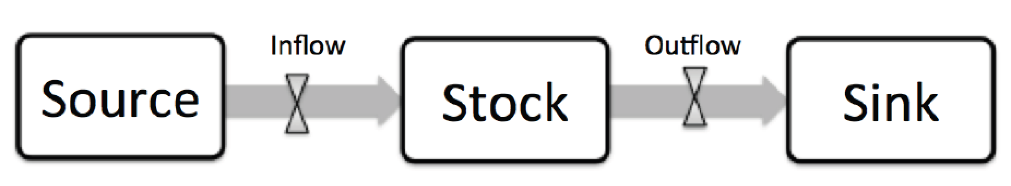
Basic Elements of a System Dynamics Model.
Figure 11.7: Basic elements of a system dynamics model.

Slide 17
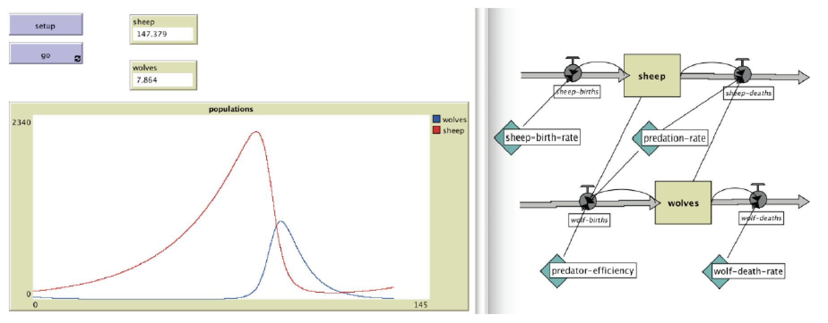
Wolf Sheep Predation implemented as a System dynamics Model
Figure 11.8: An Example of a Wolf Sheep Predation model implemented as a system dynamics model (source: Wilensky, 2005a).

Slide 18
Spatial Interaction Models

Slide 19
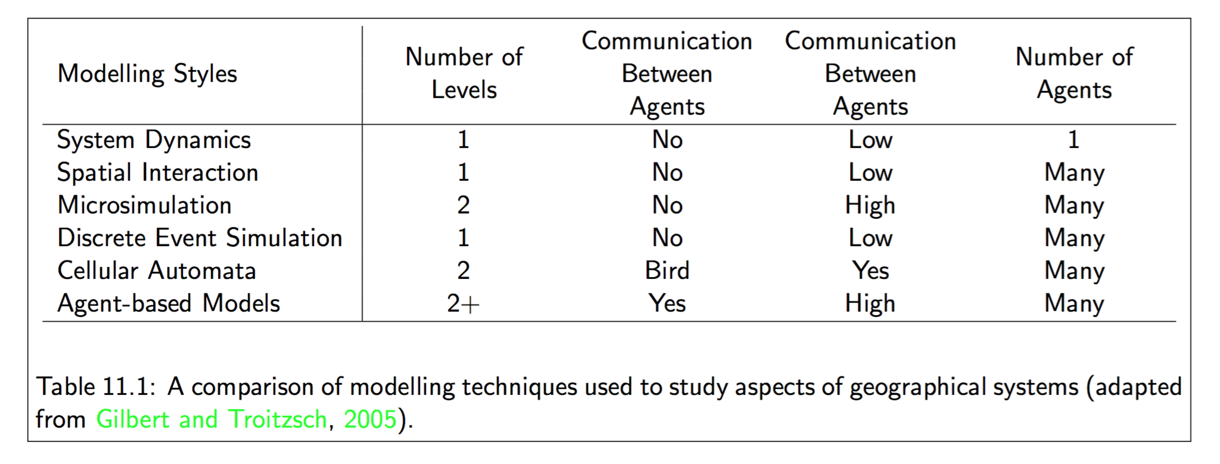
Comparing Different Modelling Approaches

Slide 20
A Practical Comparison: The SIR Model

Slide 21
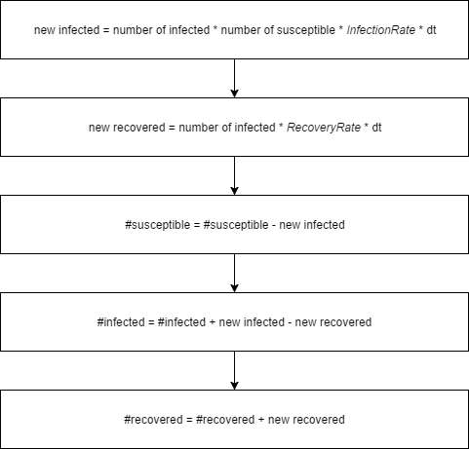
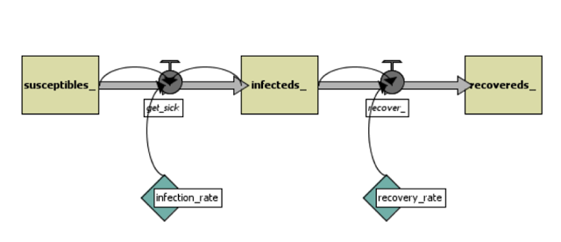
The System Dynamics Approach
Figure 11.9: System Dynamics process (source: Shiflet and Shiflet, 2014).
Figure 11.10: System Dynamics flowchart.

Slide 22
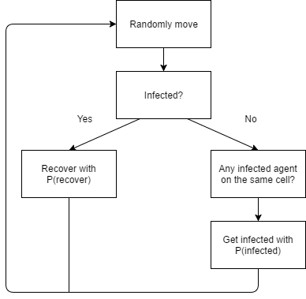
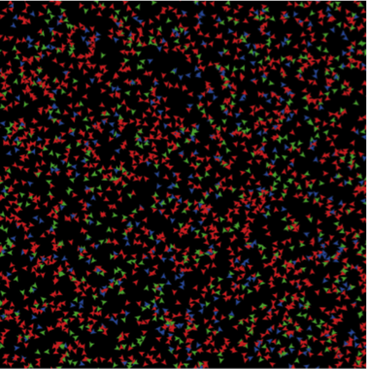
The Agent-Based Approach
Figure 11.12: Display of the agent-based model. Green = susceptible. Red = infected. Blue = recovered.
Figure 11.11: Agent-based Modelling: agent decision process.

Slide 23
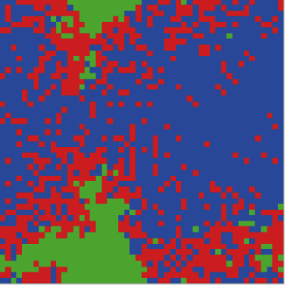
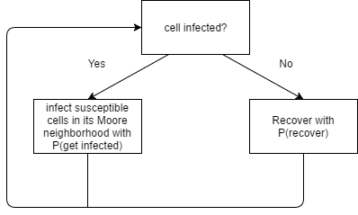
The Cellular Automata Approach
Figure 11.14: Display of the CA model. Green = susceptible. Red = infected. Blue = recovered.
Figure 11.13: Cellular Automata cell changing process.

Slide 24
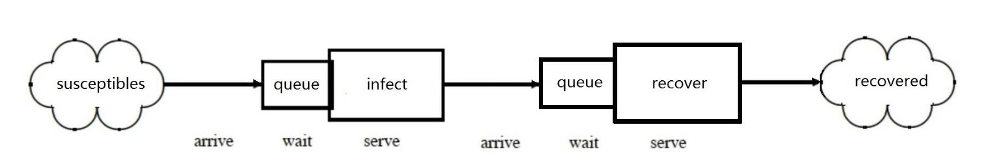
The Discrete Event Simulation Approach
Figure 11.15: Discrete event simulation process.

Slide 25
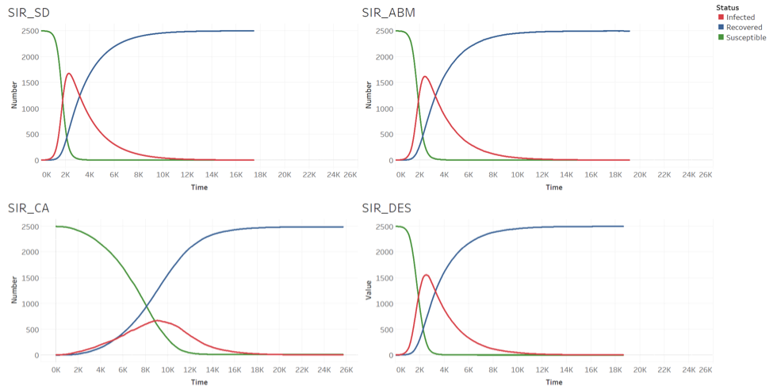
Comparative Analysis
Figure 11.16: Results for the different models. Clockwise from top left: SD model, agent-based model, DES and CA.

Slide 26
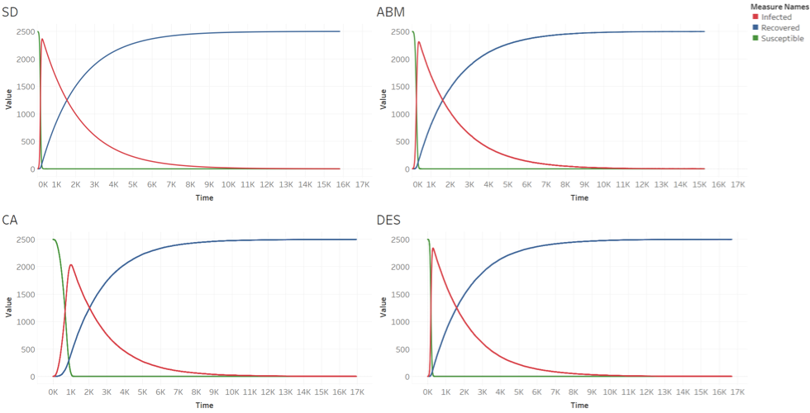
Comparative Analysis
Figure 11.17: Results for the different models with infection rate = 0.02. Clockwise from top left: SD model, agent-based model, DES and CA.

Slide 27
Discussion
Notes:
In this chapter agent-based models have been contrasted to other common modelling approaches used within the social sciences. The purpose of this was to give an overview of these approaches and through experimentation, to highlight their differences to agent-based modelling. In agent-based models, patterns emerge from the direct interaction of multiple heterogeneous agents from the '\textit{bottom up}'. In such models we have individual agents, which is not the case in SD or spatial interaction models. The use of the SIR example demonstrated that diseases do not spread via spatial diffusion (i.e. from one cell to another cell as in the CA model) but by direct agent-to-agent interaction.

Slide 28
Further Reading
Lastly, for a more detailed discussion of all the techniques discussed in this chapter and their history, readers are referred to the following excellent resources:
Gilbert, N. and Troitzsch, K.G. (2005) Simulation for the Social Scientist (2nd ed.). Maidenhead: Open University Press.
Shiflet, A.B. and Shiflet, G.W. (2014) Introduction to Computational Science: Modeling and Simulation for the Sciences (2nd ed). Princeton, NJ: Princeton University Press.
Sterman, J.D. (2000) Business Dynamics: Systems Thinking and Modeling for a
Complex World. Boston: McGraw-Hill.
Wolfram, S. (2002) A Knew Kind of Science. Champaign, IL: Wolfram Media.

Slide 29
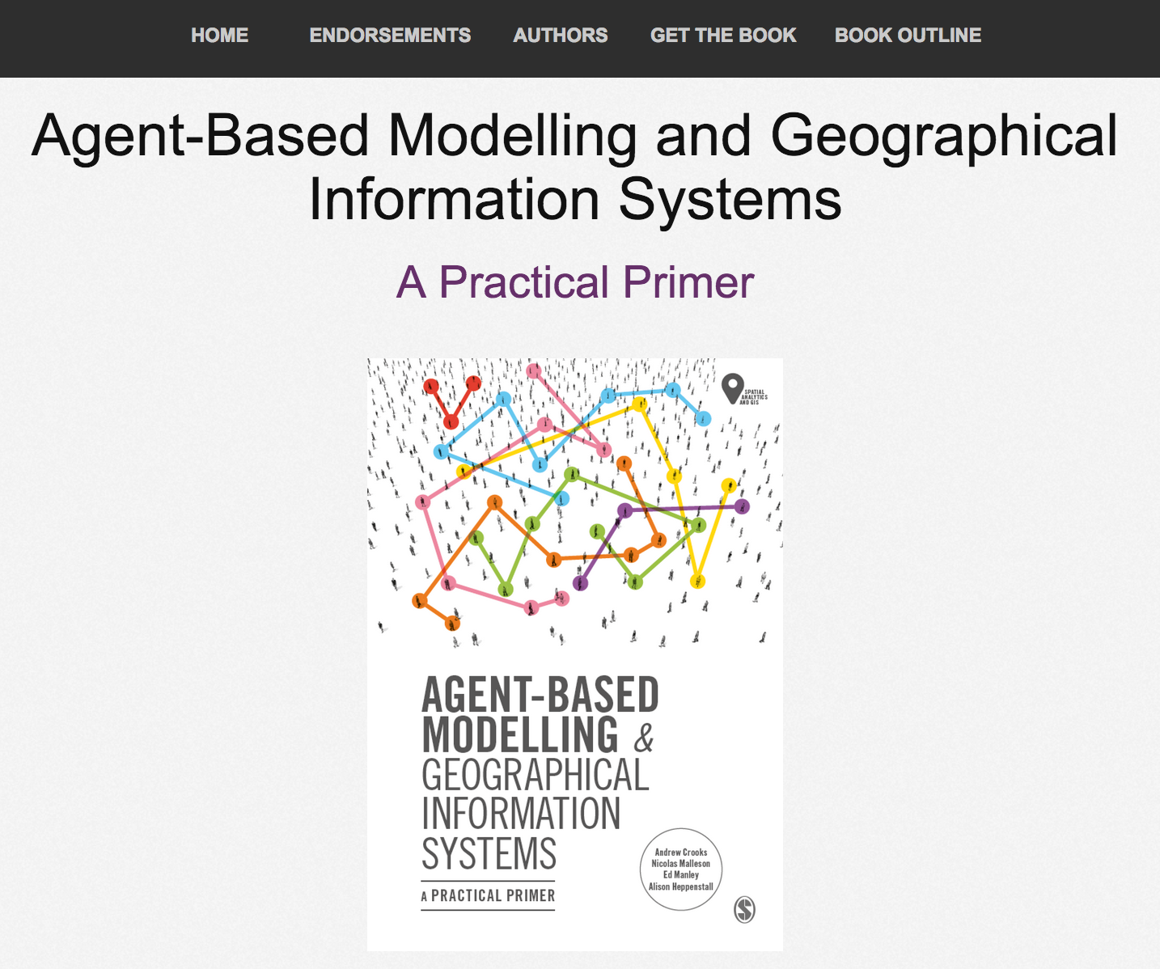
Online Resources
Visit: https://github.com/abmgis/abmgis/tree/master/Chapter11-AlternativeModellingApproaches for a selection of models to highlight core concepts introduced in this chapter

