Slide 1
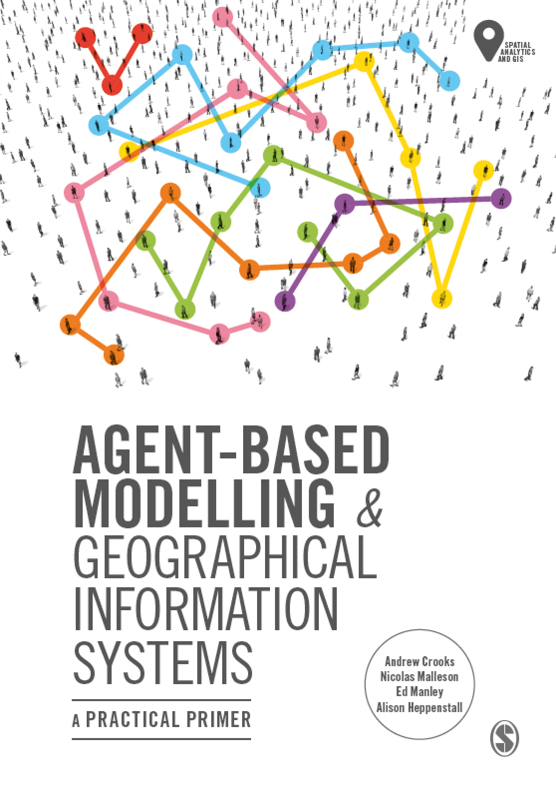
Chapter 10
Evaluating Our Models: Verification, Calibration, Validation
Notes:
Model evaluation is one of the central challenges associated with agent-based models. A key question that all modelers face is “how well does this model simulate the phenomenon of interest?”. While there are no universally accepted methods for evaluating agent-based models, researchers often adopt the same three stage process of verification, calibration and validation. This chapter presents an overview of the methods that are commonly used within each of these stages. The overarching aim of this chapter is to provide the reader with the knowledge to design their own approach to evaluating agent-based models.

Slide 2
Learning Objectives
Understand the importance of evaluation in ensuring wider acceptance and utility of the model
Learn methods for verifying the development of a model
Apply approaches for parameterising and calibrating uncertain aspects of the model design
Learn approaches for validating the predictions from a model relative to observed real-world conditions

Slide 3
Lecture Outline
Verification
Calibration
Validation

Slide 4
Introduction

Slide 5
Evaluating Models

