Slide 1
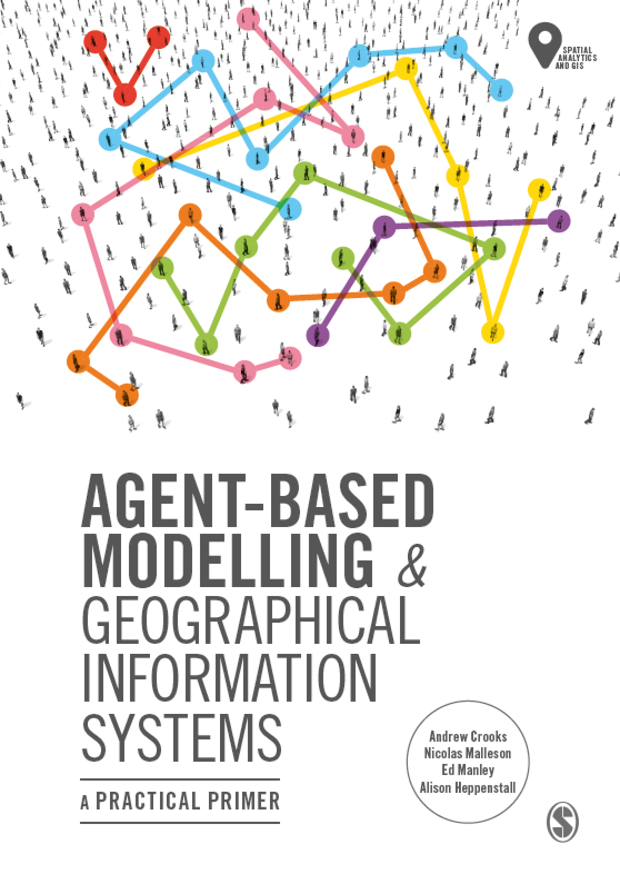
Chapter 12
Summary and Outlook
Notes:
This chapter reflects on the current state of the art of agent-based models and factors that may shape the future of this discipline. Specifically we will discuss the key challenges for developing robust agent-based models of geographical systems as well as potential solutions. We argue that we need to make progress on these challenges if these models are to be used to offer insight into key societal challenges, for example climate change, urban growth and migration.

Slide 2
Learning Objectives
By the end of this lecture, students will be able to:
Discuss the key challenges for developing robust agent-based models of geographical systems
Have ideas on potential solutions for overcoming such challenges
Be able to identify areas for productive future research in the fields of agent-based modeling and GIS.

Slide 3
Introduction
Agent-based models can be used to study geographical systems,
Throughout this course we have demonstrated how geographical information can be used as the grounding of our ‘artificial worlds’.
We have explored issues pertaining to:
How to design and development of agent-based models;
Incorporate human behavior into agent-based models;
Outlined methods for understanding and evaluating;
Compared and contrasted agent-based models to other modeling approaches.
But what challenges remain?

Slide 4
Remaining Challenges
The challenges include:
Reasons for Modelling
Theory and Models
Inter-Model Comparison
Replication and Experiment
Verification and Validation
Agent Representation, Aggregation and Dynamics
Behavior
Sharing and Dissemination of the Model
Data Challenges

Slide 5
Challenge 1: Reasons for Modelling
In the early days of computer modelling, models were built to test the impacts of policies rather than scientific understanding per se.
Agent-based models are now built to explore all stages of the theory–practice continuum (not just for prediction).
However, agent-based models are only useful for the purpose for which it was constructed, and as modelers we need to be explicit about this.

Slide 6
Challenge 2: Theory and Models
The goal of theory is to make the world understandable by finding the right level of abstraction (or simplification).
Traditionally in the social sciences, the role of a model was to translate a theory into a form whereby it could be tested, manipulated and refined.
But which theory to test?
Does the theory have enough details to be agentized?
With agent-based models (along with computational modelling more generally) models are often being used to develop theory.
If this is the case we need to be explicit about the assumptions.

Slide 7
Challenge 3: Inter-Model Comparison
Growing number of agent-based models.
Many are based on case studies, one-off models or as proof of concept.
Limited inter-model comparison such as is seen in other disciplines.
E.g., the Ice Sheet Model Intercomparison Project
Efforts are being made to compare different models applied to the same phenomena.
E.g. Ebola, Maleira,
Efforts also being made to common features of models exploring the same phenomena in order to find what constitutes the must have features
E.g. Slums
However, there are no centralized agent-based modelling repositories that pool together knowledge, code and data.
Nor is there any standard model or protocol on what constitutes an agent or its decision-making process.

Slide 8
Challenge 4: Replication and Experiment
Replication is one of the main principles of the scientific method
In the confines of a publication, this is hard to achieve with agent-based models.
Attempts are being made
ODD protocol, the ODD+D protocol and UML
Many modelers don’t share their models or data
Why?

Slide 9
Challenge 5: Verification & Validation (V & V)
While discussed earlier we list these here as V & V is needed for replication and experimentation
Validation is a big challenge.
How can we rigorously evaluate how well the model matches the real-world system it is attempting to simulate?
Agent-based models embrace heterogeneous systems that evolve over time, where the linkages between dependent and independent variables are difficult, if not impossible, to observe due to their rich model structure
Finding appropriately rich and detailed data to validate such systems is difficult.

Slide 10
Challenge 6: Agent Representation, Aggregation and Dynamics
Agents can be defined at a variety of levels (individuals, households, etc.) and can operate at very different temporal and spatial scales (e.g. from seconds to years).
But how should we we chose such representation or dynamics.
How should we aggregate these rules and behaviors from the individual level to, say, groups or higher aggregations of agents?
How many agents and how many attributes for each agent we should account for?
Modelers need to be more explicit with respect to:
Agent representations,
Why they chose a specific spatial and temporal scales,
What data exists to support their assumptions and validate their outcomes.
Notes:
This representation
also raises questions about what are the most appropriate methods for agents to
communicate with each other (i.e. via Moore or von Neumann neighbourhoods
or social networks). These questions are not new (see, for example, Cioffi-Revilla,
2002) but we would like to see modellers be more explicit with respect to their
agent representations, why they chose specific spatial and temporal scales, and what
data exists to support their assumptions and validate their outcomes.

Slide 11
Challenge 7: Behaviour

Slide 12
Challenge 8: Sharing and Dissemination of the Model

Slide 13
Challenge 9: Data Challenges

Slide 14
Looking Ahead

Slide 15
Big Data and Agent-based Modeling

Slide 16
Model Integration

Slide 17
Uncertainty and Ensembles

Slide 18
Data Assimilation

Slide 19
Spatially Learning Agents

Slide 20
Discussion

Slide 21
Summary

Slide 22
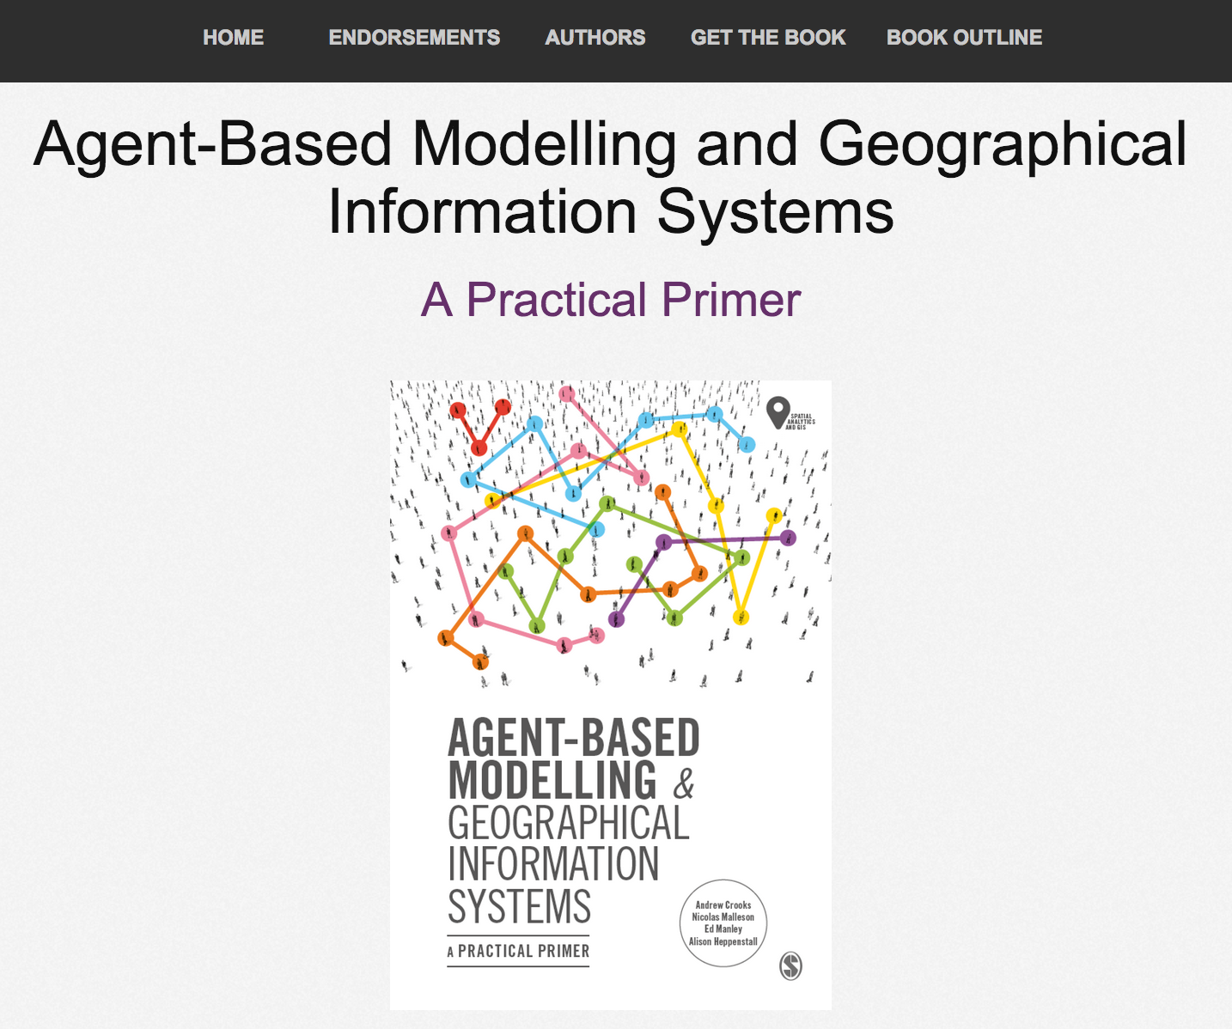
Online Resources
Visit: www.abmgis.org/Chapter12.html for a selection of models to highlight core concepts introduced in this chapter

