Slide 1
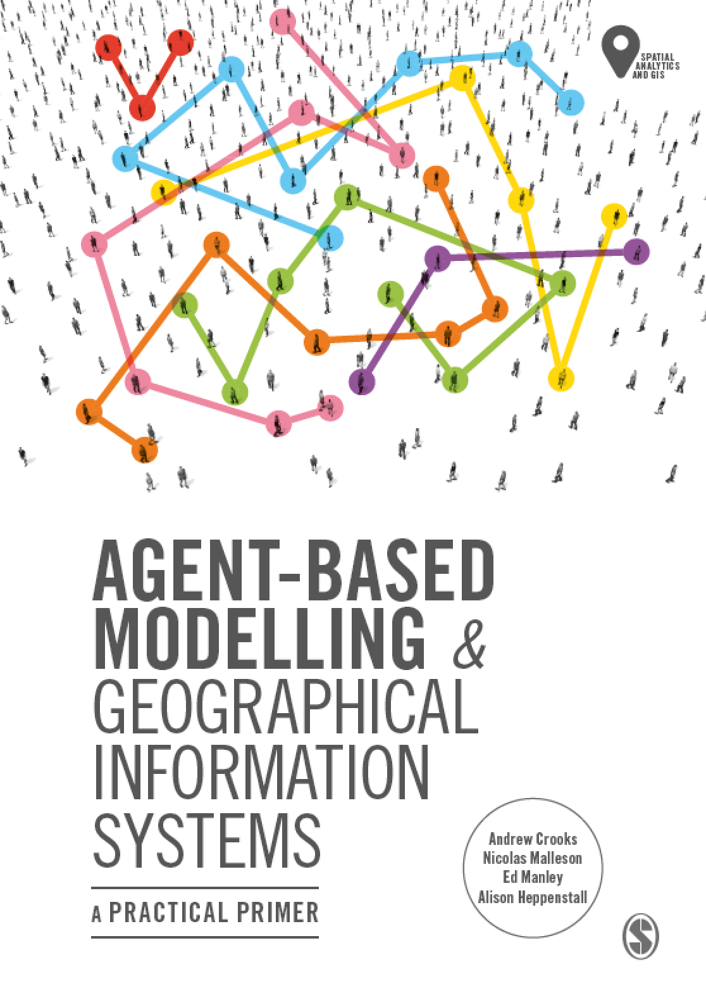
Chapter 9
Spatial Statistics
Notes:
This chapter presents a range of statistics and algorithms that can be used to compare two spatial data sets. These are important for modelling because, at some point, it will be necessary to compare a model outcome to some real-world data in order to assess the reliability of the model. This chapter examines the statistics themselves, before Chapter 10 elaborates on how to evaluate the success of a model more broadly, part of which includes making use of the methods discussed here.

Slide 2
Learning Objectives
By the end of this chapter, students will be able to:
Identify some commonly-used statistics that can be used to quantify the difference between spatial data sets.
Explain which are the most appropriate statistics for use in comparing aggregate data and point data.
Explain four different ways of identifying the differences in spatial data sets: visual comparison; descriptions of point patterns; global difference; local difference.
Calculate the value of these statistics.

Slide 3
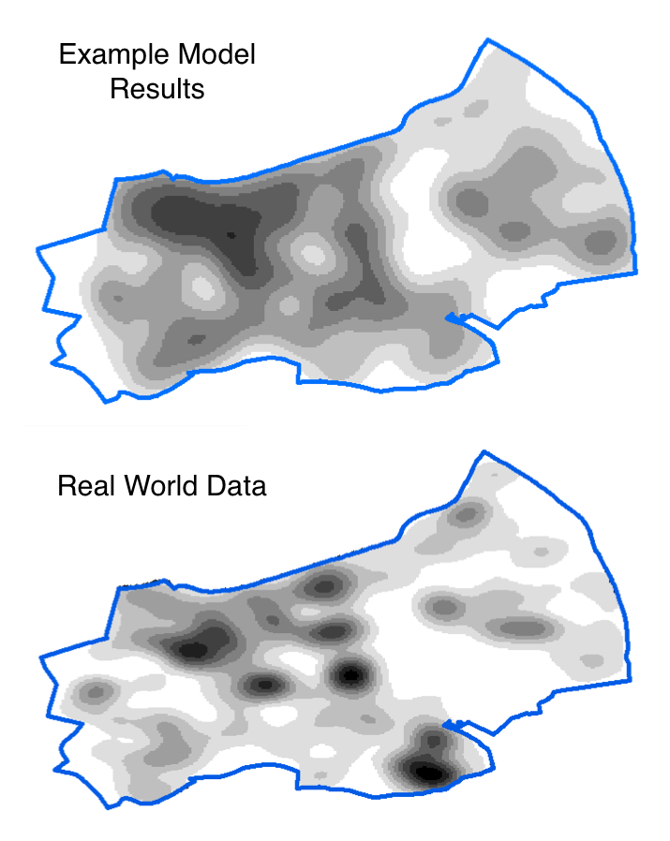
Introduction
We often need to compare two spatial data sets:
For example: Model results against real-world data
There are many ways to do this
Choosing the most appropriate method is vital
This lecture will introduce and compare a number of different ‘goodness of fit’ statistics.

Slide 4
Overview
XXXX

Slide 5
Glossary
Goodness of fit – a broad description for statistics that quantify how well a model fits a set of real-world observations.
RSS – residual sum of squares; a statistic that estimates the overall difference between two data sets by summing the square of the errors.
R2 – ‘R squared’; a statistic that estimates the overall difference between two data sets.
(S)RMSE – (standardised) root mean square error; a statistic that esti- mates the overall difference between two data sets.
KDE – kernel density estimation; a means of estimating point density at a particular location. Often used to draw maps of point patterns.
LISA – local indicators of spatial association; statistics that can estimate the locations of local clusters (areas with a higher than expected point density).
NNI – nearest neighbour index; measures global spatial uniformity (i.e. the overall amount of clustering in a point pattern). Also known as the Clark and Evans R statistic (Clark and Evans, 1954).
Ripley’s K function; another measure for global spatial uniformity (i.e. the overall amount of clustering in a point pattern).
GI* – a statistic that estimates the spatial locations of ‘hot’ (e.g. high) and ‘cold’ (e.g. low) spot

Slide 6
Goodness of Fit
XXXX What this means.

Slide 7
