Slide 1
Chapter 11
Alternative Modelling Approaches

Slide 2
Introduction
Notes:
Agent-based modelling is one of the most popular approaches used in social and spatial simulation. However, there are several other alternative approaches that are available to the researcher including Cellular Automata, Microsimulation, Discreet Event Simulation, System Dynamics and Spatial Interaction models. This chapter presents an overview of these other approaches giving simple examples on how they can be used and summarising the main differences between them. To compare these models, they are applied to the same issue, the spread of a disease using a Susceptible-Infected-Recovered (SIR) epidemic model. This shows that while the same general patterns emerge, the reasons for this are very different. The chapter ends with a discussion and summary.

Slide 3
Cellular Automata

Slide 4
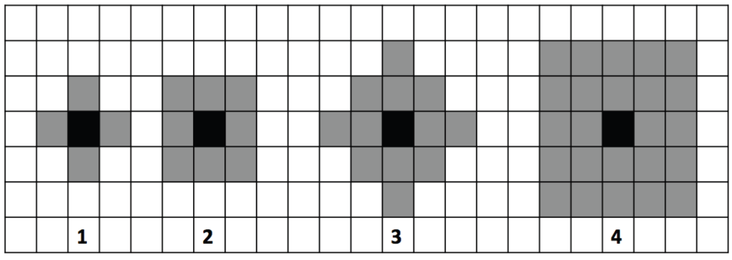
Different Neighborhood Configurations
Figure 11.1: Diagrammatic representation of 2D cellular automata and the most commonly used neighborhoods (1) von Neumann 1-neighbourhood, (2) Moore 1-neighbourhood, and extended (3) von Neumann and (4) Moore neighborhoods.

Slide 5
Game of Life

Slide 6
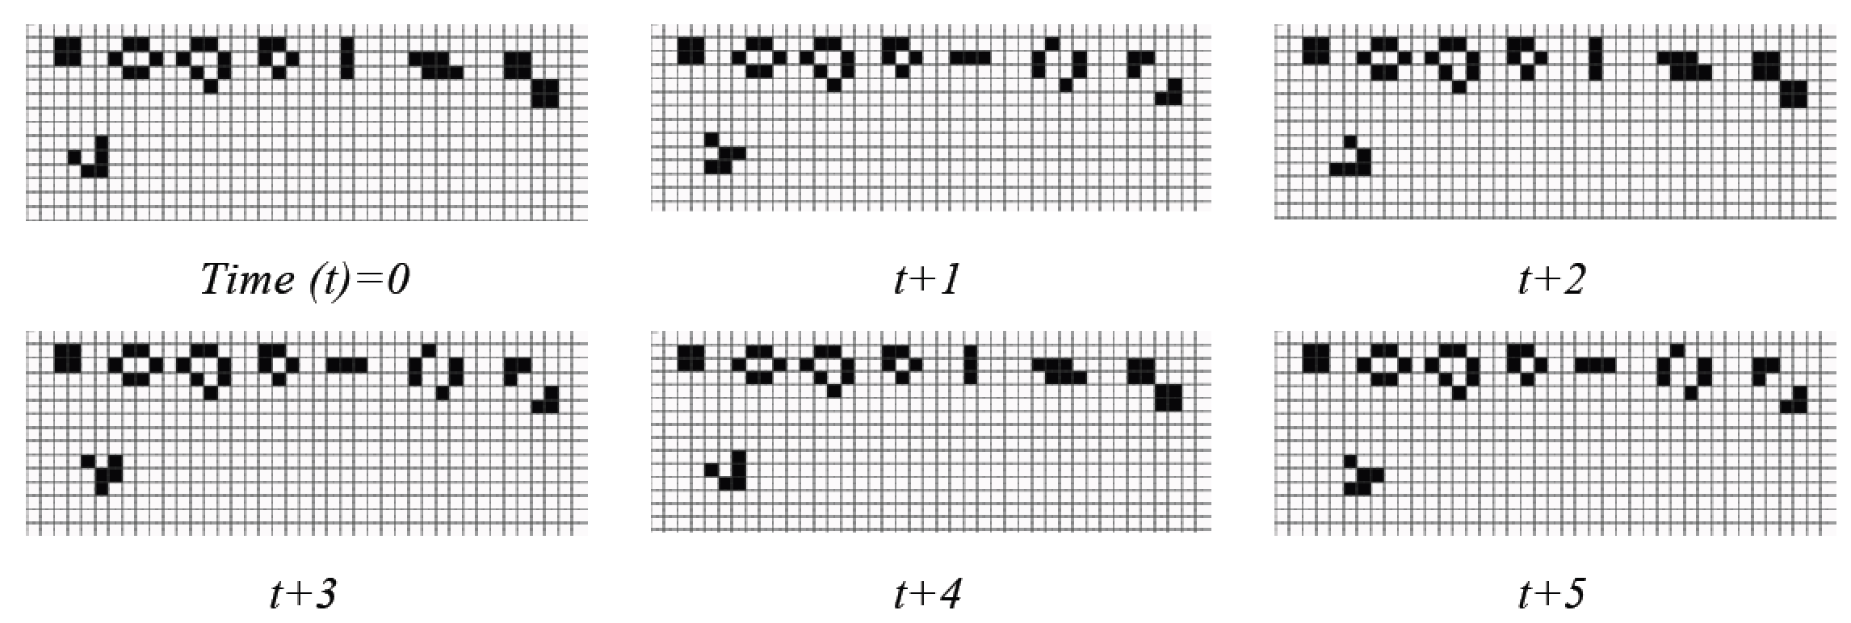
Cells Changing State in the Game of Life
Figure 11.2: Example of cells changing state from dead (white) to alive (black) over time depending on the states of its neighboring cells (modified from Wilensky, 1998).
Notes:
Add Link to Model

Slide 7
Microsimulation

Slide 8
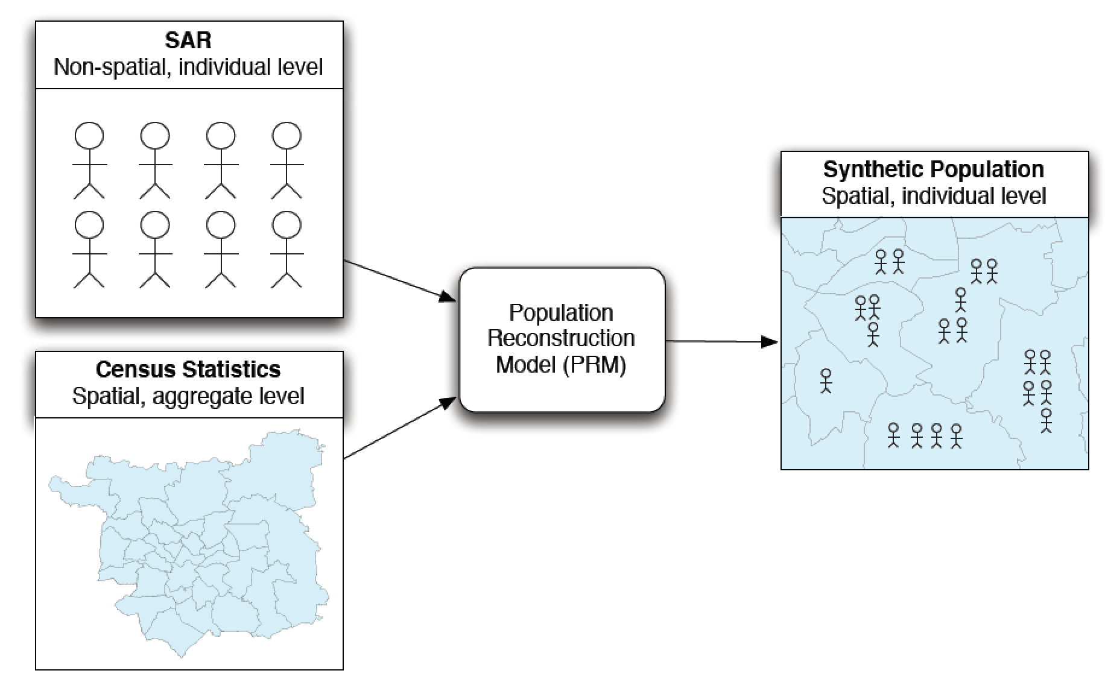
Creating a Synthetic Population using Microsimulation
Figure 11.3: Schematic outlining the basic process of creating a synthetic population using microsimulation.

Slide 9
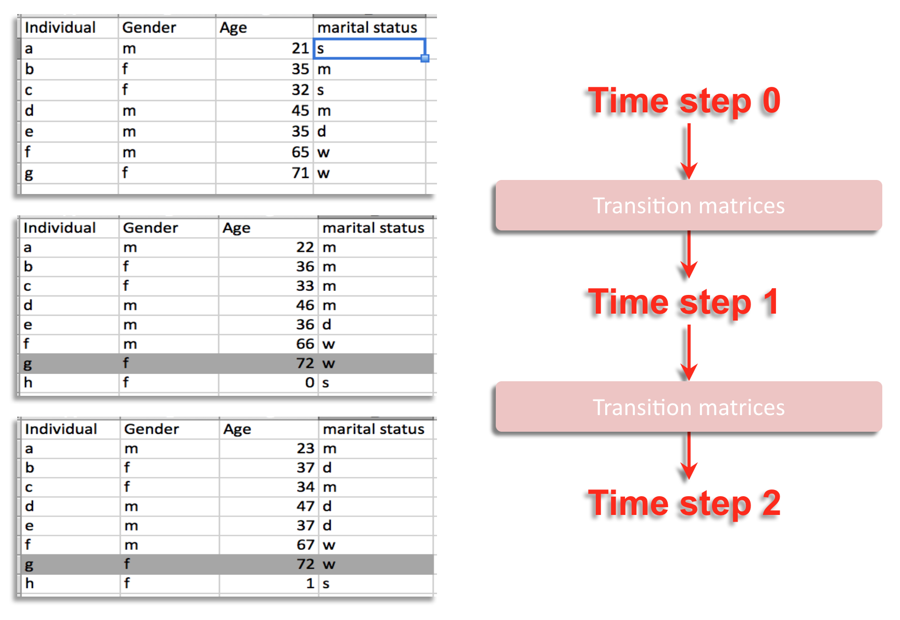
Changing the Population Over Time
Figure 11.4: A simple example of dynamic microsimulation process where individuals change over time (m = married, d = divorced, w = widowed).

Slide 10
Discreet Event Simulation

Slide 11
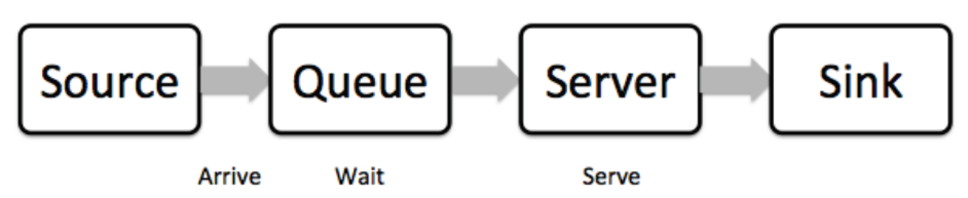
Basic Properties of a Discrete Event Simulation
Figure 11.5: Simple example of a Discreet Event Simulation.

Slide 12
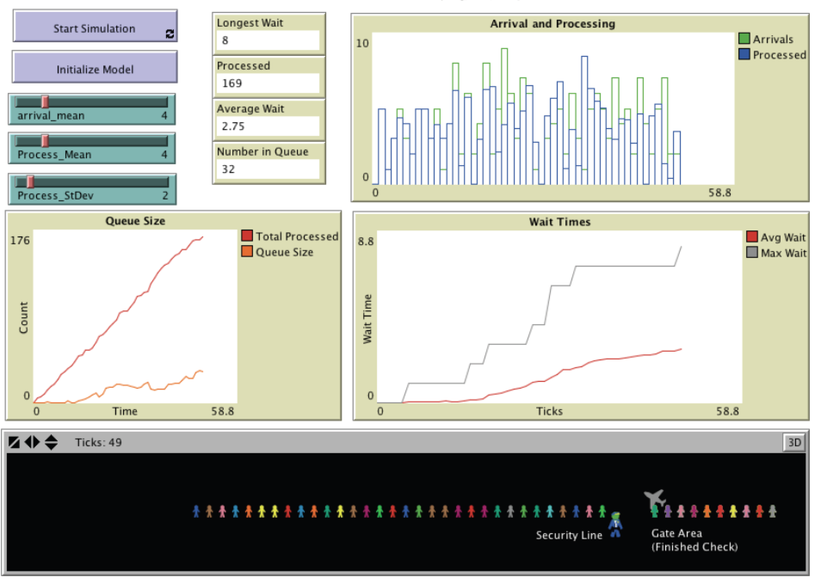
Airport Security via a Discrete Event Simulation Model
Figure 11.6: Airport security line simulation (Source: Bybee and Eng, 2012).

Slide 13
System Dynamics

Slide 14
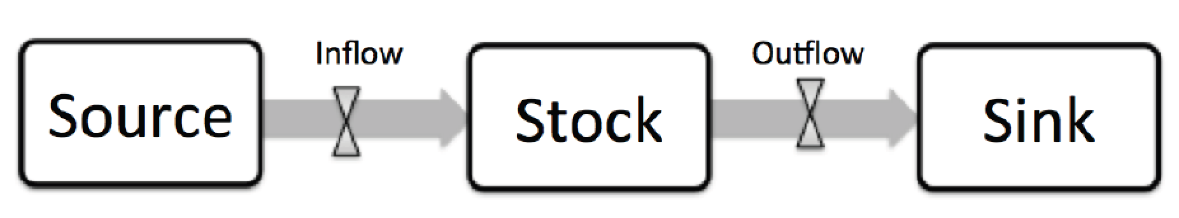
Basic Elements of a System Dynamics Model.
Figure 11.7: Basic elements of a system dynamics model.

Slide 15
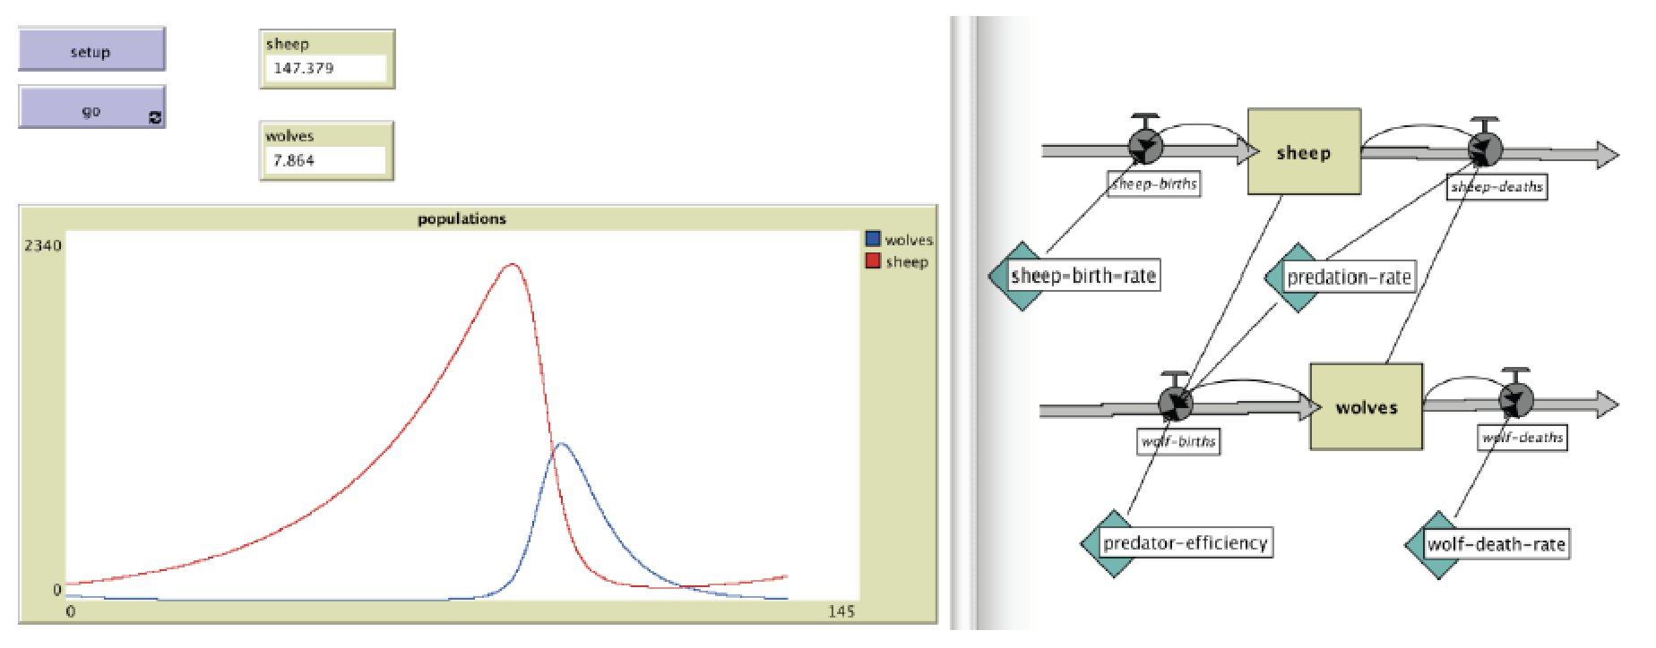
Wolf Sheep Predation implemented as a System dynamics Model
Figure 11.8: An Example of a Wolf Sheep Predation model implemented as a system dynamics model (source: Wilensky, 2005a).

Slide 16
Spatial Interaction Models

