Slide 1
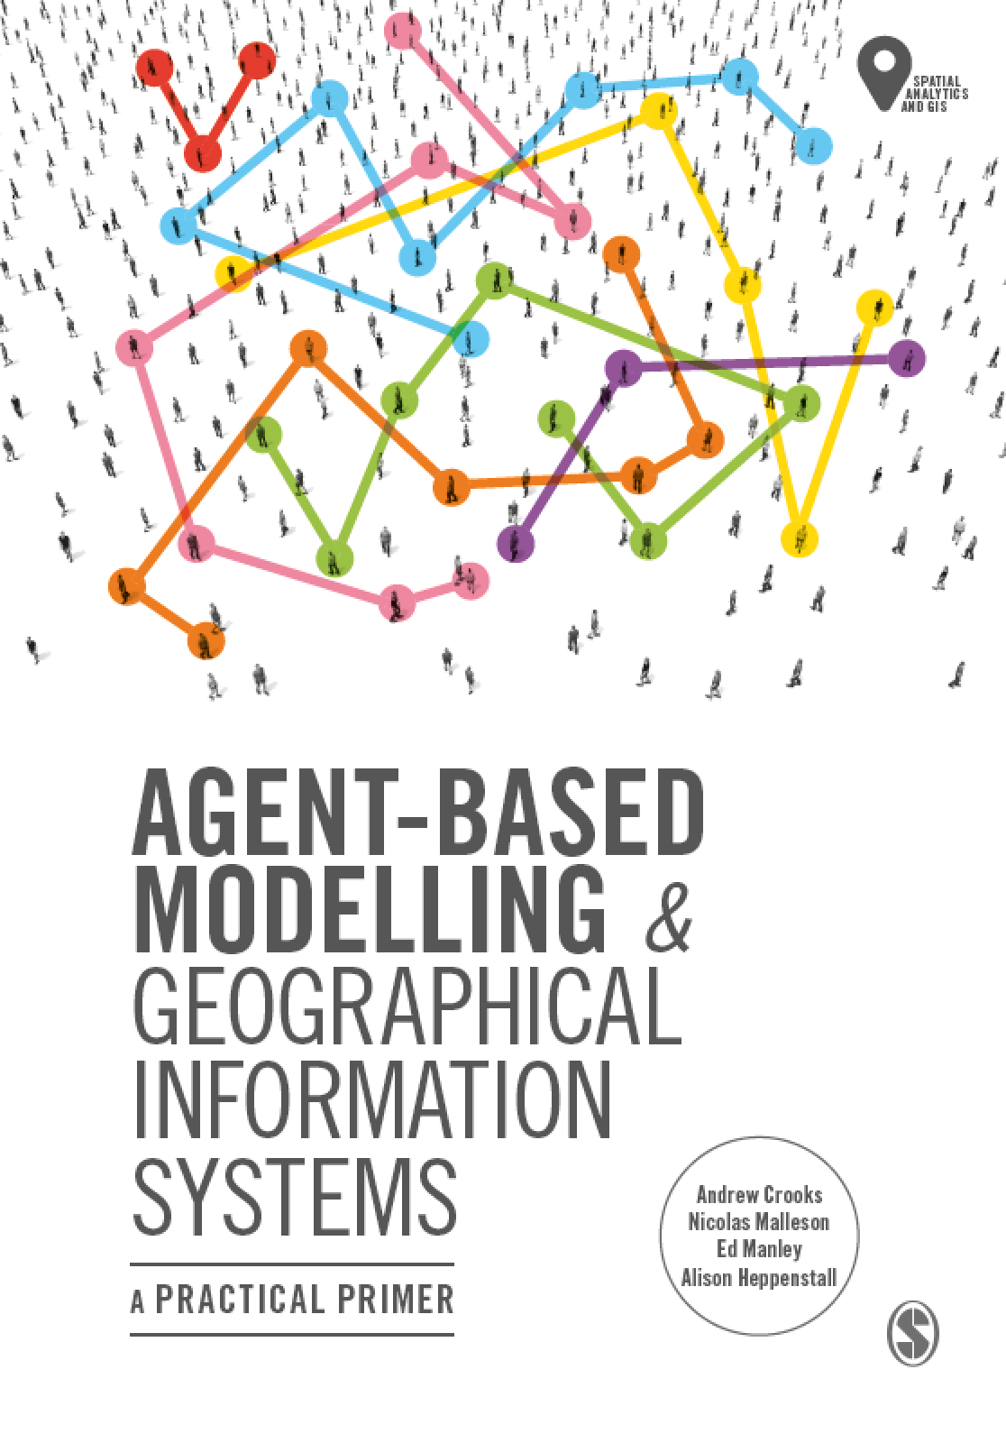
Chapter 1
Agent-based Modelling and Geographical Information Systems
Notes:
The overarching aim of this chapter is to give the reader a contextual background and general overview of the major developments in geographical modelling for the simulation of the individual. The reader is introduced to a discussion around the purpose of modelling as well how complexity theory has influenced the way that we view (and simulate) geographical systems. We end the chapter by discussing the benefits of bringing together agent-based modelling and GIS.

Slide 2
Learning Objectives
Provide contextual background and general overview of the major developments in geographical modelling for the simulation of the individual

Slide 3
Introduction

Slide 4
Complexity and Geographical Systems

Slide 5
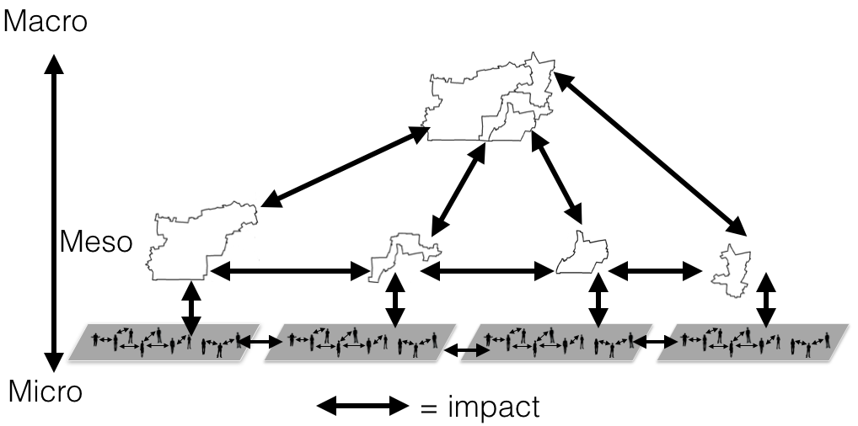
Hierarchies and Interactions
A simple hierarchical structure of a city composed of multiple neighborhoods which form a hierarchy at the more macro level but also have interactions (e.g. commuter flows) amongst each other.

Slide 6
Models

Slide 7
Data

Slide 8
Individuals

Slide 9
Agent-based Modelling and Geographical Information Systems

Slide 10
Book Outline

Slide 11
Chapter 2

Slide 12
Chapter 3

Slide 13
Chapter 4

Slide 14
Chapter 5

Slide 15
Chapter 6

Slide 16
Chapter 7

Slide 17
Chapter 8

Slide 18
Chapter 9

Slide 19
Chapter 10

Slide 20
Chapter 11

Slide 21
Chapter 12

