Slide 1
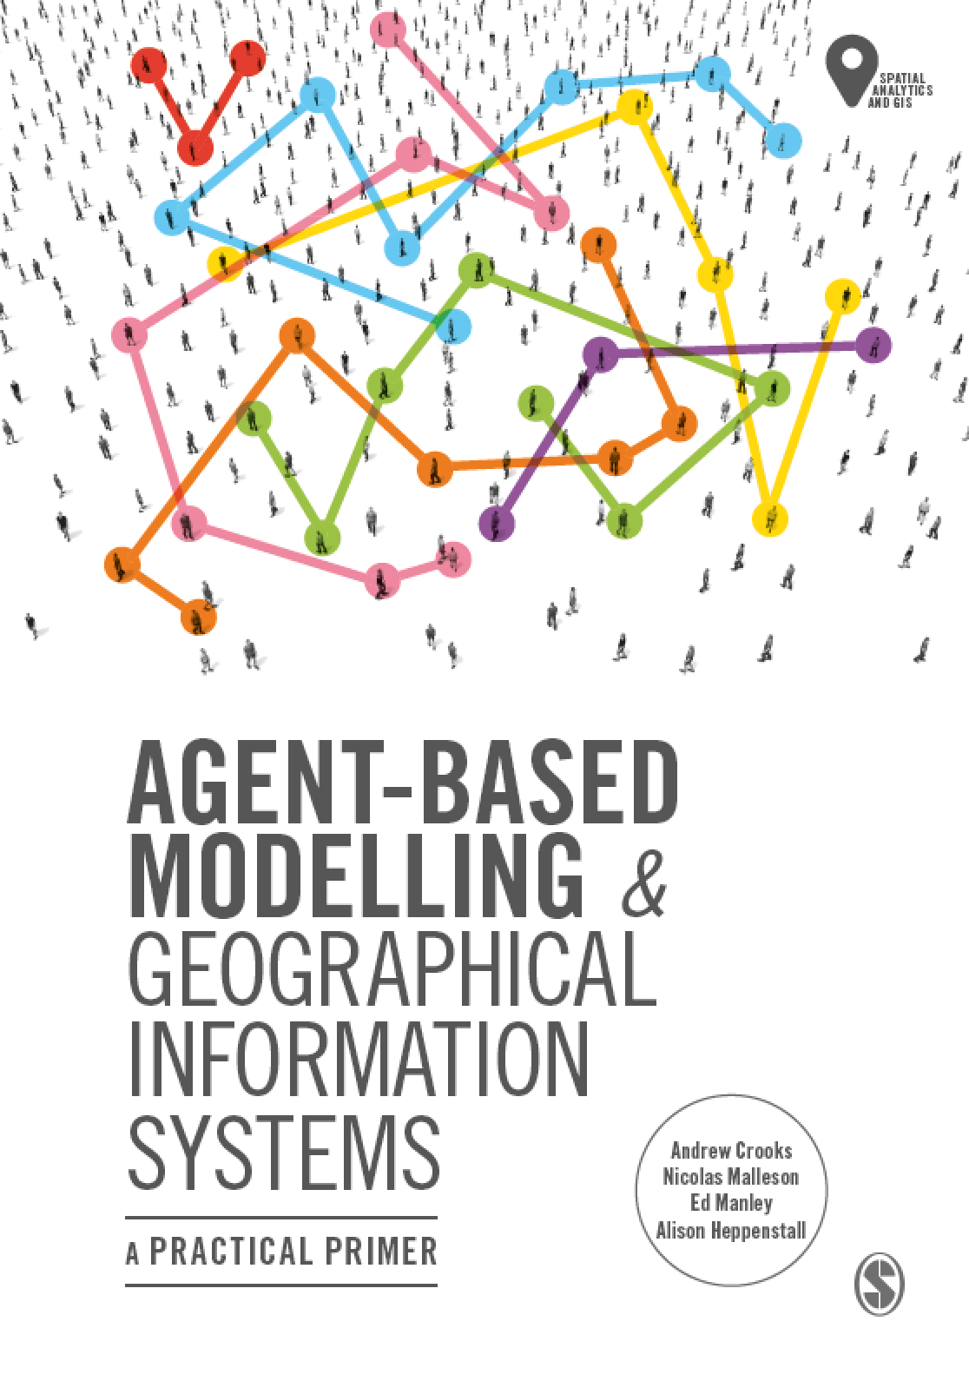
Chapter 4
Building Agent-Based Models with NetLogo
Notes:
This chapter provides an overview of the programming language and concepts that are used within NetLogo. NetLogo basics, such as how to create a simple environment, commands and procedures, are presented with step by step instructions for creating a simple model. Following this basic model, more advanced features are introduced. The overall aim of this chapter is to provide an understanding of the main components that make a NetLogo program. Subsequent chapters build upon the basics presented here.

Slide 2
Learning Objectives

Slide 3
Introduction

Slide 4
Summary

