Slide 1
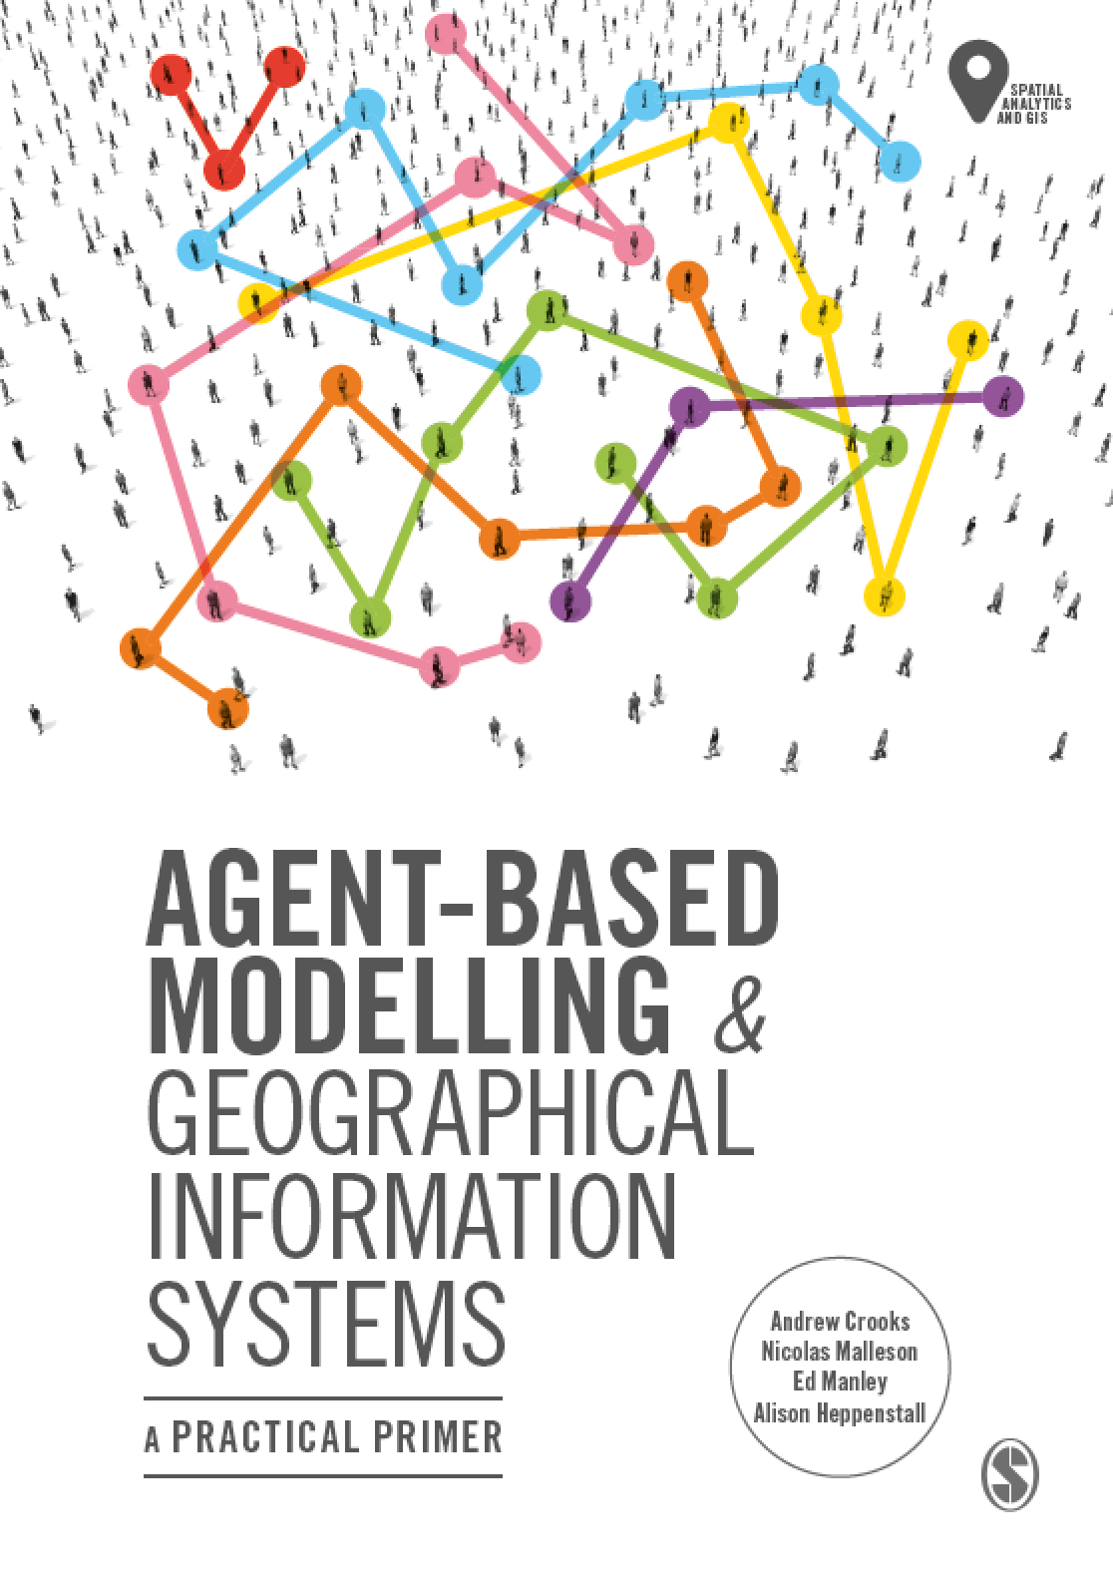
Chapter 6
Integrating Agent-Based Modelling and GIS
Notes:
Building on previous chapters outlining the fundamentals of GIS and agent-based modelling, what are the benefits to linking these approaches? How is this undertaken? This chapter will explain loose and tight coupling critiquing the relative advantages and disadvantages of both. We present an overview of open source toolkits that can be used for the creation of geographically explicit agent-based models before providing a critical look at where and how GIS and ABM should be combined offering practical advice on best practice.

Slide 2
Learning Objectives

Slide 3
Introduction

Slide 4
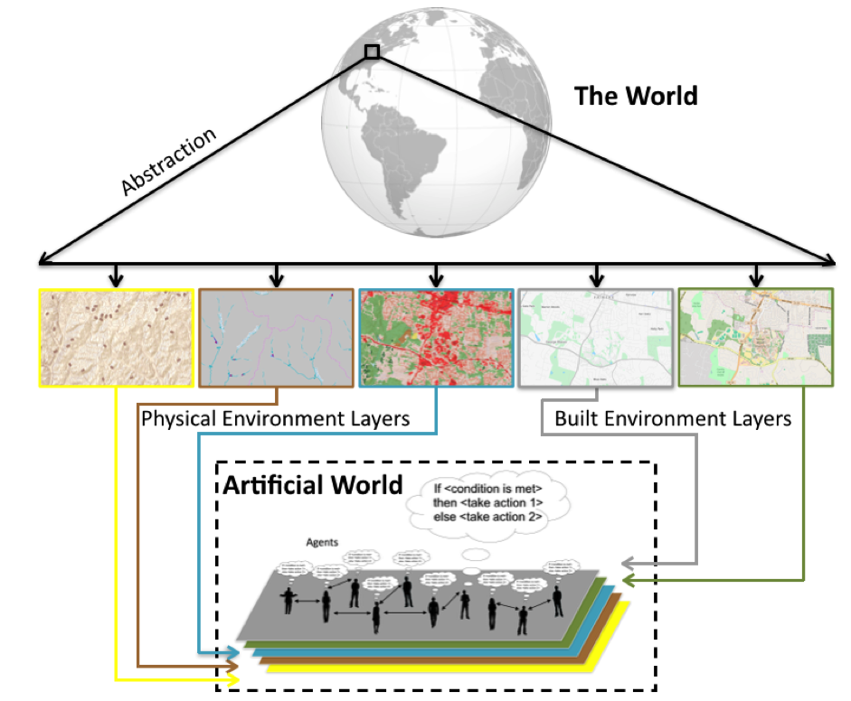
Creating an ‘Artificial World’ from GIS Data
Figure 6.1: Abstracting from the “real” world into a series of layers to be used in the artificial world for which to base the agent-based model upon.

Slide 5
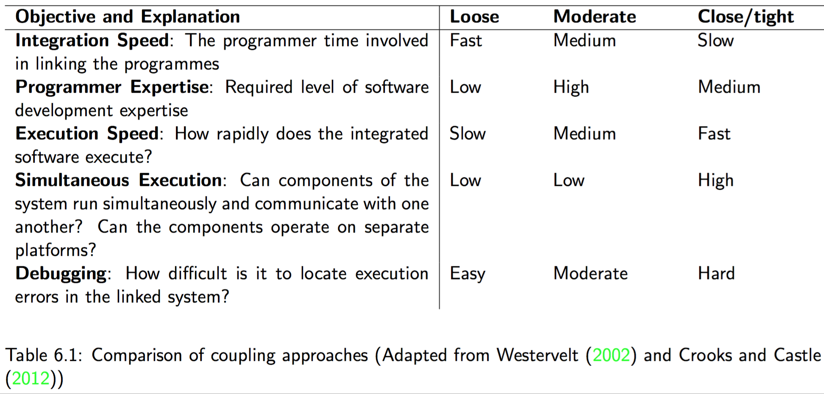
Coupling and Embedding GIS and Agent-based Models

Slide 6
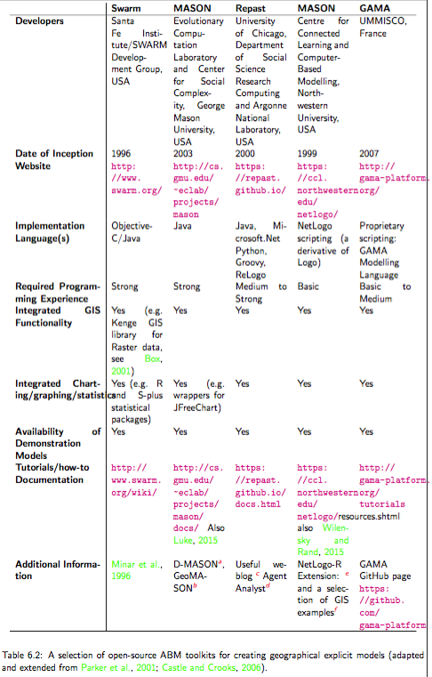
Tools for Constructing and Developing Agent-based Models

Slide 7
Swarm

Slide 8
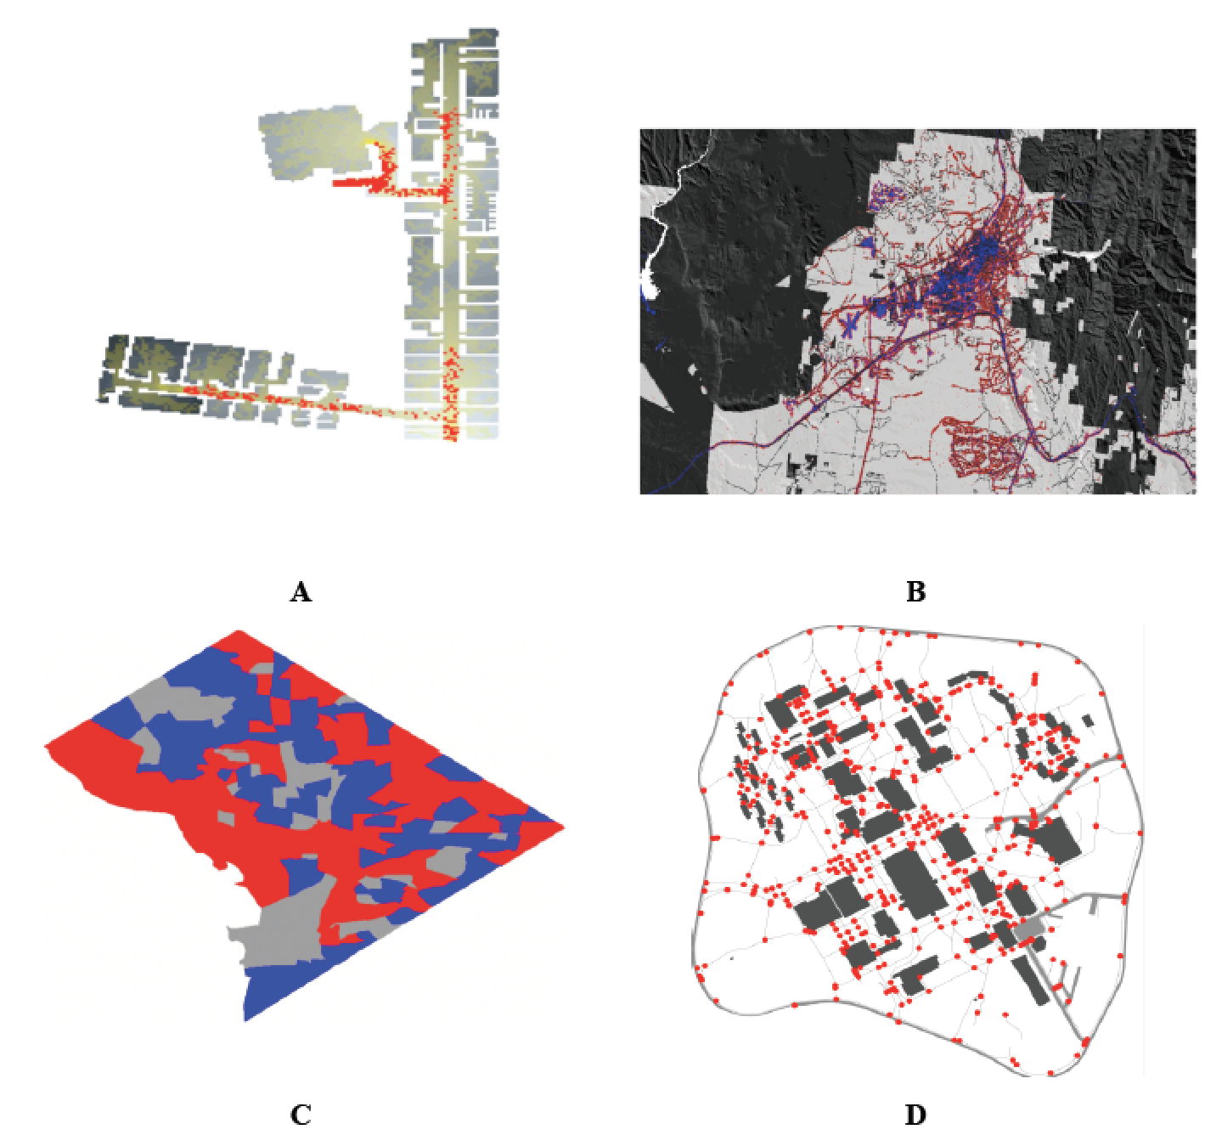
MASON
Figure 6.2: A selection of MASON spatial models (A): Agents (red) exiting a building based on raster data and the resulting trails (yellow). (B) An urban growth model where red areas represent new developments. (C) A Schelling type of model using census areas in Washington DC as its spatial environment. (D) Agents (red circles) moving along on sidewalks (grey lines).

Slide 9
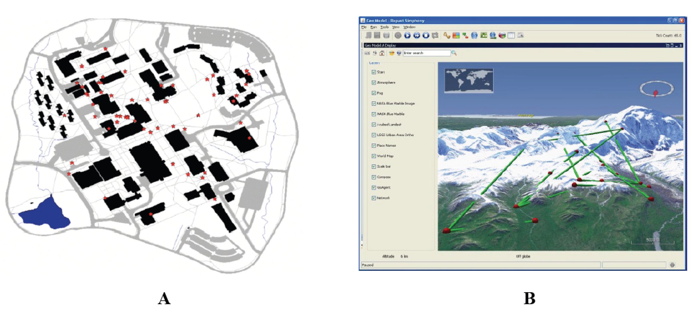
Repast
Figure 6.3: Examples of vector agent-based models in Simphony. (A) Agents (red stars) moving along on sidewalks (grey Lines). (B) An agent-based model overlaid on NASA world wind (Source: Repast, 2016)

Slide 10
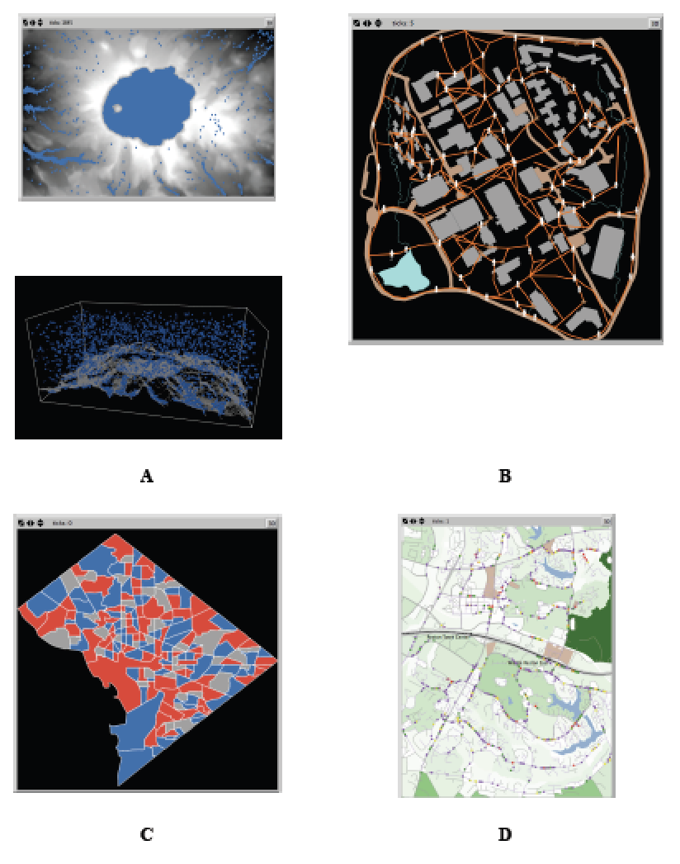
NetLogo
Figure 6.4: A selection of geographically explicit agent-based models utilising NetLogo. (A) Rainfall where rain (blue) falls and flows to a lower elevation based on a digital elevation model captured in 2 and 3D. (B) Agents (white) moving along on sidewalks (orange). (C) Schelling type model using census areas in Washington DC as their spatial environment. (D) Commuting along a road network.

Slide 11
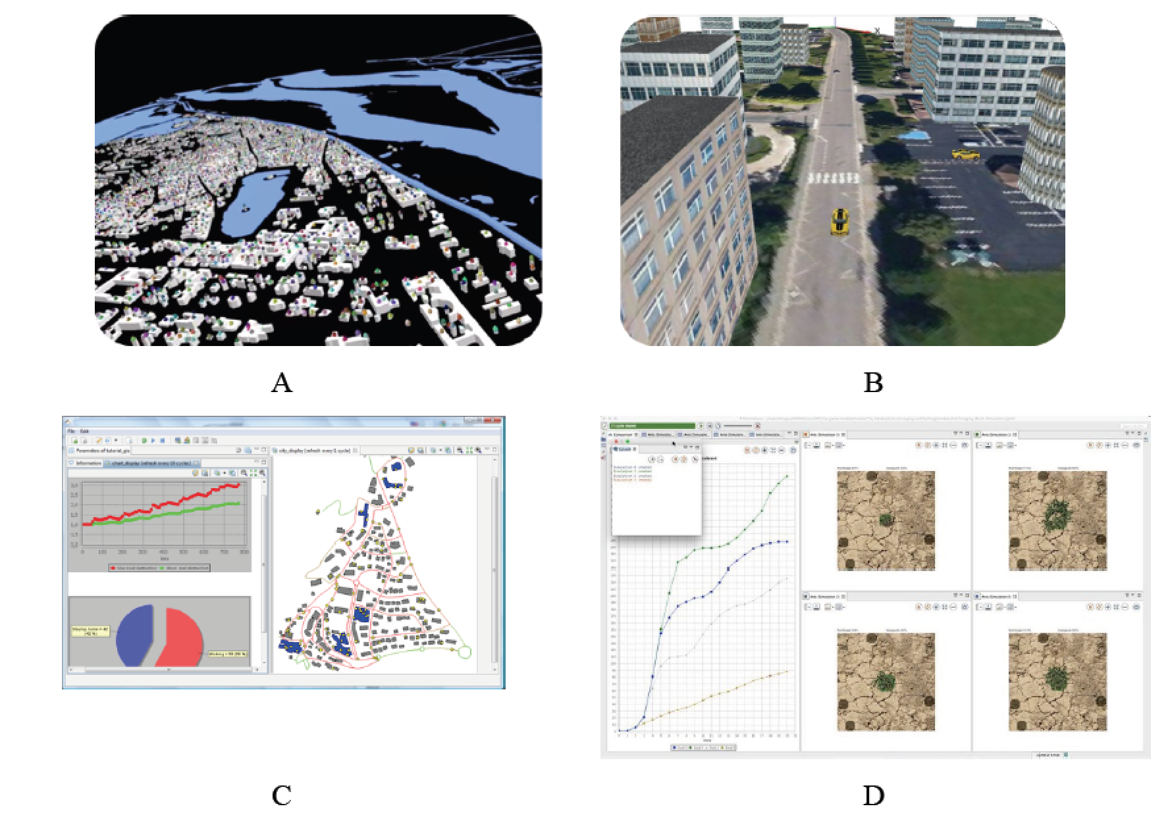
GAMA
Figure 6.5: GAMA platform: Advanced visualisation of simulations (A and B). (C) Built in charting and functions. (D) User interface (Source: GAMA, 2016).

Slide 12
Using Raster Data in NetLogo

Slide 13
Raster Model Examples: Urban Growth and Pedestrian Modelling

Slide 14
Urban Growth

Slide 15
Pedestrian Modelling

