Slide 1
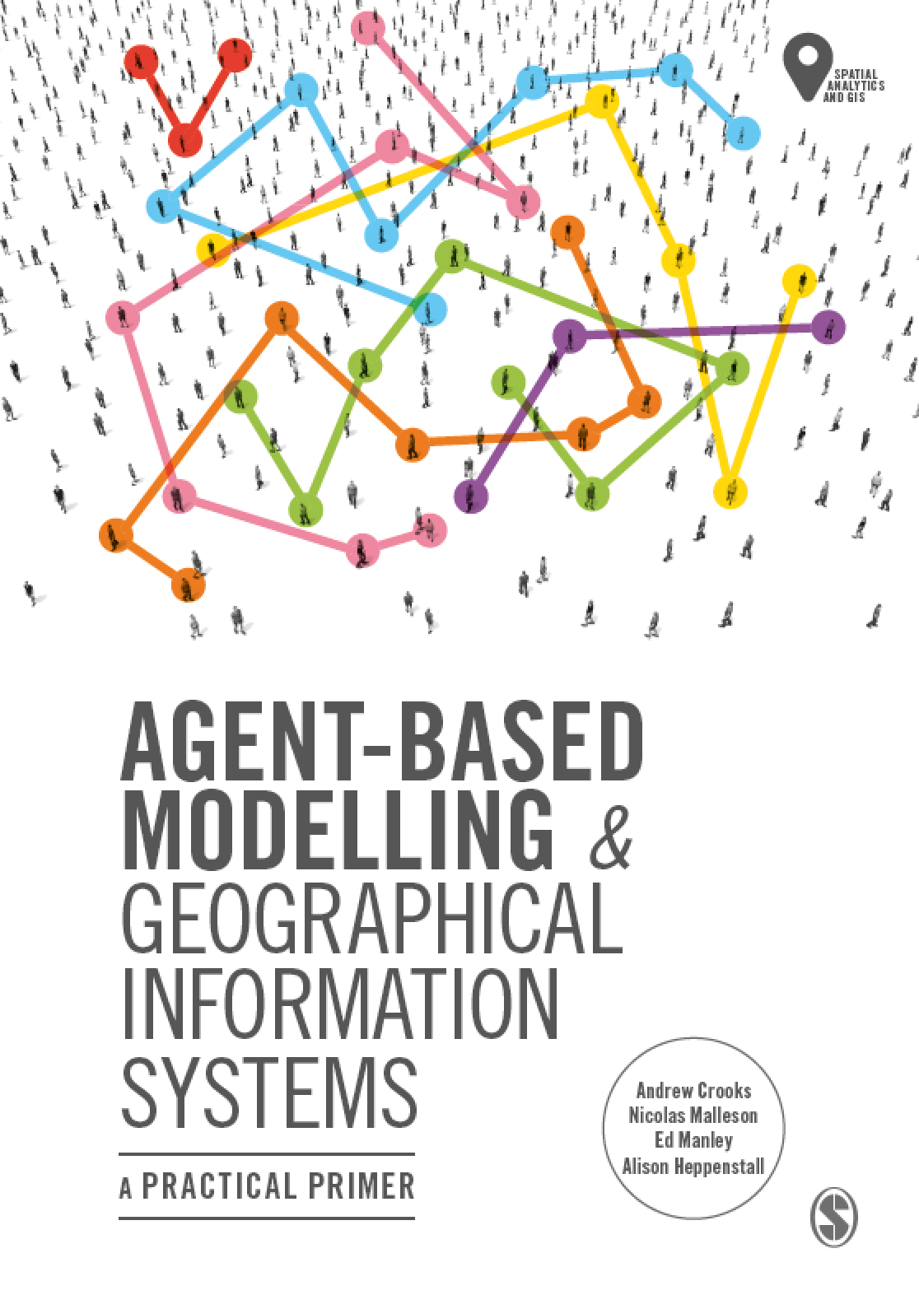
Chapter 7
Modelling Human Behavior
Notes:
This chapter explores the most common approaches by which researchers incorporate human behaviour into agent-based models. We explain why it can be necessary to model human behaviour and the main considerations that the researcher needs to be aware of when developing an agent-based model. From this, we present an overview of the two main broad approaches, mathematical and conceptual cognitive models when it comes to modelling human behaviour in agent-based models. We supplement this discussion with two case-studies that provide examples of how these approaches can be implemented, both examples have the model code available that can be downloaded and experimented with. The chapter finishes with a discussion of some of the thorny issues that researchers need to be aware of when attempting to simulate behaviour within agent-based models.

Slide 2
Learning Objectives

Slide 3
Introduction

